Slide 1
Industrial Revolution Does Technology benefit society?
Chapter 25

Slide 2
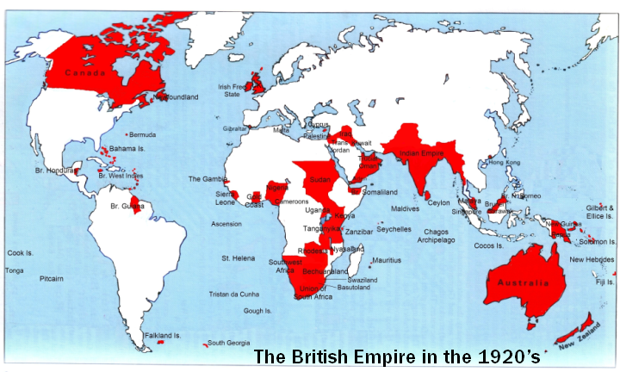
Great Britain controlled 25% of the world! WOW!

Slide 3
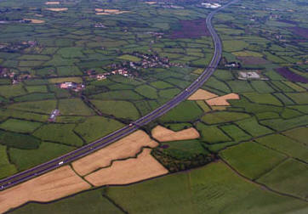
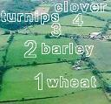
Agricultural Revolution
Change in farming
Changes:
Enclosure Movement
Lands “fenced off”
Crop Rotation
Plant diff. crops in fields ea. Year
Invented by Charles “Turnip” Townshend
New Machines

Slide 4
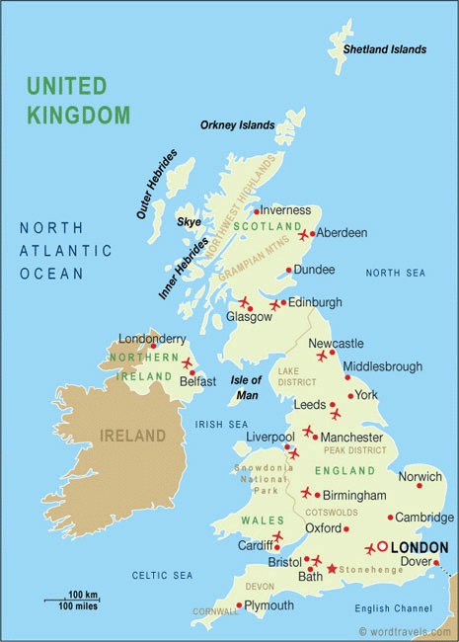
Industrial Revolution
Era of rapid industrial development
Began in England
B/C had ALL factors of production (land, labor, capital)
Land- natural resources, rivers, harbors
Labor- Population & migration to cities
Capital- $, tools, machines

Slide 5
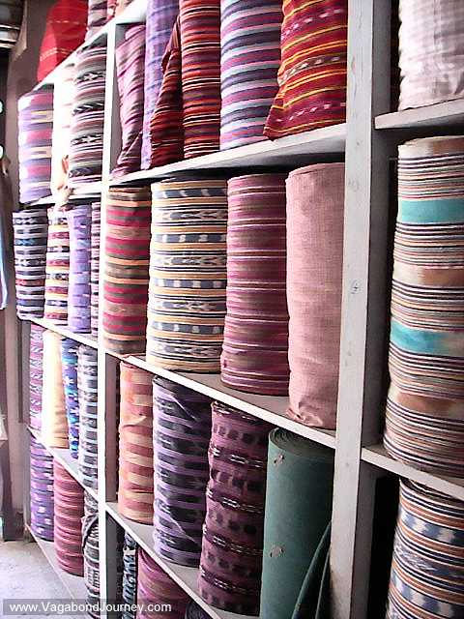
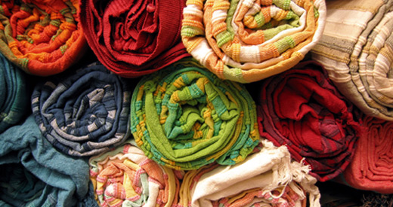
Textile Industry
AKA - cloth industry
1st industry to be mechanized (replaced by machines)
Old way = Cottage/Domestic system
Making goods at home
New way = Factory System

Slide 6
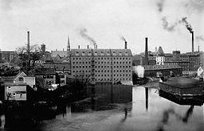
Factory System
Production in 1 place
Factory near power source
Workers paid fixed hourly wage
Goal = Mass Production (make large #’s of identical items)

Slide 7
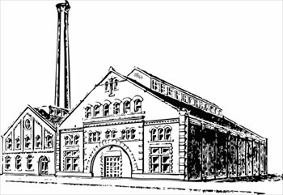
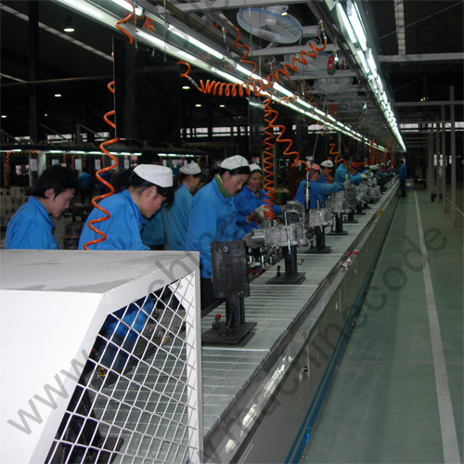
Factory System: How it Works
Process:
Division of Labor
Hire unskilled worker
Worker makes 1 interchangeable (identical) part of whole product
Assembly Line
Products move from worker to worker until end product created

Slide 8
How did the Industrial Revolution Change Society?

Slide 9
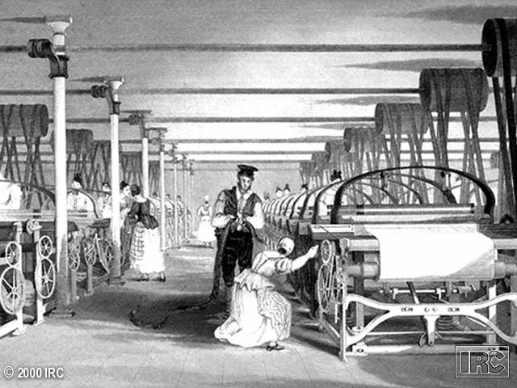
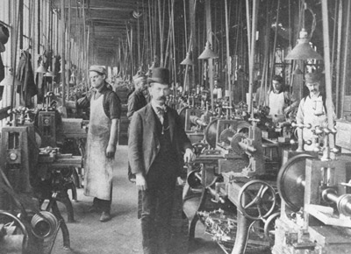
Lives of Factory Workers/Proletariat

Slide 10
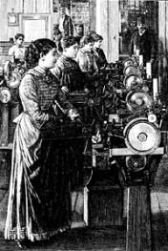
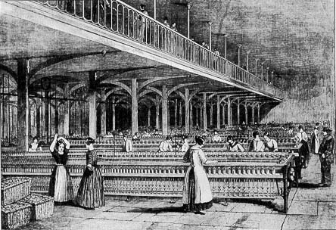
Women

Slide 11
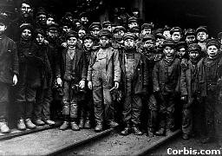
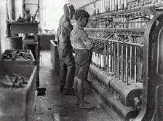
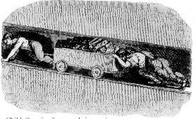
Child Labor

Slide 12
Worker Housing/Tenements

Slide 13
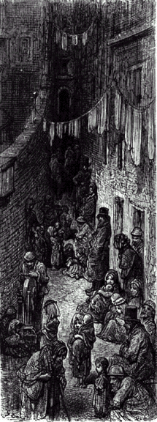
The New Industrial City

Slide 14
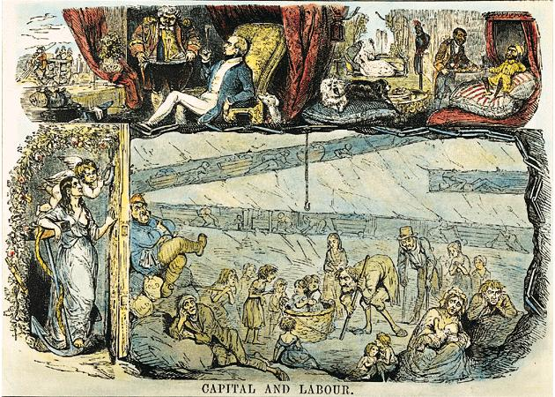
“Up Stairs” / “Down Stairs” Life

Slide 15
Factory Owners/Capitalists
Capitalism
Econ. system where individuals or corporations, not gov., own factors of prod.
Corporation
Businesses form groups to work together
Monopoly
Corporation controls almost all prod. of good

Slide 16
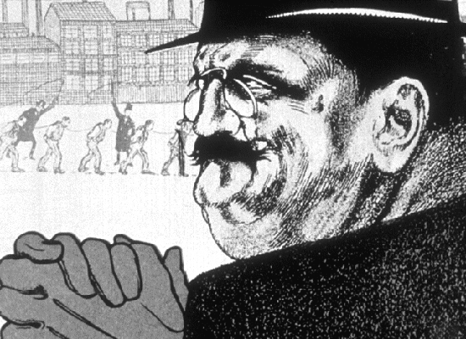
Stereotype of Factory Worker/Capitalists

Slide 17
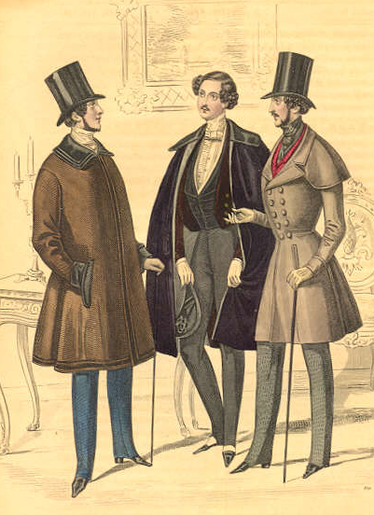
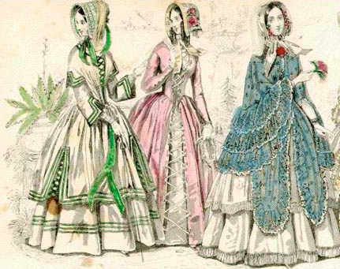
Bourgeoisie: The New Upper Class
Owners of
capital/means of
production

Slide 18
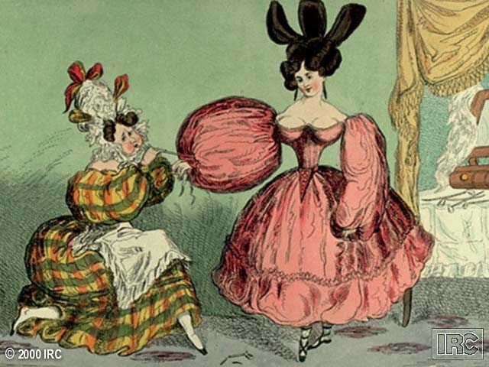
Criticism of the New Bourgeoisie

Slide 19
New Economic Theories
Mercantilism OUT!
Free Enterprise (no laws or regulations) IN!
Adam Smith
2 Natural Laws of Business
Law Supply and Demand
Law of Competition
Free Enterprise
Consequence
Business Cycle
New laissez-faire (“leave things alone”) theory appealed to Factory Owners/Capitalists
WHY?

Slide 20
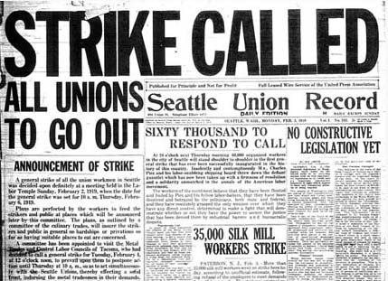
Attempts to Reform Inequalities
Humanitarians
People who worked to improve conditions
Collective Action – aka “Unions”
Strikes
Collective bargaining

Slide 21
Attempts to Reforms
Factory Acts (1802 & 1833)
Shorter workdays
Age requirements- could not hire anyone under 9 years old. From 9-13 yr. – could work no more than 8 hours a day, 6 days a week.
Improve factory conditions
Factory Acts Unsuccessful
Not enforced
Ex: Triangle Shirtwaist Fire (1911)

Slide 22
A New System All Together
Socialism
Econ. & political system
Gov. own means of production (MOP)
Gov. operates (MOP) for benefit of all people
Many variations of Socialism
Utopian Socialism-All people would own all means of production in common and share the products.

Slide 23
Marx and Engels
Marx and Engels two German men who believed that the Utopian society was impractical.
They said the entire capitalist system should be destroyed.
Marx believed that all changes in history come from changes in economic conditions.

Slide 24
Marx and Engels cont.
Marxism-believed that each stage of history involved inequality. The rich and the poor. He dreamed of Revolution in which the workers of the world would unite to gain political power.
Marx argued that all wealth is created by labor.
Under capitalism, however, labor receives only a small fraction of the wealth it creates.
He called for a revolution on the capitalists and the workers to rise up and overthrow them.

Slide 25
Marx Cont.
First the revolutionaries would control the government by force. Eventually after people learn the benefits of working together cooperatively, the state would wither away?
Marx called this a true classless society
“pure communism”!!!
Can it work??? Why ? Or Why not??

Slide 26
Government Types Cont.
Communism-Government owns all means of production and controlled all economic planning. No civil rights!
Democratic Socialism- Northern and Western Europe. People retain partial control over economic planning through the election of government officials.

Slide 27
Do the advancements of the Industrial Revolution out way the hardships and inequalities that developed because of the Industrial Revolution?

