Slide 1
Imperialism-Southeast Asia

Slide 2
Have you ever seen something you wanted and did absolutely anything in order to get it? Describe different examples!
How is this similar to imperialism?

Slide 3
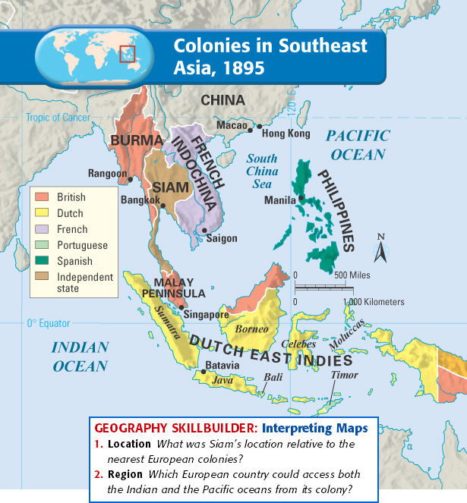
What’s next?
Recap:
Rushed to divide Africa
Next, carve up SE Asia
Pacific Rim: border Pacific Ocean
Strategic Location
Tropical Agriculture
Minerals
Oils
Everyone wants a piece of the action!

Slide 4
Dutch get there first
Seized Malacca
Fought British/Java for Java
Rule whole island chain of Indonesia
Dutch East Indies
Plantations/Trade
Many move there
Think of Tourists? Why?
Social Class
Dutch on top
Indonesians next
Plantation workers

Slide 5
Britain
Gain Singapore, Malaysia
Sheltered harbor
Why do they want this harbor?
Location, Location, Location
India-China sea routes
Malaysia
Becomes leading Rubber importer
Who is going to make products?
Chinese migrate there, Malaysia
Become minority.

Slide 6
French
French Indochina
Vietnam, Laos, Cambodia, and N. Vietnam
Most of land=rice production
More exportation then import
Vietnamese resistance
Impact on All
Economies grew
Roads, harbors, rail systems.
How do these help?
Education, health, sanitation down
Different Religions (Why would this cause a problem)?

Slide 7
Siam: Independent
Lay between Burma (Britain) and
Indochina (French)
Is this good or bad?
Siamese kings promote neutrality
King Mongkut
Progress
Schools started
Reform legal system
Railroads/telegraph systems
End to slavery
Why does Siam not want to be imperialized?
What are some good and bad things about being imperialized?

Slide 8
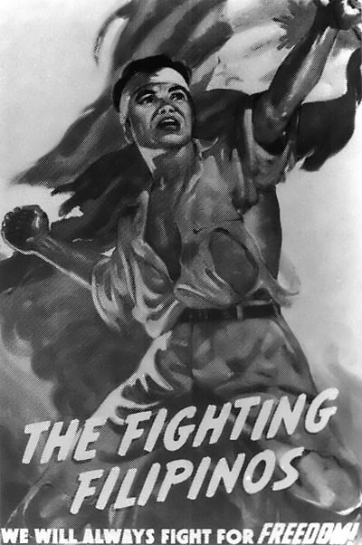
United States/Philippines
US acquire through Spanish-American War:
Philippines, Puerto Rico, and Guam
Philippines: Not ok with imperializing
Philippine Nationalist:
Claim US promised Independence
Philippine Republic
Fierce struggle
Defeat Philippines in 1902
Prepare them to self-rule
Roads, railroads, school systems

Slide 9
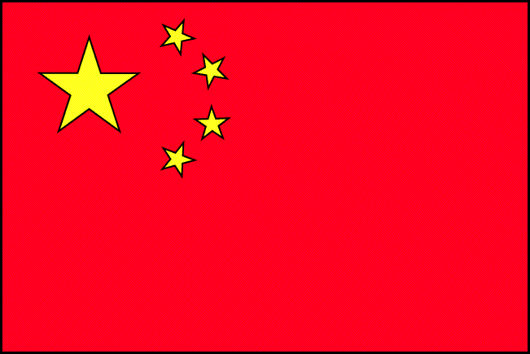
China
Recap: 1793: Englishmen brings gifts to Qing Dynasty.
Not impressed, state they have everything they need (Isolationism)
Economy Grew (Rice and products from Americas)
Mining and Manufacturing
Many Jobs

Slide 10
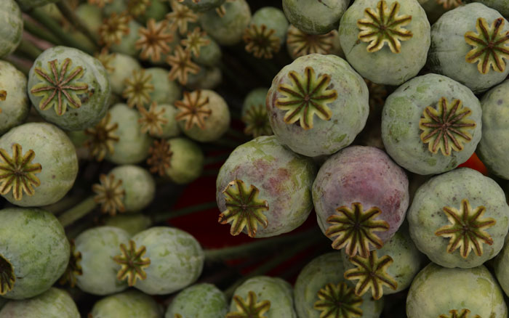
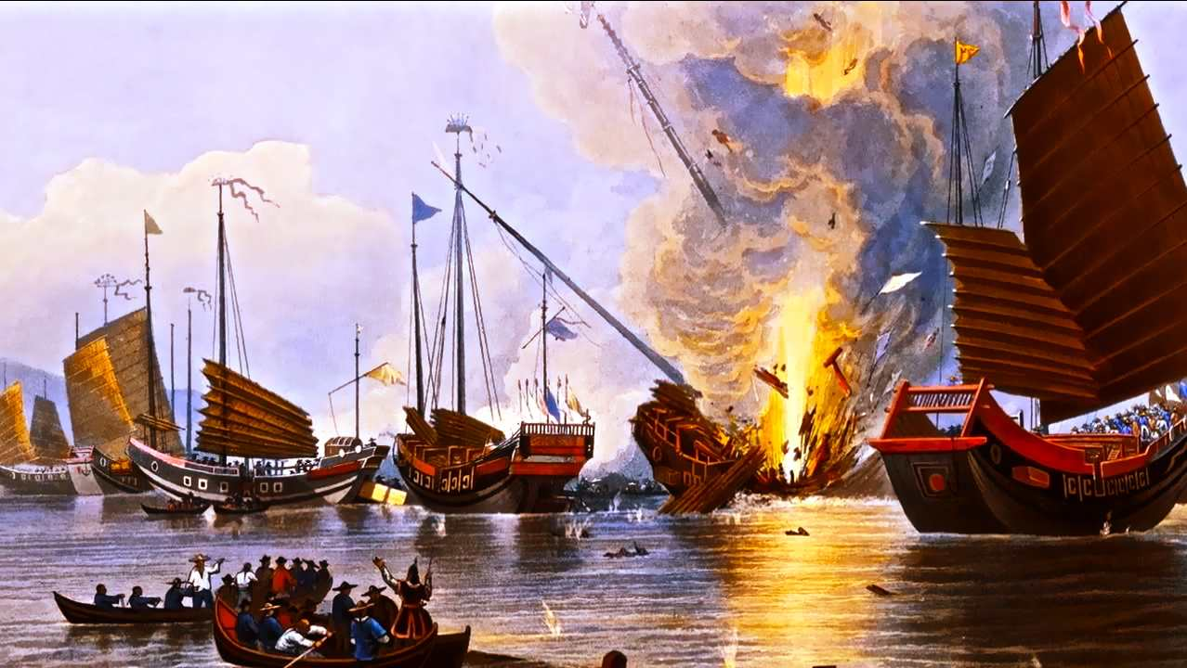
Tea Opium Connection
Think to yourself, what makes you want to buy a
product?
Product Europe made that China wanted
Opium: Narcotic product from poppy plant
12 million eventually become addicted
Much medical harm came from it
Britain does not stop trading illegally
Opium War: mostly at sea
British navy great, China’s ships outdated
Treaty of Nanjing:
Hong Kong given to Britain
Extraterritorial rights: not subject to Chinese law
if Britain controlled territories.

Slide 11
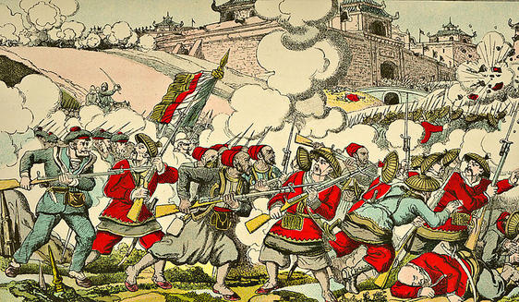
Taiping Rebellion
Taiping: “Great Peace”
Share China’s vast wealth
No poverty
1 million peasants join
SE Asia take over
Taiping govt constantly feuding
British and French help China
Taiping government brought down
20 million died from rebellion

Slide 12
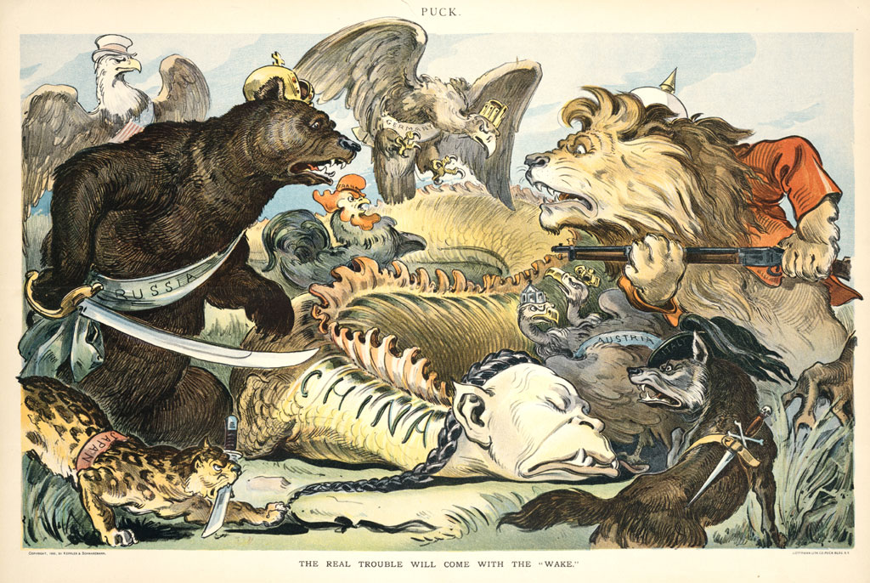
Why is this a good time to attack China?
Other countries attack China
while weak
Treaties give
Spheres of Influence: Have a say
in Trade and investment.
United States worried they will
be shut out
Open Door Policy: China’s doors
be open to all nations.

Slide 13
Boxer Rebellion
Poor Peasants resent special privileges granted to foreigners
Resent Chinese Christians: Foreign Faith
Boxer Rebellion:
Secret Society “The Boxers”
Take down government and
Foreign influence
Take Beijing
Awaited an alliance (no show)
19,000 troops march to Beijing
Boxers lose
Nationalism-heavy
Talk of a new form of government

Slide 14
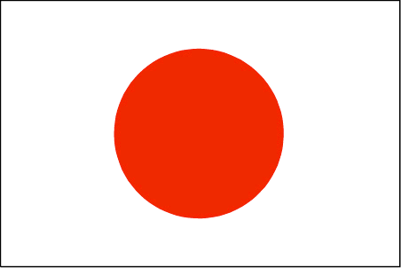
Japan
Up until now: No contact with industrialized world.
Only traded with China and Dutch (Trade grew important)
Matthew Perry (America):
4 steamed ships with cannons to
Japan
Japan impressed and was convinced
they needed to trade
President Fillmore writes polite note
about trade
Treaty of Kanagawa:
Japan opens two ports for trade to US
Other Western powers follow
Opened the door to others

Slide 15
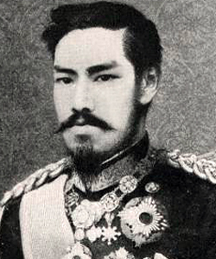
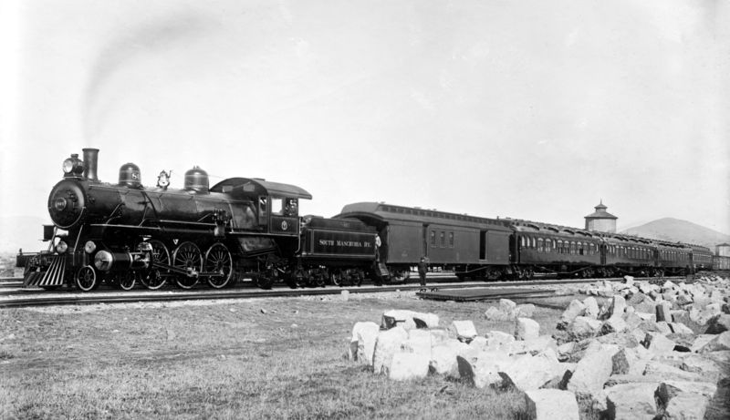
Reform and Modernization
Why would the Japanese be mad about trading with others?
Mutsuhito: Takes power (Military dictatorship before him)
Meiji: Enlightened rule
Best way to counter West influence is to modernize
Germany: Centralized govt.
(Japan makes their own)
German Army/British Navy
American: Public Education
Industrialization Begins
Railroad Lines
Coal Production
Factories (Tea and Silk)

Slide 16
Imperialize
Warships built, army raised (500,000)=strongest military power in Asia.
Mission: Eliminate Extra-territorial rights of foreigners
Extra-territorial rights eliminated
Japan and China interested in Korea
Hands-On Agreement: Neither would send
Armies into Korea
China breaks agreement
Sino-Japanese War
Japan drives China out
Treaty signed
Japan gets Taiwan and Pescadores Islands

Slide 17
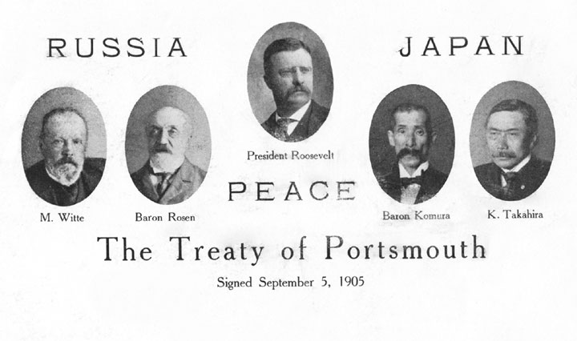
Russo-Japanese War
Russia and Japan: 2 powerhouses and enemies
Japan offers Russian rights in Manchuria if they do not go into Korea
Russia refuses, war breaks out
Japan destroys Russia
Treaty of Portsmouth:
Gave every conquered territory
In that war

Slide 18
Occupation of Korea
China out, Russia out, now Japan attacks Korea
Annexation of Korea, (Japan control)
Education: Korean language to Japanese
Farm land given to Japanese
Japan businessmen start
Korean Nationalism
Whole world saw brutality of Japan
They ignore it Why?

