Slide 1
Fascist Dictatorships in Italy and Germany
Chapter 28 Section 4

Slide 2
What is Fascism??
Comes from the Latin word fasces
A bundle of rods bound together around an axe
Dictatorship and Totalitarianism
Nationalistic
Militaristic
Opposed to communism
Appeals to the upper and middle classes b/c private property and social classes would remain unchanged

Slide 3
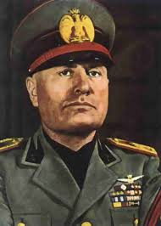
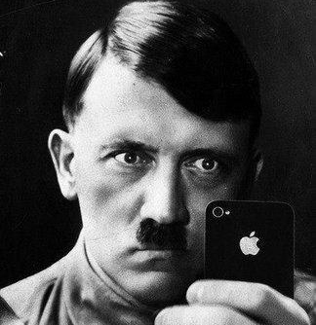
Fascist Dictatorships
Benito Mussolini
Adolf Hitler
Italy
Il Duce
Germany
Führer
Notes:
Doo chay

Slide 4
The Rise of Fascism in Italy
After WWI Mussolini becomes an extreme nationalist
Believed democracy was weak and ineffective
Anti-communist solution for people of Italy
Mussolini emphasized the importance of:
Cooperation between management and workers
National Pride
Returning Italy to the glory days of the Roman Empire

Slide 5
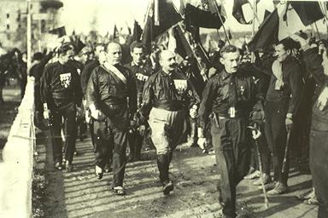
Mussolini’s Rise to Power
Black Shirts carry out a violent campaign against opposition by
Intimidating voters
Breaking up strikes
Forcing socialists out of office
Italian King appoints Mussolini premier to help defend Italy against a communist revolution

Slide 6
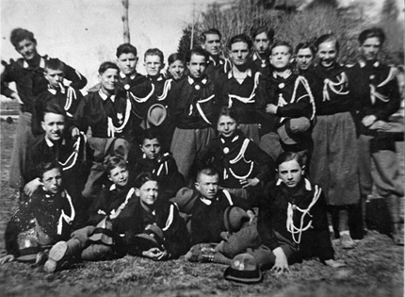
Mussolini in Power
Dictator
Suspends the rights of citizens
NO free speech, freedom of press, trial by jury
Crushes opposition
Italians okay with violence b/c of progress
“Sons of the Wolf”

Slide 7
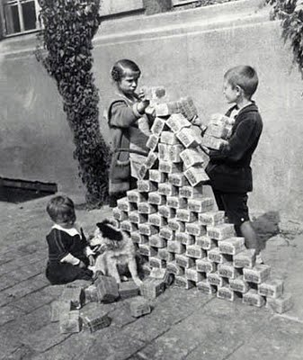
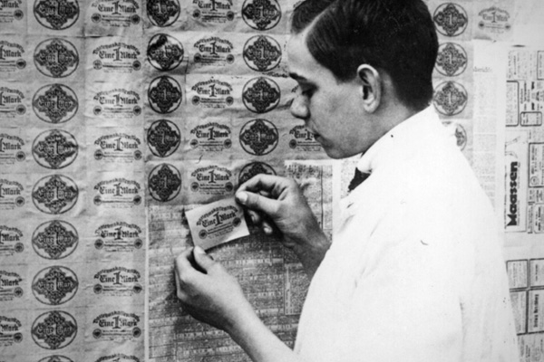
Germany After WWI
Weimar Republic-attempt at democracy
Lacked support of German people
Inflation was insane!
Price for a loaf of bread?
Notes:
Gallon of milk cost 1 billion marks\
No more numbers on bills
People decorated their homes with the money because it was cheaper than wallpaper

Slide 8
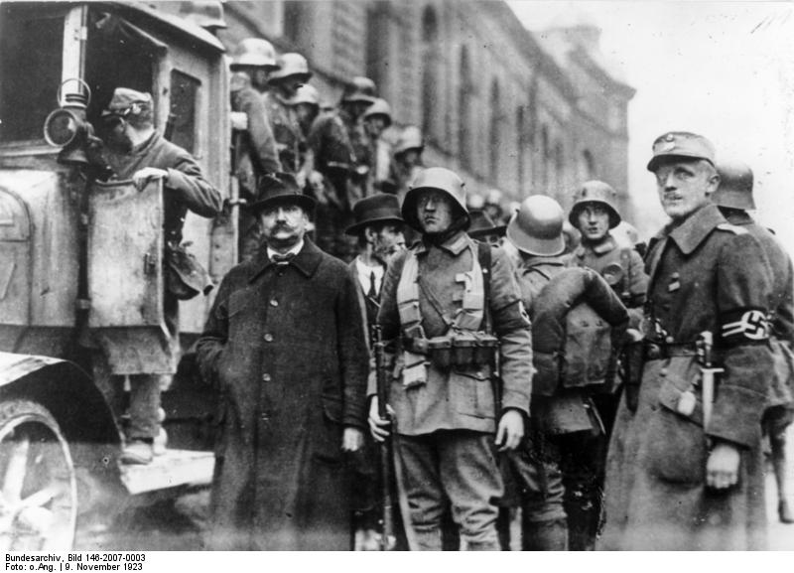
The Beer Hall Putsch
Uprising led by Adolf Hitler in 1923
Trying to seize power in Bavaria
Highlighted the weaknesses of the government
Hitler and the others are put into jail
In jail Hitler writes Mein Kampf (My Struggle)

Slide 9
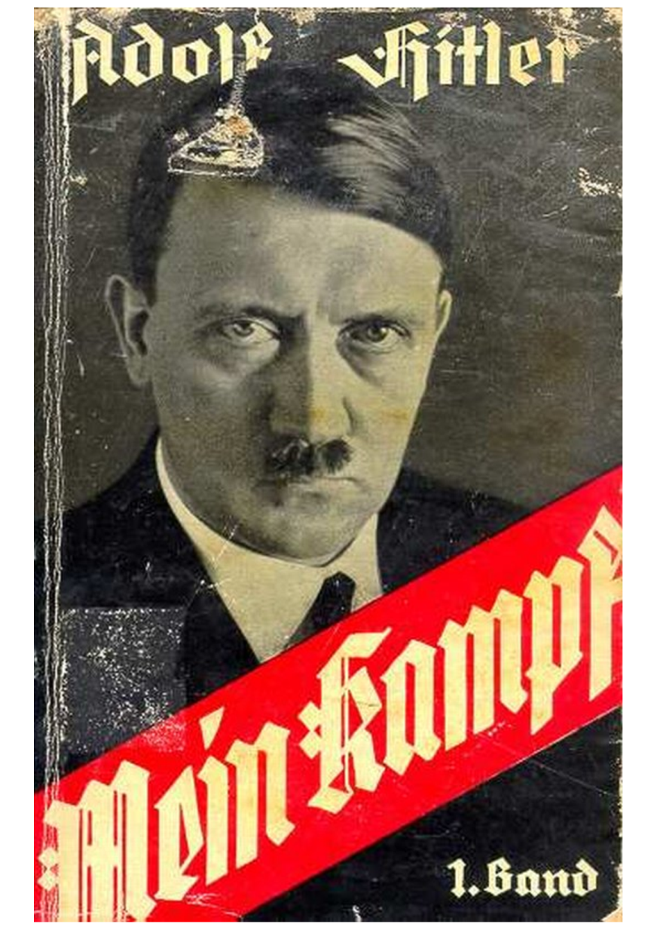
Mein Kampf
Outlines Hitler’s plan for Germany
Racial purity through extermination of the Jews
Develops the concept of the Aryan Race
Blonde hair, blue eyes, white
Germany must defeat their old enemy France
Notes:
Original Title was "Four and a Half Years of Struggle against Lies, Stupidity and Cowardice.“
Aryan race has its roots in Hinduism in Northern India-highly unlikely that the Germans had any real ties to the race at all

Slide 10
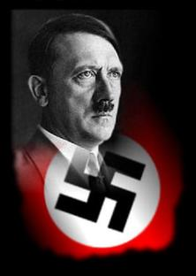
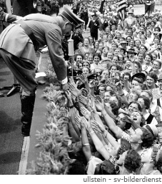
Support for Hitler
Hitler promised to restore Germany back to their glory
Build a “Greater Germany”
Emotional speeches
Restore Germany’s military power
Notes:
Hindu sign for peace

Slide 11
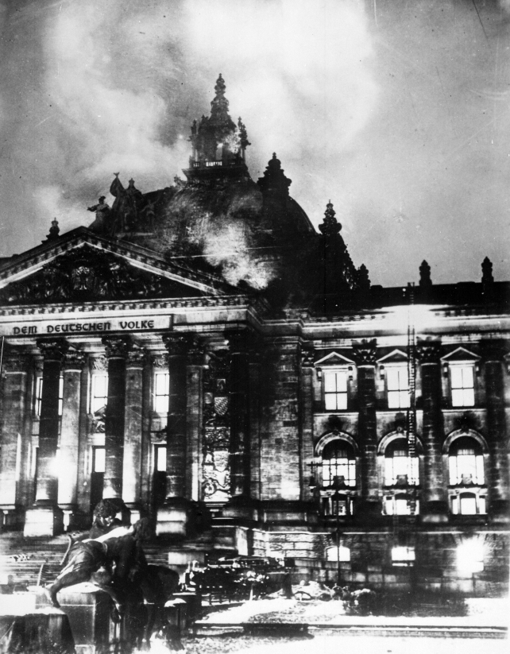
The Nazis in Power
Nazi Party
Socialist German Worker’s Party
Extreme nationalists, anti-Semitic, anti-communist
1932 hold the most seats in the Reichstag
Hitler appointed Chancellor
1933 Reichstag burns down
Hitler blames it on communist party
Hitler receives emergency powers
Notes:
Uses these emergency powers to make himself the dictator

Slide 12
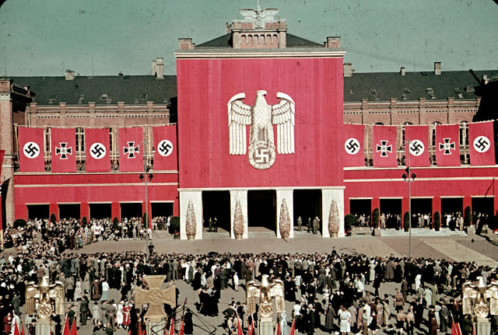
The Third Reich
The Third German Empire
Police State
No labor unions, opposition papers
Gestapo
Secret police force with wide ranging powers
Inferior races suffered persecution
Led to the development of ghettos and concentration/extermination camps

Slide 13
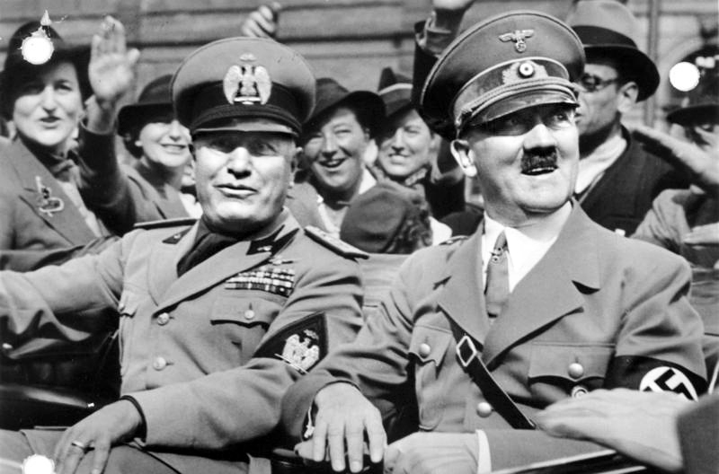
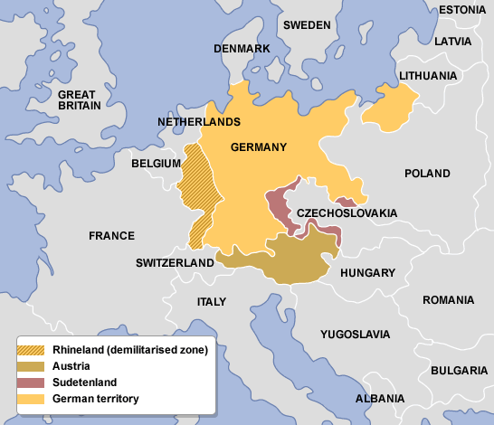
Hitler’s Endeavors
Hitler began to secretly rebuild Germany’s military
1936 Hitler ordered troops into the Rhineland
France and Great Britain do not react…
Hitler and Mussolini create an alliance
Rome-Berlin Axis
Notes:
Because of the easy success in the Rhineland Hitler is encouraged in Germany

Slide 14
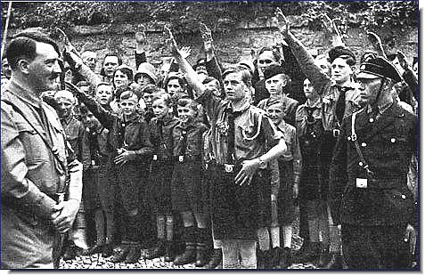
Exit Question
Why do you think both Hitler and Mussolini focus on educating the youth?
Do you think the United States changes history that is being taught to students the same way the Hitler and Mussolini tried to?

