Slide 1
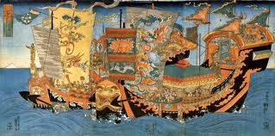
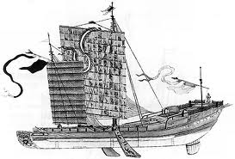
Chapter 18 Asia in Transition
During the early period of the Ming Dynasty – the late 1300s and early 1400s-
The Chinese were probably the most skilled sailors in the world.

Slide 3
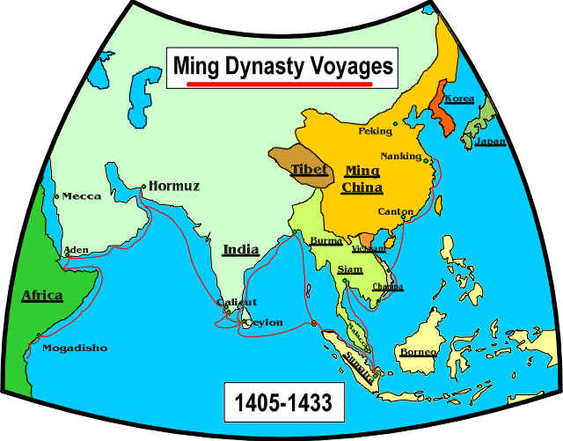

Slide 4
Attitudes toward trade
After defeating the Mongols in 1386, the Ming Emperors tried to rid China of all Mongol influences.
The Ming emperors restored Confucianism as the official philosophy of the government.

Slide 5
Confucianism
Official philosophy adopted by Ming government in order to make China GREAT again.
Righteousness in heart = Beauty in Character
Beauty in Character = Harmony in Home
Harmony in Home = Order in Nation
Order in Nation = Peace in World

Slide 6
4 Classes Under Confucianism
Scholar | 2) Farmers | 3) Artisans | 4) Merchants
Educated Class | Produced Food and Paid Taxes | Made Beautiful Objects | Bottom of Social Order! Made Living by Selling Objects

Slide 7
Attitudes toward trade
The Ming emperors wanted China to be self-sufficient.
They refused to rely upon foreign trade as a source of government revenue.
In the minds of the emperors, foreign trade did not bring enough benefits to China to make it worthwhile.
This view was completely different from that of the European monarchs, who were strongly influenced by the ideas of Mercantilism.

Slide 8
The Great Wall of China
Why was the Great Wall Constructed?

Slide 9
The Great Wall of China: Group Questions
Who was the Great Wall meant to protect? From whom or what?
What does the Great Wall tell us about China’s Ming relationship with its northern neighbors?

Slide 10
The Great Wall of China: Group Questions
Who was the Great Wall meant to protect? From whom or what?
What does the Great Wall tell us about China’s Ming relationship with its northern neighbors?

Slide 11
The Great Wall of China: Group Questions
While the Great Wall kept invading armies at bay for more than 200 years during the Ming Dynasty, the Ming were eventually o/thrown and China was ruled by the Manchu/Qing Dynasty outsiders. Considering this information, was the Great Wall successful or not?

Slide 12
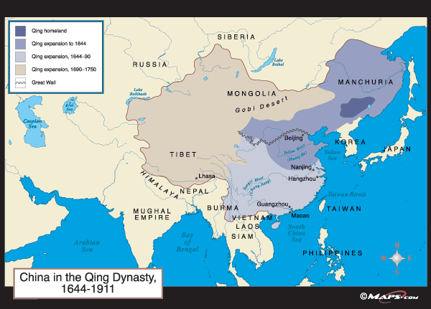
The Qing Dynasty

Slide 13
The Qing Dynasty
In Manchuria, ( a region northeast of China), a chieftain named Nurhachi unified many tribes into a single people, called Manchu.
Nurhachi, conquered Korea, and Mongolia and he named his new dynasty the Quing.
In 1644 the Manchu captured Beijing. The Qing Dynasty ruled from 1644 to 1912.
The Qing emperors were not Chinese but adopted Chinese culture and traditional techniques.
The Emperors always tried to keep the Manchua people separate from the Chinese by language, cultural traditions, marriage, banning emigration of Chinese to Manchuria.

Slide 14
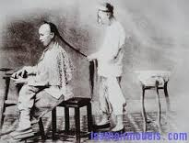
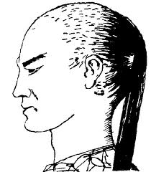
Queue-Chinese Submission to Manchu Rule

Slide 15
Qing Economy, Culture, and Society
Trade just like in the Ming Dynasty continues to grow
Cities really began to prosper and develop.
Still there were more people living in the countryside.
Sweet Potato “ Poor Man’s Food”
Chinese society continued to be based on the family.

Slide 16
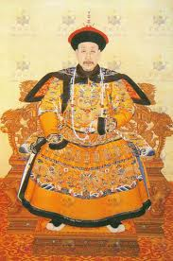
Decline of the Qing Dynasty
Peace and the ability for farmers to grow more crops led to a huge population explosion.
Corruption at court and government inefficiency
Floods and Famine widespread
Increase in taxes- People are not happy
White Lotus Rebellion

Slide 17
China and Europeans

Slide 18
The Portuguese

Slide 19
Jesuit Missionaries

Slide 20
Jesuits Cont.

Slide 21
The British

Slide 22
Free Trade ideas

Slide 23
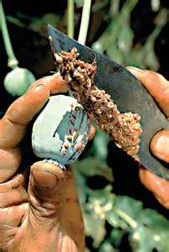
Trade Problems
Expansion of tea trade
British East India Company paid for:
Purchases with cotton from India.
Chinese demand for cotton=same
British demand for tea=kept rising
Company found a drug to exchange for tea called
Opium
Problem?
Opium addictions spread throughout China
Huge trade imbalance grew, with more silver going out than coming in.
Demanded opium trade stop
All opium cargo be turned over to them

Slide 24
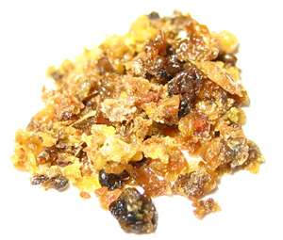
Opium Wars
When Chinese tried to stop trade:
War broke out
Conflict between China and Britain known as the:
Opium War
Chinese army and navies no match compared to Britain.
Qing officials agree to negotiate with British officials.
Treaty of Nanjing
China gave island of Hong Kong to British.
Opened five ports to British trade (Fixed low tariff).
Subjects in ports governed by British laws and courts.
Extraterritoriality
Foreigners must follow laws of their home country instead of laws of country they live in.

Slide 26
More Concessions
Unequal treaties
Chinese signed treaties under the pressure of defeat and fear of further invasion.
Benefits went to foreign powers.
Gained little from them.
Another war, Another British win, another unequal treaty.
Opened additional ports along Yangtze River
Chinese had to allow British Embassy in Beijing.
Chinese govt. had to protect Christian missionaries and their converts in China.
Other countries also opened embassies in Beijing.

Slide 27
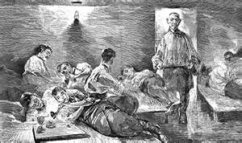
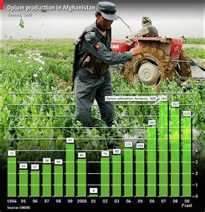
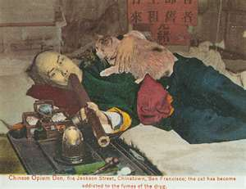
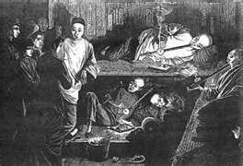
Opium Pictures

