Slide 1
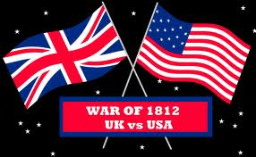
War of 1812

Slide 2
https://www.youtube.com/watch?v=1nRIQVNUI4I
Napoleonic Wars: Why does this help the United States?
Continental System (1810-1811), and Two Front War
Battle of Tippecanoe (November, 1811)
Native Americans increase their attacks against settlers. Why?
Most Americans believe they were encouraged and armed by British.
War Breaks Out
Congress in 1812 included many members from South and West (expansion of farmers moving west into Indian lands).
John Calhoun + Henry Clay )War Hawks: Favored war with Britain to push Britain out of North America and to stop attacks.
Anger Toward Britain
President Madison urged Congress toward war
Encouraged Indians
Impressment: Forcing people to military service
Seizing American ships
Violates Free Trade Policy:
Congress approves War (War of 1812)

Slide 3
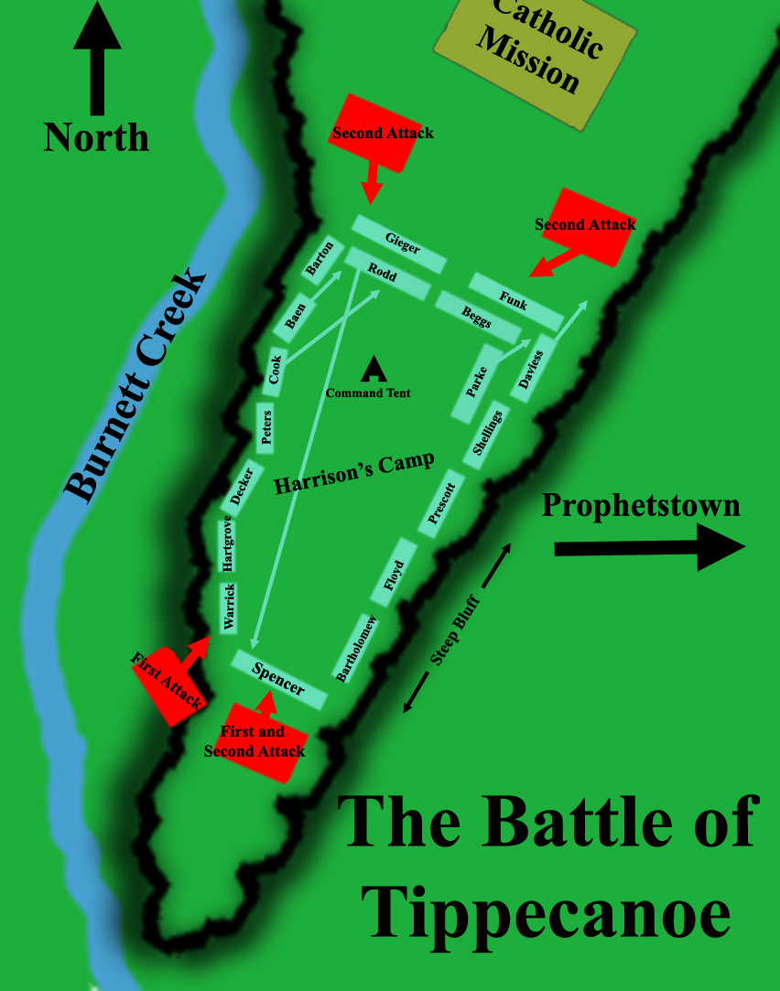
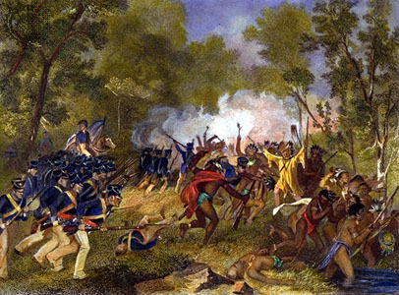

Slide 4
Why could it have been foolish for the United States to declare war on Britain?
Had a small army and navy
No offers of help from foreign countries
Not only Britain, but Native Americans
Neither side really gained ground on one another
Land War (Big Wins and Losses)
First invaded British held Canada (Were beaten by British in summer of 1812).
Battle of Thames (October, 1813): defeated British and NA in Chatham, Canada
Andrew Jackson: defeat NA tribe in Horseshoe Bend in Alabama
3,000 vs. 1,000
From Native Americans
800 died,
500 women and children imprisoned
Treaty of Fort Jackson: 23 million acres of land
(Most of present-day Alabama and S. Georgia)

Slide 5
Naval War
Outnumbered American ships 20 to 1
Early victories and capture 1,000 ships
Number of defeats weaken US navy
US win battle to control Lake Erie
British blockade US coast
http://www.pbs.org/wned/war-of-1812/essays/american-perspective
Burning of Washington D.C.: Napoleon exiled
British land on Chesapeake Bay
Successful and go after D.C
President and wife flee
Set on fire including Capitol and White House
Went after Baltimore next
Francis Scott Key: National Anthem/bombardment on Fort McHenry
American forces were able to turn back the enemy. (End of War)

Slide 6
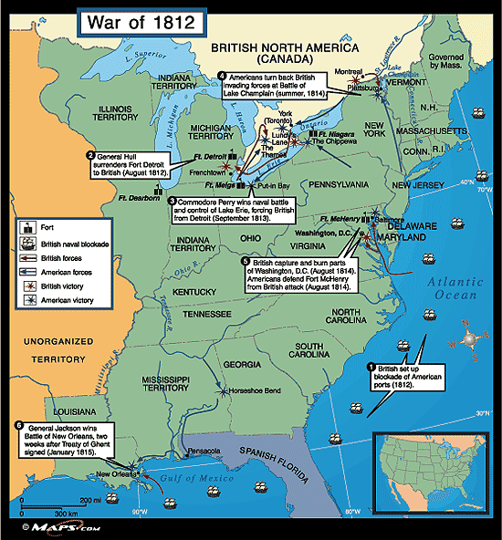

Slide 7
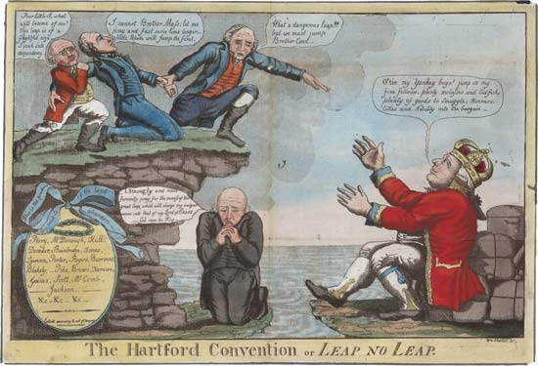
National Treasury Empty, The Capitol laid in ruins, and blockade brought trade to standstill.
Hartford Convention: New England suffers substantial losses in trade. Call a meeting in Hartford, CT to consider leaving the nation. All they asked for was more political power.
Treaty of Ghent: December 24th, 1814 Met in Belgium
Did not resolve issues that started war
Practice of impressment and respect
Of natural rights of United States.
United States and British territory were
Restored. Many in US happy that the war was
over.

Slide 8
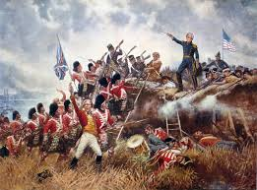
Battle of New Orleans: Slow communication at this time (2 weeks after Treaty was signed this war lasted). News of treaty did not reach United States until February.
British force of more than 5,000 men tried to take New Orleans from South.
Jackson and 5,000 troops come from Mississippi Valley.
Toe to toe with America (Well protected and riflemen)
Ended on positive note, unified country, restores patriotism, and made Andrew Jackson a national hero.

Slide 9
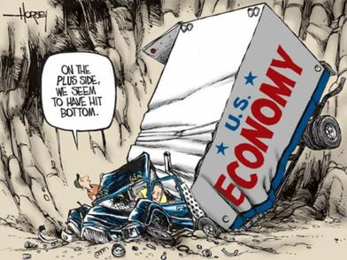
Election of 1816: James Monroe wins election (Republican Party) as Federalists start to fade out of existence.
Panic of 1819: First Depression country goes through
First Bank of United States dissolved (1811)
Second Bank of United States established (1816).
Gave credit to move westward
1819, London banks demanded money
owed to them.
4. United States turned to people who took
out loans.
5. If you borrowed too much, you were
ruined

Slide 10
Missouri Compromise
Congress began debating whether they should allow admission of the state Missouri to the United States. What was the issue?
Northwest Ordinance of 1787: No state northwest of Ohio River could be a SLAVE state.
North objects: Increase in power to the southern states in the Senate (11 free, 11 slave).
South: “If you tell Missouri they cannot be a slave state, they can do it with other states as well.”
Results of Missouri Compromise:
Missouri could be slave state; Maine broke off of Mass. And became free state. Why did this help balance of power?
When United States expanded westward, territories North of 36 degrees 30’ N latitude in Louisiana Purchase would be closed to slavery.

Slide 11
