Slide 1
Chapter 6 Section 2-3

Slide 2
Review Questions: Homework check
What did Citizen Genet (2:40) try to convince Americans to do?
Serve as soldiers and privateers against the British.
What did Hamilton try to do that started the Whiskey rebellion?
Tax whiskey at the federal level
Who ran for office in the election of 1796? Who won?
John Adams (federalist) won
Jefferson and Burr (Republican)- Jefferson became the VP!

Slide 3
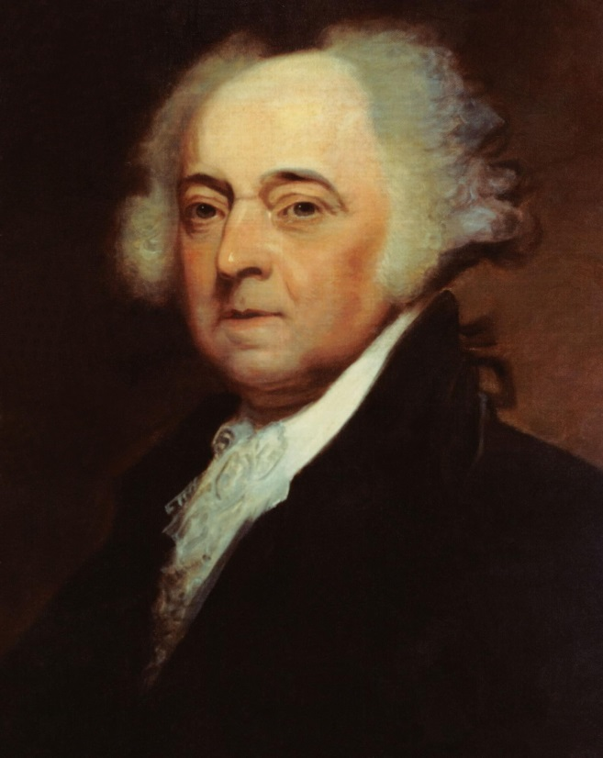
John Adams presidency!
Jay’s Treaty reminder!
XYZ affair
American officials in France were met by secret agents sent by the French foreign minister-agents later known as XYZ
French agents demanded a bribe of $250,000 and a loan to the French of $10 million before the Americans would even be allowed to see the French foreign minister-common practice in foreign diplomacy but enraged Americans
American diplomats refuse to pay-returned home
Unable to resolve their differences, by 1798, France and the U.S. were involved in what amounted to an undeclared naval war- both sides fired upon and seized ships

Slide 4
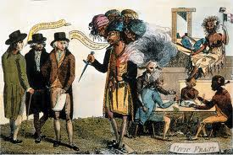
The Alien and Sedition Acts
Federalists took advantage of war crisis-pushed things like increased size of army, higher taxes, etc through Congress
Alien Act
Gave the President the power to arrest and deport citizens of other countries living in the U.S.
5 year process to obtain citizenship to 14 years
Sedition Act
Persons who wrote, published, or said anything “FALSE, scandalous, and malicious” against the American government or its officials could be fined or jailed- Used to silence Republican opposition

Slide 5
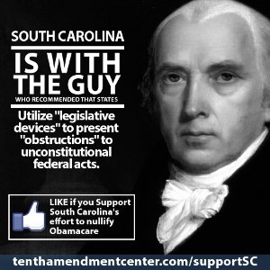
Virginia and Kentucky Resolutions
Jefferson, Madison (irony), and other Republicans believed that the Sedition Act violated the constitutional protection of freedom of speech
Constitution did not spell out who had the authority to judge whether an act of Congress went beyond the powers stated in the Constitution.
These resolutions, adopted by the legislatures of those two states, argued that the states had the right to judge whether federal laws were Constitutional
Could a state declare that law be “null and void”- nullification?

Slide 6
Election of 1800
The election of 1800 was “as real a revolution in the principles of our government as that of 1776 was in its form”
John Adams loses federalist support
Tried to peacefully resolve the undeclared naval war with France (successful after two trips)….accomplishment hurt Adams in the long run
Upset hardliners like Hamilton- wanted an actual declaration of war with France
Jeffersonian Republicans’ support for France became less of a rallying point for the federalists and a non-issue for the Jeffersonians
Alien and Sedition Acts less justifiable and hated even more

Slide 7
Election 1800 continued
Jefferson’s V.P. Aaron Burr obtained a copy of a privately distributed pamphlet written by Hamilton called “the Public Conduct and Character of John Adams”
“I should be deficient in candor were I to conceal the conviction, that Adams does not possess the talents adapted to Administration of Government, and that there are great and intrinsic defects in his character which unfit him for the office of Chief Magistrate.”
Hamilton supported Charles Pinckney
Adams always received a bad rep- reluctant Federalist= Moderate!

Slide 8
Election of 1800
Jeffersonian Republicans
All time low 1798 mid term election- support for France backfires
Naval war and XYZ
Campaign ad- if they could have them back then..brutal but more behind the scenes in newspapers, pamphlets, etc.

Slide 9
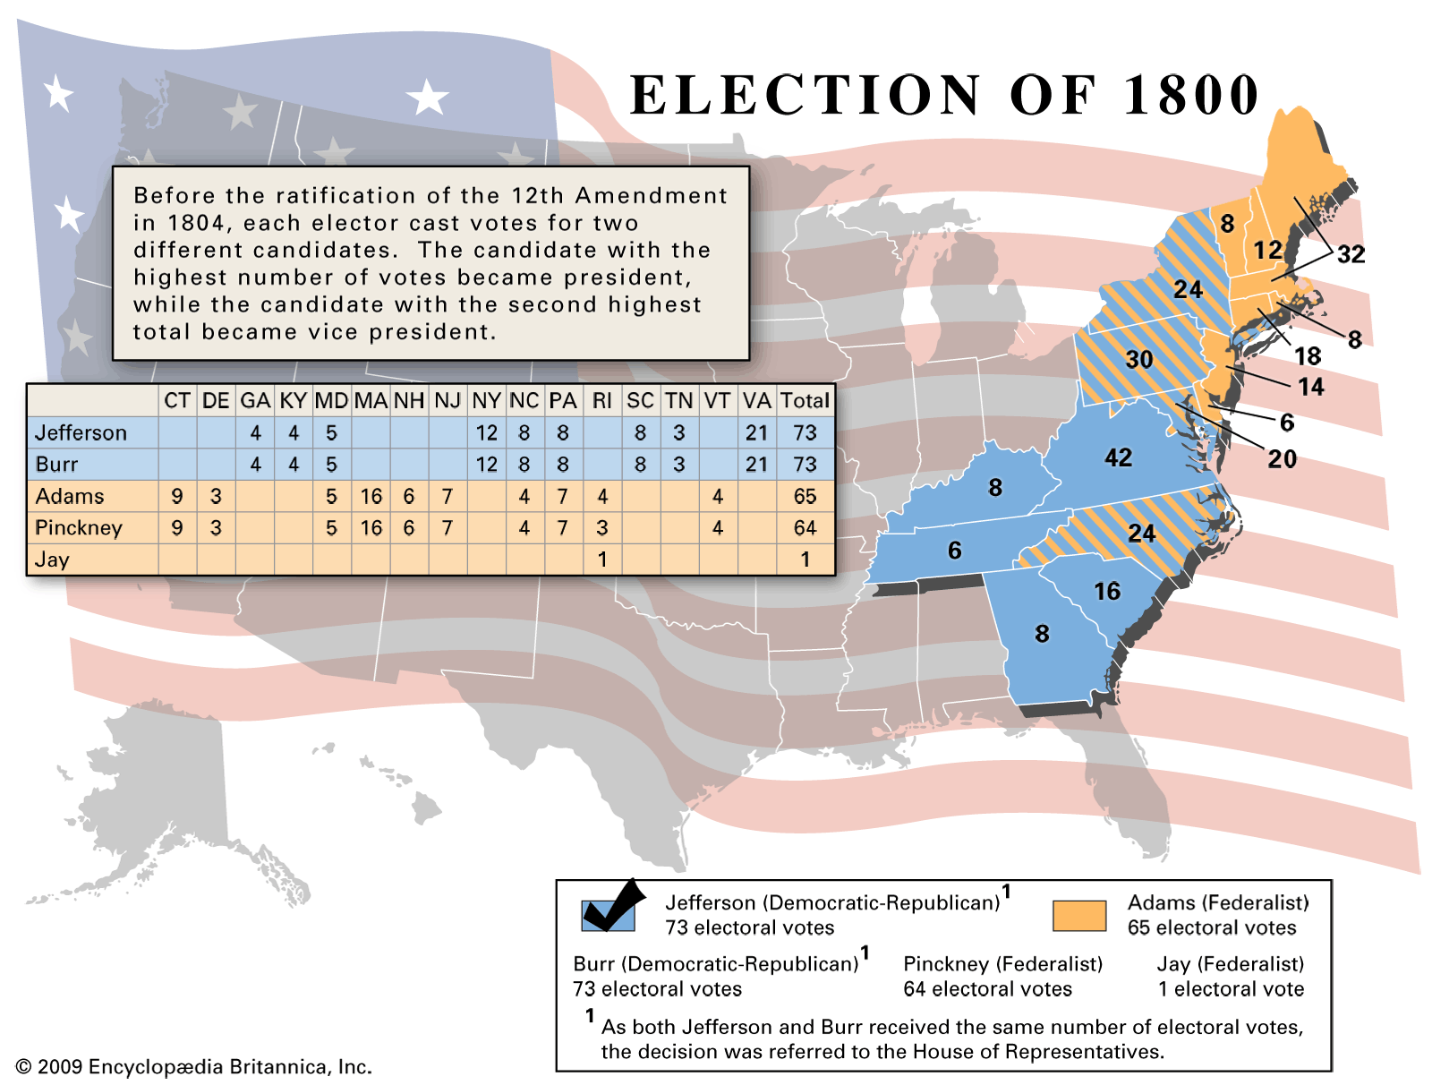
Notes:
Jefferson’s Victory
Jefferson won the popular vote but not the electoral college
Main rival was not Adams. It was Aaron Burr.
Each received 73 electoral votes
Adams 65
Pinckney 64
House of Representatives broke the tie
Federalists still controlled the house from previous midterm election
Gridlocked for days
Hamilton finally sided with Jefferson who he preferred over Burr
1801- peaceful transfer of power- From Federalists to Democratic Republicans

Slide 10
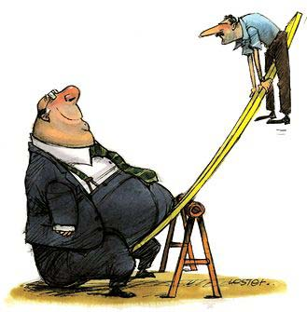
Jefferson Administration
Reducing the government
Agenda = cut the fat! Or the bureaucracy
Cut taxes
Attorney General was not even allowed to have a clerk
Slashed the army down to only 3,000

Slide 11
Jefferson Administration
Jefferson and the Courts
Biggest controversy
Key question: What will we do with the Supreme Court?
Constitution creates a Supreme Court (read article III- it does not take that long)
Section 1: How long will judges serve for? Who creates the inferior courts?
Section 2: What is meant by jurisdiction? What kinds of cases will it hear? Original Jurisdiction v. Appellate? – Supreme Court has both!
Section 3: What does section 3 state? Why is treason the only criminal offense defined in the U.S. Constitution?

Slide 12
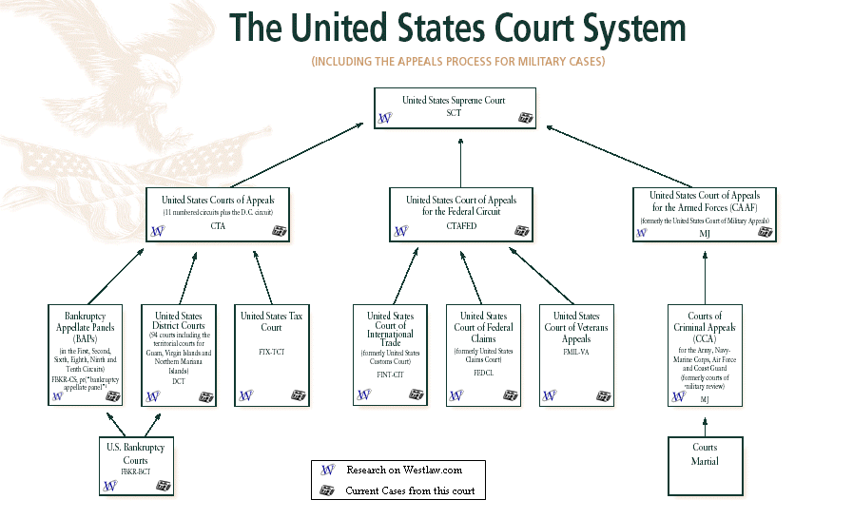

Slide 13
Marbury v. Madison
The Judiciary Acts 1789
LEGISLATION OF CONGRESS!! (Section 1)
Created a national court system
Three circuit and 13 district courts all headed by the Supreme Court
Supreme court would settle differences between state and federal law
1801
Outgoing members of Congress (and president Adams) were trying to limit Jefferson’s opportunity to appoint judges to the Supreme Court
Wanted federalists (for life terms)
Last minute appointments-AKA midnight judges- angered Jefferson b/c he wanted to appoint them from his party.
Adam’s appoints John Marshall (federalist)
Secretary of State under Adams
Held post for 34 years until his death in 1835
Federalist legacy!

Slide 14
Marbury v. Madison
The Case
Jefferson tried to deny appointments of Federalist judges
John Adams appointed William Marbury at the end of his term in office to fed court of District of Columbia
Secretary of State James Madison (Jefferson) never delivered the official papers giving Marbury his authority.
Marbury (federalist) sued Madison (Jefferson), demanding that the Supreme Court let him take his office….Judiciary Act of 1789 gave the Supreme Court the power to give such an order to the executive.
What would the logical ruling be for Chief Justice John Marshall (federalist)?

Slide 15
Marbury v. Madison
The Ruling
Ruled against Marbury!
Giving an order like that (part of the Judiciary Act) was unconstitutional.
FIRST TIME EVER TO RULE SOMETHING CONSTITUTIONAL OR NOT!!
ESTABLISHED JUDICIAL REVIEW!

Slide 16
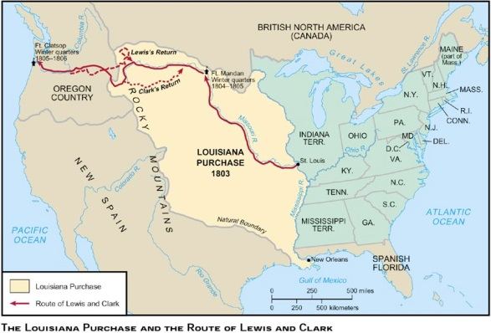
How did Jefferson’s program in the west actually mirror federalist policy?
Notes:
The Land Act of 1800
Northwest ordinance of 1787 had established a where western territories could become states.
Land Act of 1800- Americans were able to buy land in small amounts on credit
There may be some use for a federal banking system
Who will the frontiersmen come into contact with at this point in American history?
Napoleon and the French
American farmers depended on the Mississippi River for trading
France gained control of Louisiana from the Spanish- NEW ORLEANS
French charging Americans large amounts of money to trade
James Monroe sent to New Orleans to purchase New Orleans
Offered $10 million
When Napoleon failed to crush the Haitian rebellion (to build a French empire in the America) he wanted to sell all of Louisiana territory
Offered $15 million without Congressional approval (did get it after the fact)
Purchasing of foreign lands not in Constitution
Immediate national debt
Lewis and Clark Expedition
1804 expedition to explore the new territory
Reached Pacific Ocean in 1805 and returned in 1806

Slide 17
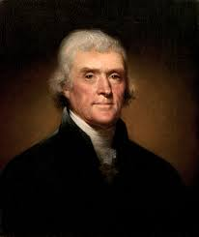
Election of 1804
Jefferson-lowered taxes, acquired new territory for potential farmers, Alien and Sedition Acts expired, peace= very popular

Slide 18
Election of 1804
Hamilton and Burr
Jefferson’s Vice President Aaron Burr – almost won election of 1800 until Hamilton’s Federalists in the House finally supported Jefferson because of hatred for Burr (lesser of two evils)
Burr decides to run for governor of New York in 1804 on the Federalist ticket (best odds of winning)
Hamilton was appalled- Burr was “an unprincipled man concerned only with interest and ambition”
Hamilton talked federalists out of supporting Burr- successful- Burr did not get nominated for governor
Burr furious- second time he was politically ruined by Hamilton-challenged him to a duel
Met in Weehawken New Jersey on July 11, 1804.
Mixed reports on what exactly happened- Hamilton mortally wounded
Burr’s political career ruined- indicted in both New Jersey and New York- but was later acquitted

Slide 19
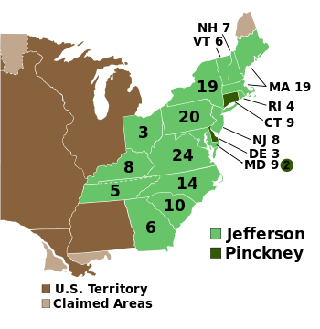
Election of 1804
Notes:
Landslide victory for Jefferson in 1804 against Federalist Charles Pinckney

Slide 20
Increasing tensions in Europe
Chesapeake
Jay’s treaty expired in 1805
Europe was back at war (Napoleonic Wars- Dropped Louisiana- now focused on all of Europe)
American’s tried to trade with everyone
1807- the British ship Leopard attacked the USS Chesapeake- 21 died
Embargo of 1807
Outlawed ALL trade with foreign nations!!??
Hurt the U.S. more than Europe
New England areas hated the legislation
Started to smuggle anyway
Jefferson was forced to enforce this bad legislation
Ruined his presidency
Despite the unpopularity of Jefferson/embargo, James Madison won on the Democratic Republican ticket in 1808.

