Slide 1
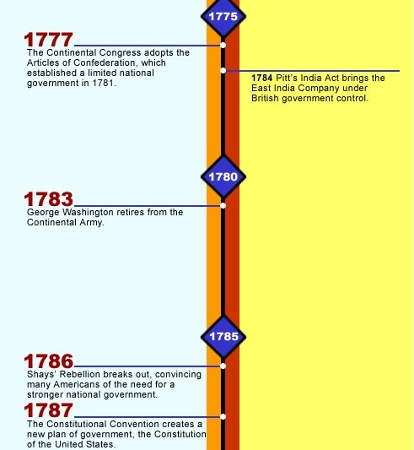
Chapter 5
Section 1
Introduction to the
Constitutional Convention

Slide 2
What are the three fundamental powers of all government? Define each?
Legislative-makes laws
Executive- Enforces laws
Judicial- interpret the laws

Slide 3
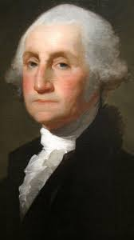
December 23, 1783- George Washington steps down from commander of the Continental Army
“Having now finished the work assigned me, I retire from the great theatre of Action—and bidding an Affectionate farewell to this August body under whose orders I have long acted, I here offer my Commission, and take my leave of all the employments of public life.”
War is over…now what? Establish a new government! What would this look like??

Slide 4
War is over…now what? Establish a new government! What would this look like??
Continental Congress-radical for time period
Responsible for fighting the war of Independence
loose collection of delegates from 13 separate states
gave approval for Declaration of Independence (JOHN ADAMS!)
There was much hesitation to unify…WHY?
Worried about results of war with Great Britain
Worried about authority of this national (continental) government
Don’t want to trade a king in England for a King in the colonies!

Slide 5
What were the Articles of Confederation? WHY WERE THEY WEAK??
In 1777, the Continental Congress adopted a set of laws to govern the United States-the Articles of Confederation-CONSERVATIVE APPROACH

Slide 6
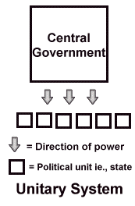
What are the three options for a NATIONAL GOVERNMENT? How would you define each?
Unitary-all powers held by the government belong to a single, central agency
The central (national) gov creates local units for its own convenience
Colonists were worried about this!
MODERN DAY GREAT BRITAIN

Slide 7
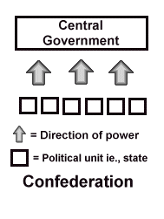
What are the three options for a NATIONAL GOVERNMENT? How would you define each?
Confederation- is an alliance of independent states
Central organization, confederate government, exists and has only powers member states (localities) assign to it.

Slide 8
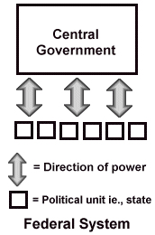
What are the three options for a NATIONAL GOVERNMENT? How would you define each?
Federal- is one in which the powers of gov are divided between a central –DIVISION OF POWERS-geographic basis
This is where we will be heading!
Weakness of Articles leads us to a Federal system- COMPROMISE!!!!!

Slide 9
What was the makeup of the Articles of Confederation and why were they WEAK??
Only had one branch-a legislative-made up of delegates from the states
Carried out the duties of executive and legislative
No judicial branch
John Hancock was first president- NO SHOW PRESIDENT!!!
SO is this even a government?
More of an alliance
Could declare war and borrow money from investors BUT could NOT TAX!!!
Had to petition states- PLEASE GIVE US MONEY….
One vote for each state- needed 9 out of 13 to pass any measure-DIFFICULT to reach that kind of majority!

Slide 10
If the Articles were so weak in power, where did all the government power reside?
STATES!
Far more important in the country's early years were the individual state constitutions- plan of government that describes the different parts of the government and their duties and powers
AKA- LAW OF THE LAND! Most of these constitutions were established during the Revolution
States acted as experiments for the future creation of our Constitution- Each were set up in own unique way

Slide 11
A comparison of two different early constitutions…
Pennsylvania-most radical
gave voting rights to all white men 21 years of age or older who paid taxes-radical
Unicameral- one house legislature
Most today are Bicameral
Nebraska today is the only unicameral legislature
Election of legislatures every year- radical
No governor-executive council
MOST democratic-illustrates tyranny
Disfranchised the Quakers
Persecuted objectors to Revolutionary War
To James Madison- dangers of too much democracy
Massachusetts-more conservative (irony)- less democratic
Separation of powers-3 branches divided
Directly elected governor-vetoed acts of legislation
Judges served for life
Vote- had to own property

Slide 12
What economic troubles did the Articles of Confederation face?
By 1786, three years after the American Revolution, the nation still had a debt of about $50 million, an unthinkably large sum at that time
Public and private debt was such a problem that some state governments, lacking gold or silver, printed cheap paper money to help their citizens pay off their loans.
Desperate for money, states with good seaports put heavy taxes on goods destined for neighboring states, stirring up hostilities and upsetting interstate commerce
Wealthy citizens concerned there was too much democracy
Taxing away property!!!

Slide 13
Nationalists- people who favor a stronger national government- push for reform
George Washington, James Madison, and Alexander Hamilton.
Nationalists saw this period, from 1781 to 1787, as a dangerous time of indecision about how to govern the new nation.
Articles are too WEAK- dangerous
Most Americans did not agree with this view
State constitutions were doing fine
better to have mistakes under a government of the people than to have order under the rule of tyrant
Articles had won independence from Britain
ALL were well educated-studied history and ideas of Enlightenment
Reflected on the downfall of Rome-REPUBLIC
MODEL for the world-all eyes on the American experiment
In 1786, Nationalists held a convention in Annapolis(Annapolis Convention), Maryland, to discuss economic problems that could not be solved under the limits of the Articles
a federal plan for regulating interstate and foreign trade was sought
Only 12 delegates from five states attended the convention
Small step in the right direction

