Slide 1
Fighting for Independence

Slide 2
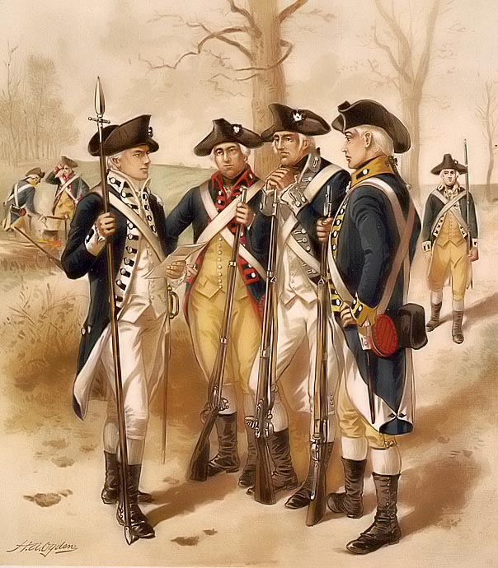
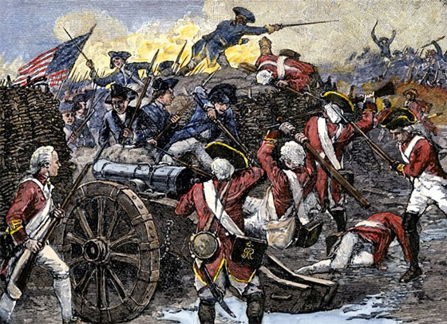
Strengths and weaknesses
British: S: Disciplined and trained army
Best navy in the world
50,000 Loyalists (African-Americans/Freedom,
Native Americans/expansion)
Mercenaries: foreign soldiers that fought for pay
W: Not popular in Great Britain
(Taxes, sympathy for Americans),
DO NOT ADAPT TACTICS to conditions
in America.
Americans: S: Fighting on own territory,
familiar with French and Indian War tactics
(George Washington)
W: Lacked well-supplied, stable, and effective fighting force
When service was up, new troops would come in

Slide 3
Siege of Boston
After Lexington and Concord, 20,000 Patriots surrounded Boston
Presence prevented 6,000 British troops from crushing rebellion.
Battle of Bunker Hill: two hills north of Boston.
General Gage (British): rebels must be driven from these from these high grounds.
British army attacks (Breed’s Hill) with battle flags and drums
1,600 Patriots waiting (Slowed, stopped, and fell back)
Second Attack of BH: Drove them back again
Third Attack of BH: Patriots out of ammunition and retreated (British take Breed’s Hill and quickly over-ran second position.
With Victory comes High Costs:
1,100 of 2,400 British soldiers killed or wounded
Fewer than 400 killed or wounded

Slide 4
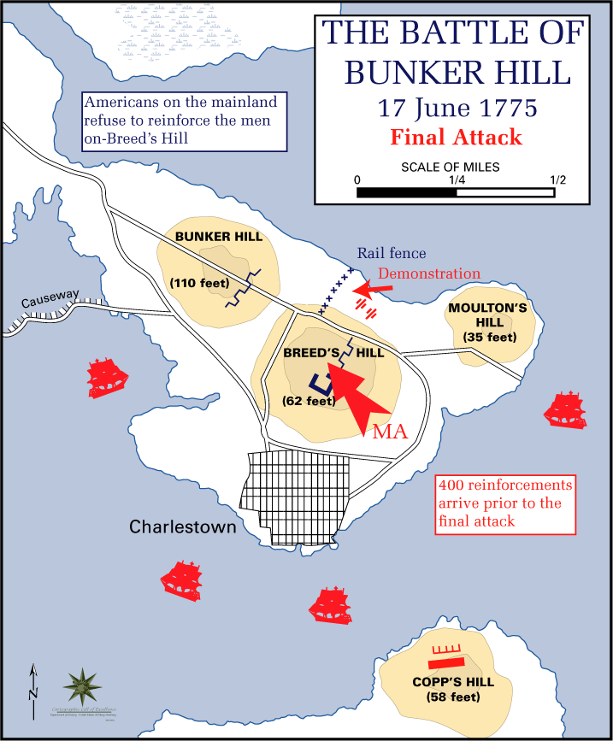

Slide 5
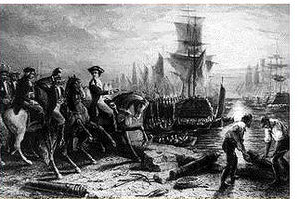
British leave boston
General Gage wants to march on Rhode Island and NY but is denied
9 months, small army remained in Boston
General George Washington: transforming troops into Continental Army
Colonel Henry Knox: brought cannons from Fort Ticonderoga in January which Washington placed in Dorchester Heights (South of Boston)
Shell British forces in city
British ships in Boston Harbor
March 1776: British abandoned
Boston (Canada of Halifax)
Loyalists: people who remained
loyal to Great Britain
Some fled to England or West
Indies

Slide 6
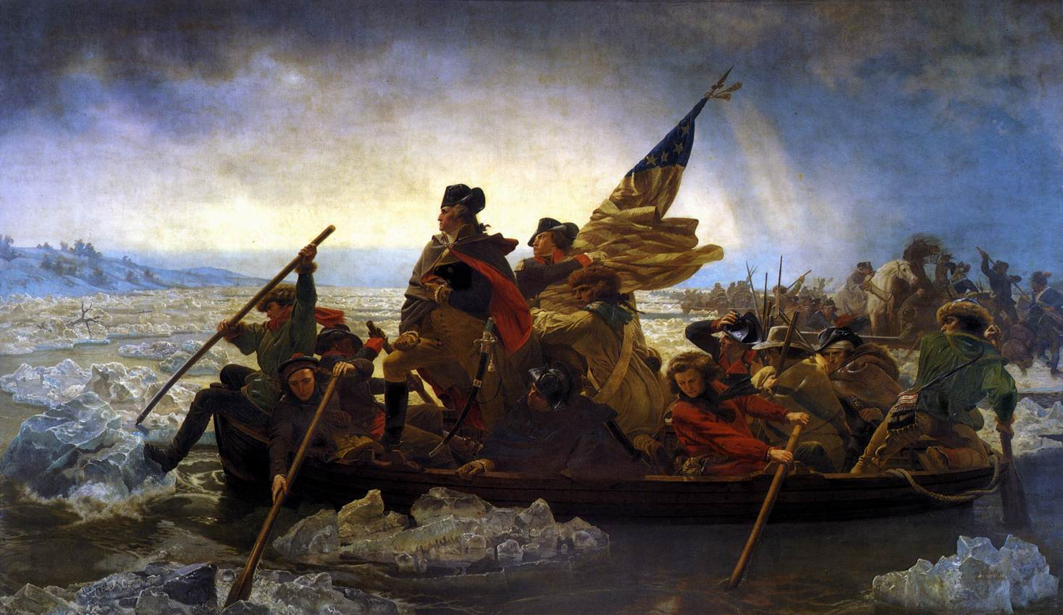
Retreats and victories
British capture New York (Continental Army to PA) (Continental Congress to Philadelphia)
Thomas Paine “The Crisis”
Washington left PA and went across Delaware River Christmas night
Battle of Trenton: Surprised 1,400 Mercenaries in Trenton where entire force was captured
Princeton Attack: Leaving fires for
Tories would think army made camp and
he led troops on another night time march.
Americans drove back British
troops and captured town
Boosted morale and more
supported Patriot cause

Slide 7
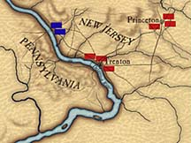

Slide 8
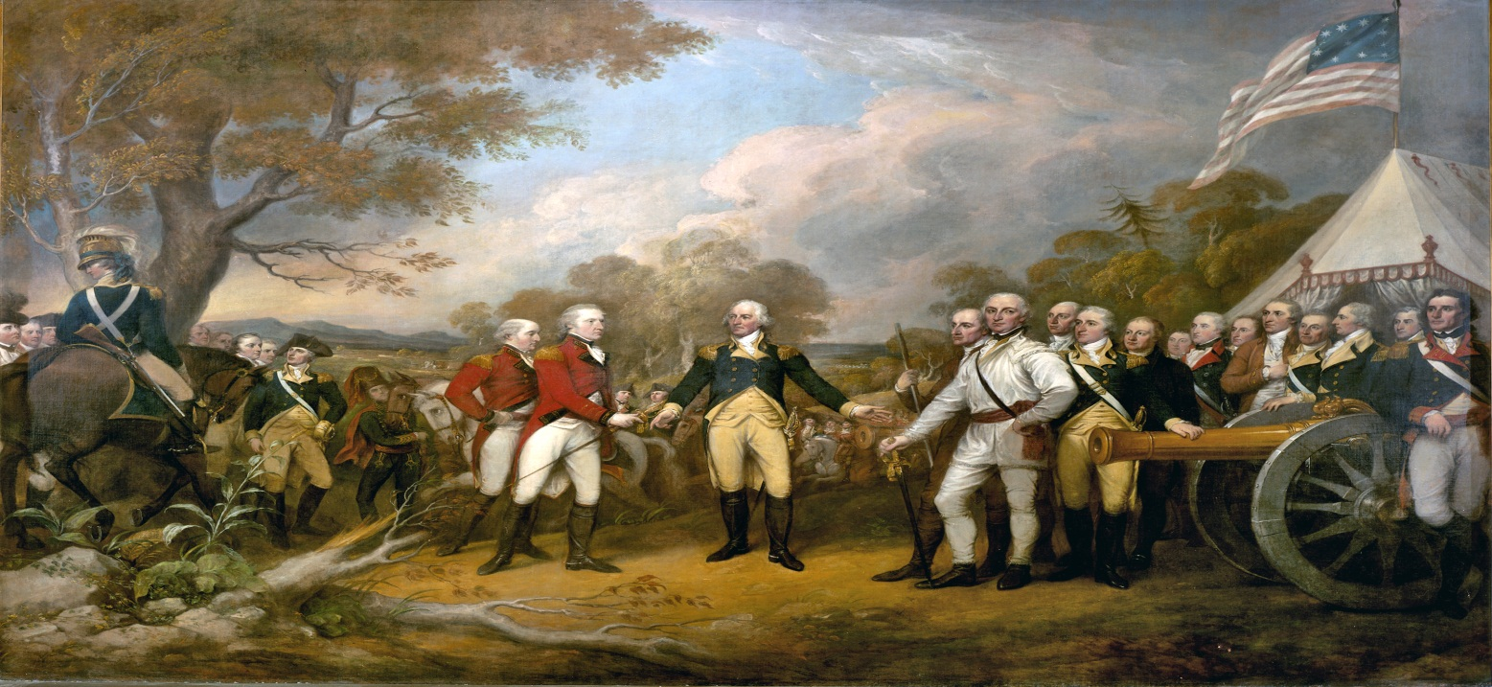
Victory at Saratoga: Army on move in Northern NY and wanted to cut New England off rom rest of colonies.
8,000 British and Mercenary troops
Patriots retreat but cut down bridges and trees (Army ran low on supplies)
Continental Army and Patriots assembled to confront invaders.
Series of Victories were around Saratoga, NY
General Burgoyne surrendered army (Biggest victory and turning point)
Brought major foreign power to aid American cause (French Fleet)

Slide 9
Winning independence

Slide 10
Americans endure harships
British might capture territory, but they could never win war if Americans continued to fight (Make any sacrifice for victory).
Financing the War: Not a lot of support from Continental Congress (little real power). Asked states for troops, money, and supplies, but without taxation (Could not force them)
Paper money to purchase supplies (Worthless if Britain wins the war)
Gold and silver worth more, so farmers would sell for gold and silver
Disruptions of Trade: British blockades: cut off from outside contact (Atlantic Coast) which disrupts trade (Shortages)
Profiteering: selling scarce items at unreasonably high prices
Inflation: steady increase in prices over time (reduced ability to buy goods)

Slide 11
Victories in west and south
West: Colonel George Rogers Clark with French settlers had captured all British posts (Indiana and Illinois)
Recaptured Vincennes fort (Strengthened Patriots claim to Ohio River Valley).
War in the South: British forces seized Savannah, Georgia and Charleston, South Carolina
2,400 British troops defeat Patriot troops at Camden, South Carolina
Battle of Kings Mountain: Patriots defeat Tories army
Battle of Cowpens: stopped Cornwallis (Cornwallis continues into NC)
Battle of Guilford Court House: defeated Patriots
Stops in Wilmington, NC to be resupplied and advanced into Virginia
Army much larger than Patriot forces (Marquis de Lafayette)

Slide 12
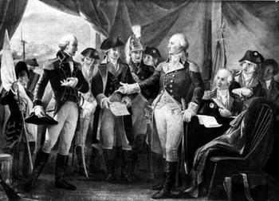
Victory at yorktown
French allies had just joined in New York
Washington moved American-French force south, while French fleet set up a blockade off the Virginia coast (British navy were driven away)
Cornwallis faced an army more than twice the size of his own blocking an escape from the peninsula (French fleet prevented reinforcements or removal).
Cornwallis surrendered (Articles of Capitulation: October 19, 1781)

Slide 13
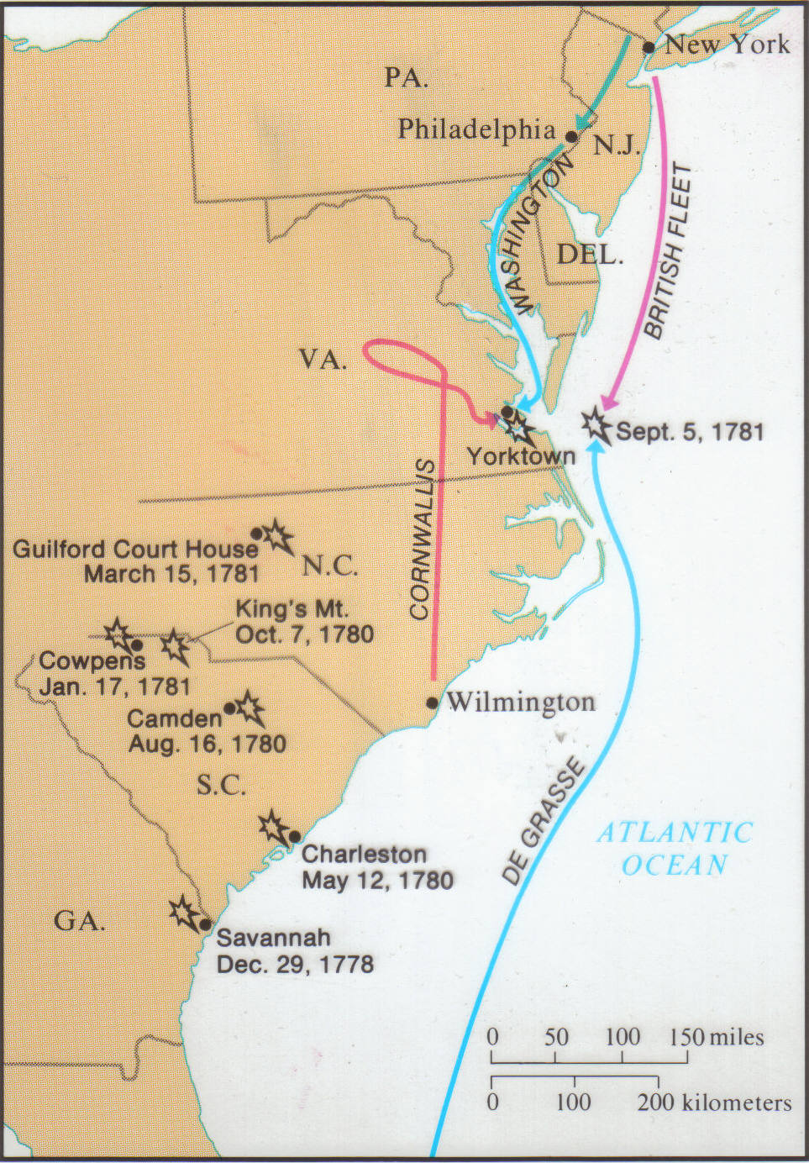

Slide 14
Treaty of paris (1783)
Four countries involved: United States, Great Britain, France, and Spain
Major provisions included:
Independence of United States of America
Northern border between US and British Canada was set from New England to Mississippi River primarily along Great Lakes.
Mississippi River boundary between United States and Spain
Florida was returned to Spain
GB withdrew its troops from US territory
Rights and property of American Loyalists
Be restored and that no future action be taken
Against them. Persecution of Tories after war

Slide 15
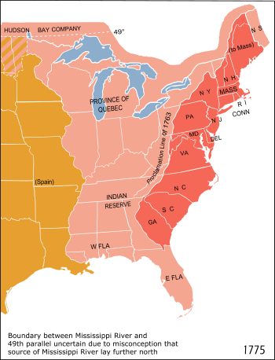

Slide 16
Impact of the revolution
Women: Took care of families, land, and businesses
Cared for husbands and fathers in battle and cared for them
African-Americans: most Northern states abolished slavery in late 1700’s
Passed laws limiting legal rights and political power
South made slavery more restrictive
Native Americans: allies with British so it was justifiable for Americans to go after land.
The Spreading of the idea of
LIBERTY (“ALL MEN ARE CREATED EQUAL”)

