Slide 1
Road to independence

Slide 2
Treaty of Paris
1763: Reps from Great Britain, France, and Spain signed treaty in Paris
Ended:
French and Indian War (Colonies)
Seven Years War (Europe)
France turns over present-day Canada over to Britain
France surrenders all land east of Mississippi River
New Orleans: Given to Spain through secret treaty a year earlier
British trade Cuba to Spain for Florida

Slide 3
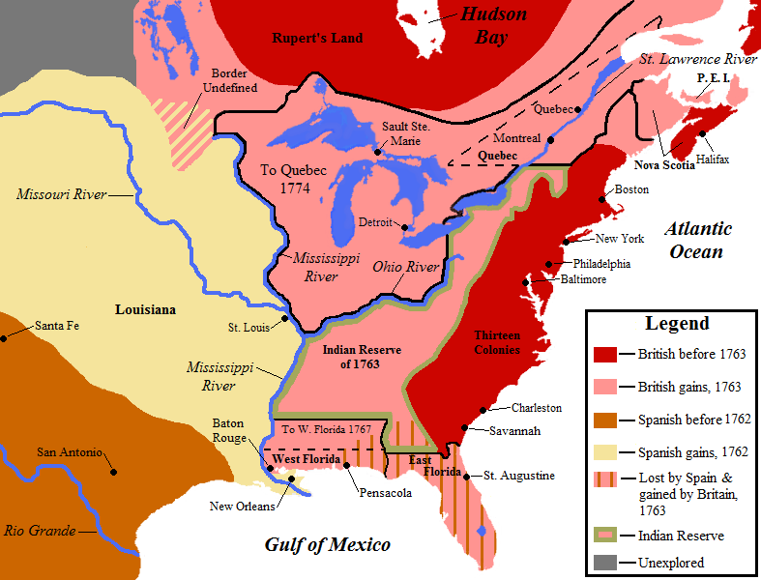

Slide 4
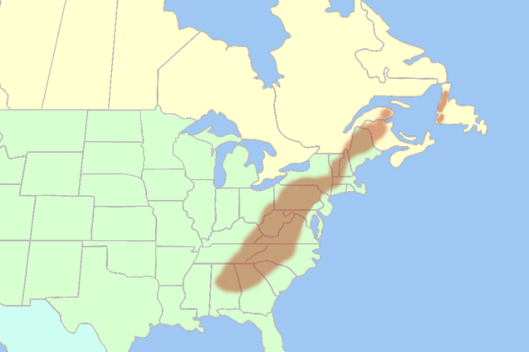

Slide 5
Weakened loyalty to britain
Lost of respect for British military power
Americans shocked by weakness of British military tactics
British did not treat them with proper respect
Did not hold same values as the colonists
French do not control Canada or region west of Appal. Mts.
Colonists see no reason why they should not expand without British help.
Feelings would lead to the rift between Britain and colonies.

Slide 6
What were the Key Events that led up to the revolutionary war?

Slide 7
Reasons that lead to indpendence
George II becomes king at age 22 (1760)
Britain is now going to try to control the colonies through laws and taxes
Geographic Consideration:
Independent streak desiring more opportunities and more freedom
Colonial Legislatures:
Many ways independent of the crown
Levy taxes, muster troops, pass laws (Rights to colonists)
Salutary Neglect:
British believed in mercantilism
Colonists folow SN: external trade was laxed
The Enlightenment:
Writings by Thomas Hobbes, John Locke, Jean-Jacques Rousseau
Social Contract: limited government (Separation of Powers)

Slide 8
Changing British Policy
British show interest in the Great Lakes Region and Ohio River Valley
Native Americans concerned (British different from French)
Stopped trade with Indian protestors
Pontiac’s Rebllion: Indian rebellion against British along the Great Lakes
NA destroy every British fort in area west of Appalachians
American army reeled for setbacks, while British govt tries to restore peace.
Proclamation of 1763: closed region west of the Appalachian Mts. to all settlement by colonists. (French to British military)
Colonists continue to move west in forbidden territory
Britain did not stop them (Undermining British government)

Slide 9
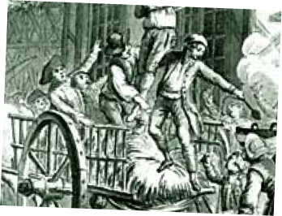
Financial issues
British: Most heavily taxed people in the world (Skyrocket during F+I War)
Struggled with heavy debts and taxes, America was prospering
Finance Minister George Greenville: “Why shouldn’t these colonists begin to pay some of the costs of their own government and defense?”
Sugar Act of 1764:
Lower tax would make Americans buy
imported molasses and pay tax rather than
risk smuggling (Increased tax collections)
Ships would be seized if they forgot
to pay debts.
Smuggling cases tried in British courts
(Judge alone not jury)
Judge receives 5 percent commission
on illegal cargoes and fines

Slide 10
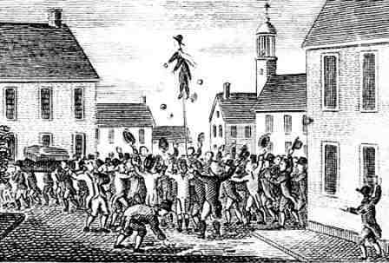
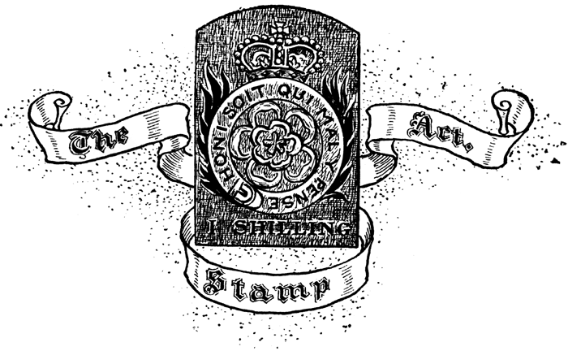
Quartering Act of 1765:
Law required the colonies to provide housing and supplies for British troops in America. (Violated rights as British subjects)
Stamp Act of 1765:
Tax on newspapers, pamphlets, legal documents, and most printed materials.
Stamp printed on material to show that tax had been paid.
Pay for cost of British troops in America.
First real indication of taxing to raise money
This act effects everyone including:
Printers, Merchants, and Lawyers

Slide 11
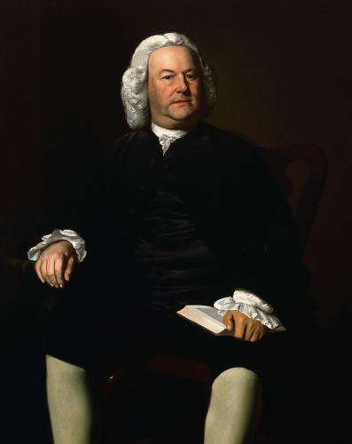
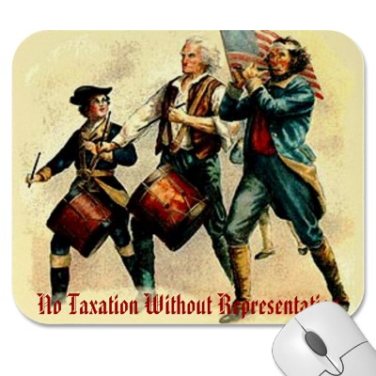
Stamp Act Congress: Nine colonies met in NY to hold meeting about Stamp Act.
James Otis: lawyer from Massachusetts and main organizer. Challenges:
Britain’s authority for general warrants used to enter any home
Britain had no right to force laws on colonies (NO reps from British Parl.)
“NO TAXATION WITHOUT REPRESENTATION”\
Delegates now sent petitions to king and Parliament

Slide 12
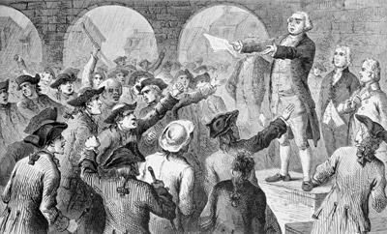
Sons/Daughters of Liberty: Organized boycotts of British goods
Refusal to buy certain products or use certain services as an act of protest
Boston Sons of Liberty: Led by Samuel Adams
Visited person who distributed stamps in Boston
Resign or we will destroy your house and life
Brother-in-law attacked (Thomas Hutchinson)
lieutenant governor of colony
His home destroyed after told to leave house
When Stamp Act was to take effect, most
Distributors resigned to fled (No one to sell)
Protest in Britain by merchants
Greenville resigns in 1765
Parliament repeals Stamp Act 1766
Declaratory Act: Parliament could make laws for colonists “in all cases”

Slide 13
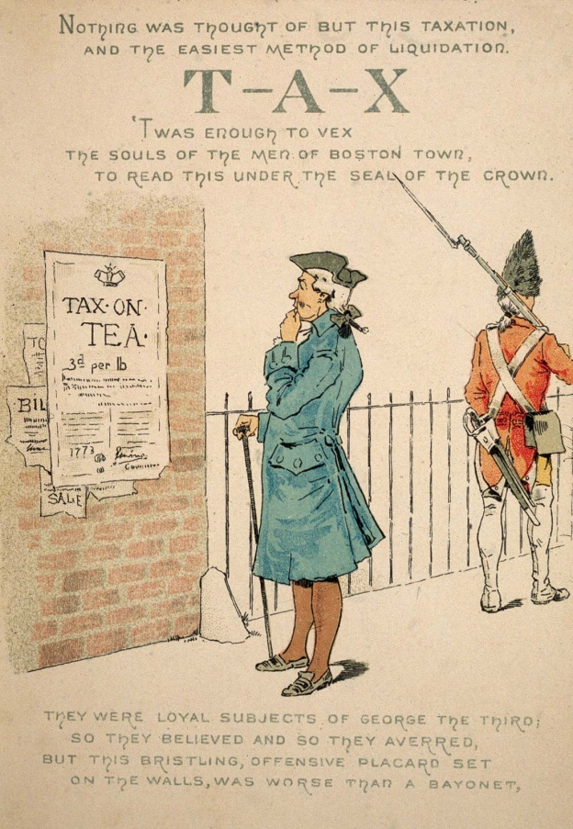
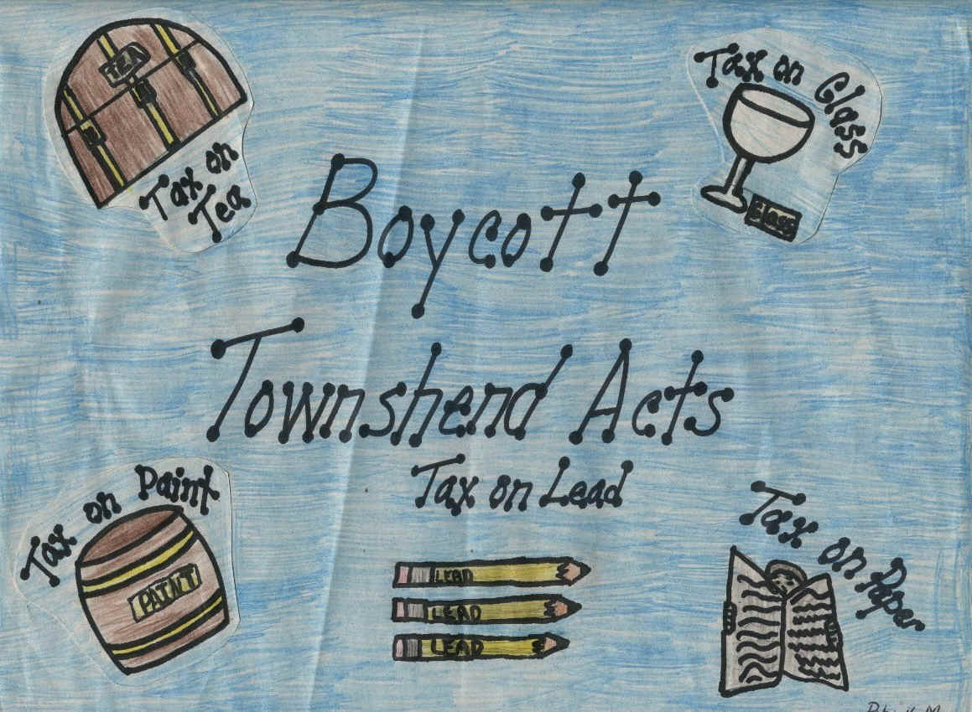
Townshend Acts: Placing duties on certain imported goods like glass and tea.
Hoped to satisfy the colonists by raising money through duties rather than direct taxes. Money would be used for “support of civil government”
Violence starts again: “Taxed without consent”
Pay goes to salaries of royal governors in America, who would not have to pay legislatures.
Congress agreed to stop importing British goods.

Slide 14
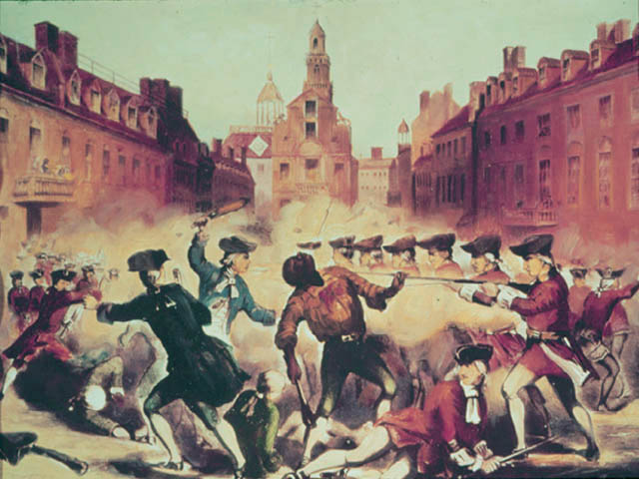
Boston Massacre:
Britain sends troops to Boston (Townshend Act)
March 5th, 1770: small crowd threatened squad of British soldiers
Soldiers open fire on crowd leaving 5 dead
Nine soldiers put on trial (John Adams
lawyer)
7 found not guilty
2 were branded as punishment and
were released
Parliament cancels Townshend
taxes except for tea
Committee of Correspondence: Bostonians
form and Coordinate resistance throughout
colonies and Nearly all colonies had committees.

Slide 15
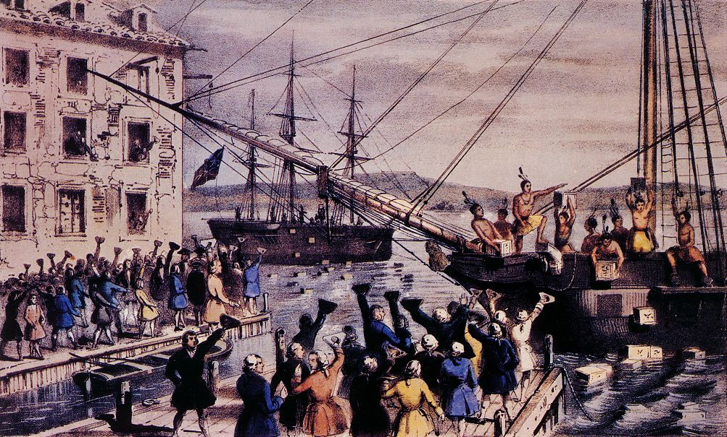
Boston Tea Party (May 1773)
Parliament passed Tea Act: sell tea in America without paying taxes.
Would make East India Company’s tea less expensive than smuggled
Sale agents threatened to resign
Ports would not let ships dock
Dec. 6th, 1773: disguised as Indians
Boarded three ships in Boston and broke
Every crate on board and
dumped tea in
harbor

Slide 16
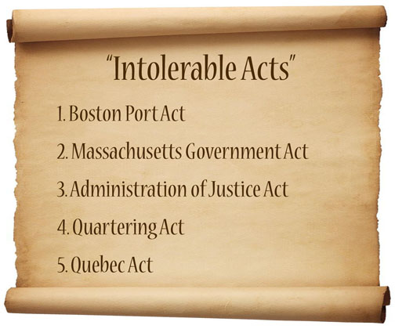
Intolerable Acts or Coercive Acts:
Limited town meeting to once a year
Suspended Massachusetts general court
Extended Canada’s boundary south to Ohio River
Stripped claims to Western land
Committee of Correspondence called for meeting
To plan a united response to these development
First Continental Congress

Slide 17
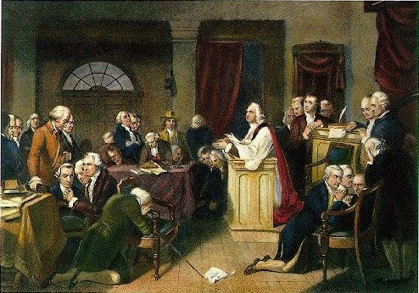
First Continental Congress: Sept. 5th, 1774
56 delegates met at Carpenter’s Hall in Philadelphia
George Washington, Patrick Henry, Richard Henry Lee (Leading Figures)
Sam Adams (Most rebellious of delegates)
John Dickinson and John Jay (moderate points)
Boycott of British goods
Arm themselves and form militias
Direct appeal to king outlining
grievances
asking for understanding.
Oct 26th, Congress ended
Vowed to meet again if
problems
b) Nov 18th King writes
“NE governments are in state of rebellion, blows must decide.”

Slide 18
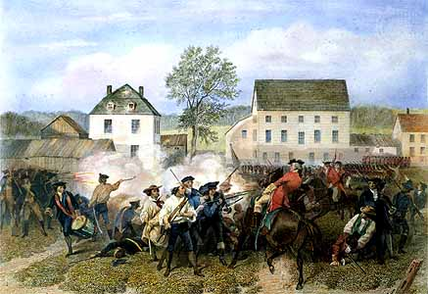
Fighting at Lexington and Concord:
Patriots: followed call of 1st Continental Congress
Mass. Pats formed militias and began to gather guns (Concord, Mass)
April 18, 1775: 800 British troops moved out of Boston and marched to Concord (Seize supplies)
Paul Revere, William Dawes, and Dr. Samuel Prescott: on horseback through countryside to warn that “The British were coming”
Destroyed some militia’s supplies
As troops returned to Boston,
4,000 Patriots gathered along road shoot
At them from behind trees and stone walls.
British: 70 killed, 170 wounded
Patriots: 90 killed, wounded, or
missing
REVOLUTIONARY WAR HAS BEGUN

Slide 19
