Slide 1
African Americans in the Colonies
What do you remember about triangular trade?

Slide 2
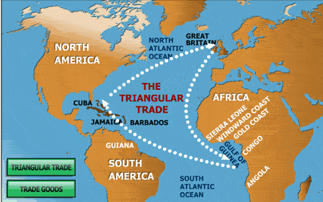

Slide 3
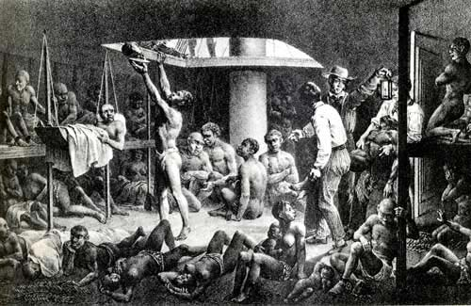
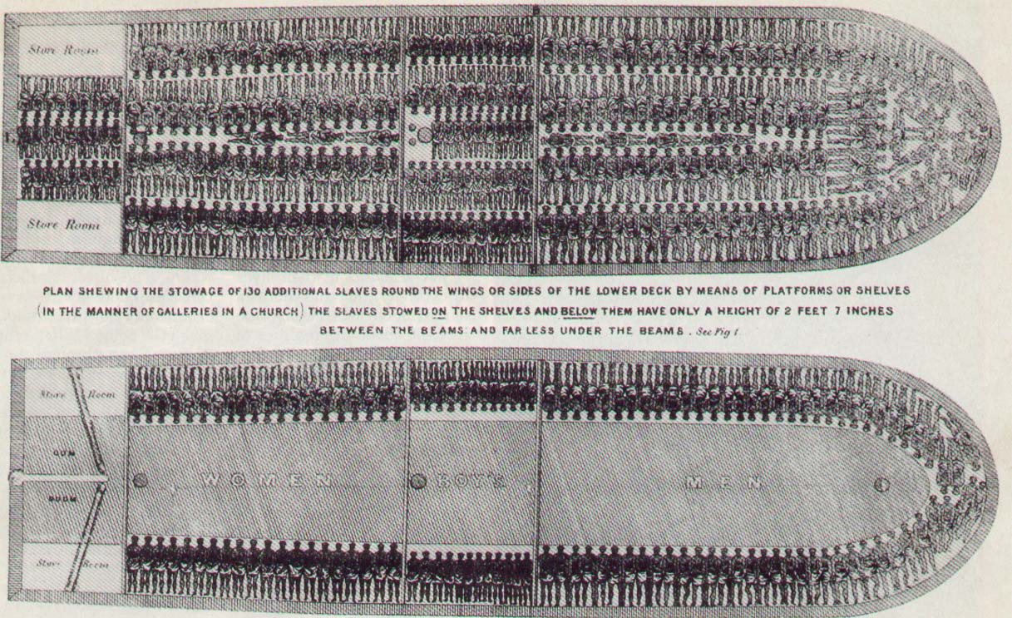
Middle Passage
One leg of the triangular trade between Americas, Europe, and Africa.
Transport slaves from Africa to the Americas.
40 percent died
What laid ahead
Chains
Heat
Disease
Overpowering odor
Lack of sanitation
Cramped
Stuffed Quarters

Slide 4
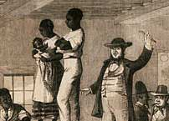
Suffocation “No fresh air”
Suicides
Mutiny: revolt (Every two years)
Heavily armed
Sold at public auction
No human rights, but property
Separation of families
Most died on sugar plantations
Most died within the first year

Slide 5
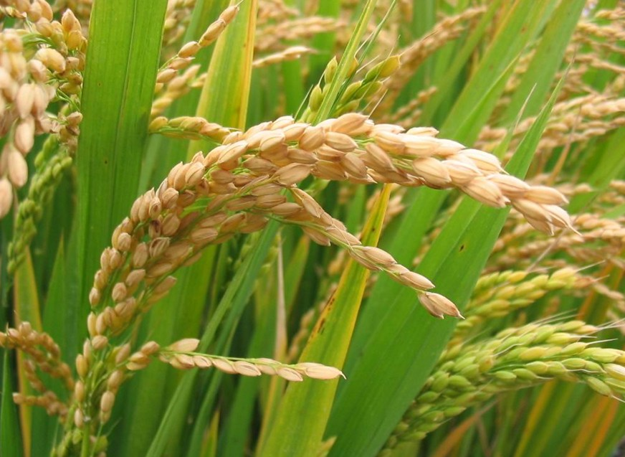
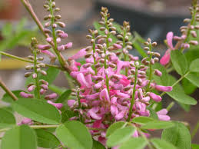
Slavery in the Colonies
Number of slaves and kind of labor differed from region to region
South Carolina and Georgia:
Growing rice and Indigo
High temperatures and diseases
Made up majority of population
100 slaves in one plantation
Slaves had regular contact with
Handful of white colonists (Cultural
Traditions)
Made baskets and pottery
Music and stories they loved
Gullah: English and AA language mixed
Great knowledge of cattle herding and fishing
Substitute Kin: substitute family
Found strength in each other’s company

Slide 6
Virginia and Maryland
Longer history of European and African settlements was one of several reasons why the lives of slaves differed from SC and Georgia.
Minority rather than majority
Slaves in Virginia more likely born in American colonies.
Different Work: Did not take long to grow tobacco did not take as long as rice. AA had variety of different tasks.
More contact with European Americans. Greater integration with European Americans.
Encouraged slaves to raise families. (Family Lives) Why?
Still lived in constant fear of being sold and separated.

Slide 7
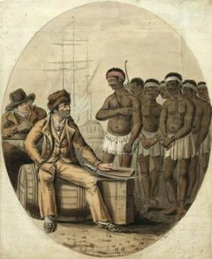
New England and Middle Colonies
400,000 lived in SC by late 1700’s and only 50,000 in NE and Middle Colonies combined.
Had more freedom to choose occupation
Smaller farms, fewer slaves
Cooks, housekeepers, personal servants
Male slaves: Manufacturing, trading,
skilled artisans, dockworkers, merchant
sailors, fishermen, whalers, and privateers
Contributed to growth of Atlantic economy.

Slide 8
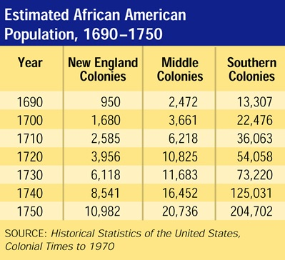
African-American Population

Slide 9
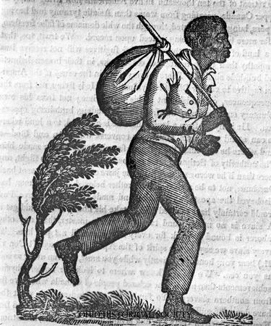
Free Blacks
After American Revolution, free black population grew significantly
Owners had to get permission from legislature before freeing slaves.
Some who got paid for their work saved enough for freedom
Worse living conditions and more discrimination
Could not vote, testify in court, or marry whites
Virginia and Maryland:
Winter seasons: worked in cities in
Richmond or Baltimore
Send portion of money to owners and
living conditions were poor
Not free, so children born enslaved

Slide 10
Laws and Revolts
Every colony had own slave laws.
General Slave Laws or Consequences:
Could not go aboard ships or ferries or leave town without a pass.
Could be accused of crimes (Carrying canes, disturbing peace, striking white person). Punishment: Whipping, banished to West Indies, even death.
Made slave rebellions difficult (Did not know slaves from territories)
Stono Rebellion: Charleston, SC killed more than 20 whites and marched toward Spanish Florida (Runaway Slaves colony). Caught and killed
Led to over 50 attempted revolts (1741: burned alive as punishment)
Indirect resistance (Pretending to misunderstand) or fake illness

