Slide 1
Chapter 3 Section 1 An Empire and its colonies
Warm Up Question:
The English Civil War was fought between 1640 and 1660. What were the sides and what did they fight over?

Slide 2
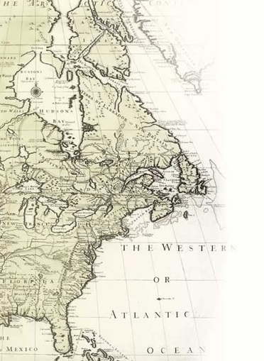
Main Idea
Between the years 1600 and early 1700s, the relationship between England and the colonies were relatively good.
Colonies
supplied food and raw materials to England in exchange for manufactured goods
governed themselves with little involvement from England-also the colonies remained loyal to England and were proud to be subjects of great empire
developed diverse economies depending on their overall geography

Slide 3
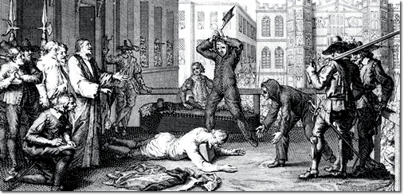
The English Civil War- 1640-1660
King Charles I
Anglican
Divine Right
wanted to tax his citizens without Parliament’s permission
Cavaliers
Parliament
Representative body of government created by the Magna Carta in 1215
Puritan
Believed that Divine right was unlawful
Parliament creates laws and passes taxes
Roundheads
Oliver Cromwell and the New Model Army
Dictatorship of Cromwell for 2 decades until he passed
1660- Restoration- Charles II, is crowned king
1685- Charles II dies and James II is crowned King- Same old problems of Charles I
1689- James II was overthrown in a bloodless revolution- Glorious Revolution
William of Orange (Netherlands) and Mary (Protestant daughter of James II) are forced to accept the English Bill of Rights- further limiting the authority of the King

Slide 4
Big Picture..????
England had too many issues to address on the home front to govern the colonies
The English found neglect to better serve economic interests
Just not from the start- initially we will see government involvement in the economy that relaxes over the century
The French and Indian War of 1754 changes everything

Slide 5
Mercantilism
Country should try to get and keep as much billion, or gold and silver, as possible.
More gold= more power and prestige
No gold in English colonies ☹…now what?
Favorable balance of trade- Export more goods than you import
By purchasing raw materials from its colonists, the parent country did not have to use its bullion to buy raw materials from its competitor countries
How to establish this?
Trade laws
Navigation Act- 1660-
Colonies have to purchase manufactured goods from England only
Required colonies to sell certain goods like sugar and cotton only to England
If colonists wanted to sell products to other countries, had to go through England first and then pay a duty (tax)

Slide 6
Review:
Why was the relationship between the colonies and England good between 1600-1754?
Who fought who during the English Civil War? What was the outcome?
When there was no gold found in the colonies, what mercantilist ideas did the English establish in order to strengthen the economy?

Slide 7
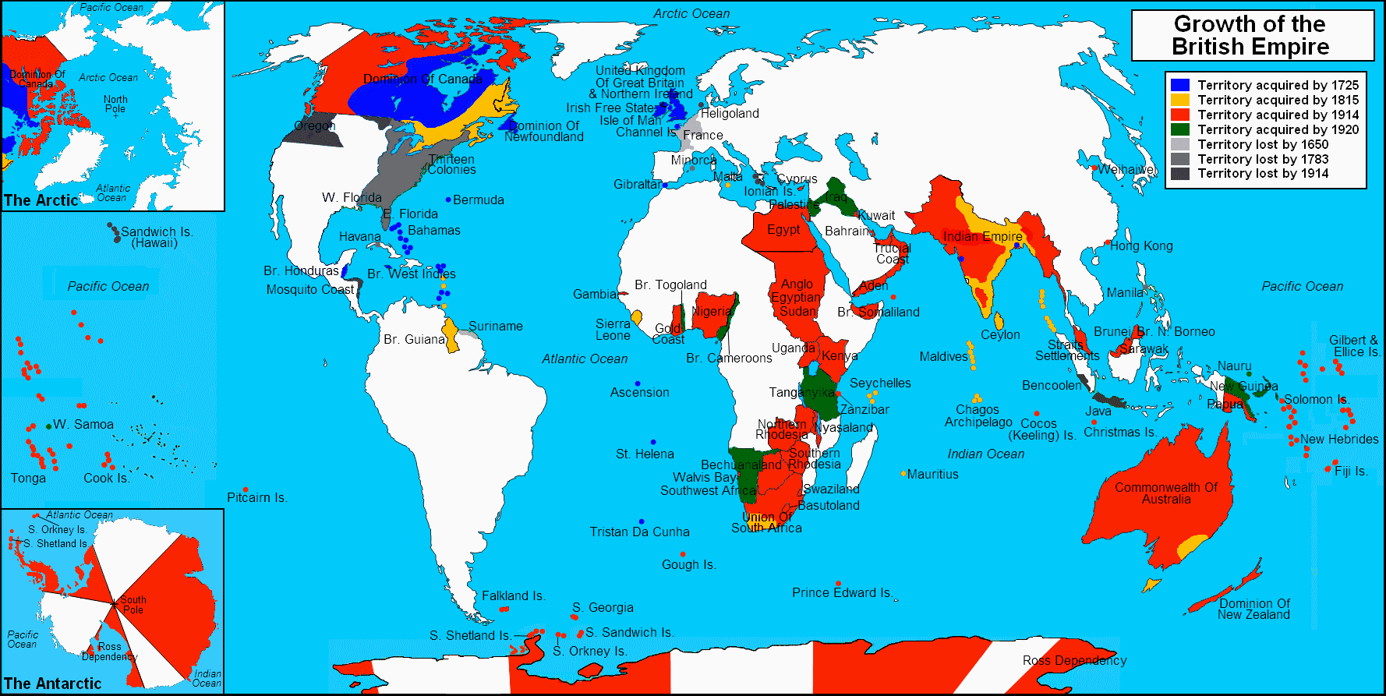
As mercantilist beliefs spread, so did the economic desire for more colonies… “sun never set on the British empire” grows drastically because of economic benefit of having colonies all around the world

Slide 8
Too much control??
1686 King James II, attempted to take direct control over New York and the New England Colonies by creating the Dominion of New England.
Abolished colonial legislatures within the Dominion and replaced them with a governor and a council appointed by James II.
Edmund Andros, whom James II had appointed governor of the Dominion, made matters worse.
collected taxes without the approval of either the king or the colonists
declared a policy of religious tolerance, or respect for different religious beliefs- upset the Puritans
Glorious Revolution inspired small insurrection in New England
William and Mary dissolved the Dominion of New England and reestablished the colonies that James had abolished.
new charter allowed the king to appoint a royal governor of the colony.

Slide 9
Nightmare rebellion leads to era of Self-Government- Early 1700’s
Over time, charter and propriety colonies turn to royal colonies
Governor (executive) appointed by King of England
Colonial legislature
Upper house appointed by King
Lower house voted by property owning white men
came to dominate the colonial governments.
created and passed laws regarding defense and taxation
(power of the purse) setting salaries for royal officials

Slide 10
Why did the British government allow its colonies freedom in governing themselves—far more than was allowed in Spanish or French colonies?
long tradition of strong local government and weak central power
lacked the resources and the bureaucracy to enforce its wishes
Most colonists were proud to be British and followed laws anyway
British realized that the most salutary (beneficial) policy was to neglect their colonies- Salutary Neglect

Slide 11
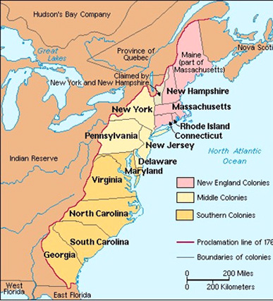
Colonial Economies Prospered- Diversity based upon geography
Spanish Colonies- mining silver/gold, sugar
French Colonies- Fur trade
British regions of eastern North America developed diverse economies- geography affected its economy
Shipments of goods/people still relied heavily on water travel- people still lived primarily on the coast and up river

Slide 12
Southern Colonies
Virginia, Maryland, South Carolina, North Carolina, and Georgia
Staple Crop- crop in constant demand- cotton, wheat, rice
Growing and harvesting these crops was extremely difficult work that most free laborers were unwilling to do
Slave trade explodes
Middle Colonies
Maryland north to New York- mixture of farming and commerce.
specialized in growing grains, including wheat, barley, and rye along fertile rivers
NYC and Philadelphia- merchants, traders, and craftspeople- many people in the business of buying and selling goods
Populations of both New York and Pennsylvania were ethnically diverse.
English, Dutch, French, Scots, Irish, Scotch-Irish, Germans, Swedes, Portuguese Jews, Welsh, Africans, and Native Americans
New England Colonies
composed of small farms and towns dependent on long-distance trade
did not rely heavily on local crops for their commerce
carried crops and goods from one place to another—a “carrying trade.”
Major stopping point of Triangular Trade

