Slide 1
EUROPEAN COLONIZTION OF THE AMERICAS

Slide 2
JAMESTOWN
First English settlement in America???
Roanoke - 1587
Virginia Dare
Vocab
charter
joint-stock company
The Viriginia Company
sent 105 colonists to Jamestown in 1607
named the village Jamestown
Reasons for failure???

Slide 3
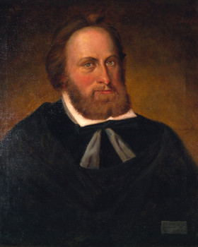
JAMESTOWN
John Smith
Clash with death
“he that will not work shall not eat”
Returns to England
Starving Time
George Percy
Whats on the menu?
Lord De La Warr
Governor 1610
Saved colony from abandonment
tactics

Slide 4
JAMESTOWN
Clashes with the Natives
Jeykll and Hyde relationship
First Anglo-Powhatan War
John Rolfe & Pocahantas
Second Anglo-Powhatan War
Role of Tobacco
John Rolfe
Headright System
Indentured Servant

Slide 5
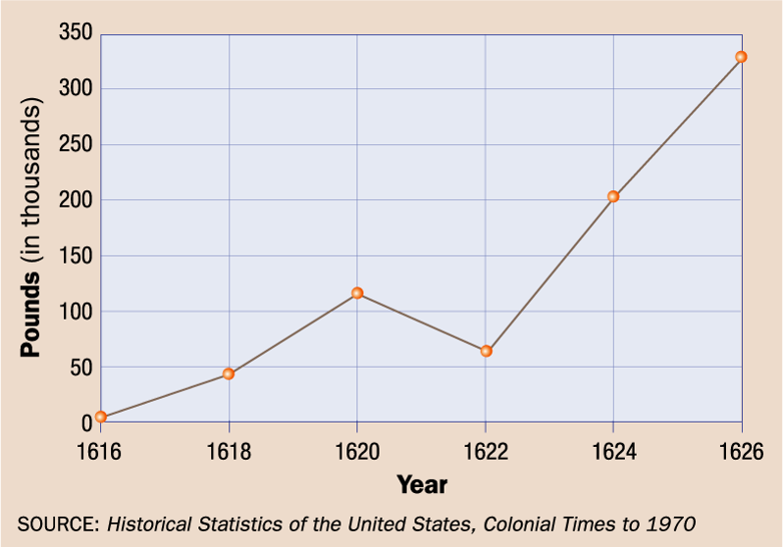
JAMESTOWN
1619- House of Burgesses
Self-government
1624- Royal Colony
Bacons Rebellion
LETS GO TO THE VIDEOTAPE

