Slide 1
Chapter 28.1.3
The Post-WWI Era
“The in Between Years”

Slide 2
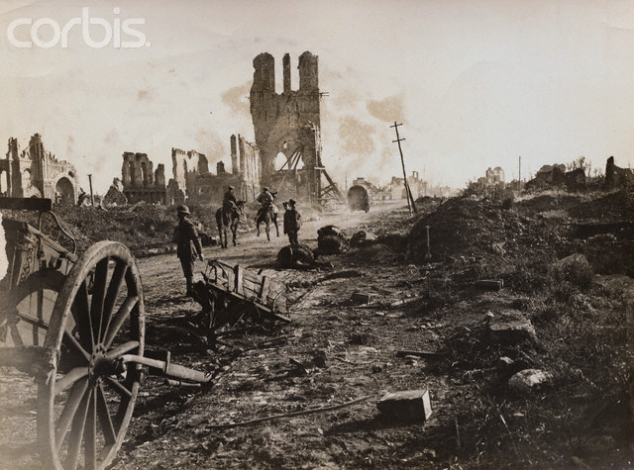
Post-WWI Mindset
The mass destruction of WWI caused many to lose faith in the idea of human progress
Notes:
Battle of Ypres-the ypres clothing mill

Slide 3
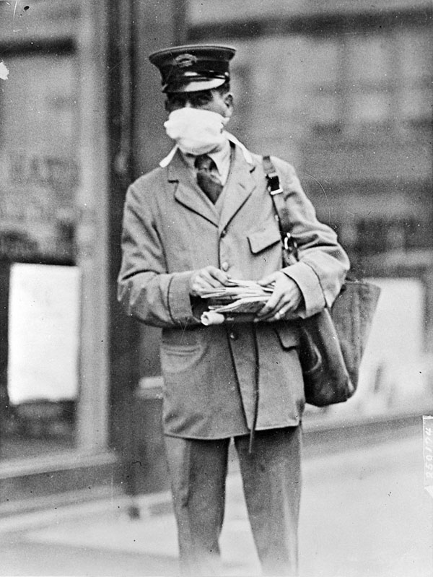
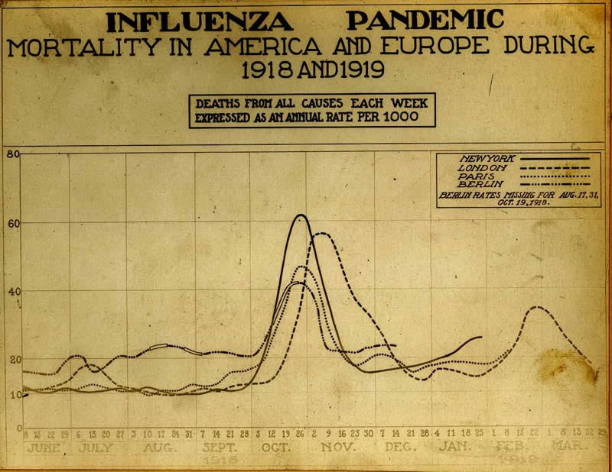
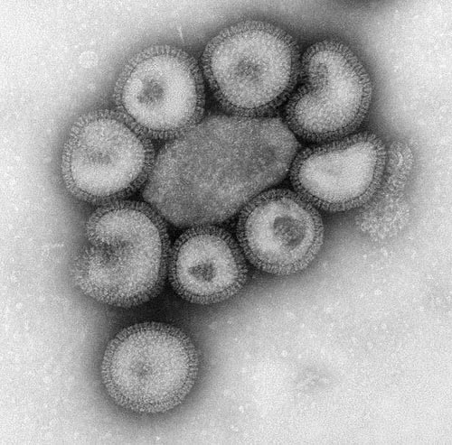
The Influenza Pandemic “The Greatest Medical Holocaust in History” 1918-1919
Mysterious pandemic (global epidemic) that killed 20-30 million
Notes:
The influenza disappeared as quickly as it appeared
Lack of cure led to the exposure of how much the world really knew about medicine
Death toll approx 20 million

Slide 4
New Directions in Music
As technology improved-radios in the home
Music aimed at the masses developed
Jazz Music
Louis Armstrong, Billie Holiday, and “Jelly Roll” Morton

Slide 5
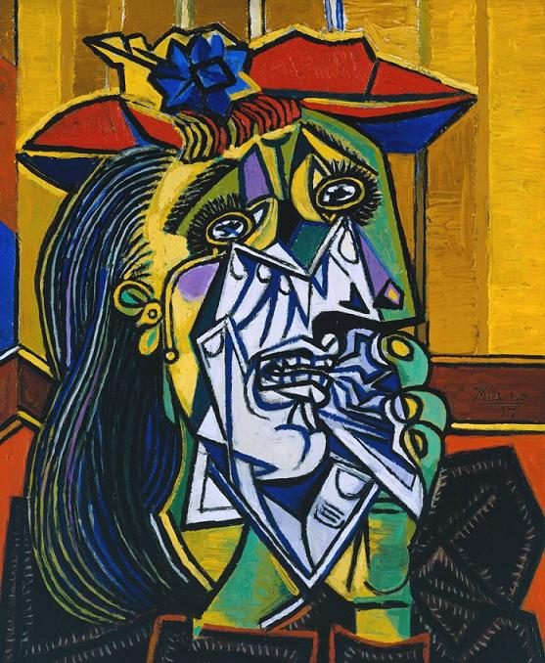
New Directions in Art
Cubism-influenced by African art-emphasizes geometric designs and uses shapes to show an object from multiple angles at the same time
Pablo Picasso-The Weeping Woman

Slide 6
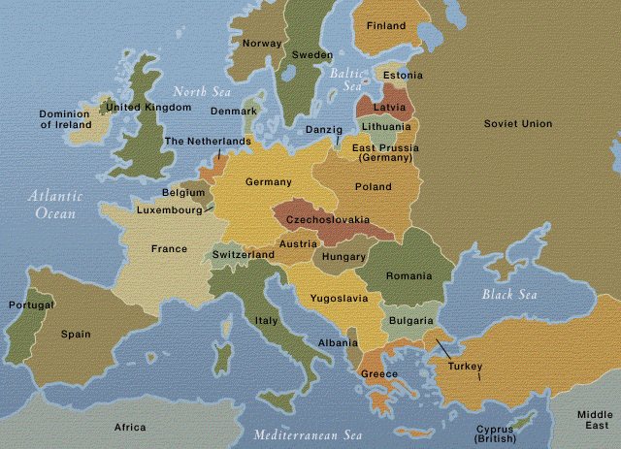
Europe After WWI

Slide 7
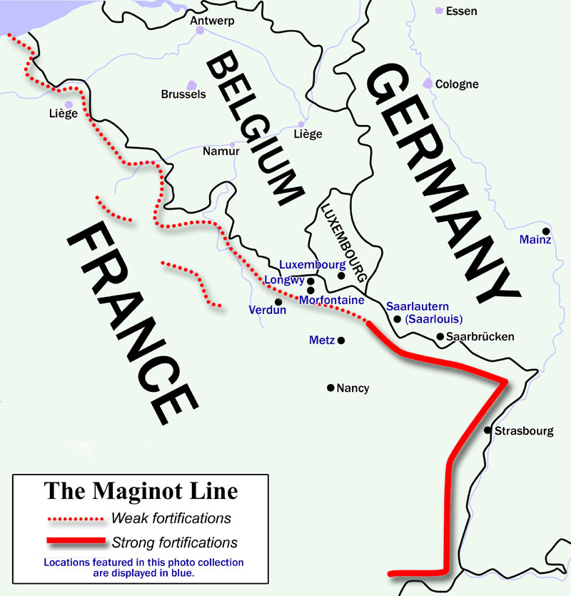
France After WWI
Victorious, but weakened
Industry & agriculture destroyed
Young men dead
Economy weak
Owed $
$ to rebuild infrastructure
$ to build up security
Maginot Line
Politically weak
Locarno Pact-plan to handle all conflicts peacefully
Fighting b/w conservatives and the liberal Popular Front
Notes:
200 miles along Germany and France
Locarno Pact- Germany, France, Great Britain, Czechoslovakia, Belgium, Poland
Popular front-government organized in response to a general strike in France-lead by socialist Leon Blum-40 hour work week-paid vacation-pay increases

Slide 8
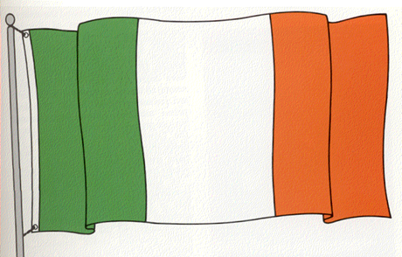
Great Britain After WWI
Economy weak
Owed $
Industry outdated
¼ workforce unemployed
Led to General Strikes & Pol. Unrest
Workforce wanted the high wages that they were earning during WWI

Slide 9
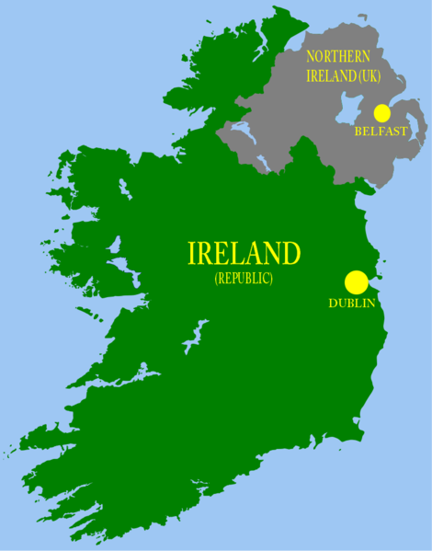
Great Britain After WWI
Problems in Ireland
Ireland wants Independence
1916 Easter Rising
Irish revolt, violently put down by GB
1918 Irish Nationalist Party Sinn Fein declared independence
Led to fighting b/w IRA (Irish Republican Army) and GB
1922 Compromise
North=Protestant, controlled by GB
South=Catholic, loose connection to GB
Notes:
Martyrdom refueled the Irish spirit in the Easter Rising

Slide 10
Eastern Europe
In general:
Struggling to build new democratic gov.
Still have ethnic tensions
Econ. Problems
Democracy failing
Military Dictatorships

Slide 11
Eastern Europe cont…
Austria
Small weak; problems between conservatives & socialists
Hungary
Communism then military dictatorship
Poland
Econ. problems led to military dictatorship-Germany
Yugoslavia, Romania, Bulgaria
Military dictatorships or monarchies

