Slide 1
Chapter 26
Imperialism

Slide 2
The Meaning of Imperialism Through Political Cartoons

Slide 3
What is the Meaning/Definition of Imperialism
Whose involved?
What are the goals?
Where is it taking place?
Why is it happening?
How is it happening?

Slide 4
Analyzing Political Cartoons
Political cartoons often…
Reflect events and express an opinion
How Read a Cartoon:
Need to look at…
Labels - what’s identified/named
Symbolism – what images are used to help make a connection
Analogy - what’s being compared
Irony – what’s the cartoonist’s opinion
Notes:
We are getting into a part of history where political cartoons start to get really good and fun to disect

Slide 5
Book’s definition of Imperialism
Imperialism is when one country takes over or controls another country.
What, in your mind, did the book’s definition leave out?

Slide 6
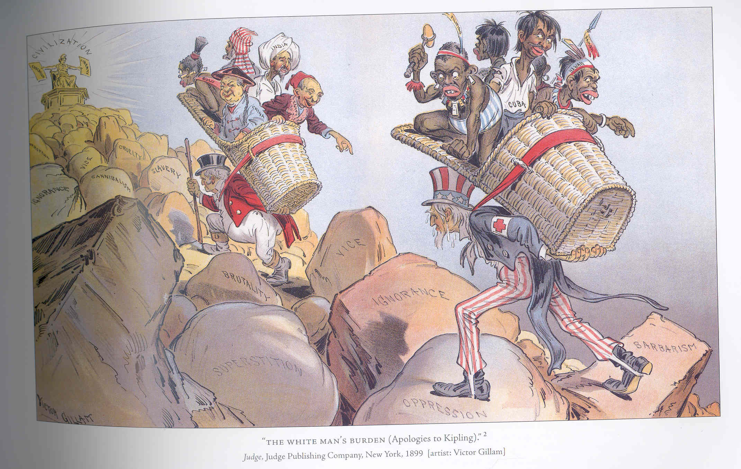
Notes:
China, Egypt, India, Cubans, Hawaiians, Samoans, and Phillipinos being carried by Uncle Sam and John Bull?
Walking up stones with names such as slavery, cannibalism, Ignorance, Brutality
The end game or the top of the mountain is civilization

Slide 7
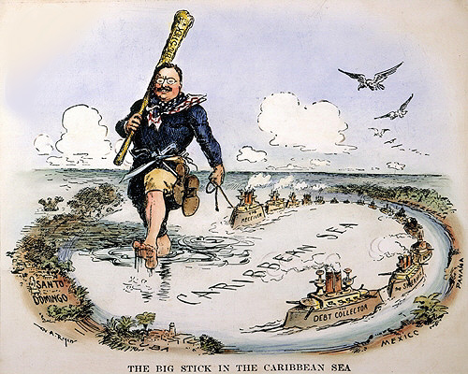
Notes:
Teddy walking softly carrying a big stick through the carribean islands
He is pulling battleships with him-tools to conquer/imperialize the islands
Geographical locations highlighted
The way he is walking seems rather confident and entitled like he is doing what is right

Slide 8
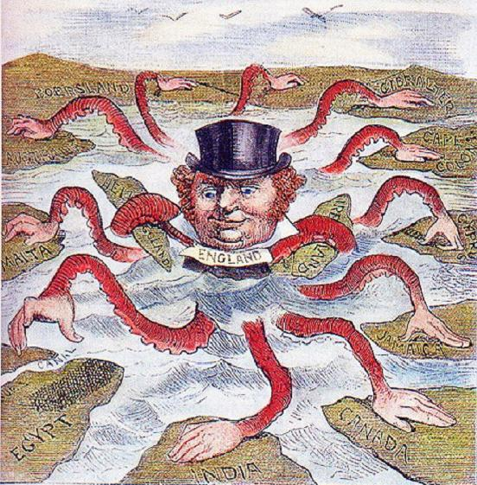
Notes:
John Bull Great Britain's equivalent to Uncle Sam grabbing all the territory that he can

Slide 9
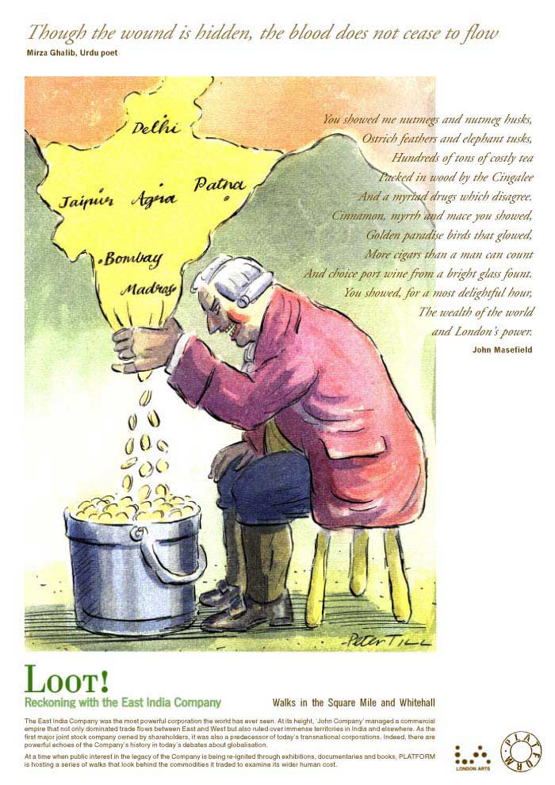

Slide 10
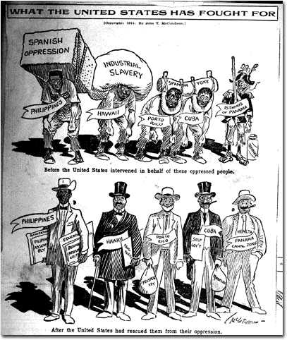

Slide 11
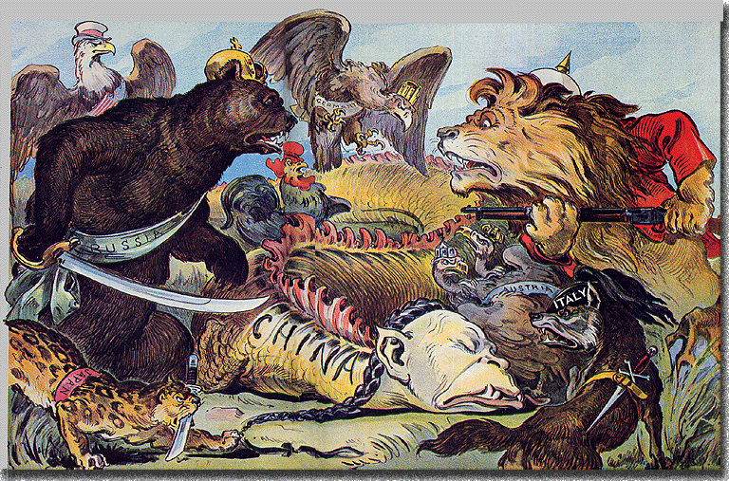

Slide 12
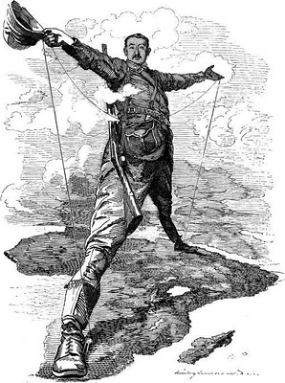
Political Motives
Believed their country would gain more…
Respect from other nations
Troops for bigger armies
Refueling stations for navies
Big Idea…
Make your country the
biggest and the best!
Notes:
Three main motives behind imperialism

Slide 13
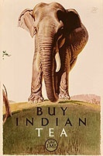
Economic Motives
Believed their country would gain more…
Raw materials for industry
New markets to sell goods
Colonies to send jobless workers

Slide 14
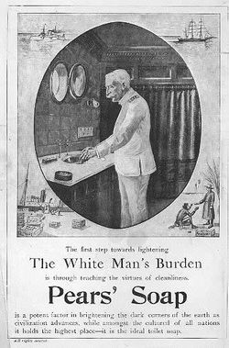
Cultural Motives
Believed it was their country’s duty to…
Spread Religion
Carry out the “White Man’s Burden”
Belief needed to civilize “half devil half child” natives.
“The first step towards lightening The White Man’s Burden is through teaching the virtues of cleanliness.”
Notes:
Perhaps flash back to the white man’s burden cartoon

Slide 15
Types of Imperialism
Settlement
Large group people settle in 1 place
Dependent
Imperialist officials rule country/natives
Protectorate
Local ruler “leads”, but Imperialists have real power
Sphere of Influence
Area where Imperialist country had a special interest, which was respected

Slide 16
Is Imperialism Morally Right?

Slide 17
Is Modern Imperialism Morally Right?
The “New White Man’s Burden”?
``…that American’s have a right and even an obligation to depose regimes they consider evil…”

