Slide 1
Colonization of the Americas
The New England Colonies

Slide 2
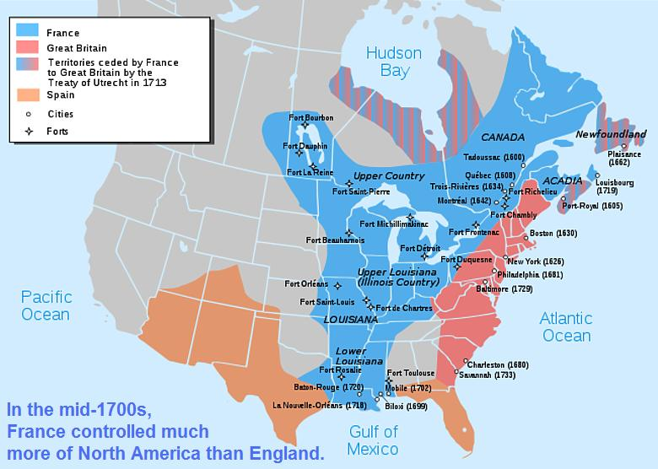

Slide 3
French voyages
Searched for NW Passage, came upon St. Lawrence River in Canada
Giovannii da Verrazano: Sailed in 1524, explored the coast of North America from present-day NC to Newfoundland. Entered NY harbor.
Jacques Cartier: Three voyages to Canada (’34-’36-’41-’42). Claimed region called New France for his nation (Present-day Canada + parts of N. US)
Samuel de Champlain: First successful French colony in N. America in 1608. In Quebec above St. Lawrence River
Louis Joliet and Jacques Marquette: Great Lakes to the Mississippi River in 1673. Traveled south along waterway into Arkansas (Found out it ran to the Gulf of Mexico). Turned back

Slide 4
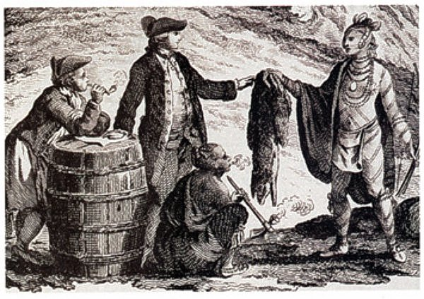
Fur trade
Skins of deer, beaver, and other animals became fashionable in France and other parts of Europe in 1600’s.
Determined shape of New France (interior of Canada along St. Lawrence River and Great Lakes)-transporting goods

Slide 5
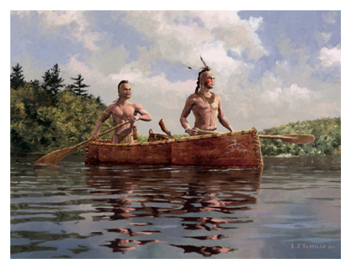
The Iroquois
Native Americans gathered furs for European markets and provided a growing market for European goods including:
Guns, Cloth, and Jewelry
NA learned Christian religion and Catholic rituals
Diseases spread to Native Americans, wars start between them
Fought over hunting grounds
Iroquois: Pushed rivals out of homelands forcing them to migrate west to the Great Lakes

Slide 6
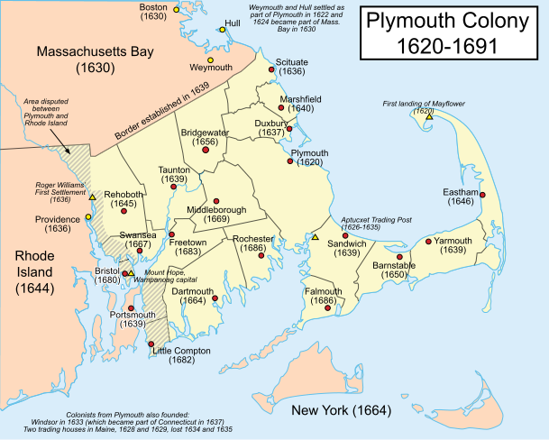
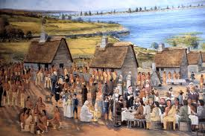
Plymouth Colony
Region included the states of Connecticut, Rhode Island, Massachusetts, Vermont, New Hampshire, and Maine. Called the New England Colonies

Slide 7
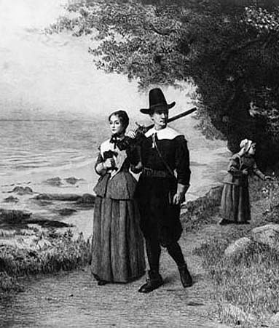
Puritans and separatists
First state founded b/c of religious conflicts
King Henry VIII had broken from Catholic Church
Founded Anglican Church
Too many Catholic practices and traditions “Purer” kind of church” (This is why they were called Puritans)
Some started own churches (Separatists)
All were persecuted: attacked b/c of
beliefs

Slide 8
Voyage of mayflower
Pilgrims: group of Separatists who decided to make a new home in North America (Freedom of Religion
100 pilgrims sailed to New England on the Mayflower
Mayflower Compact: settlers agreed to obey all of their government’s laws.
William Bradford: drew up the compact and became governor for 35 years in this colony.
People would guide their own affairs
Early Difficulties: Settled in New Plymouth
Half died within the first winter alone
Squanto: NA taught how to plant corn
Harvest plenty of corn with feast of
Thanksgiving in 1621.

Slide 9
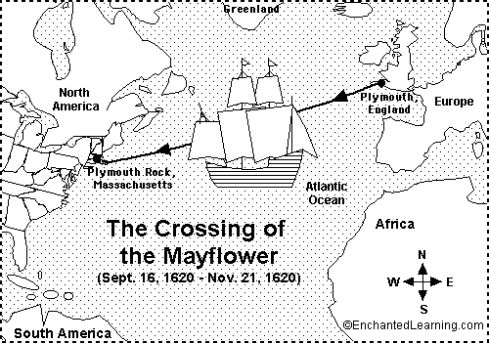

Slide 10
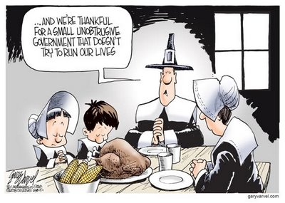
Massachusetts bay colony
Great Migration: English settlers set on voyage across Atlantic and found Massachusetts Bay Colony located north of Plymouth Colony in New England.
Capital: Boston and 20 towns with 20,000 people by 1643.
Reasons for Migrating:
Worship as they wanted (No religious tolerance for other groups). Had to attend Puritan church and pay taxes.
Puritans: Farmland and purify the Protestant church
Wanted to study bible, listen
to sermons, and examine lives

Slide 11
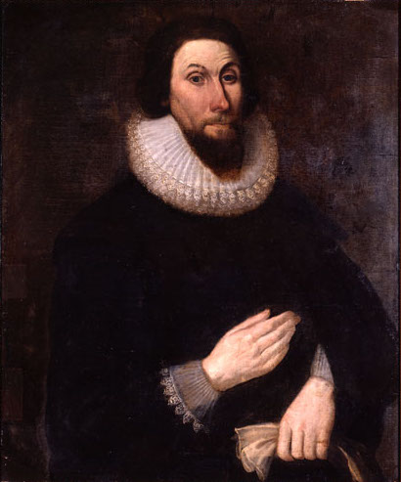
Transforming New England
Forests into fields: Wheat, Barley, and Corn
Cows and Pigs rather than Deer and Beaver
Congregaciones: radical changes by NA in Puritan religion and culture.
City Upon a Hill
Frowned on people who wanted to live alone
“Common” land used by all in the town
Church, meeting house, house for minister, school
Each family had strip of farmland
John Winthrop: founder and governor of
colony
Sermon that showed America would be
example
Worked hard, good health, children lived
Twice as long as they would in Viriginia

Slide 12
Other puritan colonies
Connecticut: Thomas Hooker led Puritan group in mid 1630’s. Wrote a new plan of government for their colony (Fundamental Orders).
New Hampshire and Maine: both from England and Mass. Became separate colony in 1679 and Maine was a part of Mass. Until 1820.
Some leave colonies of Puritans b/c they do not cherish same values.
Roger Williams/Providence: Land could only be rightly owned
Should not punish settlers over matters of religion
Started settlement called Providence (South of Mass.)
Separatist communities became colony of Rhode Island
Guaranteed religious tolerance to all settlers.
Other Separatist Colonies: New group founded New Haven, Connecticut (Colony was combined into single colony under royal charter).

Slide 13
War with the indians
The Pequot War: Lived in Connecticut
Puritans burned down a fort near Mystic, Conn killing more than 500 people inside.
Went on hunt to kill or capture rest of tribe
Pequot survive barely
King Philip’s War: Plymouth Colony
NA killed cows in the pasture of a farm
Boy fired at NA and wounded onepe
Metacom: life between NA and white society
Tribe helped Pilgrims settle and survive and led to trade
45,000 English people in New England ruined livelihood
Made a speech and gather NA groups to drive out English
Destroyed 20 English towns, killed 2,000 settlers
English killed 4,000 NA
NA either joined English or split up within tribes

Slide 14
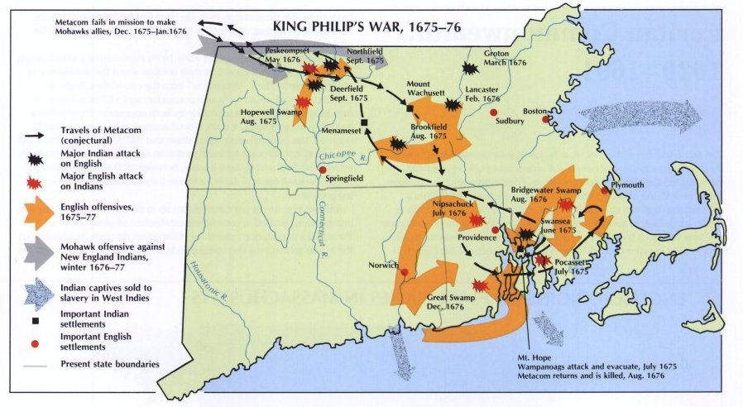

Slide 15
Final outcome
Metacom shot through heart
War went on for nearly a year
Devastated Economy of New England
English conquest nearly complete
NA life in S. New England nearly extinct

