Slide 1
European Colonization of the America’s
Jamestown

Slide 2
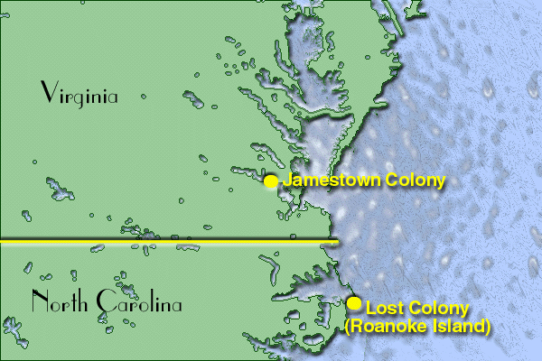
Summer of 1590: two ships from England arrive on American shores for a colony on Roanoke Island
They could not find the other settlers (Mystery)
White: Comes from Native American group with white settlers (Joined or Defeated?)
Lack of colonization of Roanoke Island shows difficulty (Still kept determination)

Slide 3
English Explorers
John Cabot: First English explorer to cross the Atlantic.
May have landed in Newfoundland, Canada in 1497.
Never returned from second voyage to the Americas
Many years would pass before next voyage
Sir Martin Frobisher: three voyages across Atlantic (1576, 77, 78)
Looking for trade route to Asia like Cabot or through the continent of North America (NW Passage)
John Davis: Three voyages to North America in search of NW Passage (1585, 86,87)
West Coast of Greenland and east coasts of Baffin Island
Henry Hudson: Explored the Hudson Bay in 1609
Turns back b/c it was not NW Passage and turned back
1610 is when he technically discovered Hudson Bay in NY

Slide 4
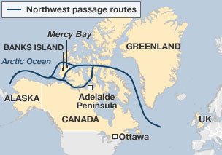

Slide 5
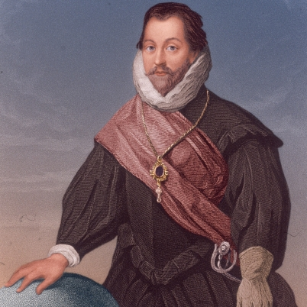
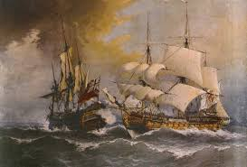
Privateers
Raided Spanish ships and cities in Americas
Hired by Queen Elizabeth I of England to attack Spanish ships. Why?
Most famous Privateers were the Sea Dogs led by Sir Francis Drake
Thefts severely weakened Spanish Empire financially

Slide 6
England Colonization in America
Reasons for England’s interest in permanent settlements.
Search of riches: Attack Spanish ships and cities
Convinced they could still find a NW Passage
Supply stations in North America
Wanted new markets (Native Americans and future populations
Homeland (Too crowded)
Religious Freedom

Slide 7
Sir Walter Raleigh
Twice to start a colony in Roanoke Island (Outer Banks, NC)
1st attempt: Settlers abandoned the colony and returned home
2nd attempt: 2 years later, ended mysteriously (Vanished)

Slide 8
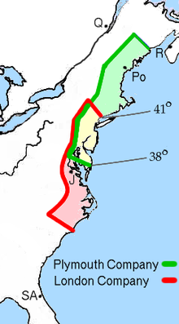
Jamestown Settlement
In 1606, English made plans to establish colony
Process? How?
Charter: certificate of
permission from the king
Joint Stock Company:
funded and run by investors
who share profits and losses.
Company called Virginia Company
Sent 100 colonists to Virginia

Slide 9
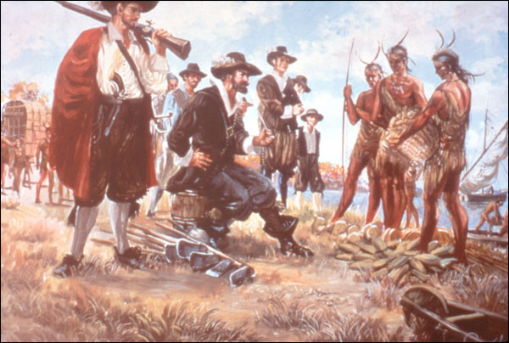
Settlers Hardships
Conflict with Native Americans: 200 attack colonists. Over 14,000 Native Americans live in Chesapeake Region
Powhatan People: Named for powerful chief, Powhatan
English honored him and paid a regular tax
After attack, they went to
Powhatan showing they meant
no harm
Resulted in a truce
Unrealistic Expectations
Were not use to the hard work
that went into building. Ex: No
experience
Many came over to get rich quick
Many ignored the advice of John Smith (Searched for gold instead of learning how to survival.

Slide 10
Location: Swampy area
Swamps and pools of standing water with disease carrying mosquitos bred (Typhus and Malaria)
Starvation: 1st 10 years of settlement (Native Americans helped)
Poor Leadership: Fought about minor issues even when starving
Writers in England were calling Virginia a paradise
Gave sermons praising the colonies
5,500 English and others migrated to Virginia.
4,000 of these settlers died within a short time arriving.

Slide 11
Governing the Colony
Virginia Company received charter to appoint governor
Could not turn profit and shut down charter in 1624.
Virginia became a royal colony: governor appointed by the king.
Legislature: lawmaking assembly with representatives of the colony. Assembly was known as House of Burgesses.

Slide 12
Growing Tobacco
First grown in the Western Hemisphere
John Rolfe: Ships to Europe where it became popular
2,500 pounds to England
By 1618, increased to 50,000 pounds
By 1640, Virginia and Maryland were sending over 3 million
Promise of Land
Headright System: giving the head who came to colony 50 acres of land to grow plants and hire laborers.
Masterless Men and Women (England): Kicked off of farmland by their Masters b/c profit came from livestock
Indentured Servants
Work for a master for a period of time (7 years)
Master paid cost of voyage to Virginia and gave them food and shelter (100,000-150,000 between age of 18-22).

Slide 13
Conflict with Native Americans
Good intentions became angry misunderstandings
Due to past experience with Irish (Catholic vs. Protestant), it was easier to remake over any culture they conquered.
Conquest (All or Nothing)
Native Americans React
Opechancanough: Powhatan’s brother organizes surprise attack on Jamestown with intention of wiping out English.
Settlers struck back killing as many or more as NA
Native Americans plan last attack at Chesapeake Bay where the failed majority.

Slide 14
Bacon’s Rebellion
Rich planters bought more land, servants, and the government supported high class (not low class)
William Berkley: refused to raise troops to defend settlers against Indian raids.
Nathaniel Bacon: Berkley’s cousin, member of council, sympathized with frontiersmen.
Bacon raised own army to fight Native Americans. Berkley angry about lack of permission and gathered an army.
Bacon turned army around and burned Jamestown and controlled until his death.

Slide 15
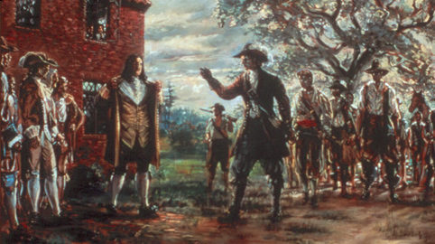
Bacon’s Rebellion
Important for 2 reasons:
Frontier settlers were frustrated with government concerned only about the interests of wealthy planters.
Poorer colonists were unwilling to tolerate such a government.

Slide 16
