Slide 1
Islamic Empires
Chapter 18

Slide 2
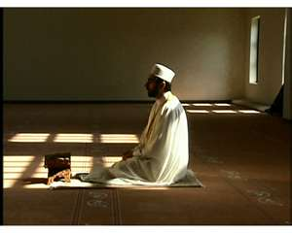
Islam – “The Basics”
Islam means “submission”
Simplest and most readily understood
Salvation – moral\ethical code
Monotheistic = 1 god
“Allah”
Prophet = Muhammad
Holy book = Koran/Quran
Worship place = Mosque
Imam – male prayer leader
Followers = Muslims

Slide 3
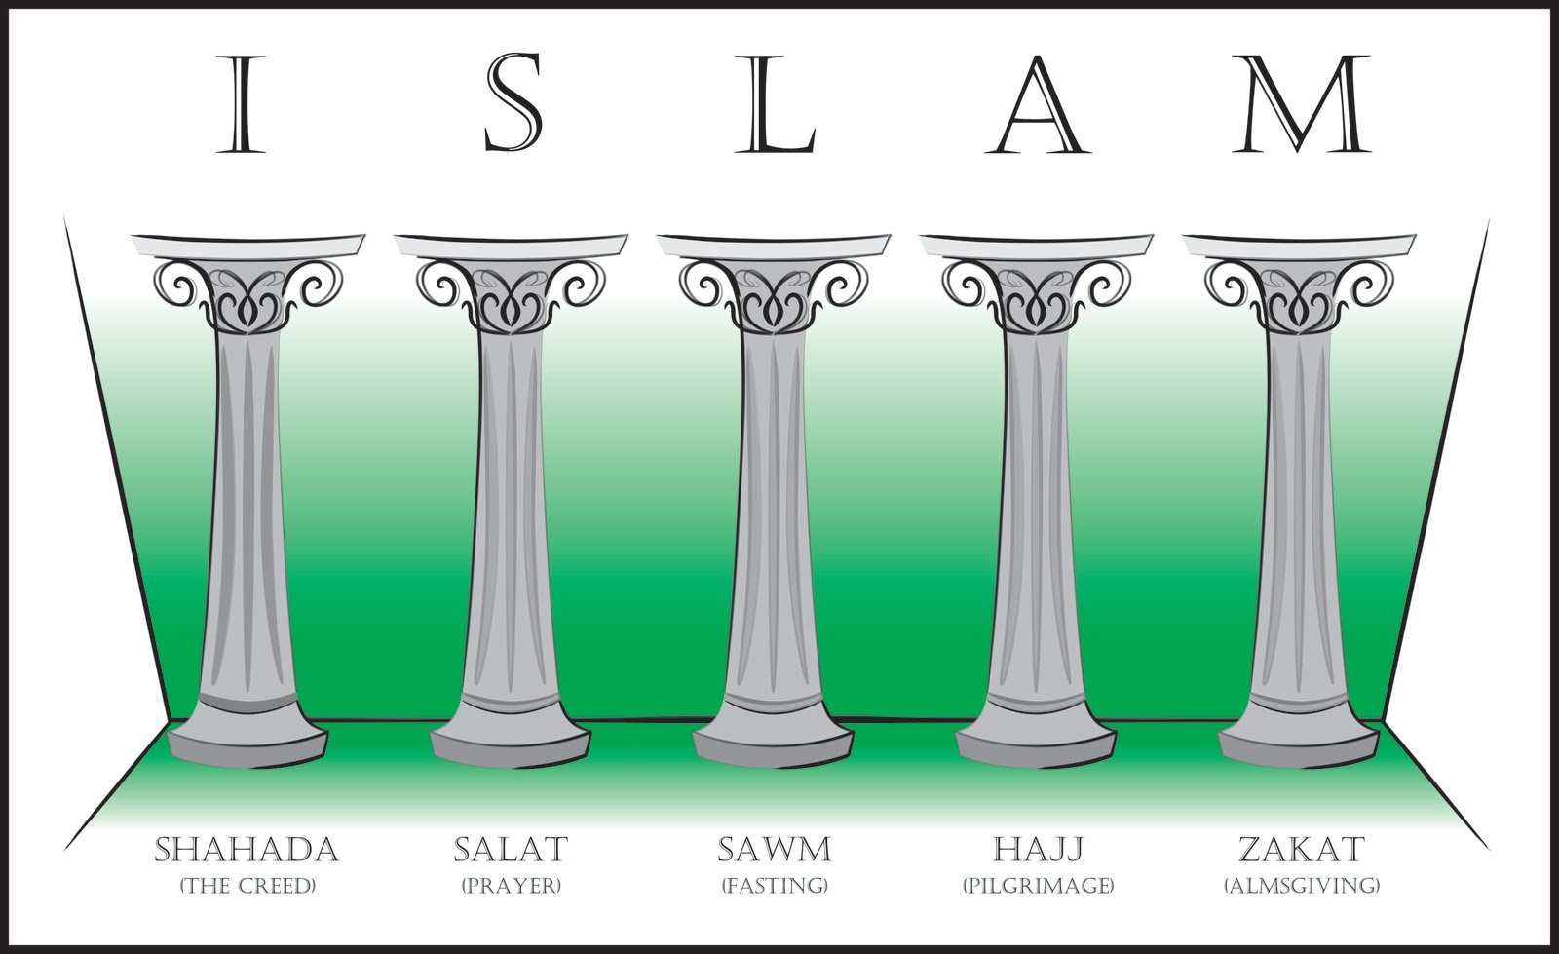
5 Pillars of Faith

Slide 4
The true meaning of Jihad = “Struggle” to strive, to exert oneself to eradicate disbelief ?????????????? Christians and Jews are of the same book Hirabah

Slide 5
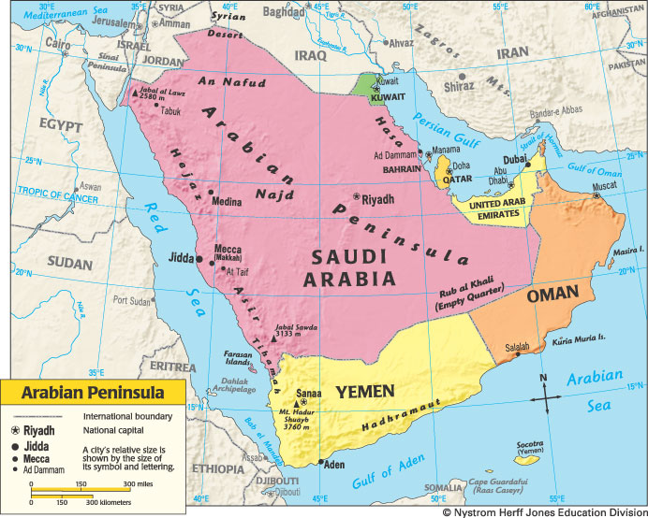
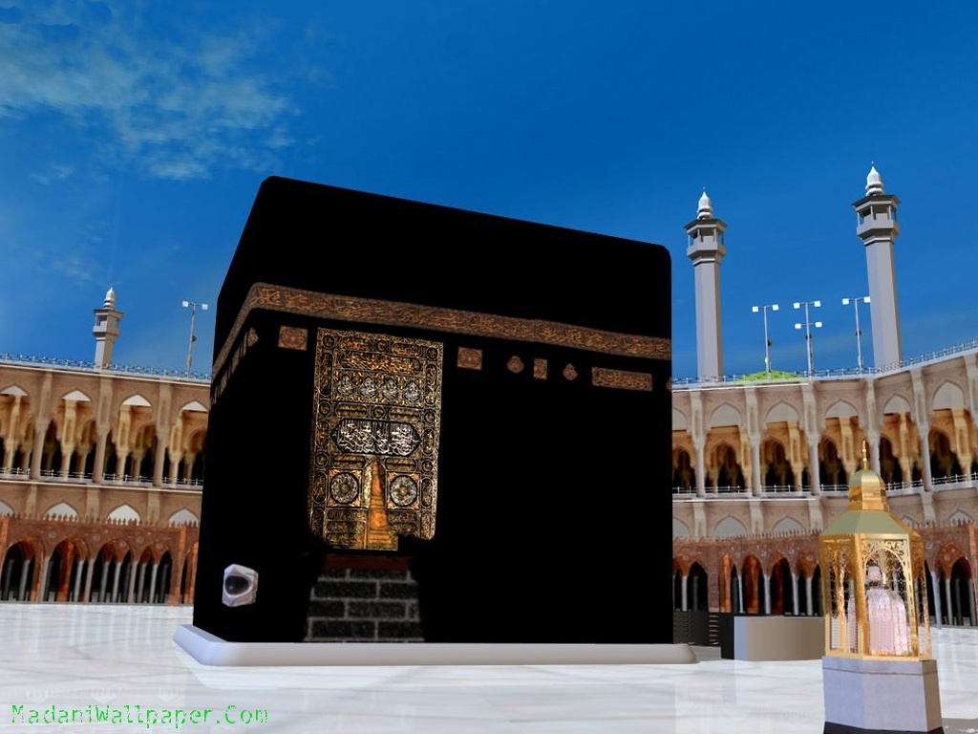
Began in Arabian Peninsula…

Slide 6
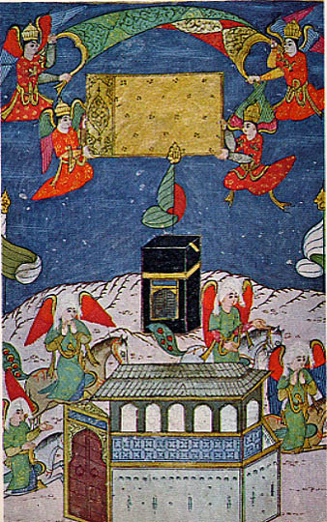
570 AD Muhammad Born… Mecca Ka’ba\polytheistic Mecca was an interchange Mecca becoming materialistic\inequalities

Slide 7
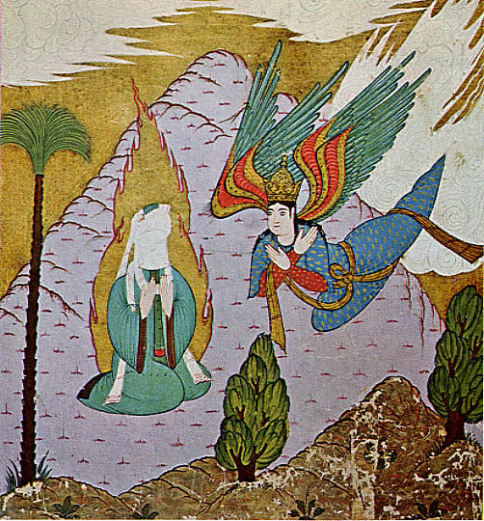
At 40, Muhammad was visited by the angel Gabriel…

Slide 8
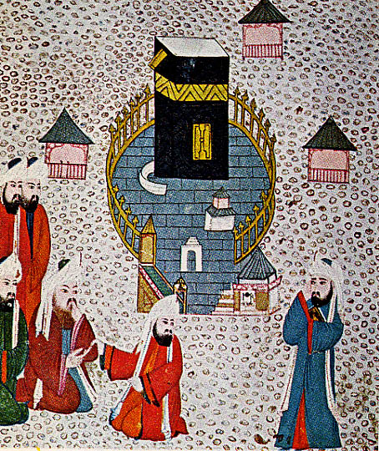
In Mecca, Muhammad began to preach one god & equality…

Slide 9
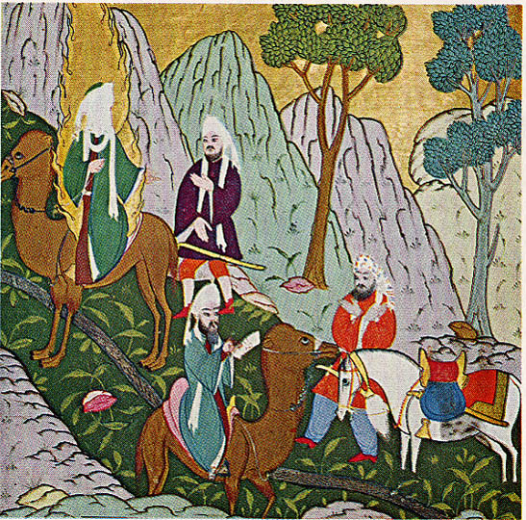
Muhammad’s teachings upset ruling class in Mecca, so Muhammad fled to Medina (flight called “Hijirah”)…

Slide 10
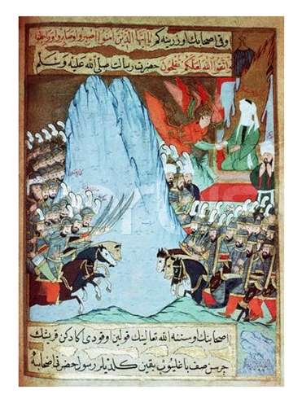
In Medina Muhammad converted many to Islam, this led to war w/ Mecca…

Slide 11
630 AD Muhammad and followers won war & returned to Mecca…

Slide 12
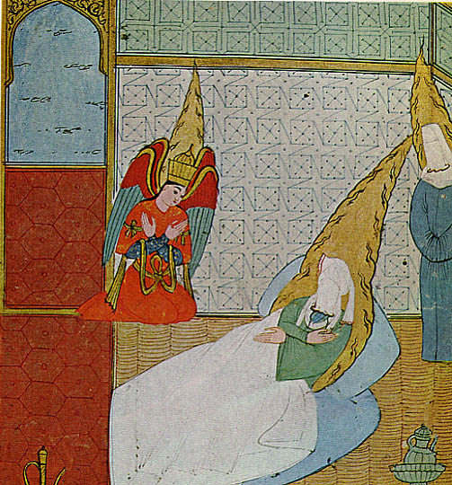
In 632 AD Muhammad died…

Slide 13
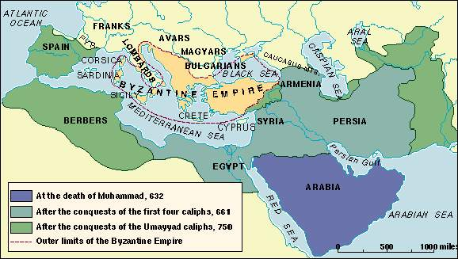
Islam after Muhammad
New leader called Caliph
“Successor of Muhammad”
New Caliphs expanded Islamic Empire
India, N. Africa, and Spain
Problem…
Arguments o/ Caliph
Led to division of Islam
3 branches

Slide 14
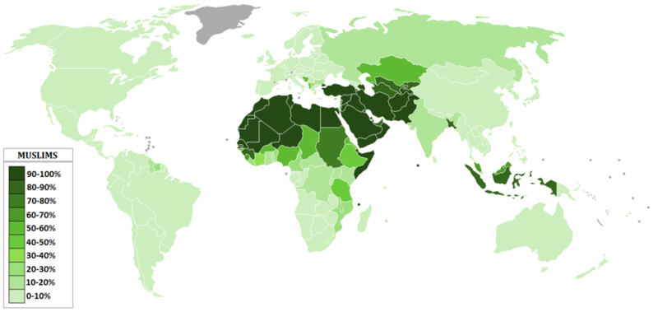
3 Branches Islam
Sunni
Majority sect – 90%
Believe followers of Islam chose Caliph
Shiite/Shiah
Minority sect – 10%
Believe Muhammad selected successor, his son-in-law Ali
Only descendents Ali rightful Caliphs
Sufi
Very, very small %
Believe experience god directly & live very simply

