Slide 1
Islamic Empires in Asia Chapter 18
“The empire of the world…must be one, one faith and one kingdom. To make this unity there is no place in the world more worthy than Constantinople” – Mehmed the conqueror

Slide 2
Ottoman Empire

Slide 3
Rise of the Ottomans
Ghazis – Warriors for Islam – 1st Ottomans (Turkish)
Anatolia (Asia Minor – Turkey) – Mongolian Persecution
Osman – 1200’s ghazi leader – tribe Ottomans
Ottoman Tribe – 1300s
Tried taking Constantinople – failed
1361 took Adrianopolis – 2nd most important Byzantine city
Renamed Edirne – 1369 1st Ottoman Sultan
Army Elite – Janissaries
War captives & Christian Slaves
Converted to Islam
Belonged to Sultan

Slide 4
Timur – Sword of Islam
Turko-Mongol Leader
Born 1336 in Uzbekistan – descendant of Genghis Khan
Restoration of Mongol Empire
Military genius & tactician
1402 invaded Anatolia – won Battle of Ankara – captured Sultan
Ottomans had to return territory taken from ghazi rulers
"Till the advent of Hitler, Timur stood forth in history as the supreme example of soulless and unproductive militarism“ – John Saunders

Slide 5
Recovery & Expansion
Civil War – Who’s Next???
1421 - 1451 Murad II (18 yrs old) – next period of expansion
25 yr war against European Crusaders
Balkans - Anatolia
Battle of Varna - Ended
Mehmed II 21 yrs old (post Murad) 1444-46 & 1451 - 1481
Took Constantinople in 1453 – renamed Istanbul (Capital)
Devoted to strengthening navy
Took Constantinople with 320 ships & 80 – 200k troops

Slide 6
The Greatest Sultan
Suleyman – 1520 – 1566
West (Europe) – “The Magnificent”
East (Own) – The Lawgiver
Reconstructed legal system
Apex of Ottoman military, economic, political power
Captured most of Hungary
Vienna 1529 – Ended Westward expansion

Slide 7
Ottoman Society
Government
Sultan – supreme ruler
Grand Viziers – 2nd in command
Societal Groups
Osmanli – ruling class
Reaya – “protected flock”
“Each man in Turkey carries in his own hand his ancestry and his position in life, which he may make or mar as he will” – Ogier Ghiselin de Busbecq (Roman Emperor’s Ambassador)

Slide 8
Millet System
Millets – Confessional Communities
Separate legal courts for communities to rule under “personal law”
Protected religious minority groups
Own laws & customs – collected taxes
Muslims: ethnicity did not matter (Sunni)
Orthodox Christians: included all orthodox sects
Armenians: Apostolic, Catholic & Evangelical groups
Syriac Orthodox – Oriental Orthodox – asked to be separated from Orthodox Christians
Jews

Slide 9
Decline of an Empire
Death of Suleyman 1566 – beginning of the end
Rise of European states – France, Spain & Poland
1571 Philip II(Spain) – Battle of Lepanto – European Navy win
1683 John III Sobieski(Poland) – Battle of Vienna – End of Empire
Holy League: Holy Roman Empire & Polish-Lithuanian Commonwealth
Decline in 1600’s – 1700’s
End of Silk Road
Internal power struggles led to corruption
Janissaries rebelled
1700’s: Crimean Peninsula (Black Sea Lands)to the Russians
1798: France takes Egypt
Restructuring failed by Sultans
1923 – Turkey established as a Republic – End of the Empire

Slide 10
End of the Silk Road

Slide 11
Safavid Empire

Slide 12
Safavid Empire
Current Day Iran
Safavids descendants of Safiodin (head of family)
Muslims – Started Sunni -> 1399 became Shi’ah
Kizilbash – Army – “Red Heads”
Esma’il: 1500-1524 Leader of Safavids
13 yrs old – Avenge his father’s death, new territories, spread Shi’ah
Iran and most of Iraq under his control
1501 Tabriz – made capital
Shah – “King of Kings”
Forced Persians to convert to Shi’ah
Persia’s neighbors threatened by Shi’ah
Ottomans and Uzbek’s invade Persia
Tahmasp tried to carry on the fight
1570’s significant territory lost

Slide 13
Shah Abbas the Great
Safavid Unrest (1576-87)
Kizilbash no longer loyal to the Shah
Shah Abbas “the Great”
Reformed military using Ottoman model
1598: regained northeastern Persia from Uzbeks
Height of an Empire
1599 moved capital to Esfahan – Iranian Plateau
Created a flourishing city
Improved manufacturing and foreign trade
carpet weaving, ceramics
Empire began a decline after Abbas’ death – ended 1736

Slide 14
Mughal Empire in India

Slide 15
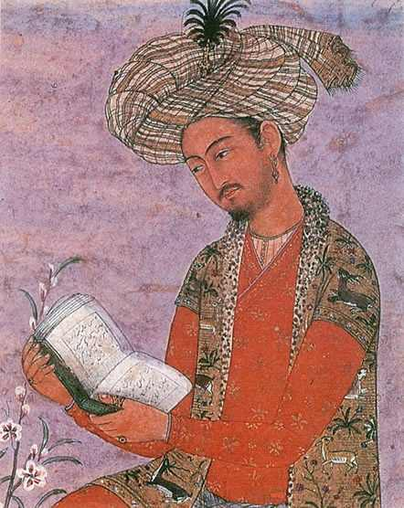
Origins
1300s Timur and Turkish Muslims controlled India
Delhi Capital – 1500s Rajputs challenged authority
Babur “the Tiger” – descendant of Timur
 | Rajputs | Babur
Who: | Indian warrior princes | Mongol leader (Timur)
What: | Weakened power of sultans | Attacked Sultanate of Delhi
When: | 1500s | 1526
Where: | Delhi | Panipat
Why: | Gain Power | Build an Empire
How: | Challenged Delhi Sultans | Defeated Sultan in Battle

Slide 16
Akbar – Greatest of the Mughal
Reign 1556 – 1605 (13 yrs old)
Gained support by including the Rajputs in gov’t
Improved tax system – based on a villages avg production over 10 yrs
Harvest bad = no tax – Harvest good = keep excess after tax
Supported the arts
Religious Policy
Tolerant of all religions
Repealed non-Muslim tax
Considered himself a Divine ruler – developed a creed claiming “Akbar is God” – Allah Akbar

Slide 17
Height of the Empire
Shah Jahan – 1628-1658 (Apex)
Controlled North & Southern India
Vigorous ruler – put down rebellions – Delhi new capital
Best known for Taj Mahal (Agra) & Hall of Private Audience (Red Fort @ Delhi)
Taj Mahal – tomb for Jahan’s wife
Hall of Private Audience – Jahan’s palace
B/c of economic burden for construction & maintaining the army taxes were raised
½ of crops raised by individuals
New Religion
Sikh – Nanak – tried to unite Muslim & Hindu
One God, no idols, less rigid social system
1600’s became militant – enemies of Mughal & Muslims

Slide 18
Taj Mahal & Hall of Private Audience

Slide 19
Aurangzeb
1657 – Aurangzeb takes power
Jahan becomes ill – Aurangzeb kills older brother, imprisons Jahan – becomes emperor
Devout Sunni – ended gov’t spending on buildings & monuments
Persecuted all non Sunni
Restored tax on Hindu’s – destroyed Temples
Est the largest territory for Mughals – rioting weakened empire

