Slide 1
Islamic Empires in Asia Chapter 18
“The empire of the world…must be one, one faith and one kingdom. To make this unity there is no place in the world more worthy than Constantinople” – Mehmed the conqueror

Slide 2
Ottoman Empire

Slide 3
Rise of the Ottomans
Ghazis – Warriors for Islam
Anatolia (Modern Day Turkey)
Osman – the Ottomans
Devshirme
Drafted boys from conquered Christian territories.
The army educated them, converted them to Islam, and trained them as soldiers.
Army Elite – Janissaries
War captives & Christian Slaves
Converted to Islam
Belonged to Sultan

Slide 4
Timur – Timur the Lame
Restoration of Mongol Empire
Military genius & tactician
Won a major battle against Ottoman forces
Slowed Ottoman advance
"Till the advent of Hitler, Timur stood forth in history as the supreme example of soulless and unproductive militarism“ – John Saunders

Slide 5
Recovery & Expansion
Murad II
next period of expansion
defeated the Venetians, invaded Hungary, and overcame an army of Italian crusaders in the Balkans
Mehmed II
Took Constantinople in 1453 – renamed Istanbul
Opened the city to people various religions and cultures
Selim
Persia, Syria, Palestine, North Africa.
Mecca, Medina, and Cairo

Slide 6
The Greatest Sultan
Suleyman
West (Europe) – “The Magnificent”
East (Own) – “The Lawgiver”
Reconstructed legal system
Apex of Ottoman military, economic, political power
Captured most of Hungary
Island of Rhodes, Austria, North Africa

Slide 7
Millet System
Millets
Separate legal courts for communities to rule under “personal law”
Protected religious minority groups
Own laws & customs – collected taxes
Muslims: ethnicity did not matter
Orthodox Christians: included all orthodox sects
Armenians: Apostolic, Catholic & Evangelical groups
Syriac Orthodox – Oriental Orthodox – asked to be separated from Orthodox Christians
Jews

Slide 8
Decline of an Empire
Death of Suleyman – beginning of the end
Rise of European states – France, Spain & Poland
Decline in 1600’s – 1700’s
End of Silk Road
Internal power struggles led to corruption
Janissaries rebelled
1700’s: Crimean Peninsula (Black Sea Lands) to the Russians
1798: France takes Egypt
Restructuring failed by Sultans
1923 – Turkey established as a Republic – End of the Empire

Slide 9
End of the Silk Road

Slide 10
Safavid Empire

Slide 11
Safavid Empire
Current Day Iran
Safavids were Shi’ite
Surrounded by other empires
Isma’il:
Iran and most of Iraq under his control
1501 Tabriz – made capital
Shah – “King”
Forced conquered peoples to convert to Shi’a or die

Slide 12
Shah Abbas the Great
Shah Abbas “the Great”
Reformed military using Ottoman model
Regained northeastern Persia from Uzbeks
Height of an Empire
Moved capital to Esfahan – Iranian Plateau
Created a flourishing city
Improved manufacturing and foreign trade
carpet weaving, ceramics
Empire began a decline after Abbas’ death – ended 1736

Slide 13
Mughal Empire in India

Slide 14
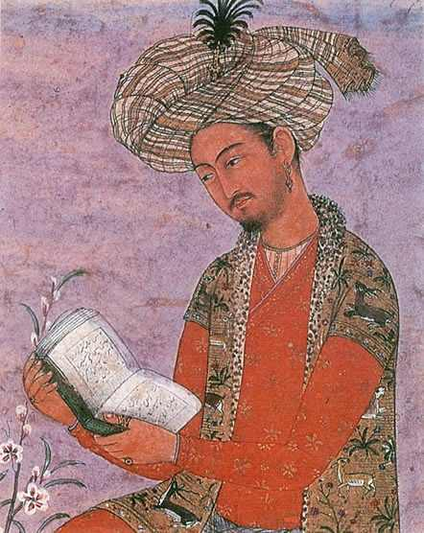
Origins
 | Rajputs | Babur
Who: | Indian warrior princes | Mongol leader (Timur)
What: | Weakened power of sultans | Attacked Sultanate of Delhi
When: | 1500s | 1526
Where: | Delhi | Panipat
Why: | Gain Power | Build an Empire
How: | Challenged Delhi Sultans | Defeated Sultan in Battle

Slide 15
Akbar – Greatest of the Mughal
Gained support by including the Rajputs in government
Improved tax system – created by a Hindu official
Supported arts
Religious Policy
Tolerant of all religions
Repealed non-Muslim tax

Slide 16
Height of the Empire
Shah Jahan
Controlled North & Southern India
Vigorous ruler – put down rebellions – Delhi new capital
Best known for Taj Mahal & Hall of Private Audience
Taj Mahal – tomb for Jahan’s wife
Hall of Private Audience – Jahan’s palace
B/c of economic burden for construction & maintaining the army taxes were raised

Slide 17
Sikh
Tried to unite Muslim & Hindu philosophies
Recognize themselves as a distinct religion not a branch of either
One God, no idols, less rigid social system
Originally peaceful, did militarize in 1600s
Conflict with Shah Jahan regarding his son

Slide 18
Aurangzeb
1657 – Aurangzeb takes power
Jahan becomes ill – Aurangzeb kills older brother, imprisons Jahan – becomes emperor
Devout Sunni – ended government spending on buildings & monuments
Persecuted all non Sunni
Restored tax on Hindu’s – destroyed Temples

Slide 19
Taj Mahal & Hall of Private Audience

