Slide 1
World War I
Major Battles and Conclusion of

Slide 2
What is a TOTAL war?
A war where all of a countries resources are used to fight
Propaganda, women in factories, civilian duty
War of Attrition:
A slow wearing-down war in which each side tried to outlast the other

Slide 3
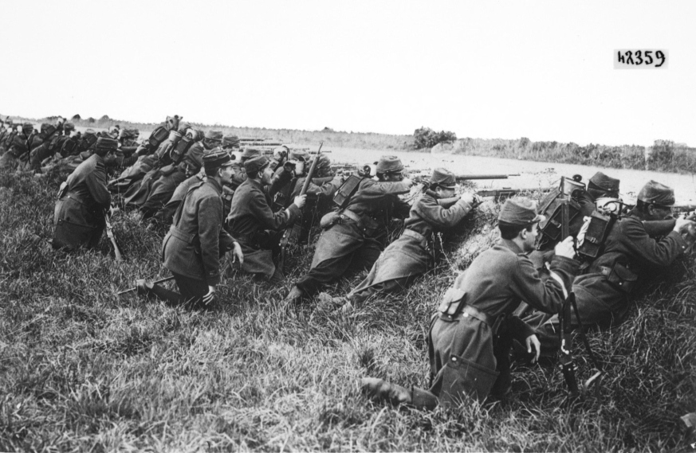
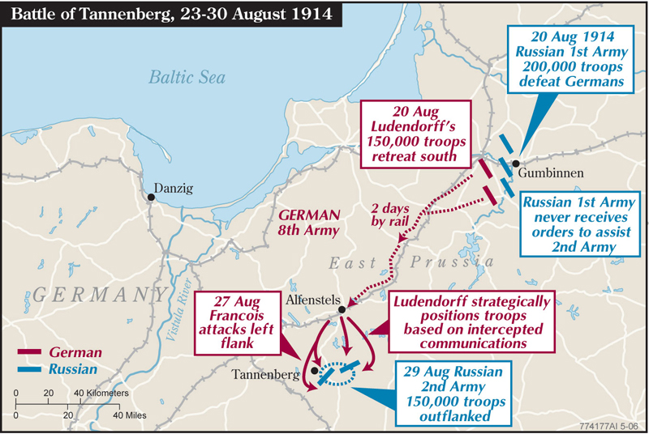
Major Battles WWI
1914
Battle of Marne:
Western Front
France stops German advance into Paris
Trench warfare begins
Battle of Tannenberg
Eastern Front
Huge German Win against the Russians
Germany in two front war
Cryptology
Notes:
Germany trying to push through the French lines-German army ends up swinging to the North-wanted to go to the Southwest-French troops save Paris by 45 Miles
Of the roughly 150,000 Russian soldiers who fought in the battle of Tannenberg, some 30,000 were killed or wounded and another 95,000 captured
The Germans suffered fewer than 20,000 casualties, captured more than 500 guns, and filled dozens of trains with captured equipment for transport to Germany.

Slide 4
Verdun – February, 1916
French losses: | 337,231 | of which 162,308 dead or missing
German losses: | 337,000 | of which 100,000 dead or missing
Total: | 714,231 | of which 262,308 dead or missing
German offensive-humiliate France
Each side had 500,000 casualties!
Notes:
The area of Verdun held numerous French forts, German plan was to capture these forts, eliminating as many French as they could in the process so that they would diminish French morale and then completely defeat France
Longest Battle of WWI- Germans got within a couple miles of Verdun but their troops were exhausted and had nothing left
The monument stands for the famous motto of Verdun 1916 "You shall not pass !": five soldiers of various arms stand side by side and form a wall against which the onslaught of the enemy has to be stopt. On the base of both sides of a cross of war, are engraved the names of the fallen at Verdun in France in both world wars

Slide 5
The Somme – July, 1916
60,000 British soldiers killed in one day
Over 1,000,000 killed in 5 months
Notes:
French and British offensive panned to eliminate the pressure off of Verdun-used a relatively new military technique called a creeping barrage

Slide 6
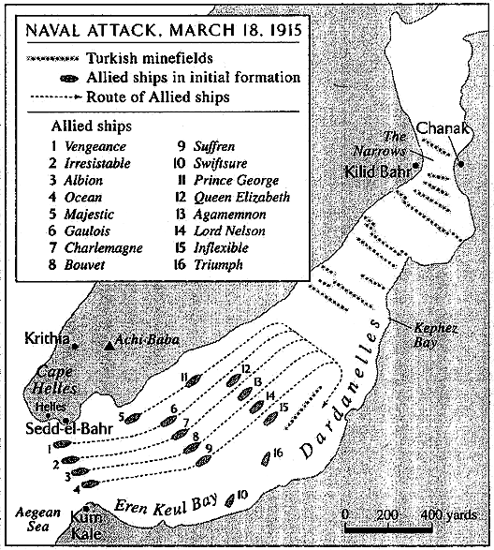
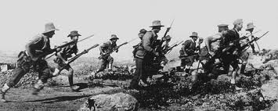
Major Battles WWI
1915
Battle of Gallipoli
Turkish Front
Allies defeated by Ottoman Empire
Russia remains landlocked
Notes:
Darnadelle straits! Open up another front because the war was at a stalemate-

Slide 7
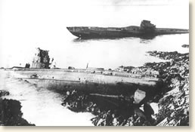
United States Entry into WWI
Events that pushed U.S. into WWI:
Unrestricted German submarine warfare
Sinking of Lusitania(1915)
Zimmerman Note
Overthrow of Russian Czar
U.S. “neutral” until April 6th, 1917
May 28th 1918 our first victory at Cantigny

Slide 8
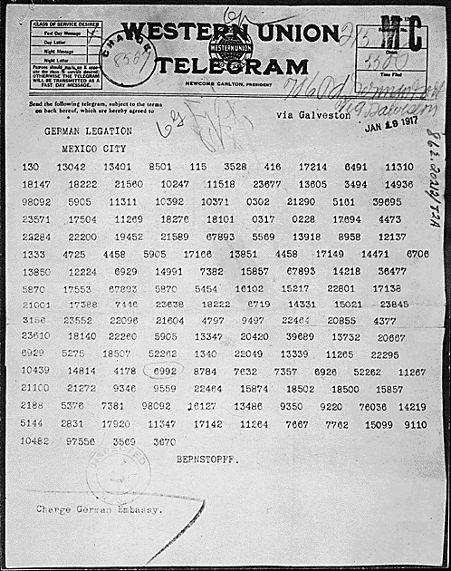
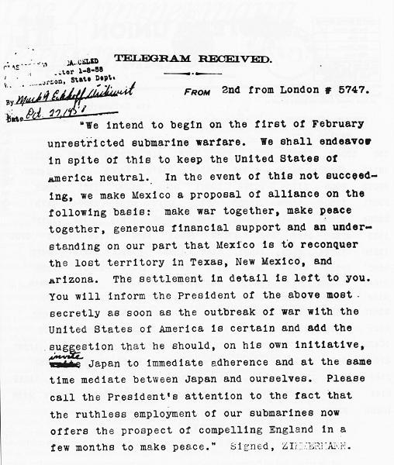
Zimmerman Note

Slide 9
Defeat of Central Powers
1918:
Germany focuses on Western Front
had to fight US
Bulgaria, AH and Ottomans surrender
German Kaiser steps down
German Weimar Republic formed
Weimar Republic signs Armistice in Nov.
WWI Fighting OVER!!!
Notes:
What is an Armistice?

Slide 10
WWI Causalities – 16 mill. Dead

Slide 11
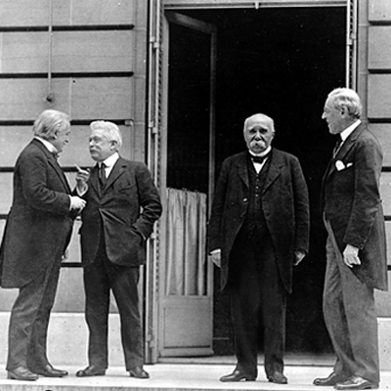
Paris Peace Conference
Meeting of the Big 4:
GB: David Lloyd George
France: George Clemenceau
United States: Woodrow Wilson
Italy: Vittorio Orlando
Who were these men and what kind of “peace” did each of them want?

Slide 12
Areas of Concern
Blame?
Reparations?
Colonies of Central Powers?
Rhineland?
Alsace-Lorraine?
Poland?
Danzig?
Finland, Estonia, Latvia, Estonia?
Czechoslovakia?

Slide 13
Other Problems w/ the Paris Peace Conference
Russia and Central Powers not invited!
Political Problems
Territorial Conflicts
Reparations
How to maintain peace
Force
Wilson’s 14 Points
Freedom of seas, no secret treaties, no economic barriers, reduce arms, fair land divisions, establish League of Nations

Slide 14
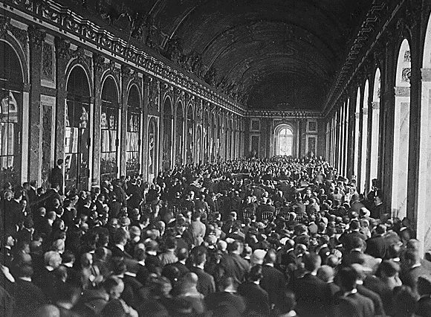
Treaty of Versailles
Officially ended WWI 1919
Treated Germany Harsh
Formed Independent Republics
Formed League of Nations

Slide 15
Europe Before WWI

Slide 16
Europe After WWI

