Slide 1
Age of Exploration

Slide 2
Why did Europeans want to explore?
What where they looking for?
Who was involved?

Slide 3
Main Goals:
Trade
Spices and luxury goods from Asia
Current trade routes are by land – needed an alternative
Resources
Spread Christianity
“God, glory, and gold”

Slide 4
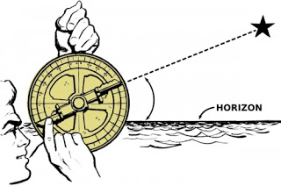
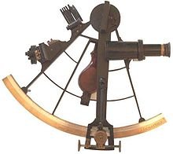
Technology:
New ship design – Caravel
Sturdier
Triangular Sails (copied from Arab ships) allowed it to sail against the wind
Astrolabe (Muslim)
Magnetic Compass (Chinese)
Sextant

Slide 5
Main Countries:
Portugal
Prince Henry - very interested in exploration
Founded a navigation school
Mapmakers, instrument makers, shipbuilders, scientists, and sea captains
Explored Coast of Africa
Traveled around southern tip
Created a trade empire in Asia
Spain
Paid for Christopher Columbus’s journey
Wound up in the Caribbean instead of India
Biggest competitor with Portugal

Slide 6
Treaty of Tordesillas
Modification of the Line of Demarcation
Affected newly discovered lands
Drew a line through the Atlantic Ocean
Lands to the west would belong to Spain
Lands to the east would belong to Portugal

Slide 7
Other Countries:
1600s, the English and Dutch began to challenge Portugal’s dominance
The Dutch Republic (the Netherlands), recently declared their independence from Spain
Quickly became a leading sea power
Soon owned the largest fleet in the world (20,000 vessels)
Both countries had formed an East India Company
The companies could mint money, make treaties, and even raise their own armies
The Dutch East India Company was richer and more powerful than England’s company

Slide 8
British and French Attempt to gain power in the region
English East India Company – focused on trade with India, cloth trade
French East India Company – low profits
Various countries continued to compete against each other
Tensions with Asian powers

