Slide 1
The American Revolution

Slide 2
Americans and the Enlightenment
“It is in their bones. It has defined part of what they have dreamed of, what they aim to become.” –Paul Brians

Slide 3
The Beginning…
1500’s English “seriously” begin to explore Americas
Sea Dogs- sea traders and pirates who challenged Spanish and Portuguese
England desired to find NW Passage
While searching for passage began settling in N. America
Look at America as new source of wealth
Mercantilist ideas

Slide 4
Setting the Stage
1700-1763:
American colonies expand on own
B/C England involved in European Wars

Slide 5
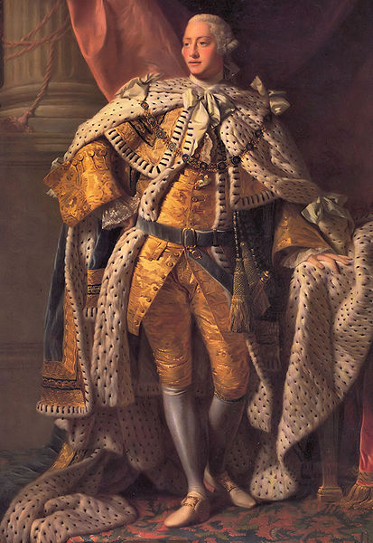
George III Reasserts Royal Power
1760 George III becomes king of England
George III feels Parliament has too much power
George III
Supervises gov.
Appoints own Prime Minister: Lord North

Slide 6
Growing Discontent in Colonies
1651 Navigation Acts
Restricted foreign trade b/w England and Colonies
Colonists feel unfair; “can’t tell me who to trade w/”
1763 French and Indian War Ends
George III wants colonists to help pay for war
Pass series of laws to raise $
1765 Stamp Act
Tax on paper
Colonists HATE; “No Taxation w/o Representation”
GB repeal tax

Slide 7
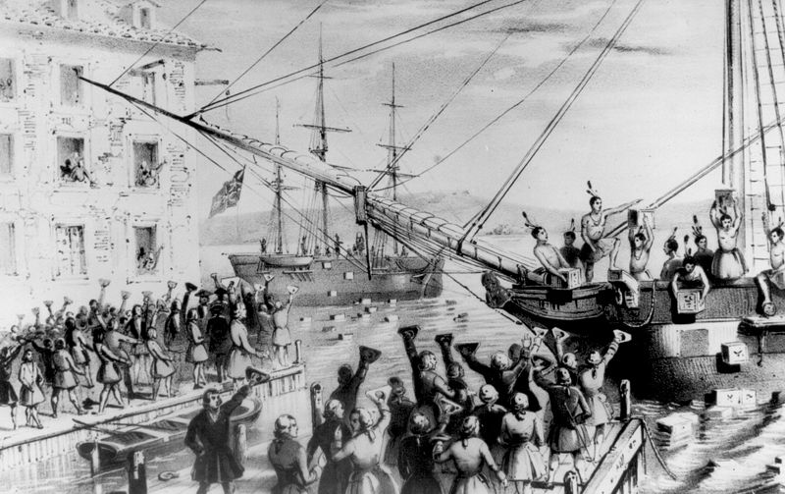
1765-1775 Relations Worsen
1773 Boston Tea Party outrages GB
1774 Intolerable Acts
Name given to a series of laws passed after Boston Tea Party

Slide 8
Patriots vs. Loyalists
American colonists were divided
Patriots- called for independence from GB
Loyalists- opposed independence; supported GB
1774 First Continental Congress
Demanded full rights as British citizens
Agreed to meet again

Slide 9
The Revolution Begins!
1775 war begins in Massachusetts
Second Continental Congress meet & prepare for war
1776 Declaration of Independence
Principal author Thomas Jefferson echoes Locke
American Colonists have natural right to “life, liberty, and pursuit of happiness”

Slide 10
American Colonists WIN!
1781 American Revolution Ends
New Government:
Article of Confederation
New American gov. gave power to the states
Very weak; never really worked

Slide 11
The United States Constitution
Ratified in 1788
Federal System of gov.- power with central gov. not states
3 Branches (checks and balances)
Executive- President
Legislative- congress
Judicial- Supreme Court
1791 Bill of Rights added
Influenced by Enlightenment
Locke- natural rights
Montesquieu- checks and balances
Rousse- popular sovereignty

Slide 12
Big Picture…
Colonists broke away from powerful British rulers and created gov. that put the ideas of the Enlightenment into practice
Declaration of Independence and Constitution of U.S. were models for others

