Slide 1

Mechanics

Slide 2
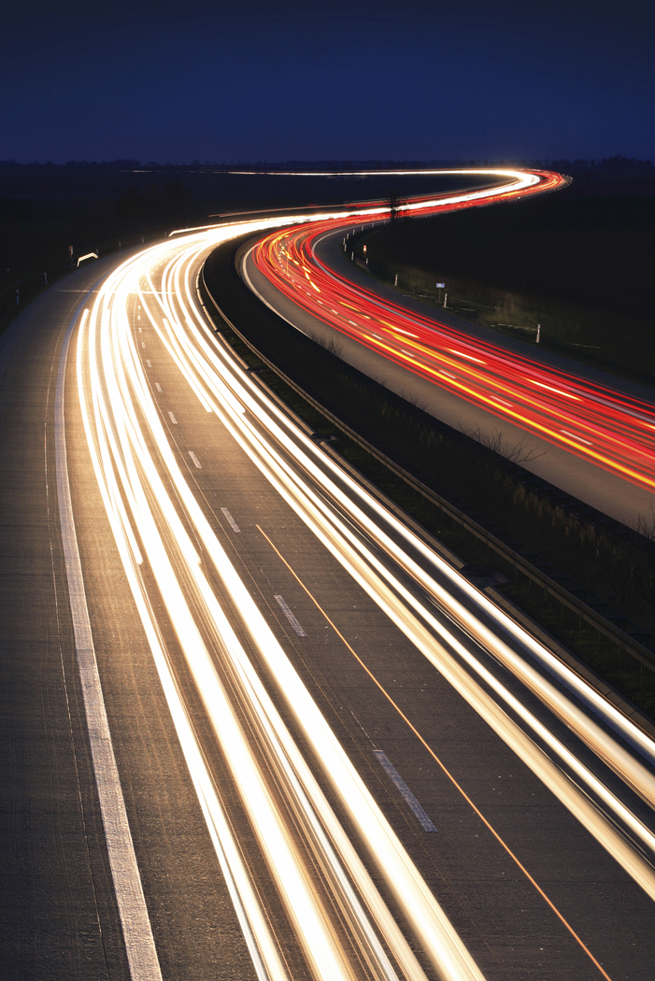
Chapter 2
Kinematics
  The Study of motion
  In chapter 2, we will study motion
    In 2 dimensions (linear motion)
    Motion in a straight line

Slide 3
Motion is Relative
Motion is easy to recognize but harder to describe
  RATE-a quantity that is divided by time
    Tells how fast something happens or how much something changes in a certain amount of time.
      Examples-speed, velocity and acceleration
      We will describe motion both qualitatively and quantitatively

Slide 4
Motion is Relative
Everything moves relative (with respect to) to something else
  The earth moves relative to the sun and stars
  While riding in a car, you are stationary in the car but move relative to the earth.
Unless otherwise stated, we will investigate motion relative to the earth

Slide 5
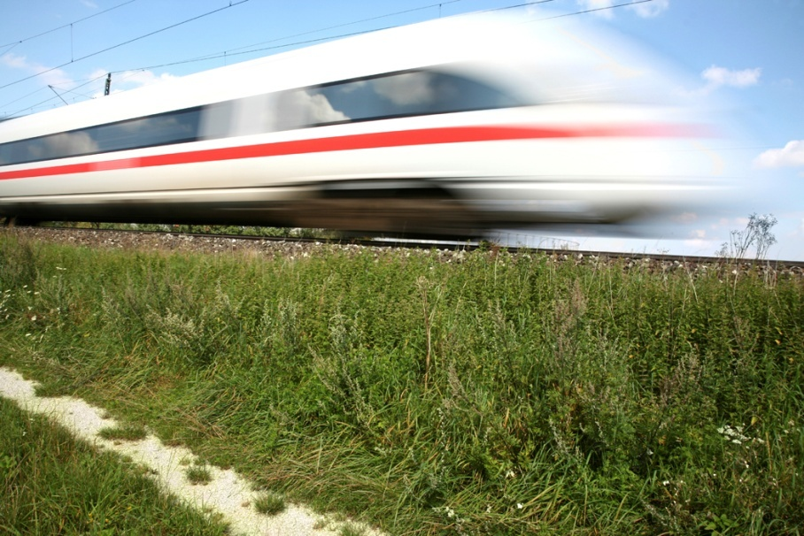
Speed
Speed-a measure of how fast something is moving; the rate at which distance is covered
  Measured in terms of a unit of distance divided by a unit of time (ex. m/s or mi/hr)
  Distance covered per unit time
  Speed=distance/time or
    S=∆D/∆t
    ∆ means a change in

Slide 6
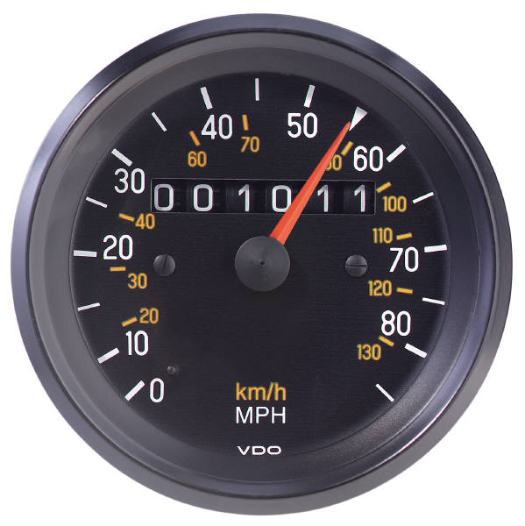
Types of Speed
Instantaneous Speed- the speed at any instant in time (ex. The speedometer in a car)
Average Speed- the total distance covered divided by the total time traveling;
    We then change our equation to read
      Save= ∆D/∆t

Slide 7
Constant Speed Lab

Slide 8
How to Solve a Physics Problem
Write down all known information, as well as what you are solving for
Write the equation that you will be using. Perform any algebra needed.
Substitute known values into the equation (including units)
Solve. Round answer to 3 digits.
Make sure you include units in your answer

Slide 9

Velocity
In everyday language, we use the words speed and velocity interchangeably.
In physics, velocity means speed in a given direction
  Speed=how fast
  Velocity =how fast and in what direction

Slide 10

Constant Velocity
Requires constant speed and constant direction
  Object does not move faster or slower
  Object moves in a straight line
If either speed or direction changes, the velocity changes
  In a car, the velocity can change using 3 different controls:
    Gas pedal
    Brake
    Steering wheel

Slide 11
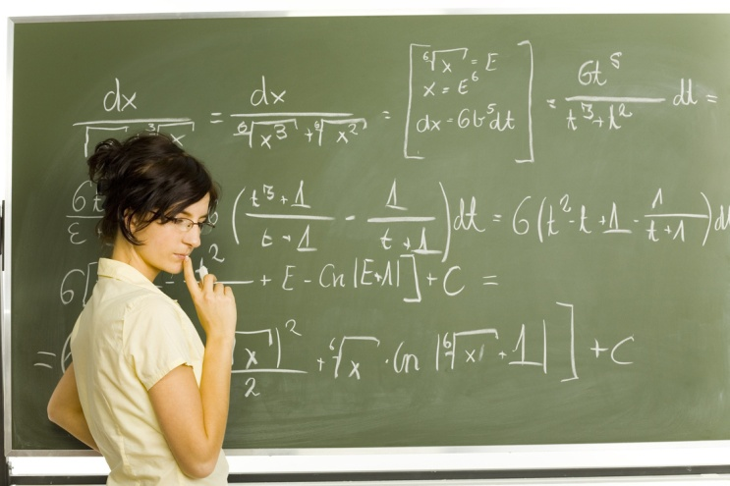
Question (Do not Write)
The speedometer of a car moving northward reads 60 km/hr. It passes another car travelling southward at 60 km/hr. Do both cars have the same speed?
  The same velocity?
  Answer-Both cars have the same speed but different velocities

Slide 12
Acceleration
Acceleration: the rate at which velocity changes
  Change in speed (faster or slower)
  Change in direction
  Or both
  The triangle is the Greek symbol delta which means a change in
  If an object slows, it is considered negative acceleration (deceleration)

Slide 13
Other ways to use this equation
If we let ΔV=Vfinal-Vinitial or Vf-Vi Then
Solving for the final velocity or time gives us

Slide 14
Units for Acceleration
Acceptable units for acceleration are any unit of distance divided by any 2 units of time
    m/s/s
    Km/hr/s
    Miles/hr/s

Slide 15
Acceleration-Continued
Unless otherwise stated, we will only be concerned with motion along a straight line; i.e. speed=velocity
Example-Suppose a car is moving in a straight line at 35 km/hr. If it increases its speed to 40 km/hr in 1 second, what is the car’s acceleration?
5 km/hr/s

Slide 16
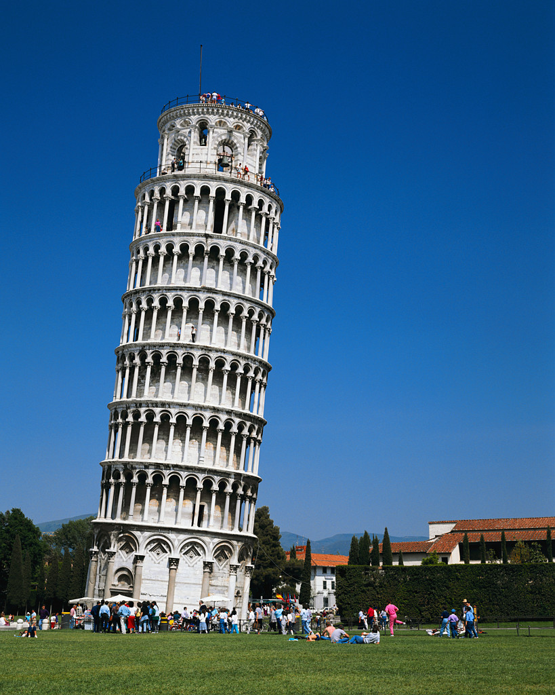
Constant Acceleration
What if we were to drop something off the leaning tower of pisa???

Slide 17
Constant Acceleration Lab

Slide 18
Freefall Lab

Slide 19
Freefall Lab
Results-(do not write down)
1. Distance versus time graph should curve upwards
2. Velocity versus time graph should be straight; the slope = the acceleration due to gravity.
3. The slope should be around 930 cm/s/s. This is a little less than the accepted value because of friction which is present as the tape goes through the timer.

Slide 20
Freefall: How fast?
What is Freefall?
  Gravity is the only force which is causing the object to fall.
  There is no air resistance
  Any object undergoing freefall is accelerating.
    Speed increases each second
    Distance traveled increases each second

Slide 21
Speed of a free-falling object
The speed of a free-falling object increases by about 10 m/s every second
  Therefore, the acceleration due to gravity is about 10m/s/s (the actual value is 9.81 m/s/s, but we will use 10 because it close enough and easier to remember)

Slide 22
Freefall-Continued
Since the acceleration due to gravity is such an important value, we give it a special symbol
        g=10 m/s/s
        g=1000 cm/s/s
        g=32 ft/s/s
        Now, what about our equations???

Slide 23
How fast?
Using our previous equation for the final velocity
We let the initial velocity=zero because we drop the object from rest and we set A=g, we get the following equation for freefall
becomes

Slide 24
How Far?
The equation to find the distance traveled while an object accelerates is
Again, setting A=g and the initial velocity to zero, we get

Slide 25
Sample Question
Suppose an object falls off of a cliff. Determine the distance it has fallen, the velocity and the acceleration at t=0 s, 1 s, 2 s, 3 s and 4 seconds.

Slide 26
Freefall Data Table
Time (seconds) | Distance (meters) | Velocity (meters/sec) | Acceleration (meters/sec/sec
0.0 | 0 | 0 | 10
1.0 | 5 | 10 | 10
2.0 | 20 | 20 | 10
3.0 | 45 | 30 | 10
4.0 | 80 | 40 | 10

Slide 27
Equation Card
g=10 m/s/s g=1000 cm/s/s
g=32 ft/s/s

Slide 28
What if we need to find g on another planet.
Using algebra to rearrange

Slide 29
Gravity on the moon
On the moon, an object dropped from a height of 7.11 m hits the ground after 3 seconds. What is g on the moon?
            =2(7.11 m)/(9 s)=1.58 m/s/s
            The acceleration due to gravity on the moon is about 1/6th Earth’s gravity.

Slide 30
What happens if you throw an object upwards from earth?
As long as the ball is in the air, gravity is the only thing causing acceleration. Therefore, A=g=10 m/s/s directed downward.
The ball loses speed at a rate of 10 m/s every second until it stops. At the top of its path, V=0 m/s.
The ball gains speed on its way down. It will reach the ball’s initial speed when it reaches the same height that it was thrown. Its motion down is just as if it had been dropped from rest.

Slide 31
Air Resistance and Falling Objects
Galileo stated that all objects fall at the same rate.
What about the coin and feather?
In a vacuum (no air), they fall at the same rate
In air, the coin falls faster. Why?
Air resistance-The frictional force on an object
moving through the air.

Slide 32

End of Chapter 2

