Slide 1
Basic concepts chapter 17: Acid-Base chemistry & pH
Recognizing acid/base and conjugate base/acid
Calculation of pH, pOH, [H₃O⁺], [OH⁻]
Calculating pH for solutions of strong acids/base
Ionization constant: K_{a}, K_{b}
Polyprotic acid (and associated K_{a} values)
pK_{a}, pK_{b}
Acid-Base properties of salts
Predicting direction of acid-base reaction
Types of acid-base reactions
Calculations with equilibrium constants

Slide 2
Defining Acids & Bases
Arrhenius Acid/Base
An acid is a substance that, when dissolved in water, increases the concentration of hydrogen ions.
A base is a substance that, when dissolved in water, increases the concentration of hydroxide ions.

Slide 3
Some Definitions
Brønsted-Lowry
An acid is a proton donor.
A base is a proton acceptor.
A Brønsted-Lowry acid:
must have a removable (acidic) proton.
A Brønsted-Lowry base:
must have a pair of nonbonding electrons in order to accept a proton (H⁺)

Slide 4
If a substance can behave as either an acid or a base…
…it is amphiprotic.
HCO₃⁻
HSO₄⁻
H₂O

Slide 5
Acids
Acids can be:
Monoprotic: example HC₂H₃O₂
Diprotic: example H₂SO₄
Polyprotic: example H₃PO₄
(We’ll talk more about these later.)

Slide 6
What Happens When an Acid Dissolves in Water?
Water acts as a Brønsted-Lowry base and abstracts a proton (H⁺) from the acid.
As a result, the conjugate base of the acid and a hydronium ion are formed.

Slide 7
Autoionization of Water
As we have seen, water is amphoteric.
In pure water, a few molecules act as bases and a few act as acids.
This is referred to as autoionization.
H₂O (l) + H₂O (l)
H₃O⁺ (aq) + OH⁻ (aq)

Slide 8
Ion-Product Constant
The equilibrium expression for this process is
K_{c} = [H₃O⁺] [OH⁻]
This special equilibrium constant is referred to as the ion-product constant for water, K_{w}.
At 25°C, K_{w} = 1.0 × 10⁻¹⁴

Slide 9
What is pH?
pH is defined as the negative base-10 logarithm of the concentration of hydronium ion.
pH = -log [H₃O⁺]

Slide 10
pH
In pure water,
K_{w} = [H₃O⁺] [OH⁻] = 1.0 × 10⁻¹⁴
Since in pure water [H₃O⁺] = [OH⁻],
[H₃O⁺] = 1.0 × 10⁻¹⁴ = 1.0 × 10⁻⁷

Slide 11
pH
Therefore, in pure water,
pH = -log (1.0 × 10⁻⁷) = 7.00
An acid has a higher [H₃O⁺] than pure water, so its pH is <7.
A base has a lower [H₃O⁺] than pure water, so its pH is >7.

Slide 12
pH relationships:
Because
[H₃O⁺] [OH⁻] = K_{w} = 1.0 × 10⁻¹⁴,
we know that
-log [H₃O⁺] + -log [OH⁻] = -log K_{w} = 14.00
or, in other words,
pH + pOH = pK_{w} = 14.00

Slide 13
Other “p” Scales
The “p” in pH tells us to take the negative base-10 logarithm of the quantity (in this case, hydronium ions).
Some similar examples are:

Slide 14
Sample calculation:
1. Calculate the pH for solution where [H₃O⁺]= 1.2x 10⁻⁵
2. Calculate the pH for a solution where [OH⁻]= 5.3 x 10⁻⁹
3. Calculate the [H₃O⁺] for a solution with a pH = 6.2
4. Calculate the pOH and [OH-] for the solution, pH = 6.2

Slide 15
pH
These are the pH values for several common substances.

Slide 16
How Do We Measure pH?
For less accurate measurements, one can use
Litmus paper
“Red” paper turns blue above ~pH = 8
“Blue” paper turns red below ~pH = 5
Or an indicator.

Slide 17
How Do We Measure pH?
For more accurate measurements, one uses a pH meter, which measures the voltage in the solution.

Slide 18
Strong Acids
You will recall that the seven strong acids are HCl, HBr, HI, HNO₃, H₂SO₄, HClO₃, and HClO₄.
These are, by definition, strong electrolytes and exist totally as ions in aqueous solution.
For the monoprotic strong acids,
[H₃O⁺] = [acid].

Slide 19
Strong Bases
Strong bases are the soluble hydroxides, which are the alkali metal and heavier alkaline earth metal hydroxides (Ca²⁺, Sr²⁺, and Ba²⁺).
Again, these substances dissociate completely in aqueous solution.

Slide 20
Conjugate Acids and Bases
The term conjugate comes from the Latin word “conjugare,” meaning “to join together.”
Reactions between acids and bases always yield their conjugate bases and acids.

Slide 21
Equilibrium Constants for Acids & Bases
Strong acids and bases almost completely ionize in water (~100%):
K_{strong} >> 1
(product favored)
Weak acids and bases ionize in water to only a small extent (<<100%):
K_{weak} << 1
(Reactant favored)

Slide 22
Equilibrium Constants for Acids & Bases
The relative strength of an acid or base can also be expressed quantitatively with an equilibrium constant, often called an ionization constant. For the general acid HA, we can write:
Conjugate
acid
Conjugate
base

Slide 23
Dissociation Constants
The greater the value of K_{a}, the stronger is the acid.

Slide 24
Weak Bases
Bases react with water to produce hydroxide ion.

Slide 25
Weak Bases
K_{b} can be used to find [OH⁻] and, through it, pH.

Slide 26
Equilibrium Constants for Acids & Bases
The relative strength of an acid or base can also be expressed quantitatively with an equilibrium constant, often called an ionization constant. For the general base B, we can write:
Conjugate
base
Conjugate
Acid

Slide 27
Acid and Base Strength
Strong acids are completely dissociated in water.
Their conjugate bases are quite weak.
Weak acids only dissociate partially in water.
Their conjugate bases are weak bases.

Slide 28
K_{a} and K_{b}
K_{a} and K_{b} are related in this way:
K_{a} × K_{b} = K_{w}
Therefore, if you know one of them, you can calculate the other.

Slide 29
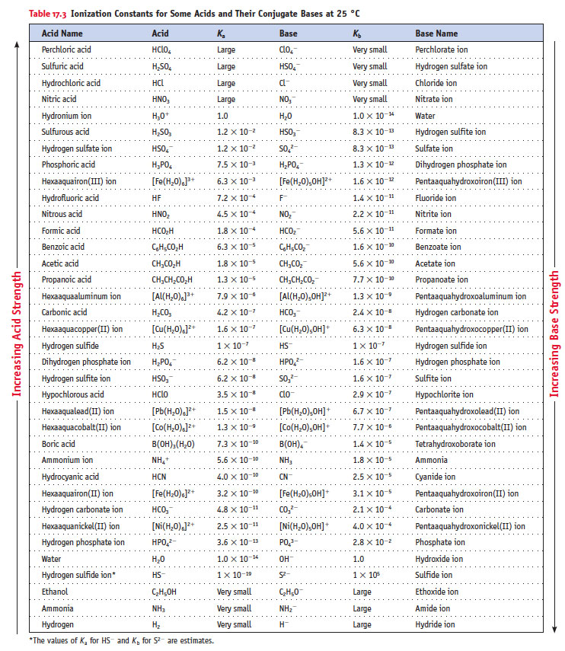
Ionization Constants for Acids/Bases
Acids
Conjugate
Bases
Increase strength
Increase strength

Slide 30
Polyprotic Acids…
…have more than one acidic proton
If the difference between the K_{a} for the first dissociation and subsequent K_{a} values is 10³ or more, the pH generally depends only on the first dissociation.

Slide 31
Equilibrium Constants for Acids & Bases
Logarithmic Scale of Relative Acid Strength, pK_{a}
Many chemists use a logarithmic scale to report and compare relative acid strengths.
pK_{a} = − log(K_{a})
The lower the pK_{a}, the stronger the acid.
Acid | HCO₃⁻ | HClO | HF
pK_{a} | 10.32 | 7.46 | 3.14

Slide 32
Calculating K_{a} from the pH
The pH of a 0.10 M solution of formic acid, HCOOH, at 25°C is 2.38. Calculate K_{a} for formic acid at this temperature.
We know that
[H₃O⁺] [COO⁻]
[HCOOH]
K_{a} =

Slide 33
Calculating K_{a} from the pH
The pH of a 0.10 M solution of formic acid, HCOOH, at 25°C is 2.38. Calculate K_{a} for formic acid at this temperature.
To calculate K_{a}, we need the equilibrium concentrations of all three things.
We can find [H₃O⁺], which is the same as [HCOO⁻], from the pH.

Slide 34
Calculating K_{a} from pH
Now we can set up a table…
 | [HCOOH], M | [H₃O⁺], M | [HCOO⁻], M
Initially | 0.10 | 0 | 0
Change | - 4.2 × 10⁻³ | + 4.2 × 10⁻³ | + 4.2 × 10⁻³
At Equilibrium | 0.10 - 4.2 × 10⁻³ = 0.0958 = 0.10 | 4.2 × 10⁻³ | 4.2 × 10⁻³

Slide 35
Calculating K_{a} from pH
[4.2 × 10⁻³] [4.2 × 10⁻³]
[0.10]
K_{a} =
= 1.8 × 10⁻⁴

Slide 36
Calculating Percent Ionization
Percent Ionization = × 100
In this example
[H₃O⁺]_{eq} = 4.2 × 10⁻³ M
[HCOOH]_{initial} = 0.10 M
[H₃O⁺]_{eq}
[HA]_{initial}
4.2 × 10⁻³
0.10
Percent Ionization = × 100
= 4.2%

Slide 37
Calculating K_{a} from experimental data such as pH:
The pH of a 0.100M solution of propanioic acid (CH₃CH₂CO₂H) is 2.94. What is the value of Ka for propanoic acid?
Write the ionization equation for this weak acid
Determine the equilibrium expression
Based on pH, determine the [H3O+]
Develop an ICE chart.

Slide 38
Use the equilibrium constant to determine the pH of a solution containing a weak acid or base.
What is the pH of 0.050M CH₃COOH? Ka = 1.8x10⁻⁵
Establish equation for ionization of CH3COOH
Set up an ICE chart
Determine equilibrium concentrations of [H3O⁺]
Calculation pH

Slide 39
pH of Basic Solutions
What is the pH of a 0.15 M solution of NH₃?
NH₃ (aq) + H₂O (l)
NH₄⁺ (aq) + OH⁻ (aq)
[NH₄⁺] [OH⁻]
[NH₃]
K_{b} =
= 1.8 × 10⁻⁵

Slide 40
pH of Basic Solutions
Tabulate the data.
 | [NH₃], M | [NH₄⁺], M | [OH⁻], M
Initially | 0.15 | 0 | 0
At Equilibrium | 0.15 - x ≈ 0.15 | x | x

Slide 41
pH of Basic Solutions
(x)²
(0.15)
1.8 × 10⁻⁵ =
(1.8 × 10⁻⁵) (0.15) = x²
2.7 × 10⁻⁶ = x²
1.6 × 10⁻³ = x²

Slide 42
pH of Basic Solutions
Therefore,
[OH⁻] = 1.6 × 10⁻³ M
pOH = -log (1.6 × 10⁻³)
pOH = 2.80
pH = 14.00 - 2.80
pH = 11.20

Slide 43
Effect of Cations and Anions
An anion that is the conjugate base of a strong acid will not affect the pH.
An anion that is the conjugate base of a weak acid will increase the pH.
A cation that is the conjugate acid of a weak base will decrease the pH.

Slide 44
Effect of Cations and Anions
Cations of the strong Arrhenius bases will not affect the pH.
Other metal ions will cause a decrease in pH.
When a solution contains both the conjugate base of a weak acid and the conjugate acid of a weak base, the affect on pH depends on the K_{a} and K_{b} values.

Slide 45
Acid – Base Properties of Ions in a water Solution
 | Spectator | Basic | Acidic
Anion | Cl⁻ NO₃⁻ Br⁻ ClO₄⁻ I⁻ (anion of strong acids) | C₂H₃O₂⁻ F⁻ CO₃²⁻ PO₄³⁻ (CB of weak acid)
Cation | Li⁺ Ca⁺ Na⁺ Sr²⁺ K⁺ Ba²⁺ (cation of strong base) |  | NH₄⁺ Mg²⁺ Al³⁺ Transition metal ions (CA of weak base)
Decide effect of the cation on pH.
Decide effect of the anion on pH.
Combine the effect of the two Ka>Kb =acidic, Kb>Ka = basic)

Slide 46
Acid–Base Properties of Salts: Practice
Salt | pH of (aq) solution
CaCl₂
NH₄Br
NH₄F
KNO₃
KHCO₃

Slide 47
Acid–Base Properties of Salts: Practice
Salt | pH of (aq) solution
CaCl₂ | Neutral
NH₄Br | Acidic
NH₄F | Acidic
KNO₃ | Neutral
KHCO₃ | Basic

Slide 48
Acid-base properties of salts of a weak acid or weak base:
Identify if the following ions contribute toward an aqueous solution being acid, basic or neutral. If acidic or basic, write a net ionic equation to explain the behavior:
NO₃⁻
2. PO₄³⁻
3. HCO₃⁻

Slide 49
pH calculation of a salt solution
What is the pH of a 0.10M solution of NH₄Cl?
The K_{b} of NH₃ = 1.8x10⁻⁵
Identify equilibrium equation.
Identify dissociation constant
Develop an ICE chart
Complete calculations
Determine pH from [H₃O+]

Slide 50
Predicting the Direction of Acid–Base Reactions
According to the Brønsted–Lowry theory, all acid–base reactions can be written as equilibria involving the acid and base and their conjugates.
All proton transfer reactions proceed from the stronger acid and base to the weaker acid and base.

Slide 51
Predicting the Direction of Acid–Base Reactions
When a weak acid is in solution, the products are a stronger conjugate acid and base. Therefore equilibrium lies to the left.
All proton transfer reactions proceed from the stronger acid and base to the weaker acid and base.

Slide 52
Types Acids–Base Reactions
Strong acid (HCl) + Strong base (NaOH)
Net ionic equation:
Mixing equal molar quantities of a strong acid and strong base produces a neutral solution.

Slide 53
Types Acids–Base Reactions
Weak acid (HCN) + Strong base (NaOH)
Mixing equal amounts (moles) of a strong base and a weak acid produces a salt whose anion is the conjugate base of the weak acid.
The solution is basic, with the pH depending on K_{b} for the anion.

Slide 54
Weak acid: Strong Base
Calculate the pH of solution prepared by mixing 100mL of O.1M HC₂H₃O₂ + 0.1M NaOH.
step one: stoichiometry
HC₂H₃O₂(aq) + NaOH(aq) → Na⁺(aq) + C₂H₃O₂⁻ _{(aq)}+ H₂O(l)
Step two: ICE based on Kb
C₂H₃O₂⁻ _{(aq)} + H₂O(l) ↔ HC₂H₃O_{2 (aq)}+ OH⁻_{(aq)}

Slide 55
Types Acids–Base Reactions
Strong acid (HCl) + Weak base (NH₃)
Mixing equal amounts (moles) of a weak base and a strong acid produces a conjugate acid of the weak base.
The solution is acidic, with the pH depending on K_{a} for the acid.

Slide 56
Types Acids–Base Reactions
Weak acid (CH₃CO₂H) + Weak base (NH₃)
Mixing equal amounts (moles) of a weak acid and a weak base produces a salt whose cation is the conjugate acid of the weak base and whose anion is the conjugate base of the weak acid.
The solution pH depends on the relative K_{a} and K_{b} values.

Slide 57
pH Stoichiometry Problem:
Calculate the pH for the following reaction:
50 ml of 0.10M Nitric acid is combined with 50 ml of 0.15M Barium Hydroxide.
50mL of 1.25M acetic acid is mixed with 50 ml of 2.0M sodium hydroxide.

Slide 58
Properties of Acid-Base behavior
Trends for Binary Acids (H-X)
Atomic radius
Electronegativity
Both factors impact bond strength
(remember strong acids give up H+ so acid strength increases when bond strength decreases)
Trends for Oxy-Acids (H-O-X)
Electronegativity (Increase X-O bond increases acid strength)
Number of oxygen atoms (resonance)

Slide 59
Molecular Structure, Bonding, & Acid–Base Behavior
Halide Acid Strengths
Experiments show that the acid strength increases in the order: HF << HCl < HBr < HI.
Stronger acids result when the H−X bond is readily broken (as signaled by a smaller, positive value of ΔH for bond dissociation) and a more negative value for the electron attachment enthalpy of X.

Slide 60
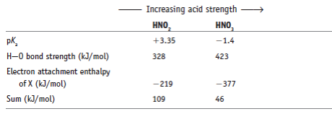
Molecular Structure, Bonding, & Acid–Base Behavior
Comparing Oxoacids: HNO₂ and HNO₃
In all the series of related oxoacid compounds, the acid strength increases as the number of oxygen atoms bonded to the central element increases.
Thus, nitric acid (HNO₃) is a stronger acid than nitrous acid (HNO₂).

Slide 61
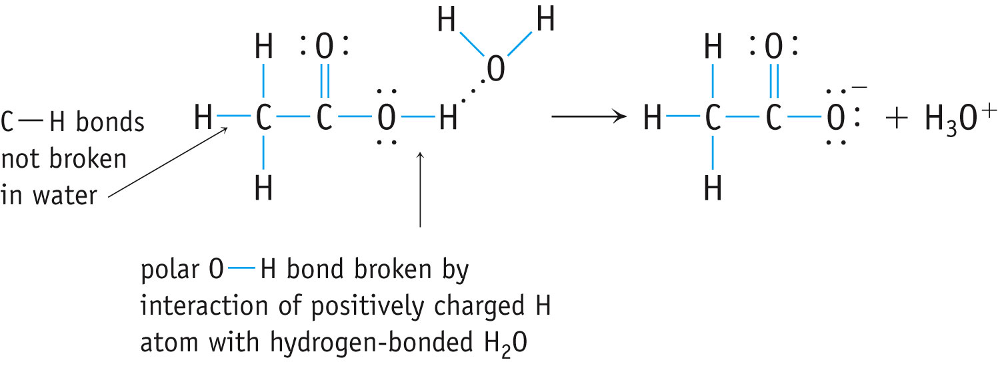
Molecular Structure, Bonding, & Acid–Base Behavior
Why Are Carboxylic Acids Brønsted Acids?
There is a large class of organic acids, all like acetic acid (CH₃CO₂H) have the carboxylic acid group, −CO₂H
They are collectively called carboxylic acids.

Slide 62
Molecular Structure, Bonding, & Acid–Base Behavior
Why Are Carboxylic Acids Brønsted Acids?
The carboxylate anion is stabilized by resonance.

Slide 63
Lewis Acids
Lewis acids are defined as electron-pair acceptors.
Atoms with an empty valence orbital can be Lewis acids.
Lewis structure-central atom is missing a pair of electrons
Example: metal cations, non-metal oxides-CO₂

Slide 64
Lewis Bases
Lewis bases are defined as electron-pair donors.
Anything that could be a Brønsted-Lowry base is a Lewis base.
Lewis bases can interact with things other than protons, however.
Lewis dot structure exhibits lone pair electrons on central atom. Example: NH₃, H₂O

Slide 65
Lewis Acid/Base
General equation for a Lewis acid-base reaction:
A _{(acid)} + B: _{(base)} → BA_{(adduct)}
The A-B adduct is called a coordinate covalent bond.
ex: formation of the hydronium ion (H₃O⁺),
H⁺ = Lewis Acid
H₂O = Lewis Base
H₃O⁺ = Adduct

Slide 66
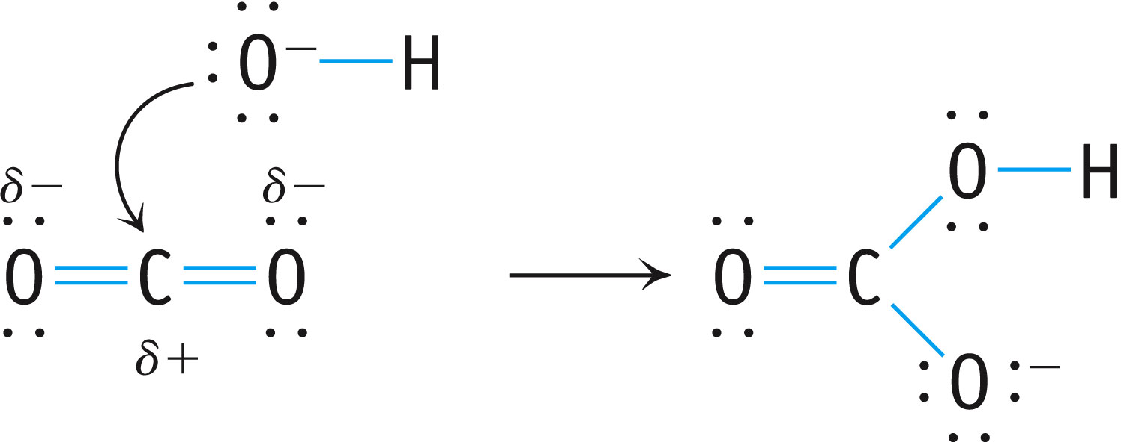
p. 794

Slide 67
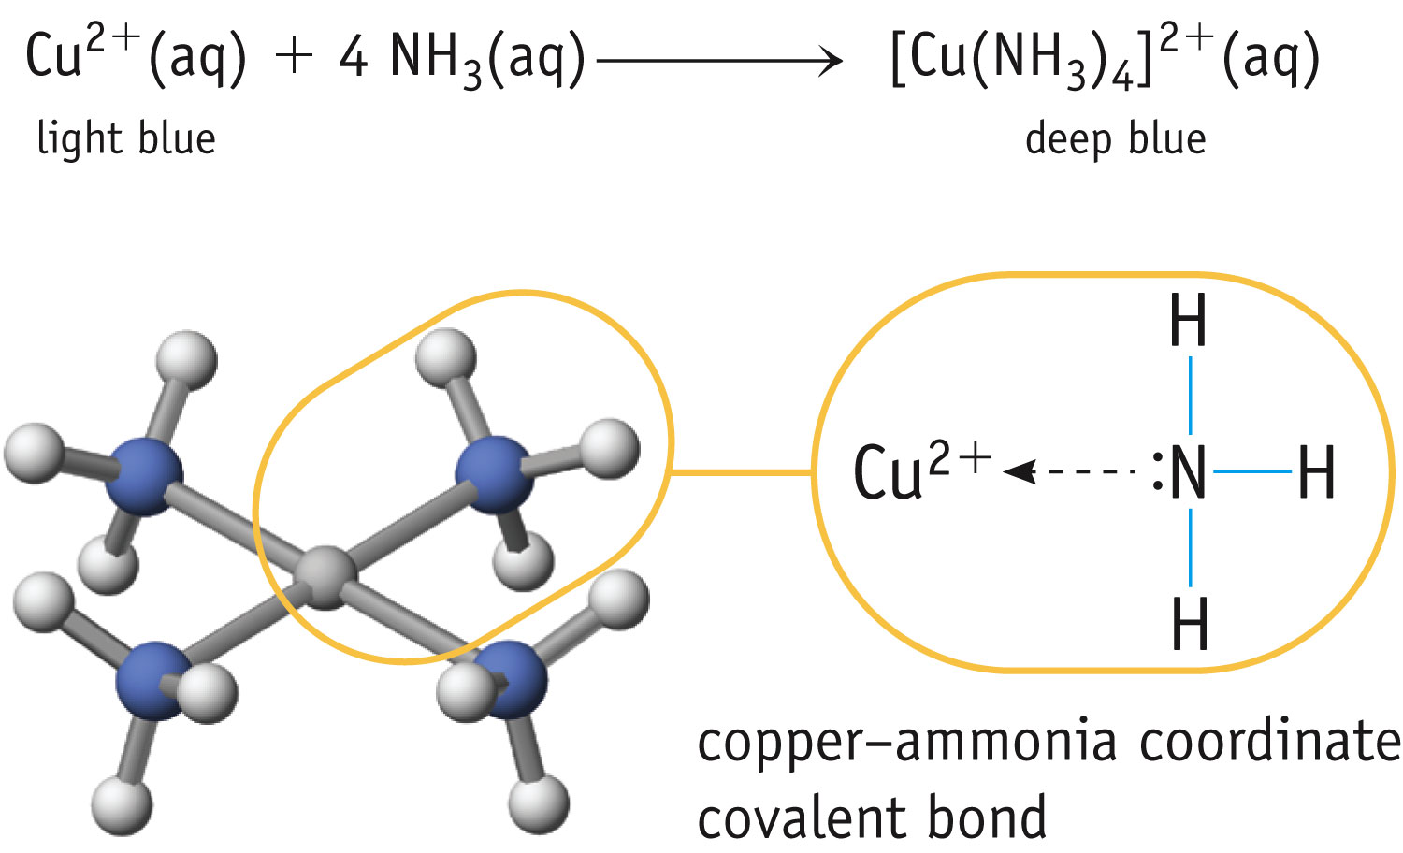
p. 792

Slide 68
Unique adduct compounds involving transition metals.
Generally characterized by their colors.
Fig. 17-11, p. 792

