Slide 1
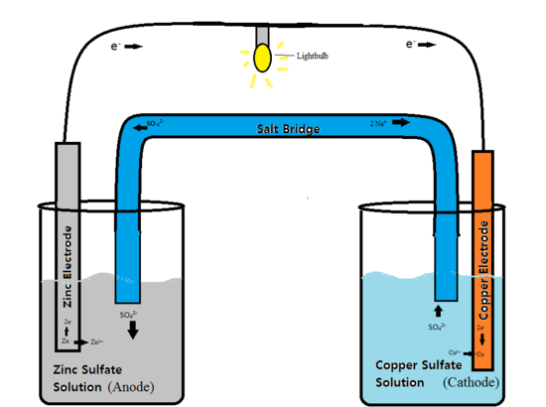
Chapter 20:
Electrochemistry

Slide 2
Electrochemical Reactions
In electrochemical reactions, electrons are transferred from one species to another.

Slide 3
Oxidation Numbers
In order to keep track of what loses electrons and what gains them, we assign oxidation numbers.

Slide 4
Oxidation and Reduction
A species is oxidized when it loses electrons.
Here, zinc loses two electrons to go from neutral zinc metal to the Zn²⁺ ion.

Slide 5
Oxidation and Reduction
A species is reduced when it gains electrons.
Here, each of the H⁺ gains an electron, and they combine to form H₂.

Slide 6
Voltaic Cells
In spontaneous oxidation-reduction (redox) reactions, electrons are transferred and energy is released.

Slide 7
Voltaic Cells
We can use that energy to do work if we make the electrons flow through an external device.
We call such a setup a voltaic cell.

Slide 8
Voltaic Cells
A typical cell looks like this.
The oxidation occurs at the anode.
The reduction occurs at the cathode.

Slide 9
Voltaic Cells
Once even one electron flows from the anode to the cathode, the charges in each beaker would not be balanced and the flow of electrons would stop.

Slide 10
Voltaic Cells
Therefore, we use a salt bridge, usually a U-shaped tube that contains a salt solution, to keep the charges balanced.
Cations move toward the cathode.
Anions move toward the anode.

Slide 11
Voltaic Cells
In the cell, then, electrons leave the anode and flow through the wire to the cathode.
As the electrons leave the anode, the cations formed dissolve into the solution in the anode compartment.

Slide 12
Voltaic Cells
As the electrons reach the cathode, cations in the cathode are attracted to the now negative cathode.
The electrons are taken by the cation, and the neutral metal is deposited on the cathode.

Slide 13
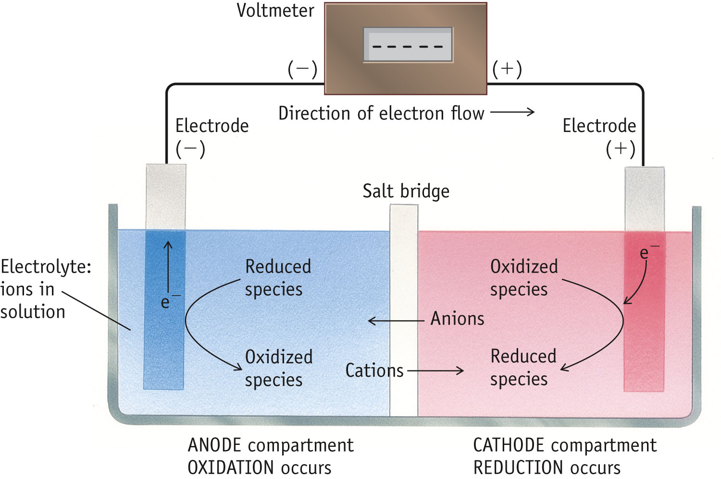
Terminology for Voltaic Cells

Slide 14
Electromotive Force (emf)
Water only spontaneously flows one way in a waterfall.
Likewise, electrons only spontaneously flow one way in a redox reaction—from higher to lower potential energy.

Slide 15
Electromotive Force (emf)
The potential difference between the anode and cathode in a cell is called the electromotive force (emf).
It is also called the cell potential and is designated E_{cell}.
Cell potential is measured in volts (V).
1 V = 1 J/C

Slide 16
Standard Reduction Potentials
Reduction potentials for many electrodes have been measured and tabulated.

Slide 17
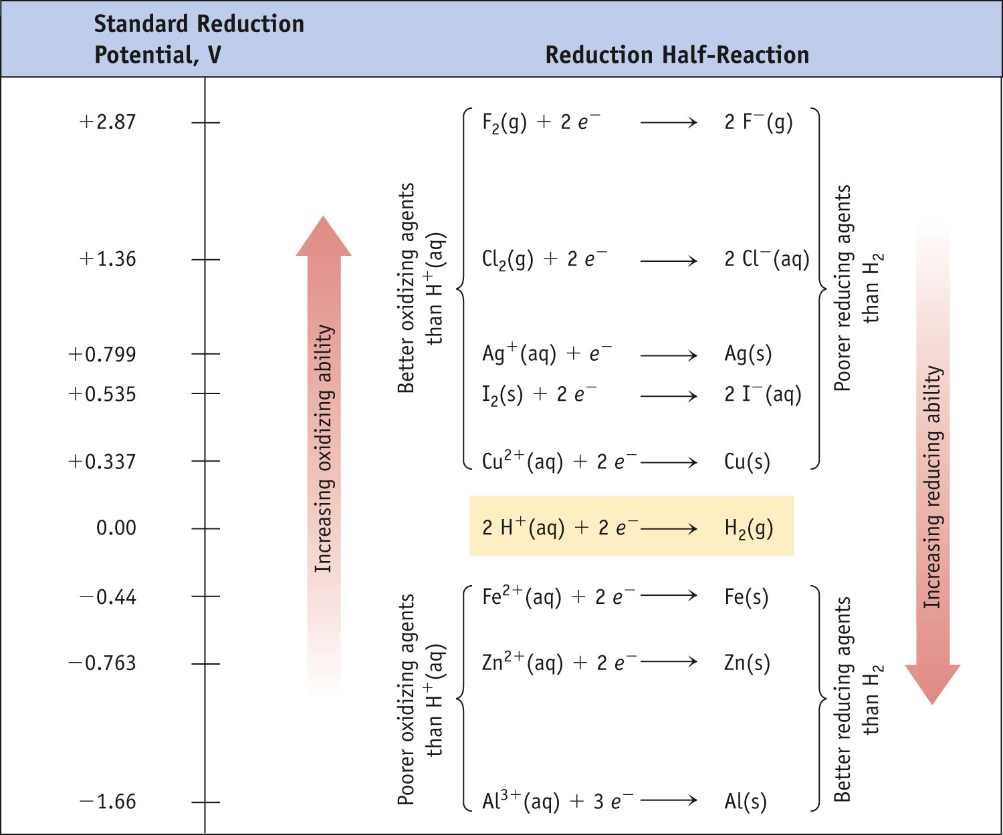
Potential Ladder for Reduction Half-Reactions
Stronger oxidizing agents
Stronger reducing agents

Slide 18
Standard Cell Potentials
The cell potential at standard conditions can be found through this equation:
°
°
°
E_{cell}
= E_{red} (cathode) − E_{red} (anode)
(also written as: E _{reduction} + E_{oxidation})
Because cell potential is based on the potential energy per unit of charge, it is an intensive property (amount is not a factor when calculating).

Slide 19
E _{cell} & Spontaneity
Under standard conditions:
25 C
1 atm pressure
1M concentration
E_{cell}> 0 = spontaneous
E _{cell} < 0 = non spontaneous
E _{cell} = 0 system as at equilibrium

Slide 20
Cell Potentials
For the oxidation in this cell,
For the reduction,
°
E_{red} = −0.76 V
°
E_{red} = +0.34 V

Slide 21
Cell Potentials
°
°
°
E_{cell}
=
E_{red}
(cathode) −
E_{red}
(anode)
= +0.34 V − (−0.76 V)
= +1.10 V

Slide 22
Oxidizing and Reducing Agents
The strongest oxidizers have the most positive reduction potentials.
The strongest reducers have the most negative reduction potentials.

Slide 23
Oxidizing and Reducing Agents
The greater the difference between the two, the greater the voltage of the cell.

Slide 24
Standard Hydrogen Electrode
Their values are referenced to a standard hydrogen electrode (SHE).
By definition, the reduction potential for hydrogen is 0 V:
2 H⁺ (aq, 1M) + 2 e⁻ ⎯⎯→ H₂ (g, 1 atm)

Slide 25
Cell Notation
Shorthand notation for describing the voltaic cell:
Anode information ll Cathode information
Ex: Cu(s)lCu2+ (aq 1.0M)ll Ag+ (aq, 1.0M)lAg(s)
Cell notation also applies when the metal(s) is not part of the reaction and an inert (non-reactive) electrode is used)
Ex: Pt_{(s)}l H_{2(g)} lH⁺_{(aq)} ll Ag⁺_{(aq)}l Ag_{(s)}

Slide 26
Example: Volatic cell with inert electrode

Slide 27
Voltaic Cells and Standard Reduction Potential
Sketch the diagram for the voltaic cell under standard conditions using the following half-cells.
Cu(s) + Ag⁺(aq) → Cu²⁺⁽aq) + Ag(s)
2. Write a balanced equation for the overall reaction.
3. Give the standard line notation for each cell (cell notation).
4. Calculate the Eº values for the cells using standard reduction potentials and the following equation:
Eº_{cell} = Eº_{red Cathode} - Eº_{red anode}
5. Determine if the process is spontaneous (E >0)

Slide 28
Free Energy
ΔG (Gibb’s free energy) for a redox reaction can be found by using the equation:
ΔG = −nFE
where n is the number of moles of electrons transferred, and F is a constant, the Faraday.
1 F = 96,485 C/mol e⁻ -or- 1F = 96,485 J/V-mol e⁻

Slide 29
Free Energy
Under standard conditions,
Standard conditions = 1 atm, 25°C, [1M] concentrations
ΔG° = −nFE°

Slide 30
Free Energy and electrochemistry
Based on the following relationships:
ΔG◦ = - nFE◦, ΔG◦ = -RTlnK
Calculate the ΔG◦ and K at 25◦C for the reaction previously described.
Cu(s) + 2Ag⁺ → Cu²⁺ + 2Ag(s) E_{cell} = 0.46V

Slide 31
Nernst Equation
Remember that
ΔG = ΔG° + RT ln Q
This means
−nFE = −nFE° + RT ln Q

Slide 32
Nernst Equation
Dividing both sides by −nF, we get the Nernst equation:
RT
nF
E = E° −
ln Q
or, using base-10 logarithms,
2.303 RT
nF
E = E° −
log Q

Slide 33
Nernst Equation
At room temperature (298 K),
2.303 RT
F
= 0.0592 V
Thus the equation becomes
0.0592
n
E = E° −
log Q

Slide 34
Nernst Equation:
Using the same system as in the previous problems, identify the voltage (E) when the concentration is altered
[Cu²⁺] = 0.75M
[Ag⁺] = 0.50M

Slide 35
Concentration Cells
Notice that the Nernst equation implies that a cell could be created that has the same substance at both electrodes.
For such a cell,
E_{cell}
would be 0, but Q would not.
°
Therefore, as long as the concentrations are different, E will not be 0.

Slide 36
Nernst Equation:
Concentration cell:
Consider the concentration cell in which both chambers contain a silver electrode and a solution containing Ag+ ions. The left compartment contains [Ag+] at standard conditions of 1M, 25 ◦ C and I atm.
Calculate the cell potential at 25◦C when the concentration of Ag+ in the compartment on the right is the following:
a. 1.0M
b. 2.0M
c. 0.10M

Slide 37
Commercial Voltaic Cells:
Requirements:
Compact, robust
Provide a constant voltage
Concentrated to produce current over prolonged use.
Rechargeable
Primary batteries: cannot be recharged
Secondary batteries: rechargeable
(reaction in the battery can be reversed)

Slide 38
Common battery chemistries :
Zinc-carbon battery (primary): The zinc-carbon chemistry is common in many inexpensive AAA, AA, C and D dry cell batteries. The anode is zinc, the cathode is manganese dioxide, and the electrolyte is ammonium chloride or zinc chloride.
Alkaline battery (primary): This chemistry is also common in AA, C and D dry cell batteries. The cathode is composed of a manganese dioxide mixture, while the anode is a zinc powder. It gets its name from the potassium hydroxide electrolyte, which is an alkaline substance.
Lithium-ion battery (rechargeable): Lithium chemistry is often used in high-performance devices, such as cell phones, digital cameras and even electric cars. A variety of substances are used in lithium batteries, but a common combination is a lithium cobalt oxide cathode and a carbon anode.
Lead-acid battery (rechargeable): This is the chemistry used in a typical car battery. The electrodes are usually made of lead dioxide and metallic lead, while the electrolyte is a sulfuric acid solution.
http://electronics.howstuffworks.com/everyday-tech/battery3.htm

Slide 39
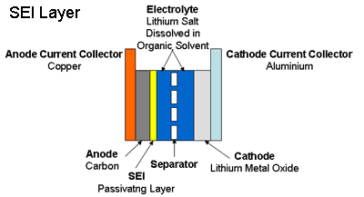
Batteries, cont.
Lithium-ion battery
Dry cell battery (zinc/carbon)

Slide 40
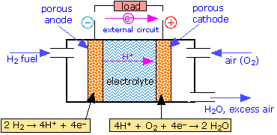
Fuel Cells:
Reactants supplied from an external reservoir.
Example: hydrogen-oxygen fuel cell
Net reaction: 2H₂ + O₂ → 2H₂O

