Slide 1
Chapter One Chemical Foundations
Scientific Math and Measurement
Significant Figures
Dimensional Analysis
Classification of Matter

Slide 2
SI Units
Système International d’Unités
A different base unit is used for each quantity.

Slide 3
Metric System
Prefixes convert the base units into units that are appropriate for the item being measured.

Slide 4
Volume
The most commonly used metric units for volume are the liter (L) and the milliliter (mL).
A liter is a cube 1 dm long on each side.
A milliliter is a cube 1 cm long on each side.

Slide 5
Temperature
By definition temperature is a measure of the average kinetic energy of the particles in a sample.

Slide 6
Temperature
In scientific measurements, the Celsius and Kelvin scales are most often used.
The Celsius scale is based on the properties of water.
0°C is the freezing point of water.
100°C is the boiling point of water.

Slide 7
Temperature
The Kelvin is the SI unit of temperature.
It is based on the properties of gases.
There are no negative Kelvin temperatures.
K = °C + 273.15

Slide 8
Temperature
The Fahrenheit scale is not used in scientific measurements.
°F = 9/5(°C) + 32
°C = 5/9(°F − 32)

Slide 9
Exact Numbers:
Exact numbers are defined numbers or result from a count.
An exact number has absolutely no uncertainty in it.
Exact numbers cannot be simplified.
Conversion factor are considered exact numbers.

Slide 10
Uncertainty in Measurements
Different measuring devices have different uses and different degrees of accuracy.

Slide 11
Measured values & uncertainty
All measurements have a degree uncertainty.
When recording these measurements, scientists are allowed to include one degree of uncertainty in the measurement.

Slide 12
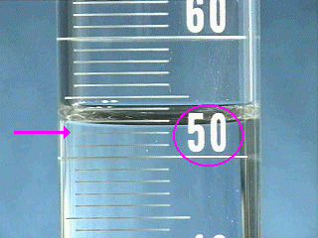
Measured Values & Uncertainty
There are two unlabeled graduations below the meniscus, and each graduation represents 1 mL, so the certain digits of the reading are…
52 mL.

Slide 13
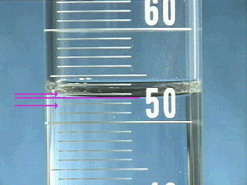
Estimate the uncertain digit and take a reading
The meniscus is about eight tenths of the way to the next graduation, so the final digit in the reading is .
0.8 mL
The volume in the graduated cylinder is
52.8 mL.

Slide 14
Significant Figures
The term significant figures refers to digits that were measured (including our exact values and one degree of uncertainty).
When rounding calculated numbers, we pay attention to significant figures so we do not overstate the accuracy of our answers.

Slide 15
Significant Figures
All nonzero digits are significant.
Zeroes between two significant figures are themselves significant.
Zeroes at the beginning of a number are never significant.
Zeroes at the end of a number are significant if a decimal point is written in the number.

Slide 16
Determine the Number of Significant Figures:
21.45
6084
.000125
1100
1100.0

Slide 17
Check your work:
21.45 (4)
6084 (4)
.000125 (3)
1100 (2)
1100.0 (5)

Slide 18
Significant Figures
When addition or subtraction is performed, answers are rounded to the least significant decimal place.
When multiplication or division is performed, answers are rounded to the number of digits that corresponds to the least number of significant figures in any of the numbers used in the calculation.

Slide 19
Complete the following calculations in the correct number of significant figures.
90.70 x 2.6 =
1980 – 587.3 =
3. (3.01 + 4.190) x 0.602=

Slide 20
Check your work:
94.70 x 2.9 = 270
1980 – 587.3 = 1393
3. (3.0 + 4.190) x 0.602= 0.34

Slide 21
Accuracy versus Precision
Accuracy refers to the proximity of a measurement to the true value of a quantity.
Precision refers to the proximity of several measurements to each other.

Slide 22
Dimensional Analysis
We use dimensional analysis to convert one quantity to another.
Most commonly dimensional analysis utilizes conversion factors (e.g., 1 in. = 2.54 cm)
1 in.
2.54 cm
or
2.54 cm
1 in.

Slide 23
Dimensional Analysis
Use the form of the conversion factor that puts the sought-for unit in the numerator.
desired unit
Given unit ×
= desired unit
given unit
Conversion factor

Slide 24
Dimensional Analysis
For example, to convert 8.00 m to inches,
convert m to cm
convert cm to in.
100 cm
1 in.
8.00 m
×
×
=
315 in.
1 m
2.54 cm
The measured value (8.00 m) will dictate the number of significant figures recorded. The other values are considered to be exact numbers (conversion factor)

Slide 25
Practice: Dimensional Analysis
Convert the following:
(English/metric conversions can be found in the back cover of the textbook)
0.0550 mi to meters.
0.510 in./ms to km/hr
22.50 gal/min to L/s

Slide 26
Check your work:
0.0550 mi 1000 m = 88.5 m (3 sig figs)
0.62137 mi
0.510 in 2.54 cm 1 km 1000ms 3600s = 46.6 km/hr
1 ms 1 in 1x10⁵cm 1 s 1 hr
22.50 gal. 4 qts. 1 L 1 min = 1.419 L/s
1 min 1 gal 1.057 qts. 60 s

Slide 27
Matter
We define matter as anything that has mass and takes up space.

Slide 28
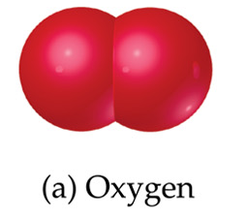
Matter
Atoms are the building blocks of matter.
Each element is made of the same kind of atom.
A compound is made of two or more different kinds of elements.

Slide 29
States of Matter

Slide 30
Properties and Changes of Matter

Slide 31
Types of Properties
Physical Properties…
Can be observed without changing a substance into another substance.
Boiling point, density, mass, volume, etc.
Chemical Properties…
Can only be observed when a substance is changed into another substance.
Flammability, corrosiveness, reactivity with acid, etc.

Slide 32
Types of Properties
Intensive Properties…
Are independent of the amount of the substance that is present.
Density, boiling point, color, etc.
Extensive Properties…
Depend upon the amount of the substance present.
Mass, volume, energy, etc.

Slide 33
Types of Changes
Physical Changes
These are changes in matter that do not change the composition of a substance.
Changes of state, temperature, volume, etc.
Chemical Changes
Chemical changes result in new substances.
Combustion, oxidation, decomposition, etc.

Slide 34
Separation of Mixtures (based on physical properties)

Slide 35
Classification of Matter

Slide 36
Distillation
Distillation uses differences in the boiling points of substances to separate a homogeneous mixture into its components.

Slide 37
Filtration
In filtration solid substances are separated from liquids and solutions.

Slide 38
Chromatography
This technique separates substances on the basis of differences in solubility in a solvent.

