Slide 1
Chapter 15
Chemical Kinetics:
The Rate of Chemical Reactions

Slide 2
Kinetics
In kinetics we study the rate at which a chemical process occurs.
Besides information about the speed at which reactions occur, kinetics also sheds light on the reaction mechanism (exactly how the reaction occurs).

Slide 3
Factors That Affect Reaction Rates
Physical State of the Reactants
In order to react, molecules must come in contact with each other.
The more homogeneous the mixture of reactants, the faster the molecules can react.

Slide 4
Factors That Affect Reaction Rates
Concentration of Reactants
As the concentration of reactants increases, so does the likelihood that reactant molecules will collide.

Slide 5
Factors That Affect Reaction Rates
Temperature
At higher temperatures, reactant molecules have more kinetic energy, move faster, and collide more often and with greater energy.
Presence of a Catalyst
Catalysts speed up reactions by changing the mechanism of the reaction.
Catalysts are not consumed during the course of the reaction.

Slide 6
Reaction Rates
Rates of reactions can be determined by monitoring the change in concentration of either reactants or products as a function of time.

Slide 7
Reaction Rates
C₄H₉Cl(aq) + H₂O(l) ⎯⎯→ C₄H₉OH(aq) + HCl(aq)
In this reaction, the concentration of butyl chloride, C₄H₉Cl, was measured at various times.

Slide 8
Reaction Rates
C₄H₉Cl(aq) + H₂O(l) ⎯⎯→ C₄H₉OH(aq) + HCl(aq)
The average rate of the reaction over each interval is the change in concentration divided by the change in time:
Δ[C₄H₉Cl]
Δt
Average rate =

Slide 9
Reaction Rates
C₄H₉Cl(aq) + H₂O(l) ⎯⎯→ C₄H₉OH(aq) + HCl(aq)
Note that the average rate decreases as the reaction proceeds.
This is because as the reaction goes forward, there are fewer collisions between reactant molecules.

Slide 10
Reaction Rates
C₄H₉Cl(aq) + H₂O(l) ⎯⎯→ C₄H₉OH(aq) + HCl(aq)
A plot of [C₄H₉Cl] vs. time for this reaction yields a curve like this.
The slope of a line tangent to the curve at any point is the instantaneous rate at that time.

Slide 11
Reaction Rates
C₄H₉Cl(aq) + H₂O(l) ⎯⎯→ C₄H₉OH(aq) + HCl(aq)
All reactions slow down over time.
Therefore, the best indicator of the rate of a reaction is the instantaneous rate near the beginning of the reaction.

Slide 12
Reaction Rates and Stoichiometry
Reaction rates can be monitored by following either the loss (-) of reactants or the production (+) of products as generalized below:
aA + bB
cC + dD
1
a
Δ[A]
Δt
1
b
Δ[B]
Δt
1
c
Δ[C]
Δt
1
d
Δ[D]
Δt
Rate = −
= −
=
=

Slide 13
Reaction Rates and Stoichiometry
Describe the stoichiometric relationship for the disappearance of reactants and the formation of product in the following balanced equation:
2HI _{(g)} → H_{2(g)} + I₂ _{(g)}

Slide 14
Concentration and Rate
NH₄⁺(aq) + NO₂⁻(aq)
N₂(g) + 2 H₂O(l)
We can gain information about the rate of a reaction by seeing how the rate changes with changes in concentration.
If we compare Experiments 1 and 2, we see that when [NH₄⁺] doubles, the initial rate doubles.

Slide 15
Concentration and Rate
NH₄⁺(aq) + NO₂⁻(aq)
N₂(g) + 2 H₂O(l)
Likewise, when we compare Experiments 5 and 6, we see that when [NO₂⁻] doubles, the initial rate doubles.

Slide 16
Concentration and Rate
This means
Rate ∝ [NH₄⁺]
Rate ∝ [NO₂⁻]
Rate ∝ [NH₄⁺] [NO₂⁻]
which, when written as an equation, becomes
Rate = k [NH₄⁺] [NO₂⁻]
This equation is called the rate law, and k is the rate constant.
Therefore,

Slide 17
Rate Laws
A rate law shows the relationship between the reaction rate and the concentrations of reactants.
The exponents tell the order of the reaction with respect to each reactant.
Since the rate law is
Rate = k [NH₄⁺] [NO₂⁻]
the reaction is
First-order in [NH₄⁺] and
First-order in [NO₂⁻].

Slide 18
Rate Laws
Rate = k [NH₄⁺] [NO₂⁻]
The overall reaction order can be found by adding the exponents on the reactants in the rate law.
This reaction is second-order overall.

Slide 19
Rate Law and Order or Reaction
0 order- the rate is independent of [reactant]
1st order- rate = [reactant]
2nd order- rate ∝ [reactant]²
3rd order- rate ∝ [reactant]³

Slide 20
Rate Law and Oder of Reaction
Since rate is defined as change in concentration (molarity)/time (s). The unit for k will vary based on the order of the reaction.
0 order: k = mole/L • s
1st order: k = 1/s
2nd order: k = L/mole • s
3rd order: k = L²/mole² • s

Slide 21
Rate Law and reactant concentration
reaction: N₂O₅→ 4NO₂ + O₂
Rate Law Equation: Rate = k [N₂O₅]¹
At 64°C, the rate constant = 4.82 x 10⁻³s-1
Determine the reaction rate when [N₂O₅] = 0.0240M.
What is the rate when the concentration is doubled ?

Slide 22
Determination of the rate law for a reaction: (role of concentration of reaction rate)
reaction: 2A + 3B → 2C
Rate Law Equation: Rate = k [A]^{m}[B]^{n}
Data:
Trial | [A] | [B] | Initial Rate (mole/L.s)
1 | 0.0010 | 0.0030 | 0.0020
2 | 0.0020 | 0.0030 | 0.0040
3 | 0.0010 | 0.0090 | 0.018
Solve for: m, n and k

Slide 23
Integrated Rate Law
Relates concentration to reaction time and expresses the concentration of reactant as a function of time.
Fits to a linear form ( y= mx +b)
Based on natural long (ln) base number e = 2.7183

Slide 24
Integrated Rate Laws
Using calculus to integrate the rate law for a first-order process gives us
[A]_{t}
[A]₀
ln
= −kt
Where
[A]₀ is the initial concentration of A, and
[A]_{t} is the concentration of A at some time, t, during the course of the reaction.

Slide 25
Integrated Rate Laws
Manipulating this equation produces…
[A]_{t}
[A]₀
ln
= −kt
ln [A]_{t} − ln [A]₀ = − kt
ln [A]_{t} = − kt + ln [A]₀
…which is in the form
y = mx + b

Slide 26
Integrated Rate Laws
Manipulating this equation produces…
[A]_{t}
[A]₀
ln
= −kt
ln [A]_{t} − ln [A]₀ = − kt
ln [A]_{t} = − kt + ln [A]₀
…which is in the form
y = mx + b

Slide 27
First-Order Processes
ln [A]_{t} = -kt + ln [A]₀
Therefore, if a reaction is first-order, a plot of ln [A] vs. t will yield a straight line, and the slope of the line will be -k.

Slide 28
First-Order Processes
CH₃NC
CH₃CN
This data was collected for this reaction at 198.9 °C.

Slide 29
First-Order Processes
When ln P is plotted as a function of time, a straight line results.
Therefore,
The process is first-order.
k is the negative of the slope: 5.1 × 10⁻⁵ s⁻¹.

Slide 30
Second-Order Processes
Similarly, integrating the rate law for a process that is second-order in reactant A, we get
1
[A]_{t}
1
[A]₀
= kt +
also in the form
y = mx + b

Slide 31
Second-Order Processes
1
[A]_{t}
1
[A]₀
= kt +
So if a process is second-order in A, a plot of vs. t will yield a straight line, and the slope of that line is k.
1
[A]

Slide 32
Second-Order Processes
The decomposition of NO₂ at 300°C is described by the equation
NO₂ (g)
1
2
NO (g) + O₂ (g)
and yields data comparable to this:
Time (s) | [NO₂], M
0.0 | 0.01000
50.0 | 0.00787
100.0 | 0.00649
200.0 | 0.00481
300.0 | 0.00380

Slide 33
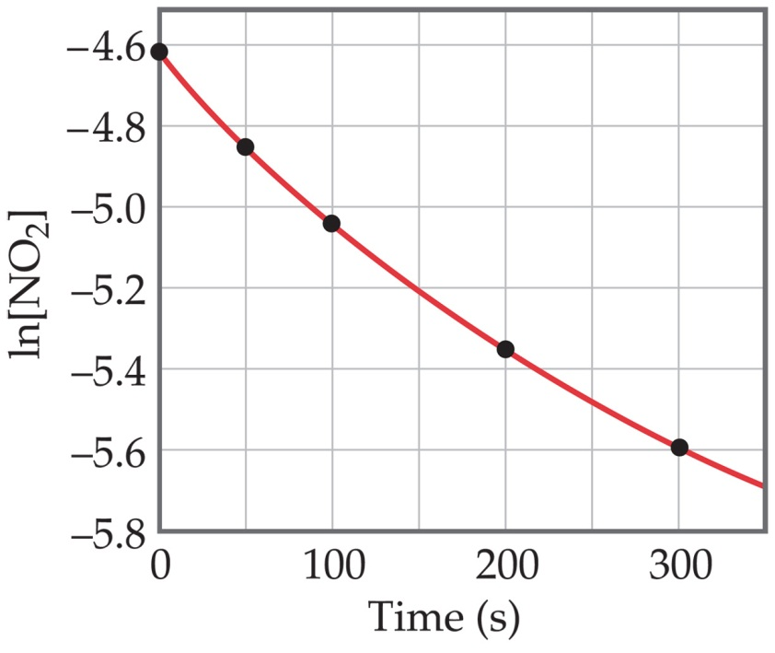
Second-Order Processes
Plotting ln [NO₂] vs. t yields the graph at the right.
The plot is not a straight line, so the process is not first-order in [A].
Time (s) | [NO₂], M | ln [NO₂]
0.0 | 0.01000 | −4.610
50.0 | 0.00787 | −4.845
100.0 | 0.00649 | −5.038
200.0 | 0.00481 | −5.337
300.0 | 0.00380 | −5.573

Slide 34
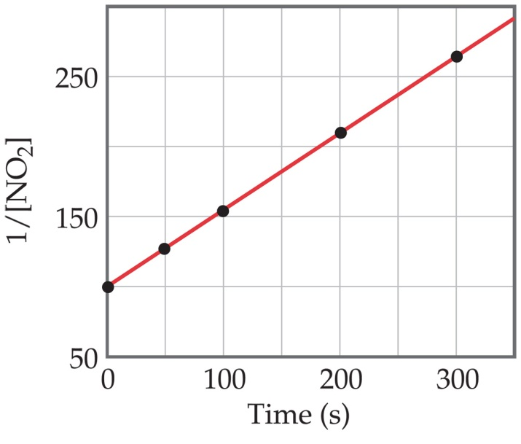
Second-Order Processes
1
[NO₂]
Graphing ln vs. t, however, gives this plot.
Because this is a straight line, the process is second-order in [A].
Time (s) | [NO₂], M | 1/[NO₂]
0.0 | 0.01000 | 100
50.0 | 0.00787 | 127
100.0 | 0.00649 | 154
200.0 | 0.00481 | 208
300.0 | 0.00380 | 263

Slide 35
Summary: Integrated rate law
Order | Rate Equation | Integrated Rate Equation | Straight Line Plot | Slope | k Units
0 | Rate = k[R]⁰ | [R]_{o} - [R]_{t} = kt | [R]_{t} vs. t | -k | mol/L⋅s
1 | Rate = k[R]¹ | ln([R]_{o}/[R]_{t}) = kt | ln[R]_{t} vs. t | -k | s⁻¹
2 | Rate = k[R]² | (1/[R]_{t}) - (1/[R]_{o}) = kt | 1/[R]_{t} vs. t | k | L/mol⋅s
 |  |  | memorize this!
Half-Life and First-Order Reactions:
(radioactivity is a first-order reaction)
ln becomes ln(2) = kt_{½}
ln(2) = 0.693
so… k = 0.693/ t_{½} and t_{½} = 0.693/k

Slide 36
Sample problem:
At 150°C the decomposition of acetaldehyde CH₃CHO to methane is a first order reaction.
If the rate constant for the reaction at 150°C is 0.029 min⁻¹, how long does it take a concentration of 0.050 mol L⁻¹ of acetaldehyde to reduce to a concentration of 0.040 mol L⁻¹?

Slide 37
Half-Life
Half-life is defined as the time required for one-half of a reactant to react.
Because [A] at t_{1/2} is one-half of the original [A],
[A]_{t} = 0.5 [A]₀.

Slide 38
Reaction Half-Life: 1st Order Kinetics
at time = t_{½}
For a first order process the half life (t_{½} ) is found mathematically from:
Start with the integrated rate law expression for a 1st order process
Bring the concentration terms to one side.
Express the concentration terms as a fraction using the rules of ln.

Slide 39
Reaction Half-Life: 1st Order Kinetics
exchange [A] with [A]₀ to reverse the sign of the ln term and cancel the negative sign in front of k
Substitute the value of [A] at the half-life

Slide 40
Half-Life
For a first-order process, this becomes
0.5 [A]₀
[A]₀
ln
= −kt_{1/2}
ln 0.5 = −kt_{1/2}
−0.693 = −kt_{1/2}
0.693
k
= t_{1/2}
NOTE: For a first-order process, then, the half-life does not depend on [A]₀.

Slide 41
Half-Life
For a second-order process,
1
0.5 [A]₀
1
[A]₀
= kt_{1/2} +
2
[A]₀
1
[A]₀
= kt_{1/2} +
2 − 1
[A]₀
1
[A]₀
=
= kt_{1/2}
1
k[A]₀
= t_{1/2}

Slide 42
Practice ½ life problem:
The gold-198 isotope has a half-life of 2.7 days.
If you start with 10 mg at the beginning of the week, how much remains at the end of the week, seven days later?

Slide 43
Temperature and Rate
Generally, as temperature increases, so does the reaction rate.
This is because k is temperature dependent.

Slide 44
The Collision Model
In a chemical reaction, bonds are broken and new bonds are formed.
Molecules can only react if they collide with each other.

Slide 45
The Collision Model
Furthermore, molecules must collide with the correct orientation and with enough energy to cause bond breakage and formation.

Slide 46
Activation Energy
In other words, there is a minimum amount of energy required for reaction: the activation energy, E_{a}.
Just as a ball cannot get over a hill if it does not roll up the hill with enough energy, a reaction cannot occur unless the molecules possess sufficient energy to get over the activation energy barrier.

Slide 47
Reaction Coordinate Diagrams
It is helpful to visualize energy changes throughout a process on a reaction coordinate diagram like this one for the rearrangement of methyl isonitrile.

Slide 48
Reaction Coordinate Diagrams
The diagram shows the energy of the reactants and products (and, therefore, ΔE).
The high point on the diagram is the transition state.
The species present at the transition state is called the activated complex.
The energy gap between the reactants and the activated complex is the activation energy barrier.

Slide 49
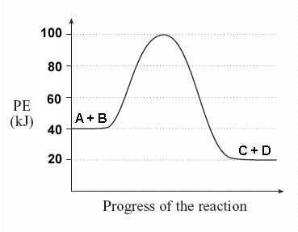
Activation Energy & Coordinate Diagram
Label the following diagram:

Slide 50
Maxwell–Boltzmann Distributions
Temperature is defined as a measure of the average kinetic energy of the molecules in a sample.
At any temperature there is a wide distribution of kinetic energies.

Slide 51
Maxwell–Boltzmann Distributions
As the temperature increases, the curve flattens and broadens.
Thus at higher temperatures, a larger population of molecules has higher energy.

Slide 52
Maxwell–Boltzmann Distributions
This fraction of molecules can be found through the expression
where R is the gas constant and T is the Kelvin temperature.
-E_{a}
RT
f = e

Slide 53
Arrhenius Equation
Svante Arrhenius developed a mathematical relationship between k and E_{a}:
k = A e
where A is the frequency factor, a number that represents the likelihood that collisions would occur with the proper orientation for reaction.
-E_{a}
RT

Slide 54
Arrhenius Equation
Taking the natural logarithm of both sides, the equation becomes
ln k = - ( ) + ln A
E_{a}
R
1
T
y = m x + b
Therefore, if k is determined experimentally at several temperatures, E_{a} can be calculated from the slope of a plot of ln k vs. .
1
T

Slide 55
Reaction Mechanisms
The sequence of events that describes the actual process by which reactants become products is called the reaction mechanism.

Slide 56
Reaction Mechanisms
Reactions may occur all at once or through several discrete steps.
Each of these processes is known as an elementary reaction or elementary process.

Slide 57
Reaction Mechanisms
The molecularity of a process tells how many molecules are involved in the process.

Slide 58
Multistep Mechanisms
In a multistep process, one of the steps will be slower than all others.
The overall reaction cannot occur faster than this slowest, rate-determining step.

Slide 59
Reaction Mechanism guidelines:
Molecularity describes the number of reactant molecules (or ions , atoms) that react in an elementary step. It is rare to have an elementary step that involves three reactants (termolecular)
The sum of the elementary steps must describe the chemical reaction.
The proposed reaction mechanism must support the experimentally determined reaction rate.
The rate of a reaction is determined by the slowest elementary step in the process.
For elementary steps, the coefficients describe the rate law exponents.

Slide 60
Slow Initial Step
CO (g) + NO₂ (g) ⎯⎯→ NO (g) + CO₂ (g)
The rate law for this reaction is found experimentally to be
Rate = k [NO₂]²
CO is necessary for this reaction to occur, but the rate of the reaction does not depend on its concentration.
This suggests the reaction occurs in two steps.

Slide 61
Possible reaction mechanisms:
Mechanism 1: single elementary step
CO(g) + NO₂(g) → CO₂(g) + NO(g)
rate equation: Rate = k [CO][NO₂]
Mechanism 2: two step
(slow) NO₂ + NO₂ →NO₃ +NO
(fast) NO₃ + CO → NO₂ + CO₂
rate equation: Rate = k[NO₂]²
Mechanism 3: two step
(slow) NO₂ →NO + O
(fast) CO + O → CO₂
rate equation: Rate = k [NO₂]

Slide 62
Slow Initial Step
A proposed mechanism for this reaction is
Step 1: NO₂ + NO₂ ⎯⎯→ NO₃ + NO (slow)
Step 2: NO₃ + CO ⎯⎯→ NO₂ + CO₂ (fast)
The NO₃ intermediate is consumed in the second step.
As CO is not involved in the slow, rate-determining step, it does not appear in the rate law.

Slide 63
What happens when there is an initial Fast Step?
2 NO (g) + Br₂ (g) ⎯⎯→ 2 NOBr (g)
The rate law for this reaction is found to be
Rate = k [NO]² [Br₂]
Because termolecular processes are rare, this rate law suggests a two-step mechanism.

Slide 64
Fast Initial Step
A proposed mechanism is
Step 1: NO + Br₂
NOBr₂ (fast)
Step 2: NOBr₂ + NO ⎯⎯→ 2 NOBr (slow)
Step 1 includes the forward and reverse reactions.

Slide 65
Fast Initial Step
The rate of the overall reaction depends upon the rate of the slow step.
The rate law for that step would be
Rate = k₂ [NOBr₂] [NO]
But how can we find [NOBr₂]?

Slide 66
Fast Initial Step
NOBr₂ can react two ways:
With NO to form NOBr
By decomposition to reform NO and Br₂
The reactants and products of the first step are in equilibrium with each other.
Therefore,
Rate_{f} = Rate_{r}

Slide 67
Fast Initial Step
Because Rate_{f} = Rate_{r} ,
k₁ [NO] [Br₂] = k₋₁ [NOBr₂]
Solving for [NOBr₂] gives us
k₁
k₋₁
[NO] [Br₂] = [NOBr₂]

Slide 68
Fast Initial Step
Substituting this expression for [NOBr₂] in the rate law for the rate-determining step gives
k₂k₁
k₋₁
Rate =
[NO] [Br₂] [NO]
= k [NO]² [Br₂]

Slide 69
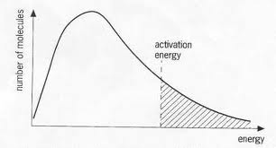
Catalysts
Catalysts increase the rate of a reaction by decreasing the activation energy of the reaction.
Catalysts change the mechanism by which the process occurs.

Slide 70
Enzymes
Enzymes are catalysts in biological systems.
The substrate fits into the active site of the enzyme much like a key fits into a lock.

