Slide 1
Intermolecular Forces (IMF) Chapter 12

Slide 2
States of Matter
The fundamental difference between states of matter is the distance between particles.

Slide 3
The States of Matter
The state a substance is in at a particular temperature and pressure depends on two antagonistic entities:
the kinetic energy of the particles;
the strength of the attractions between the particles.

Slide 4
Intermolecular Forces
The forces holding solids and liquids together are called intermolecular forces.
Intermolecular Forces are the attractions and repulsions between molecules.
They are NOT chemical bonds.
The intermolecular forces of a substance may exhibit are a function of:
charge (ions vs. neutrals)
polarity (molecular shape, dipoles)
molar mass

Slide 5
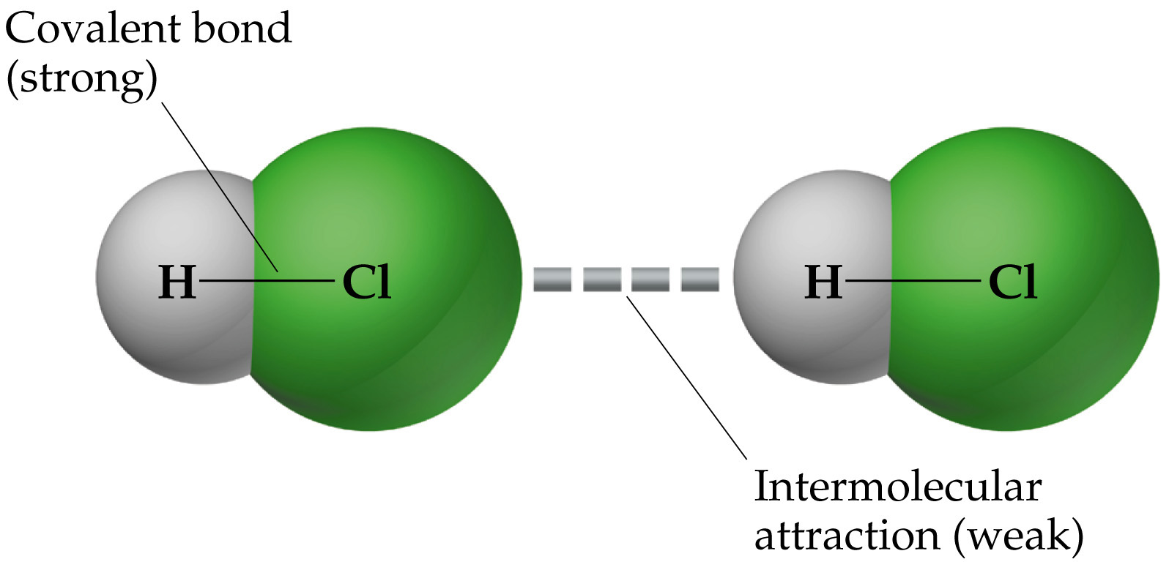
Covalent Bonding Forces for Comparison of Magnitude
20 to 30 kJ/mol
D_{(H-Cl)} = 432 kJ/mol
Intermolecular forces are much weaker than the covalent bonds that make up compounds.

Slide 6
Intermolecular Forces
They are, however, strong enough to control physical properties such as boiling and melting points, vapor pressures, and viscosities.

Slide 7
Intermolecular Forces
These intermolecular forces as a group are referred to as van der Waals forces.

Slide 8
IMF (intermolecular forces)
Properties of liquids influenced by IMF:
Vapor pressure
Boiling point (vaporization)
Melting point (fusion)
Viscosity
Surface tension
Adhesion/cohesion
Capillary action

Slide 9
Types of IMF:
Van der Waals forces:
Dipole-dipole interactions
Hydrogen bonding
London dispersion forces
Others attractive forces:
Ion-dipole
Ion- ion

Slide 10
Summarizing Intermolecular Forces

Slide 11
Dipole-Dipole Interactions
Molecules that have permanent dipoles are attracted to each other.
The positive end of one is attracted to the negative end of the other and vice-versa.
These forces are only important when the molecules are close to each other.

Slide 12
Dipole-Dipole Interactions
The more polar the molecule, the higher is its boiling point.

Slide 13
Hydrogen Bonding
The dipole-dipole interactions experienced when H is bonded to N, O, or F are unusually strong.
We call these interactions hydrogen bonds.

Slide 14
Hydrogen Bonding
Hydrogen bonding arises in part from the high electronegativity of nitrogen, oxygen, and fluorine.
Also, when hydrogen is bonded to one of those very electronegative elements, the hydrogen nucleus is exposed.

Slide 15
London Dispersion Forces
London dispersion forces, or dispersion forces, are attractions between an instantaneous dipole and an induced dipole.

Slide 16
London Dispersion Forces
These forces are present in all molecules, whether they are polar or nonpolar.
The tendency of an electron cloud to distort in this way is called polarizability.

Slide 17
Factors Affecting London Forces
The shape of the molecule affects the strength of dispersion forces: long, skinny molecules (like n-pentane tend to have stronger dispersion forces than short, fat ones (like neopentane).
This is due to the increased surface area in n-pentane.

Slide 18
Factors Affecting London Forces
The strength of dispersion forces tends to increase with increased molecular weight.
Larger atoms have larger electron clouds which are easier to polarize.

Slide 19
Which Have a Greater Effect? Dipole-Dipole Interactions or Dispersion Forces
If two molecules are of comparable size and shape, dipole-dipole interactions will likely the dominating force.
If one molecule is much larger than another, dispersion forces will likely determine its physical properties.

Slide 20
How Do We Explain This?
The nonpolar series (SnH₄ to CH₄) follow the expected trend.
The polar series follows the trend from H₂Te through H₂S, but water is quite an anomaly.
Water (H₂O) exhibits Hydrogen bonding, a very strong dipole-dipole interaction.

Slide 21
Type of IMF?
CH₄
CH₃Cl
CH₃OH
NaSO₄
H₂

Slide 22
IMF (intermolecular forces)
Properties of liquids influenced by IMF:
Vapor pressure
Boiling point (vaporization)
Melting point (fusion)
Viscosity
Surface tension
Adhesion/cohesion
Capillary action

Slide 23
Intermolecular Forces Affect Many Physical Properties
The strength of the attractions between particles can greatly affect the properties of a substance or solution.

Slide 24
Viscosity
Resistance of a liquid to flow is called viscosity.
It is related to the ease with which molecules can move past each other.
Viscosity increases with stronger intermolecular forces and decreases with higher temperature.

Slide 25
Surface Tension
Surface tension results from the net inward force experienced by the molecules on the surface of a liquid.

Slide 26
States of Matter & Phase Changes

Slide 27
Energy Changes Associated with Changes of State
The heat of fusion is the energy required to change a solid at its melting point to a liquid.

Slide 28
Energy Changes Associated with Changes of State
The heat of vaporization is defined as the energy required to change a liquid at its boiling point to a gas.

Slide 29
Energy Changes Associated with Changes of State
The heat added to the system at the melting and boiling points goes into pulling the molecules farther apart from each other.
The temperature of the substance does not rise during a phase change.

Slide 30
Vapor Pressure
The boiling point of a liquid is the temperature at which it’s vapor pressure equals atmospheric pressure.
The normal boiling point is the temperature at which its vapor pressure is 760 torr (1 atm).

Slide 31
Phase Diagrams
Phase diagrams display the state of a substance at various pressures and temperatures and the places where equilibria exist between phases.

Slide 32
Phase Diagram of Water
Note the high critical temperature and critical pressure.
These are due to the strong van der Waals forces (H-bonding) between water molecules.

Slide 33
Phase Diagram of Water
The slope of the solid-liquid line is negative.
This means that as the pressure is increased at a temperature just below the melting point, water goes from a solid to a liquid.

Slide 34
Phase Diagram of Carbon Dioxide
Carbon dioxide cannot exist in the liquid state at pressures below 5.11 atm; CO₂ sublimes at normal pressures.

Slide 35
Properties of Solids chapter 13

Slide 36
Properties of Solids:
Pure Solid
Crystalline
Amorphous
Atomic
Ionic
Molecular
Metallic
Network solid

Slide 37
Properties of solids
Type | Example | Structural unit | Forces | Properties
Ionic | NaCl, K2SO4 | (+)/(-) ions | Electrostatic attraction | Hard, brittle, high melting pt.
Metallic | Fe, Ag, Cu | Metal atoms [(+) ions surrounded by delocalized electrons.] | Electrostatic attraction | Malleable, ductile, conductive, range of MP & BP
Molecular | H₂, O₂, CH₄ | Molecules | van der Waals forces (dispersion, dipoloe-dipole, H-bond) | Low/mod. Melting points, poor conductors
Network | Graphite, diamond (C), Quartz, etc. (Si) | Atoms with infinite 2 or 3-D network | Covalent-directional electron pair bonds | Wide range of hardness & MP. Poor conductors of electricity (with some exceptions)
Amorphous | Glass, polyethlene (plastics) | Covalently bonded network with no crystalline structure | Covalent-directional electron pair bonds | Noncrystalline wide range mp. Poor conductors.

Slide 38
Identify the type of solid for each of the following substances:
C
CO₂
P₄
CH₃OH
Mo
NH₄Cl
Li₂O
H₂S

Slide 39
Answers:
C –atomic, covalent network
CO₂ – molecular (London dispersion)
P₄ - molecular
CH₃OH – molecular (H-Bonding)
Mo – atomic, metallic
NH₄Cl - ionic
Li₂O - ionic
H₂S – molecular (dipole-dipole)

Slide 40
Unit Cell: the smallest repeating unit of a solid.
Arrangement (repeating pattern) of crystal lattice:
Simple cube
Body centered cube
Face centered cube
Determining the number of atoms/unit cell=
# atoms total within cell + ½ # atoms in the face of cell + ¼ # atoms on the end of cell + 1/8 # of atoms at the corners of the unit cell.

Slide 41
Cubic Unit Cells
There are 7 basic crystal systems, but we will only be concerned with CUBIC form here.
All sides
equal length
1/8 of each atom on a corner is within the cube
1/2 of each atom on a face is within the cube
1/4 of each atom on a side is within the cube
All angles
are 90 degrees

Slide 42
Fig. 13-3bc, p. 585

Slide 43
Simple Cube:
# atoms = 8 x 1/8 atom of corner = 1 atom

Slide 44
Body Center Cubic Cell
# atoms = 1 center + 8 x 1/8 corner = 2 atoms

Slide 45
Face-centered Cubic Cell
# atoms = 6 x ½ face + 8 x 1/8 corner = 4 atoms

Slide 46
Space filled face-centered cubic cell:

Slide 47
Metallic Bonds
Metallic bonding is the force of attraction between valence electrons and the metal ions.

Slide 48
Metal Alloys
Brass: substitutional alloy of copper and zinc.
Bronze: substitutional alloy of copper and tin.
Steel: interstitial alloy of iron and carbon atoms

Slide 49
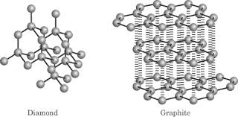
Network solids:
A network solid or covalent network solid is a chemical compound (or element) in which the atoms are bonded by covalent bonds in a continuous network extending throughout the material. In a network solid there are no individual molecules, and the entire crystal may be considered a macromolecule.

Slide 50
Ionic compounds and Lattice energy
Ionic compounds are typically hard, crystalline solids with high melting points due to the organized arrangement of ions in a crystal lattice.
Lattice energy describes the energy of formation of one mole of a solid crystalline ionic compounds when ions in the gas phase combine. ex. Na⁺_{(g)} + Cl⁻_{(g)} → NaCl_{(s)}
Remember: ΔH_{f}° = Na(s) + ½ Cl₂(g) → NaCl(s)
Born-Haber cycle- applies Hess’s law to the calculation of lattice energy.

Slide 51
Born-Haber cycle
Enthalpy calculation for ionic compound

Slide 52
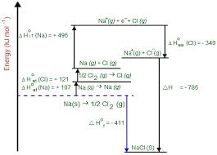
Born-Haber cycle for NaCl
Enthalpy considerations for the formation of NaCl(s)

