Slide 1
Chapter Six: The Structure of the atoms

Slide 2
Electromagnetic Radiation
To understand the electronic structure of atoms, one must understand the nature of electromagnetic radiation.
The distance between corresponding points on adjacent waves is the wavelength (λ).

Slide 3
Electromagnetic Radiation
The number of waves passing a given point per unit of time is the frequency (ν).
The frequency of light is represented by the Greek letter “nu”, ν
ν has units of “cycles per sec” or Hertz (s⁻¹)

Slide 4
Electromagnetic Radiation
All radiation obeys the relationship:
c = λ × ν
c = speed of light (constant)
= 2.9979 x 10⁸m/s
Long wavelength , low frequency
Short wavelength, high frequency
Wavelength and frequency are inversely proportional.

Slide 5
Electromagnetic Radiation
Wavelength has units of length: m… μm… nm… pm
Frequency has units of inverse time: s⁻¹ or Hz (hertz)
λ (m) × ν (s^{–1}) = c (m s^{–1})
Useful relationships:
or

Slide 6
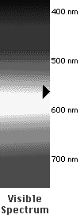
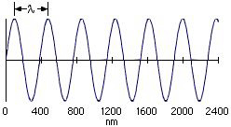
Electromagnetic Radiation
Long wavelength = low frequency
Short wavelength = high frequency
increasing frequency
increasing wavelength
Notes:
See Chapter 6 Video Presentation Slide 7

Slide 7
Electromagnetic Radiation
All electromagnetic radiation travels at the same velocity: the speed of light (c), 3.00 × 10⁸ m/s.
The spectral regions of the electromagnetic spectrum vary according to frequency and wavelength.

Slide 8
Electromagnetic Radiation
Sample Problem:
Visible red light has a wavelength (λ) of 685 nm,
calculate the frequency.

Slide 9
Quantization of Energy
The wave nature of light does not explain how an object can glow when its temperature increases.
Max Planck explained it by assuming that energy comes in packets called quanta.

Slide 10
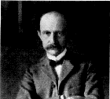
Quantization of Energy
An object can gain or lose energy by absorbing or emitting radiant energy in QUANTA. A quanta of energy is the smallest unit of energy that may be exchanged between oscillators or emitted as radiation. It is too small to be observed in the classical world in which we live.
Energy of radiation is proportional to frequency
E = h · ν
h = Planck’s constant = 6.6262 x 10⁻³⁴ J·s

Slide 11
Planck’s Law
and
yields:
As the frequency of light increases, the energy of the photon increases (direct relationship)
As the wavelength of light increases, the energy of the photon decreases (inverse relationship).
Blue Light, (higher frequency) has more energy than
Red Light, with a lower frequency.

Slide 12
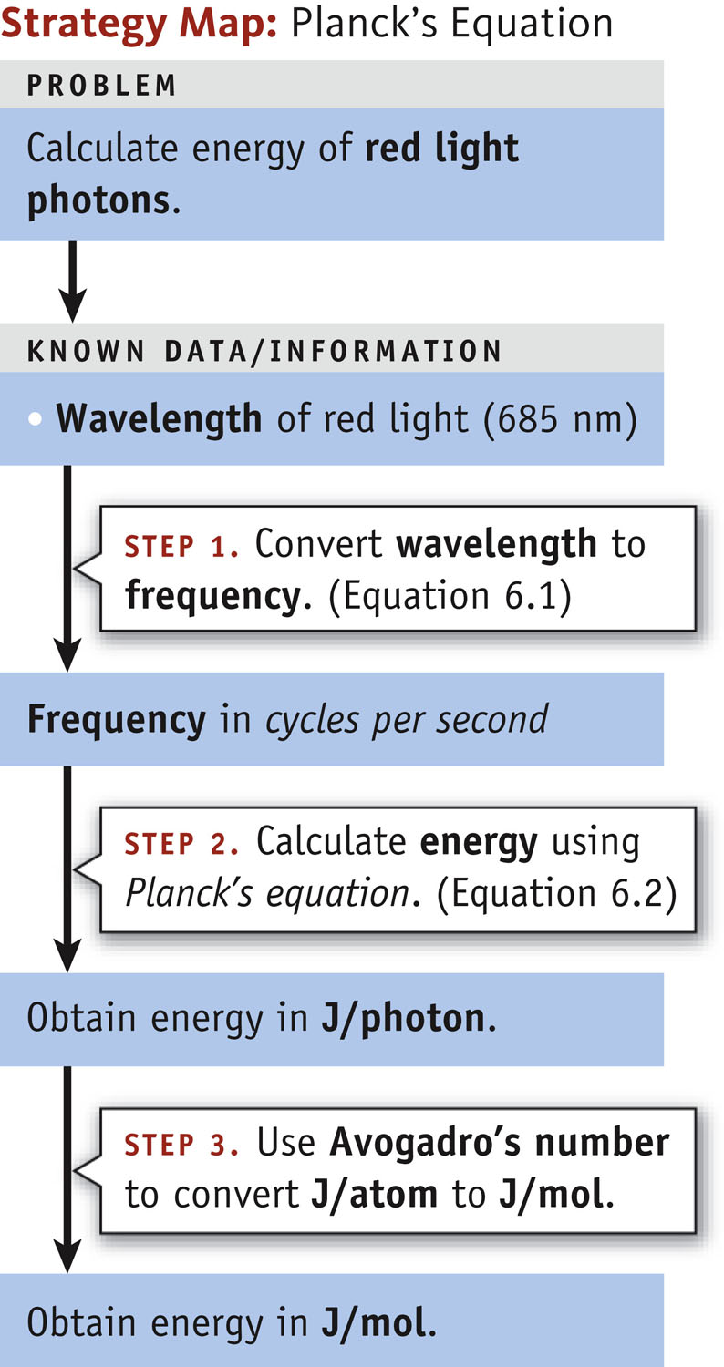
Energy of Radiation
Problem:
Calculate the energy of 1.00 mol of photons of red light at 685 nm units of kJ/mol.
The energy of a photon in units of kJ/mol can be determined by converting units of wavelength to frequency to energy using Planck’s law and Avogadro's number via dimensional analysis.

Slide 13
Energy of Radiation
Problem:
Calculate the energy of 1.00 mol of photons of red light
at 685 nm units of kJ/mol.

Slide 14
Energy of Radiation
Problem:
Calculate the energy of 1.00 mol of photons of red light at 685 nm units of kJ/mol.

Slide 15
Energy of Radiation
Problem:
Calculate the energy of 1.00 mol of photons of red light at 685 nm units of kJ/mol.

Slide 16
Energy of Radiation
Problem:
Calculate the energy of 1.00 mol of photons of red light at 685 nm units of kJ/mol.
Notes:
Instructor note: Each part of the calculation on this slide can be made to appear individually using the :custom animation” function in PowerPoint.

Slide 17
Energy of Radiation
Problem:
Calculate the energy of 1.00 mol of photons of red light at 685 nm units of kJ/mol.
The units cancel leaving J/mol of photon.

Slide 18
Photoelectric Effects
Certain metals will release (eject) electrons when light strikes the metal surface.
The energy of the light must exceed a minimum or “threshold energy” for this to occur.
Any excess energy beyond this minimum goes into the kinetic energy of the ejected electron. (They fly away with greater velocity)
A. Einstein (1879-1955)
Notes:
Note: Albert Einstein received the 1921 Nobel Prize in physics for his explanation of the Photoelectric Effect”.

Slide 19
Photoelectric Effect
Classical theory suggests that energy of an ejected electron should increase with an increase in light intensity.
This however is not experimentally observed!
No ejected electrons were observed until light of a certain minimum energy is applied.
Number of electrons ejected depends on light intensity so long as the light is above a minimum energy. (This “minimum energy” is also the ionization energy of the metal.)
A. Einstein (1879-1955)

Slide 20
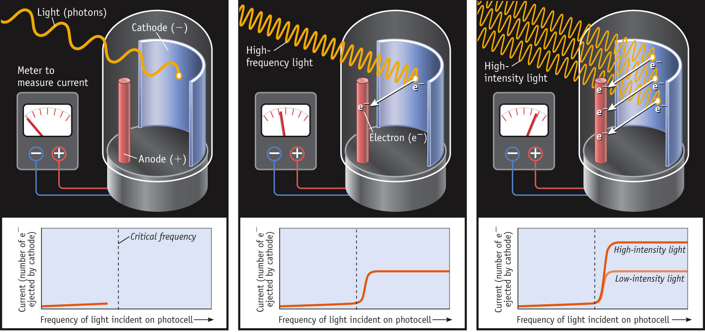
Photoelectric Effect
Experiment demonstrates the particle like nature of light.

Slide 21
Photoelectric Effect
Einstein used this assumption to explain the photoelectric effect.
He concluded that energy is proportional to frequency:
E = hν
where h is Planck’s constant, 6.626 × 10⁻³⁴ J-s.
If one knows the wavelength of light, one can calculate the energy in one photon, or packet, of that light.
Concept of Photon: defines the particle property of light and relates to the concept that light energy is bundled in quanta units.

Slide 22
Photoelectric Effect
Conclusion: There is a one-to-one correspondence between ejected electrons and light waves.
This can only occur if light consists of individual units called “PHOTONS” .
A Photon is a packet of light of discrete energy.
https://www.youtube.com/watch?v=kcSYV8bJox8

Slide 23
Interesting fact about Albert Einstein
During the summer of 1939 (just prior to the start of the Manhattan Project), Albert Einstein vacationed at the same beach that I do!
Nassau Point in Cutchogue, NY
(North Fork of Long Island)

Slide 24
The Nature of Energy
Another mystery in the early 20th century involved the emission spectra observed from energy emitted by atoms and molecules.
Intro to line spectra : http://www.youtube.com/watch?v=kfS5Qn0wn2o

Slide 25
Electromagnetic Radiation
All electromagnetic radiation travels at the same velocity: the speed of light (c), 3.00 × 10⁸ m/s.
The spectral regions of the electromagnetic spectrum vary according to frequency and wavelength.

Slide 26
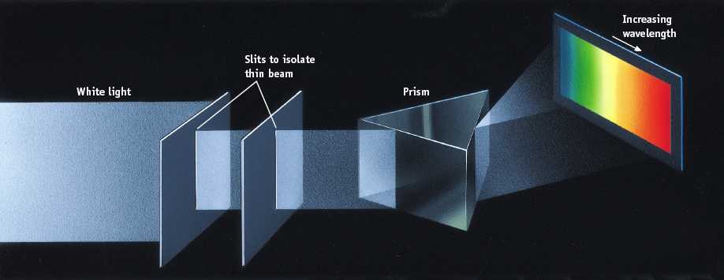
Spectrum of White Light
When white light passes through a prism, all the colors of the rainbow are observed.

Slide 27
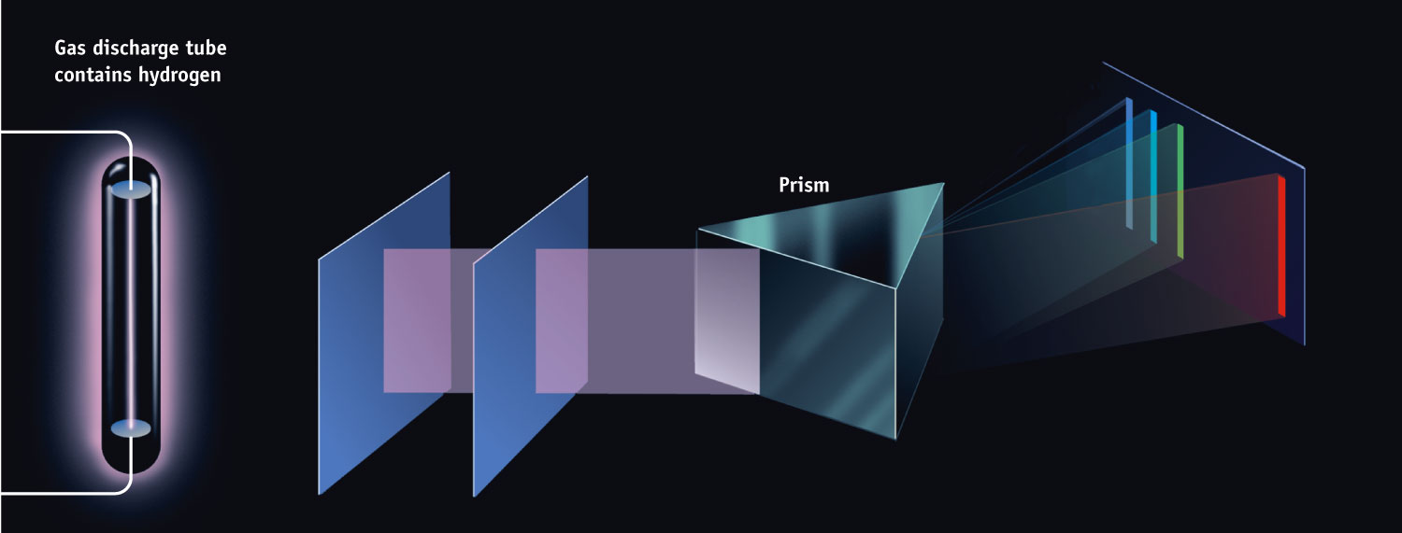
Spectrum of Excited Hydrogen Gas
When the light from a discharge tube containing a pure element (hydrogen in this case) is passed through the same prism, only certain colors (lines) are observed. Recall that color (wavelength) is related to energy via Planck’s law.

Slide 28
The Nature of Energy
Niels Bohr adopted Planck’s assumption and explained these phenomena in this way:
Electrons in an atom can only occupy certain orbits (corresponding to certain energies).

Slide 29
The Nature of Energy
Niels Bohr adopted Planck’s assumption and explained these phenomena in this way:
Electrons in permitted orbits have specific, “allowed” energies; these energies will not be radiated from the atom.

Slide 30
The Nature of Energy
Niels Bohr adopted Planck’s assumption and explained these phenomena in this way:
Energy is only absorbed or emitted in such a way as to move an electron from one “allowed” energy state to another; the energy is defined by
E = hν

Slide 31
The Nature of Energy
The energy absorbed or emitted from the process of electron promotion or demotion can be calculated by the equation:
( )
ΔE = −R_{H}
1
n_{f}²
-
1
n_{i}²
where R_{H} is the Rydberg constant, 2.18 × 10⁻¹⁸ J, and n_{i} and n_{f} are the initial and final energy levels of the electron.

Slide 32
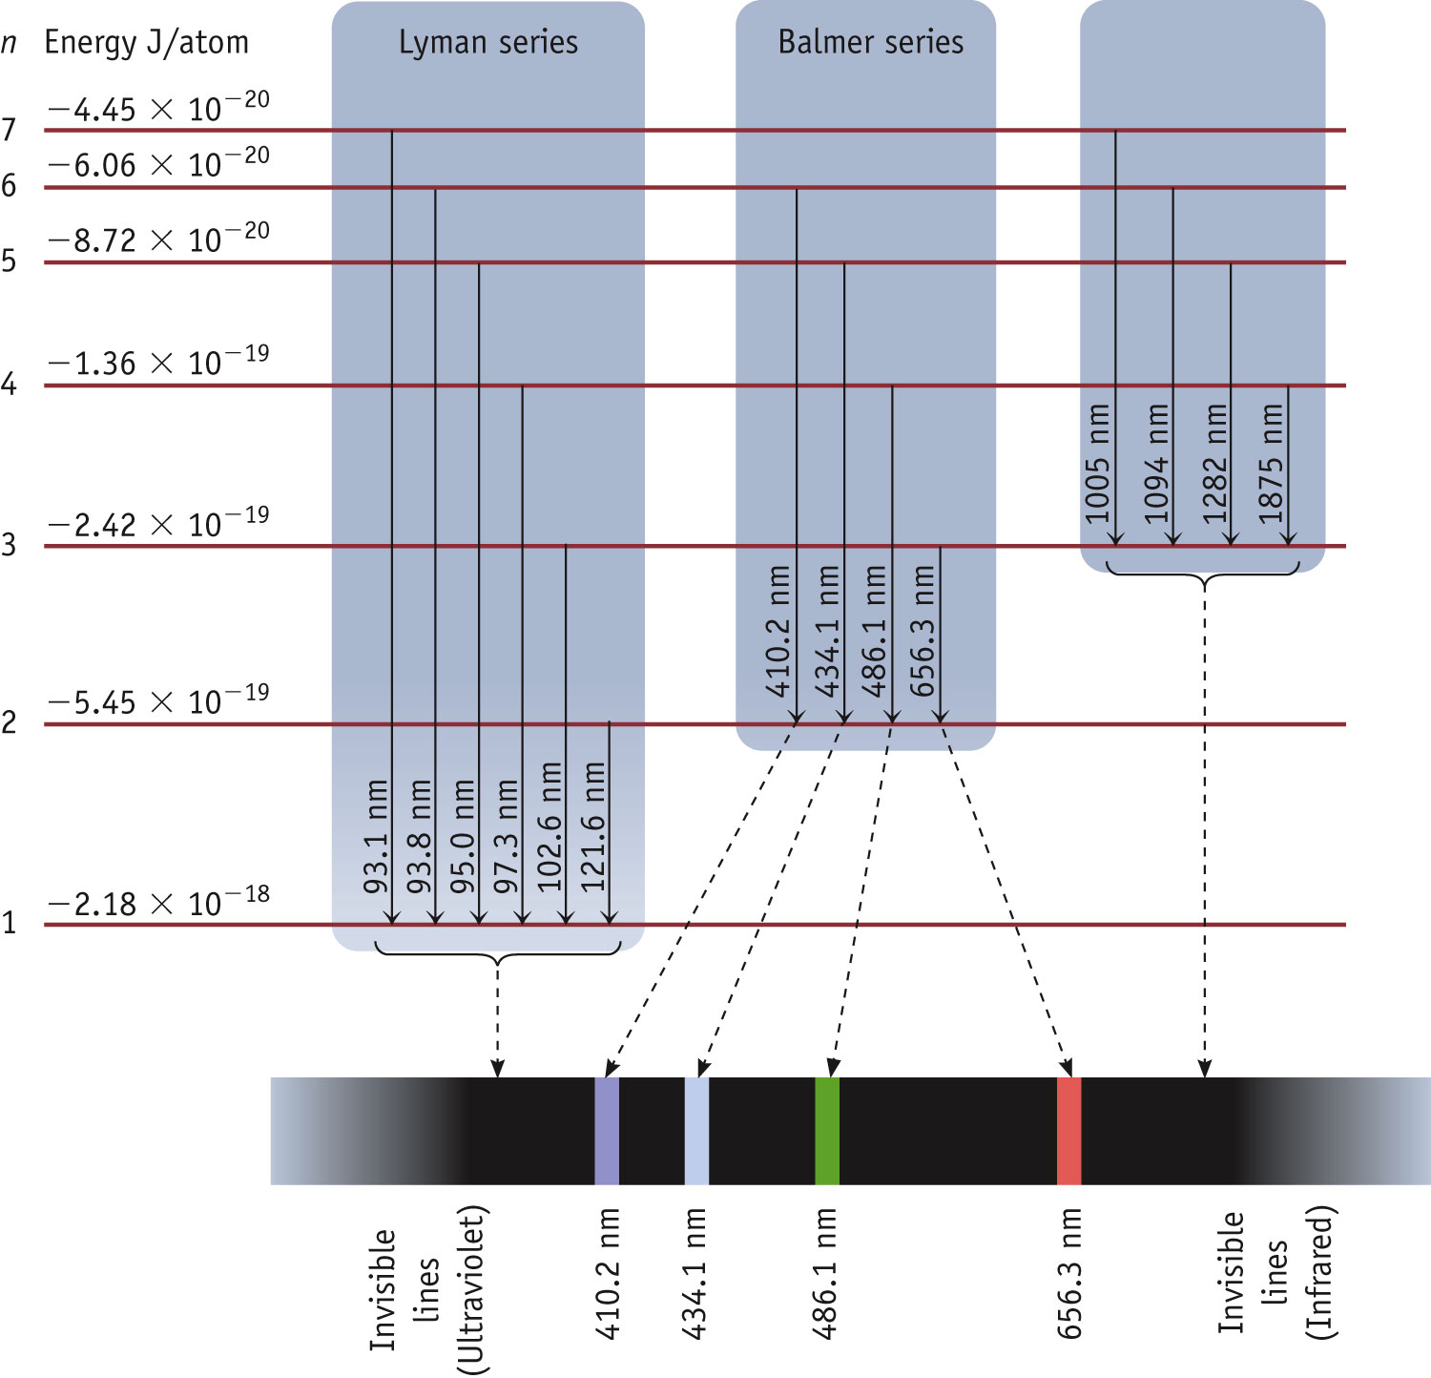
Origin of Line Spectra
The “Balmer” series for the hydrogen atom is in the visible region of the spectrum.
A “series” of transitions end with a common lower level.

Slide 33
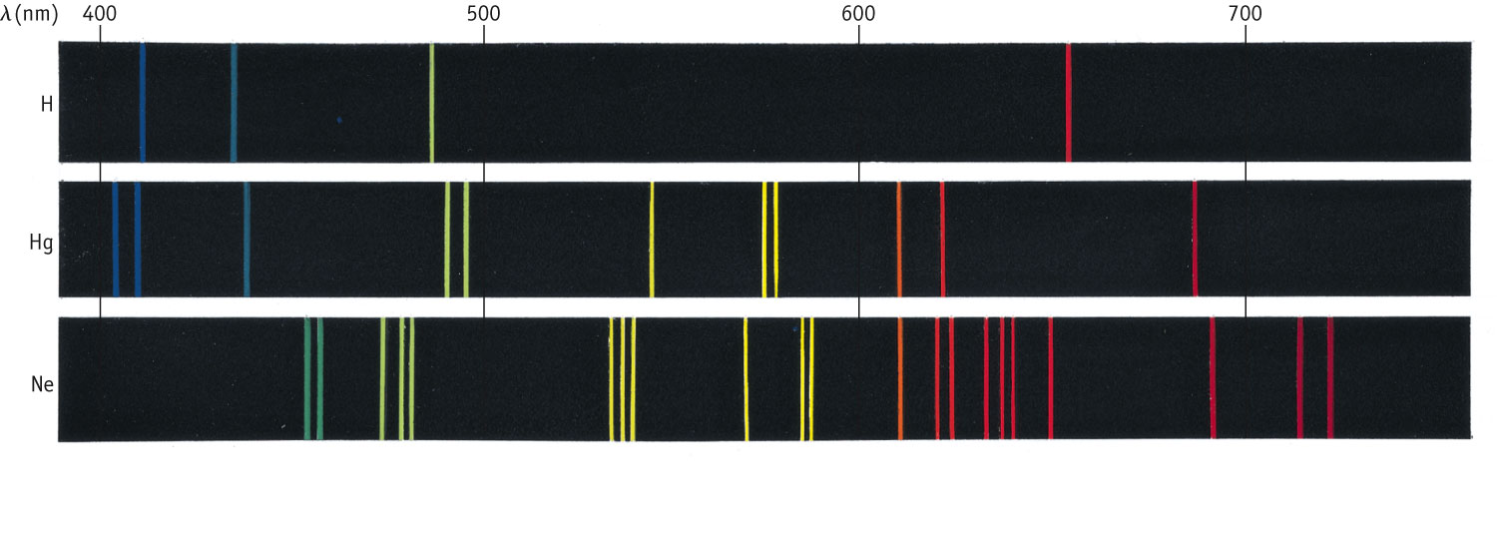
Line Spectra of Other Elements
Each element has a unique line spectrum.
The lines indicate that the electrons can only make “jumps” between allowed energy levels.
Knowing the color (wavelength) on can determine the magnitude of the energy gaps using Planck's Law.

Slide 34
The Bohr Model of the Atom
The energy of each level is given by:
R = Rydberg constant (1.097 × 10⁷ m⁻¹)
c = speed of light
(2.997 × 10⁸ ms⁻¹⁾
h = Planck’s constant
(6.626 ×10⁻³⁴Js)
n = the quantum level of the electron (1, 2, 3…∞)
The sign of E_{n} is negative because the potential energy between the electron and the nucleus is attractive.

Slide 35
Total energy of electron in the n^{th} level:
The quantum number (n) defines the energies of the allowed orbits in the H atom.
The energy of an electron in an orbit has a negative value because the electron in the atom has a lower energy than when it is free. The zero of energy occurs when n =  (when the electron is infinitely separated from the nucleus).
An atom with its electrons in the lowest possible energy levels is said to be in the ground state.
Because the energy is dependent on 1/n², the energy levels are progressively closer together as n increases.

Slide 36
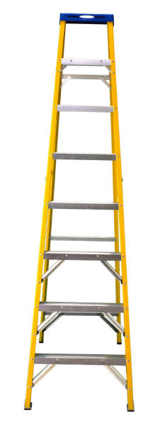
Energy Levels
The location of electrons in an energy level is indicated by assigning a number n. The value of n can be 1, 2, 3, 4, etc.
The higher the n value, the higher is the energy of the “shell” that that the electrons occupy.
n = ∞
n = 3
n = 2
Each shell can be thought of as a step on a ladder
n = 1
Notes:
See Chapter 6 Video Presentation Slide 10

Slide 37
Energy Levels
The spacing between adjacent levels is given by:
n = ∞
virtual continuum of levels
between n = 1 and 2:
n = 4
n = 3
Energy
n = 2
between n = 2 and 3:
n = 1
(as n increases, the levels get closer together)

Slide 38
Energy Levels
Key terms and Vocabulary:
Ground State: The lowest energy level (n = 1)
Excited State: A subsequently higher energy level. n = 2 is the “first excited state” and so on.
Absorption: An electron moving from a lower energy level to a higher energy level via excitation.
Emission: An electron moving from a higher to a lower energy level accompanied by the release of a photon.

Slide 39
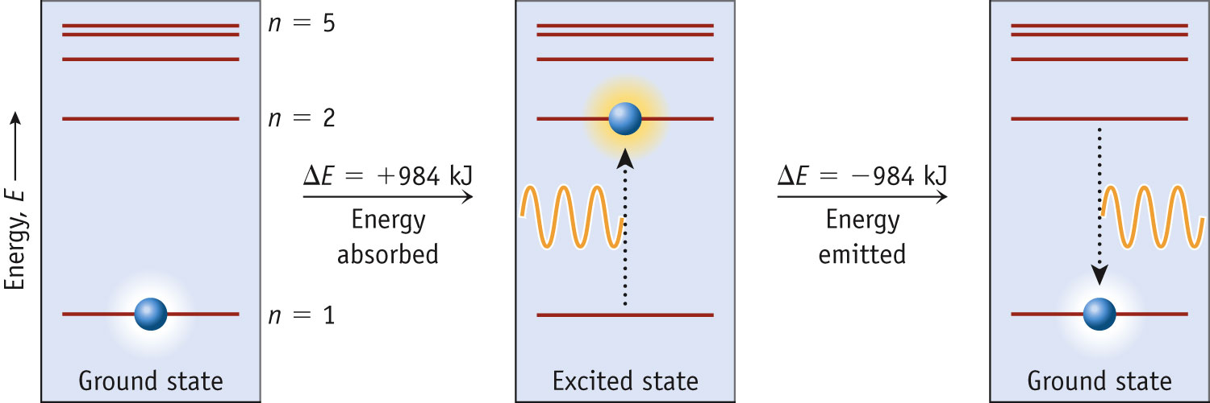
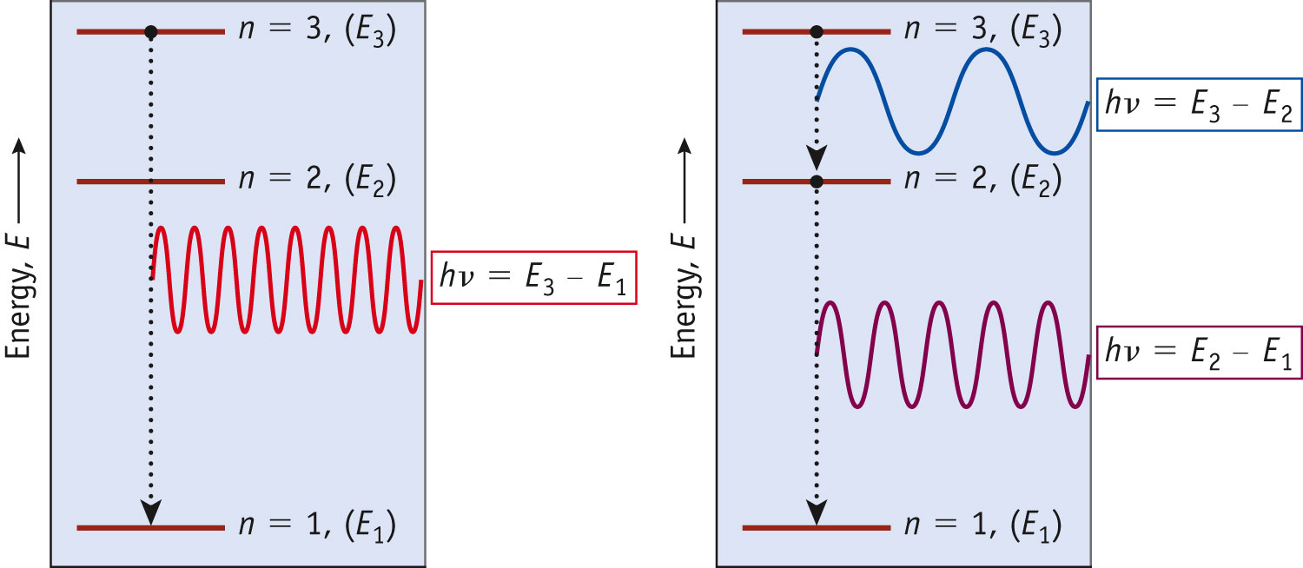
Energy Absorption/Emission
Since the gaps between states get closer and closer together with increasing n, the frequency of the light emitted changes.
Notes:
See Chapter 6 Video Presentation Slide 11

Slide 40
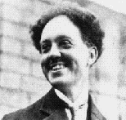
Particle-Wave Duality: A Prelude to Quantum Mechanics
Louis de Broglie in response to Planck & Einstein’s assertion that light was “particle-like” (photon) stated that small particles should exhibit a characteristic wavelength.
L. de Broglie
(1892-1987)

Slide 41
Particle-Wave Duality: A Prelude to Quantum Mechanics
L. de Broglie
(1892-1987)
Conclusion:
Light waves have mass,
particles have a wavelength.
Notes:
Instructor note: Each object can be made to appear individually using the custom animation options.

Slide 42
The Wave Nature of Matter
Louis de Broglie posited that if light can have material properties, matter should exhibit wave properties.
He demonstrated that the relationship between mass and wavelength was
h
mv
λ =

Slide 44
The Uncertainty Principle
Heisenberg showed that the more precisely the momentum of a particle is known, the less precisely is its position known:
In many cases, our uncertainty of the whereabouts of an electron is greater than the size of the atom itself!
h
4π
(Δx) (Δmv) ≥

Slide 45
Quantum Mechanics
Erwin Schrödinger developed a mathematical treatment into which both the wave and particle nature of matter could be incorporated.
It is known as quantum mechanics.

Slide 46
Quantum Mechanics
The wave equation is designated with a lower case Greek psi (ψ).
The square of the wave equation, ψ², gives a probability density map of where an electron has a certain statistical likelihood of being at any given instant in time.

Slide 47
Quantum Numbers
Solving the wave equation gives a set of wave functions, or orbitals, and their corresponding energies.
Each orbital describes a spatial distribution of electron density.
An orbital is described by a set of three quantum numbers.

Slide 48
Quantum Numbers & Electron Orbitals
Quantum Numbers are terms that arise from the mathematics of the Schrödinger equation. They describe location of an electron in a particular orbital much like an address.
Each electron in an orbital has its own set of three quantum numbers.
Principal Quantum Number
“n”
= 1, 2, 3, 4…up to infinity
shell
Azimuthal or Angular Quantum Number
“l”
= 0, 1, 2, 3…up to a maximum of “n – 1”
sub-shell
Magnetic Quantum Number
“m_{l}”
m_{l} may take on the value an integer from – l to + l
individual orbitals

Slide 49
Principal Quantum Number (n)
The principal quantum number, n, describes the energy level on which the orbital resides.
The values of n are integers ≥ 1.

Slide 50
Angular Momentum Quantum Number (l)
This quantum number defines the shape of the orbital.
Allowed values of l are integers ranging from 0 to n − 1.
We use letter designations to communicate the different values of l and, therefore, the shapes and types of orbitals.

Slide 51
Quantum Numbers & Electron Orbitals
Each “l” within an “n-level” represents a sub-shell.
Each “l” sub-shell is divided into m_{l} degenerate orbitals, where m_{l} designates the spatial orientation of each orbital.
Type of orbital # of orbitals
l = 0 “s” sub-shell (sharp) 1
l = 1 “p” sub-shell (Principal) 3
l = 2 “d” sub-shell (diffuse) 5
l = 3 “f” sub-shell (fine) 7
each subshell contains 2l+1 orbitals

Slide 52
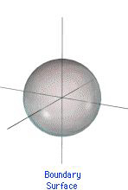
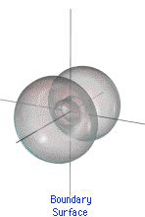
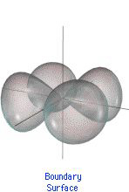
Types of Orbitals
s orbital
p orbital
d orbital
Notes:
See Chapter 6 Video Presentation Slides 13, 14, & 15

Slide 53
Angular Momentum Quantum Number (l)
Value of l | 0 | 1 | 2 | 3
Type of orbital | s | p | d | f

Slide 54
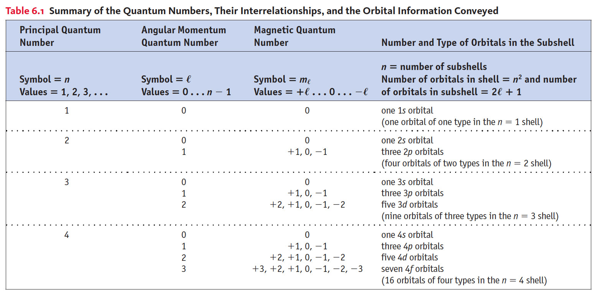
Summary of Quantum Numbers

Slide 55
s Orbitals
The value of l for s orbitals is 0.
They are spherical in shape.
The radius of the sphere increases with the value of n.

Slide 56
p Orbitals
The value of l for p orbitals is 1.
They have two lobes with a node between them.

Slide 57
d Orbitals
The value of l for a d orbital is 2.
Four of the five d orbitals have 4 lobes; the other resembles a p orbital with a doughnut around the center.

Slide 58
Magnetic Quantum Number (m_{l})
The magnetic quantum number describes the three-dimensional orientation of the orbital.
Allowed values of m_{l} are integers ranging from -l to l:
−l ≤ m_{l} ≤ l.
Therefore, on any given energy level, there can be up to 1 s orbital, 3 p orbitals, 5 d orbitals, 7 f orbitals, etc.

Slide 59
Spin Quantum Number, m_{s}
In the 1920s, it was discovered that two electrons in the same orbital do not have exactly the same energy.
The “spin” of an electron describes its magnetic field, which affects its energy.

Slide 60
Spin Quantum Number, m_{s}
This led to a fourth quantum number, the spin quantum number, m_{s}.
The spin quantum number has only 2 allowed values: +1/2 and −1/2.

Slide 61
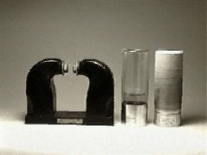
Electron Spin & Magnetism
Diamagnetic Substances: Are NOT attracted to a magnetic field
Paramagnetic Substances: ARE attracted to a magnetic field.
Substances with unpaired electrons are paramagnetic.
Ferromagnetism when the spin of unpaired electrons in a solid align themselves in one direction.
Notes:
See Chapter 6 Video Presentation Slide 24

Slide 62
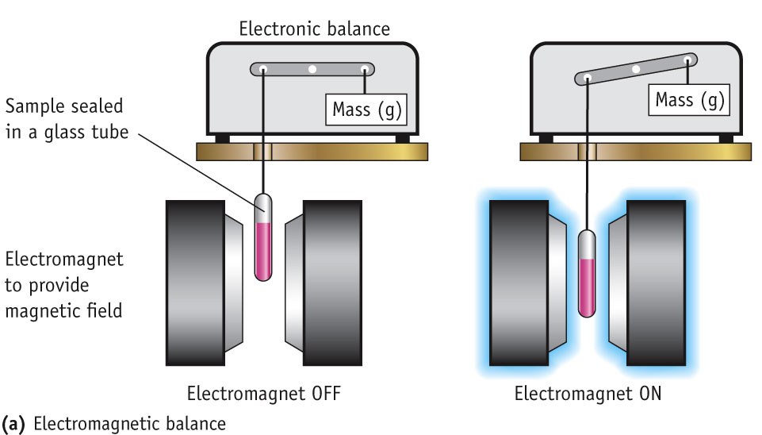
Measuring Paramagnetism
When a substance containing unpaired electrons is place into a magnetic field, it is attracted to that magnetic field.
The effect is proportional to the number of unpaired electrons.

