Slide 1
Chapter 5
Energy and Chemical Reactions

Slide 2
Thermochemistry
The study of energy changes and transformations related to chemical reactions.
How do we measure and calculate the energy changes that are associated with physical changes and chemical reactions?
What is the relationship between energy changes, heat, and work?
How can we determine whether a chemical reaction is product-favored or reactant-favored at equilibrium?
How can we determine whether a chemical reaction or physical change will occur spontaneously, that is, without outside intervention?

Slide 3
Units of Energy
The SI unit of energy is the joule (J).
Another unit for measuring heat energy is calories
1 calorie = heat required to raise temp. of 1.00 g of H₂O by 1.0 °C.
1000 cal = 1 kilocalorie = 1 kcal
1 kcal = 1 Calorie (a food “calorie”)
1 calorie = exactly 4.184 J
kg m²
1 J = 1
s²

Slide 4
Energy & Chemistry
Some Basic Principles
Energy has the capacity to do work or transfer heat (q).
Heat (q) is NOT temperature, temperature is a measure of kinetic energy.
Energy is divided into two basic categories:
Kinetic energy (the energy associated with motion)
Potential energy (energy that results from an object’s position).
The law of conservation of energy requires that energy can neither be created nor destroyed.
However, energy can be converted from one type into another.

Slide 5
Energy & Chemistry
Energy can be divided into two forms:
Kinetic: Energy of motion:
Thermal
Mechanical
Electrical
Potential: Stored energy:
Gravitational
Electrostatic
Chemical & Nuclear

Slide 6
Energy
Energy is the ability to do work or transfer heat.
Energy used to cause an object that has mass to move is called work.
Energy used to cause the temperature of an object to rise is called heat.

Slide 7
Definitions: Work
Energy used to move an object over some distance is work.
w = F × d
where w is work, F is the force, and d is the distance over which the force is exerted.

Slide 8
Heat
Energy can also be transferred as heat.
Heat flows from warmer objects to cooler objects until thermal equilibrium is achieved.
Temperature: is a measure of kinetic energy. KE = ½ mv²

Slide 9
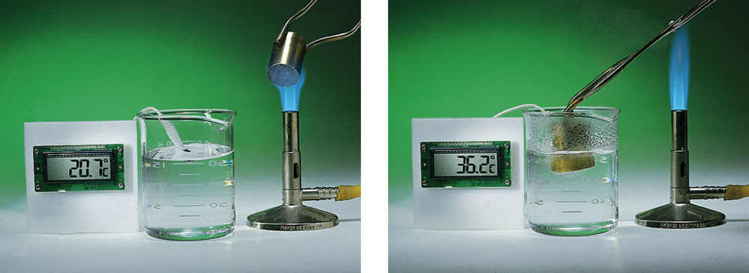
Thermal Equilibrium
Energy transfer as heat will occur spontaneously from an object at a higher temperature to an object at a lower temperature.
Transfer of energy as heat continues until both objects are at the same temperature and thermal equilibrium is achieved.
At thermal equilibrium, the object with a temperature increase has gained thermal energy, the object with a temperature decrease has lost thermal energy.
Notes:
See Chapter 5 Video Presentation Slide 12 & 13

Slide 10
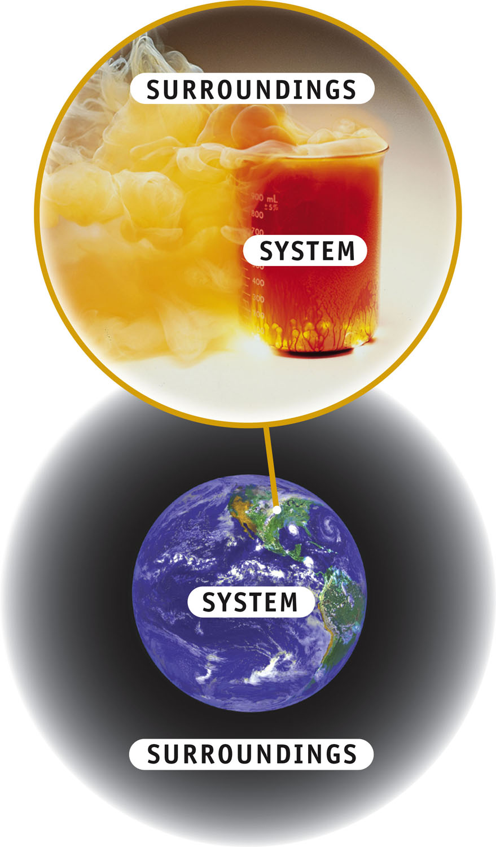
System & Surroundings
SYSTEM
The object under study
SURROUNDINGS
Everything outside the system
Energy flows between the two

Slide 11
Directionality of Energy Transfer
When energy leaves the system and goes into the surroundings, the process is said to be EXOTHERMIC.
In the case of thermal energy, the temperature of the system decreases. (q_{system} < 0)
ΔT_{system} = (T_{final} – T_{initial}) < 0

Slide 12
Directionality of Energy Transfer
When energy enters the system and from the surroundings, the process is said to be ENDOTHERMIC.
In the case of thermal energy, the temperature of the system increases. (q_{system} > 0)
ΔT_{system} > 0

Slide 13
Heat Capacity and Specific Heat
We define specific heat capacity (or simply specific heat) as the amount of energy required to raise the temperature of 1 g of a substance by 1 K.

Slide 14
Heat & Specific Heat Capacity
When heat is absorbed or lost by a body, the temperature must change as long as the phase (s, g or l) remains constant.
q = heat lost or gained (J)
m = mass of substance (g)
C = the Specific Heat Capacity of a compound
ΔT = T_{final} − T_{initial} is the temperature change ( ºC or K)

Slide 15
Specific Heat Capacity Problem:
Determine the specific heat capacity (C) of substance “X” , knowing that when 34.80g of X is heated by 2.54 kJ of energy, the temperature increased from a starting temperature of 20.5 ºC to 40.9 ºC
Answer: 3.58J/g °C

Slide 16
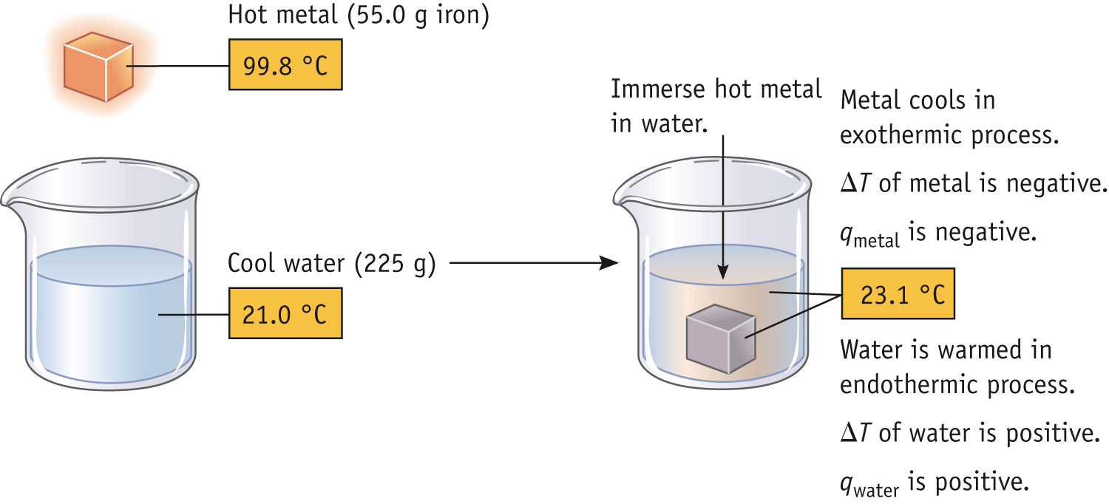
Example Problem:
55.0 g of iron at 99.8 °C is placed into into 225 g water at initially at 21.0 °C.
At thermal equilibrium, the water and iron are both at 23.1 °C
What is the specific heat capacity of the metal?

Slide 17
Energy & Changes of State
When matter absorbs heat, its temperature will rise until it undergoes a Phase Change.
The matter will continue to absorb energy, however during the phase change its temperature remains constant: Phase changes are “Isothermal” processes.
Notes:
See Chapter 5 Video Presentation Slide 14

Slide 18
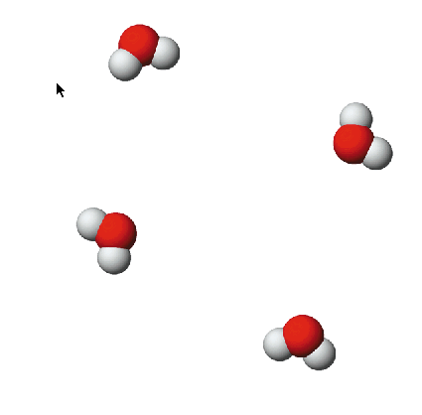
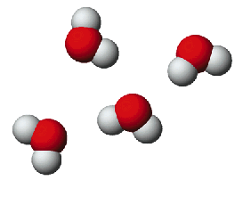
Energy Transfer & Changes of State
Some changes of state (phase changes) are endothermic:
When you perspire, water on your skin evaporates.
This requires energy.
Heat from your body is absorbed by the water as it goes from the liquid state to the vapor state, as a result you cool down.
+ energy

Slide 19
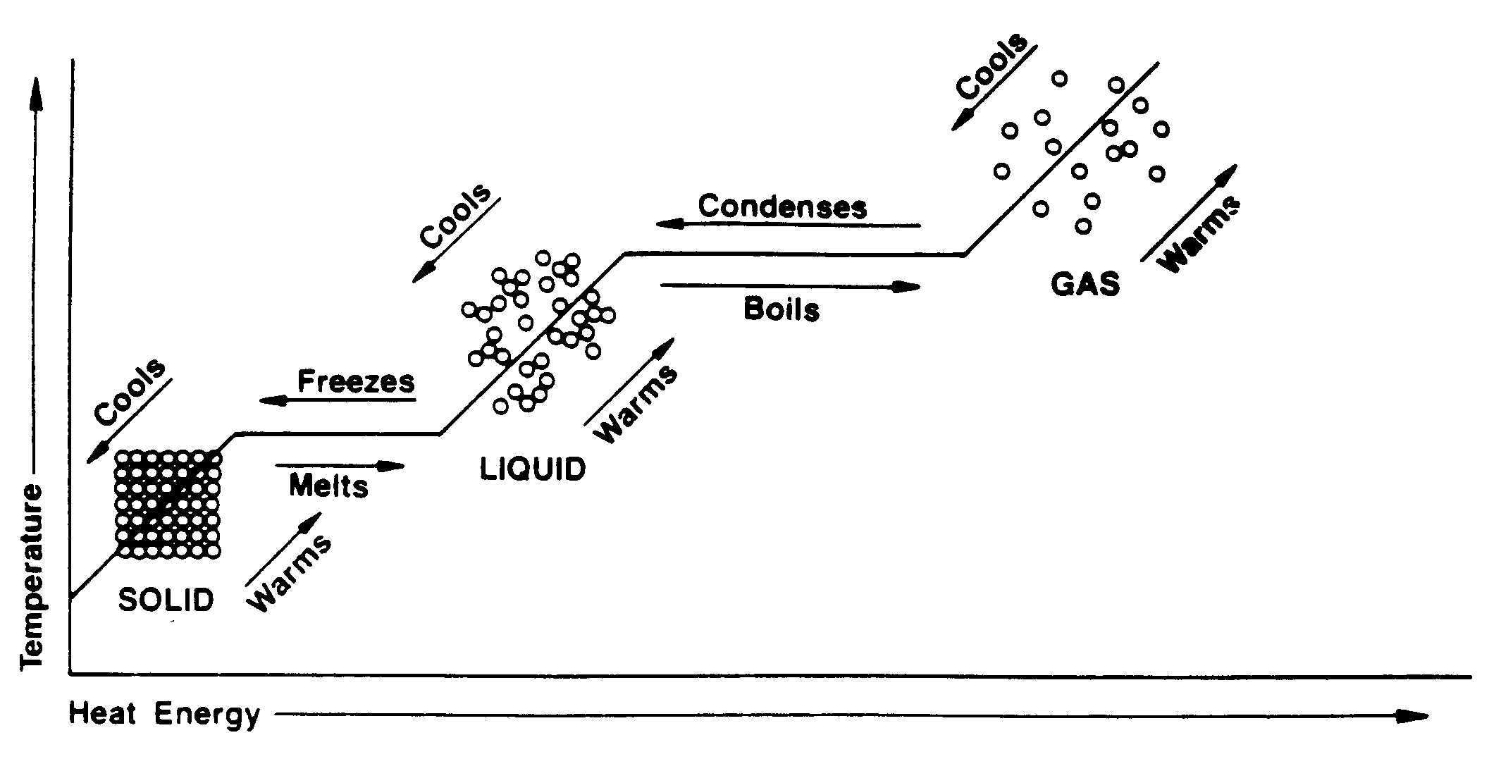
Heating/Cooling Curve for Water

Slide 20
Energy and phase change:
Specific heat ice:
2.06 J/gC
Specific heat water:
4.18J/g C
Specific heat steam:
2.02J/g C
H fusion:
335J/g
 H vaporization:
2260J/g
Note: solid → liquid→ gas is an Endothermic process (heat is absorbed)

Slide 21
Changes in States of Matter
How much energy is required to melt 100.g ice at O C, knowing that the ΔH_{fusion}= 335J/g
How much energy is required to heat 100.g of water from 0C to 100 C knowing that the specific heat of water is 4.184 J/g°C?
Calculate the energy required to melt 100.g of ice and raise the temperature to 100°C.

Slide 22
First Law of Thermodynamics
Energy is neither created nor destroyed.
In other words, the total energy of the universe is a constant; if the system loses energy, it must be gained by the surroundings, and vice versa.
Energy can be converted from one type into another.

Slide 23
Changes in Internal Energy
When energy is exchanged between the system and the surroundings, it is exchanged as either heat (q) or work (w).
That is, ΔE = q + w.

Slide 24
ΔE, q, w, and Their Signs

Slide 25
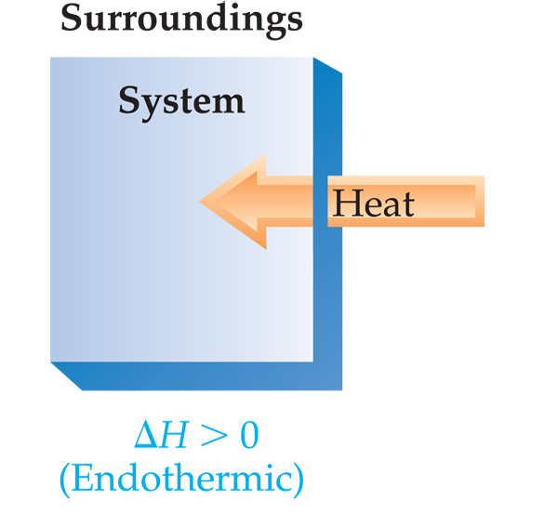
Exchange of Heat between System and Surroundings
When heat is absorbed by the system from the surroundings, the process is endothermic.

Slide 26
Exchange of Heat between System and Surroundings
When heat is absorbed by the system from the surroundings, the process is endothermic.
When heat is released by the system into the surroundings, the process is exothermic.

Slide 27
State Functions
Usually we have no way of knowing the internal energy of a system; finding that value is simply too complex a problem.

Slide 28
State Functions
The internal energy of a system is independent of the path by which the system achieved that state.
In the system below, the water could have reached room temperature from either direction.

Slide 29
State Functions
Usually we have no way of knowing the internal energy of a system; finding that value is simply too complex a problem
Therefore, internal energy is a state function.
It depends only on the present state of the system, not on the path by which the system arrived at that state.
And so, ΔE depends only on E_{initial} and E_{final}.

Slide 30
Work
Usually in an open container the only work done is by a gas pushing on the surroundings (or by the surroundings pushing on the gas).
w = -PΔV

Slide 31
Work
We can measure the work done by the gas if the reaction is done in a vessel that has been fitted with a piston.
w = -PΔV

Slide 32
Enthalpy
If a process takes place at constant pressure (as the majority of processes we study do) and the only work done is this pressure-volume work, we can account for heat flow during the process by measuring the enthalpy of the system.
Enthalpy is the internal energy plus the product of pressure and volume:
H = E + PV

Slide 33
Enthalpy
When the system changes at constant pressure, the change in enthalpy, ΔH, is
ΔH = Δ(E + PV)
This can be written
ΔH = ΔE + PΔV

Slide 34
Enthalpy
Since ΔE = q + w and w = -PΔV, we can substitute these into the enthalpy expression:
ΔH = ΔE + PΔV
ΔH = (q+w) − w
ΔH = q
So, at constant pressure, the change in enthalpy is the heat gained or lost.

Slide 35
Enthalpy of Reaction
ΔH, is called the enthalpy of reaction, or the heat of reaction.
The change in enthalpy, ΔH, is the enthalpy of the products minus the enthalpy of the reactants:
ΔH = H_{products} − H_{reactants}

Slide 36
The Truth about Enthalpy
Enthalpy is an extensive property.
ΔH for a reaction in the forward direction is equal in size, but opposite in sign, to ΔH for the reverse reaction.
ΔH for a reaction depends on the state of the products and the state of the reactants.

Slide 37
Enthalpy of reaction:
For the reaction:
S(s) + O₂(g) → SO₂(g) ΔH° = -296 kJ/mole
How much heat is evolved when 275g sulfur is burned in excess O₂?
How much heat is evolved when 150.g of sulfur dioxide is produced.
How much energy (kJ) would be required to reverse this reaction?

Slide 38
Constant Pressure Calorimetry
Because the specific heat for water is well known (4.184 J/g-K), we can measure ΔH for a chemical or physical process with this equation:
q = m × c × ΔT
The insulating calorimeter allows us to make the following comparison:
- q_{system} = +q _{surrounding}

Slide 39
Calorimetry & reactions
50.0 mL of 0.100M AgNO₃ and 50.0 mL of 0.10M HCl are mixed to yield the following reaction:
Ag⁺ + Cl⁻ → AgCl(s)
The two solutions are initially at 22.6C and the final temperature is 23.4C.
Calculate the ΔH for this reaction, assuming that the combined solution has a mass of 100. g and a specific heat of 4.184 J/g C

Slide 40
Bomb Calorimetry
Reactions can be carried out in a sealed “bomb” such as this one.
The heat absorbed (or released) by the water is a very good approximation of the enthalpy change for the reaction.

Slide 41
Bomb Calorimetry
Because the volume in the bomb calorimeter is constant, what is measured is really the change in internal energy, ΔE, not ΔH.
For most reactions, the difference is very small.

Slide 42
Bomb Calorimetry
0.1964g sample of quinone (C₆H₄O₂) is burned in a bomb calorimeter that has a heat capacity of 1.56 kJ/°C.
The temperature of the calorimeter increased by 3.2°C.
Calculate the energy of combustion of quinone per gram and per mole

Slide 43
Hess’s Law
ΔH is well known for many reactions, and it is not always convenient to measure ΔH for every reaction in which we are interested.
However, we can estimate ΔH using published ΔH values and the properties of enthalpy.
Its useful to remember that enthalpy is a state function!

Slide 44
Hess’s Law
Hess’s law states that “if a reaction is carried out in a series of steps, ΔH for the overall reaction will be equal to the sum of the enthalpy changes for the individual steps.”

Slide 45
Enthalpies of Formation
An enthalpy of formation, ΔH_{f}, is defined as the enthalpy change for the reaction in which a compound is made from its constituent elements in their elemental forms.
Ex: Carbon dioxide: C(s) + O₂(g) → CO₂(g)
Nitrogen dioxide: ½ N₂(s) + O₂(g) → NO₂(g)

Slide 46
Standard Enthalpies of Formation
Standard enthalpies of formation, ΔH_{f}°, are measured under standard conditions (25 °C and 1.00 atm pressure).

Slide 47
Calculation of ΔH
We can use Hess’s law in this way:
ΔH = Σ n ΔH_{f}°_{products} – Σ m ΔH_{f}° _{reactants}
where n and m are the stoichiometric coefficients.

Slide 48
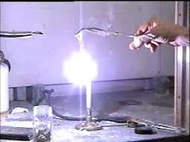
Example of Hess’s Law: H_{f} for MgO(s)
Reaction: 2Mg(s) + O₂(g) →2MgO
Enthalpy of formation equation?

Slide 49
Application of Hess’s Law
Mg(s) + 2HCl(aq) → MgCl₂(aq) + H₂(g) -444.8 kJ/mol
MgO(s) + 2HCl(aq) → MgCl₂(aq) + H₂O(l) -130.3 kJ/mol
H₂(g) + ½ O₂(g) → H₂O(l) -285.83 kJ/mol
H_{f} for MgO(s) = -601.24 kJ/mol

