Slide 1
Chapter Four: Stoichiometry
Stoichiometry is a branch of chemistry that deals with the quantitative relationships that exist between the reactants and the products in chemical reactions
Applications include:
Reaction stoichiometry Composition stoichiometry Solution stoichioimetry Gas stoichiometry

Slide 2
Just a reminder:
Moles provide a bridge from the molecular scale to the real-world scale.
We’ve practices gram-mole-atom relationships.
Our next step is to apply this relationship across a balanced equation.
This is one of the MOST important skills of a chemist.
Use Dimensional Analysis!

Slide 3
Stoichiometric Calculations
The coefficients in the balanced equation give the ratio of moles of reactants and products.

Slide 4
Stoichiometric Calculations
Starting with the mass of Substance A you can use the ratio of the coefficients of A and B to calculate the mass of Substance B formed (if it’s a product) or used (if it’s a reactant).

Slide 5
Stoichiometry practice problem:
Given the following combustion reaction:
2C₂H₆(l) + 7 O₂(g) → 4CO₂(g) + 6H₂O(l)
How many moles of water are produced when 3.0 mols of oxygen react?

Slide 6
Answer:
2C₂H₆(l) + 7 O₂(g) → 4CO₂(g) + 6H₂O(l)
How many moles of water are produced when 3.0 mols of oxygen react?
mol O₂ → mol H₂O

Slide 7
Given the following reaction:
2C₂H₆(l) + 7 O₂(g) → 4CO₂(g) + 6H₂O(l)
How many moles of water are produced when 3.0 mols of oxygen react?
mol O₂ → mol H₂O
2 sig. figs.
exact conversion factor
2 sig. figs.

Slide 8
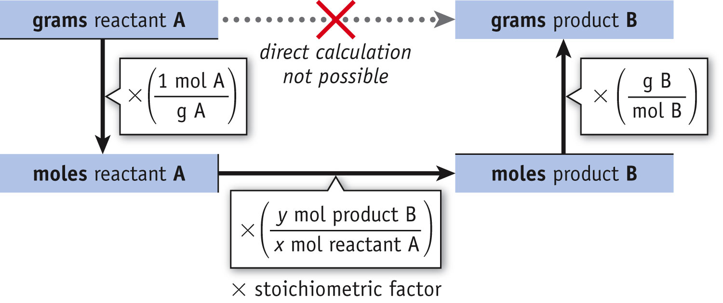
Stoichiometry
Mole/Mass relationships.
It is not possible to relate masses in reactions without going through moles.

Slide 9
Stoichiometry Problems
In order to solve stoichiometry problems, one must go through moles using molar masses and mole ratios as conversion factors.
One cannot do this without writing a balanced chemical equation first.
grams → moles → moles → grams
↑
Using molar mass
↑
Using mole ratios
↑
Using molar mass

Slide 10
Stoichiometry
Potassium chlorate decomposes to potassium chloride and oxygen gas. What mass of oxygen gas could be obtained from the decomposition of 3.00g of potassium chlorate?
Balance equation:
2KClO₃ → 2KCl + 3O₂
Solve by: Mass KClO₃ → Mass O₂
Answer: 1.18g O₂

Slide 11
Practice stoichiometry:
Based on the following chemical reaction, how many grams of ammonia will form if 13.5g of nitrogen reacts will excess amount of hydrogen?
N₂(g) + 3H₂(g) → 2NH₃(g)
Answer: 16.4 g NH₃

Slide 12
Limiting Reactants

Slide 13
Limiting Reactants
The limiting reactant is the reactant present in the smallest stoichiometric amount.
In other words, it’s the reactant you’ll run out of first (in this case, the H₂).

Slide 14
Another stoichiometry problem:
N₂(g) + 3H₂(g) → 2NH₃(g)
How many grams of NH₃ will form if 13.5g of N₂ and 0.900g of H₂ react to form ammonia?
Start with each reactant and identify how much product can be formed. The reactant that produces the smallest quantity of product will limit the reaction.
Limited reactant: Hydrogen gas
Answer: 5.06g NH₃

Slide 15
Excess reactant:
The excess reactant is the reactant that does not get used up in the reaction. Remaining amount of excess reactant can also be determined.
Excess reactant: Nitrogen
Amt. used = 4.2g
Excess N₂ = 13.5-4.2 = 9.3g

Slide 16
Theoretical Yield
The theoretical yield is the maximum amount of product that can be made.
In other words it’s the amount of product possible as calculated through the stoichiometry problem.
This is different from the actual yield, which is the amount one actually produces and measures.

Slide 17
Percent Yield
One finds the percent yield by comparing the amount actually obtained (actual yield) to the amount it was possible to make (theoretical yield).
Actual Yield
Theoretical Yield
Percent Yield = x 100

Slide 18
Sample Problem:
Determine the limiting and excess reactant when 10.0g of solid iron is oxidized by 8.00g of atmospheric oxygen to form iron (III) oxide.
What is the theoretical yield for this reaction?
What is the percent yield if 12.5g of iron (III) oxide is actually recovered at the end of the reaction?

Slide 19
Compositional Analysis & Stoichiometry

Slide 20
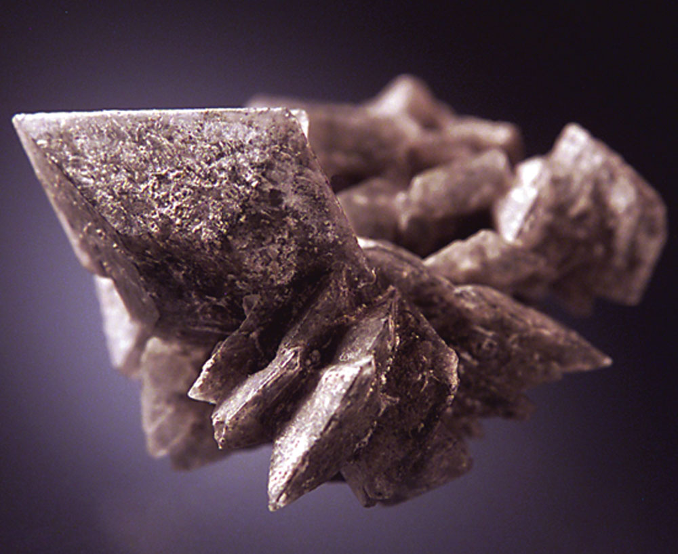
Compositional analysis: Below is a picture of the mineral, Thenarite.
Thenarite is an anhydrous salt of sodium sulfate and can be found in dry caves.
Can you think of a way to quantitatively determine the % composition of sodium sulfate in this sample? What do you know about the solubility of sulfates?
Fig. 4-5, p. 167

Slide 21
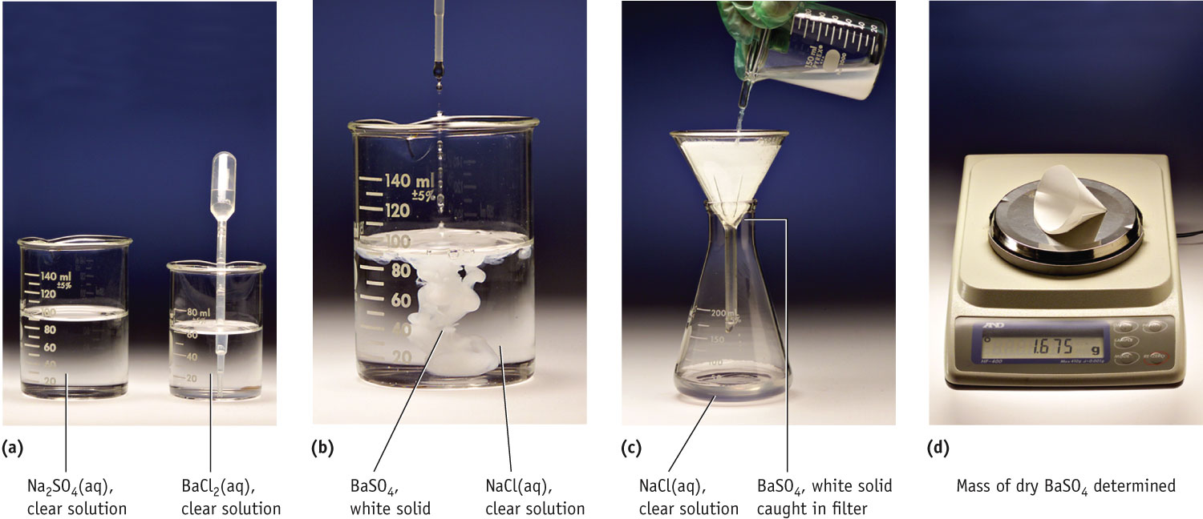
Chemical Analysis
Determination of the % sodium sulfate in 1.250 g of the mineral Thenarite

Slide 22
Chemical Analysis
Na₂SO₄(aq) + BaCl₂(aq) → BaSO₄(s) + 2 NaCl(aq)
↑
molar mass BaSO₄
↑
mole ratio
↑
molar mass Na₂SO₄

Slide 23
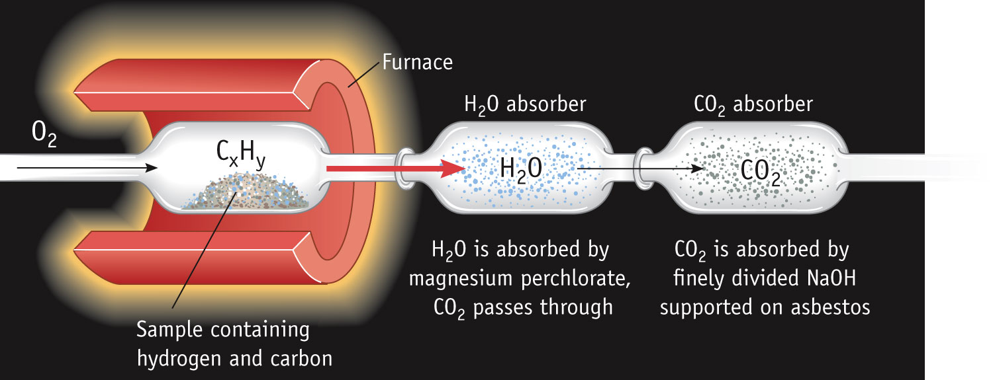
Determining the Formula of a Hydrocarbon by Combustion
Combustion involves the addition oxygen to another element.
When hydrocarbon molecules burn completely, the products are always carbon dioxide gas and water.
Notes:
See Chapter 4 Video Presentation Slide 6

Slide 24
Combustion Analysis
A hydrocarbon is a compound that contains predominately carbon and hydrogen and possibly smaller amount of elements such as O, N and S.
A streaming flow of pure O₂ is passed over a weighed mass of the unknown sample in an apparatus like the one above.
The heat from the furnace converts the carbon in the compound to CO₂ and the hydrogen into H₂O.
The CO₂ and H₂O are collected in pre-weighed traps.

Slide 25
Combustion Analysis
All of the carbon in the sample ends up in the CO₂.
All of the hydrogen in the sample ends up in the water.
Using stoichiometry, one can relate the carbon in CO₂ and the hydrogen in H₂O back to the carbon and hydrogen in the original sample.
Any oxygen in the sample can be deduced via conservation of mass.

Slide 26
Sample Combustion Problem:
Determine the molecular formula of an organic compound(C_{x}H_{Y}O_{z}) from the following information:
When 19.81 g of sample is placed in a combustion furnace:
CO₂ = 41.98g
H₂O = 6.45g
The molecular weight is 166 g/mole
Answer: C₈H₆O₄

Slide 27
Solution Concentration & Solution Stoichiometry

Slide 28
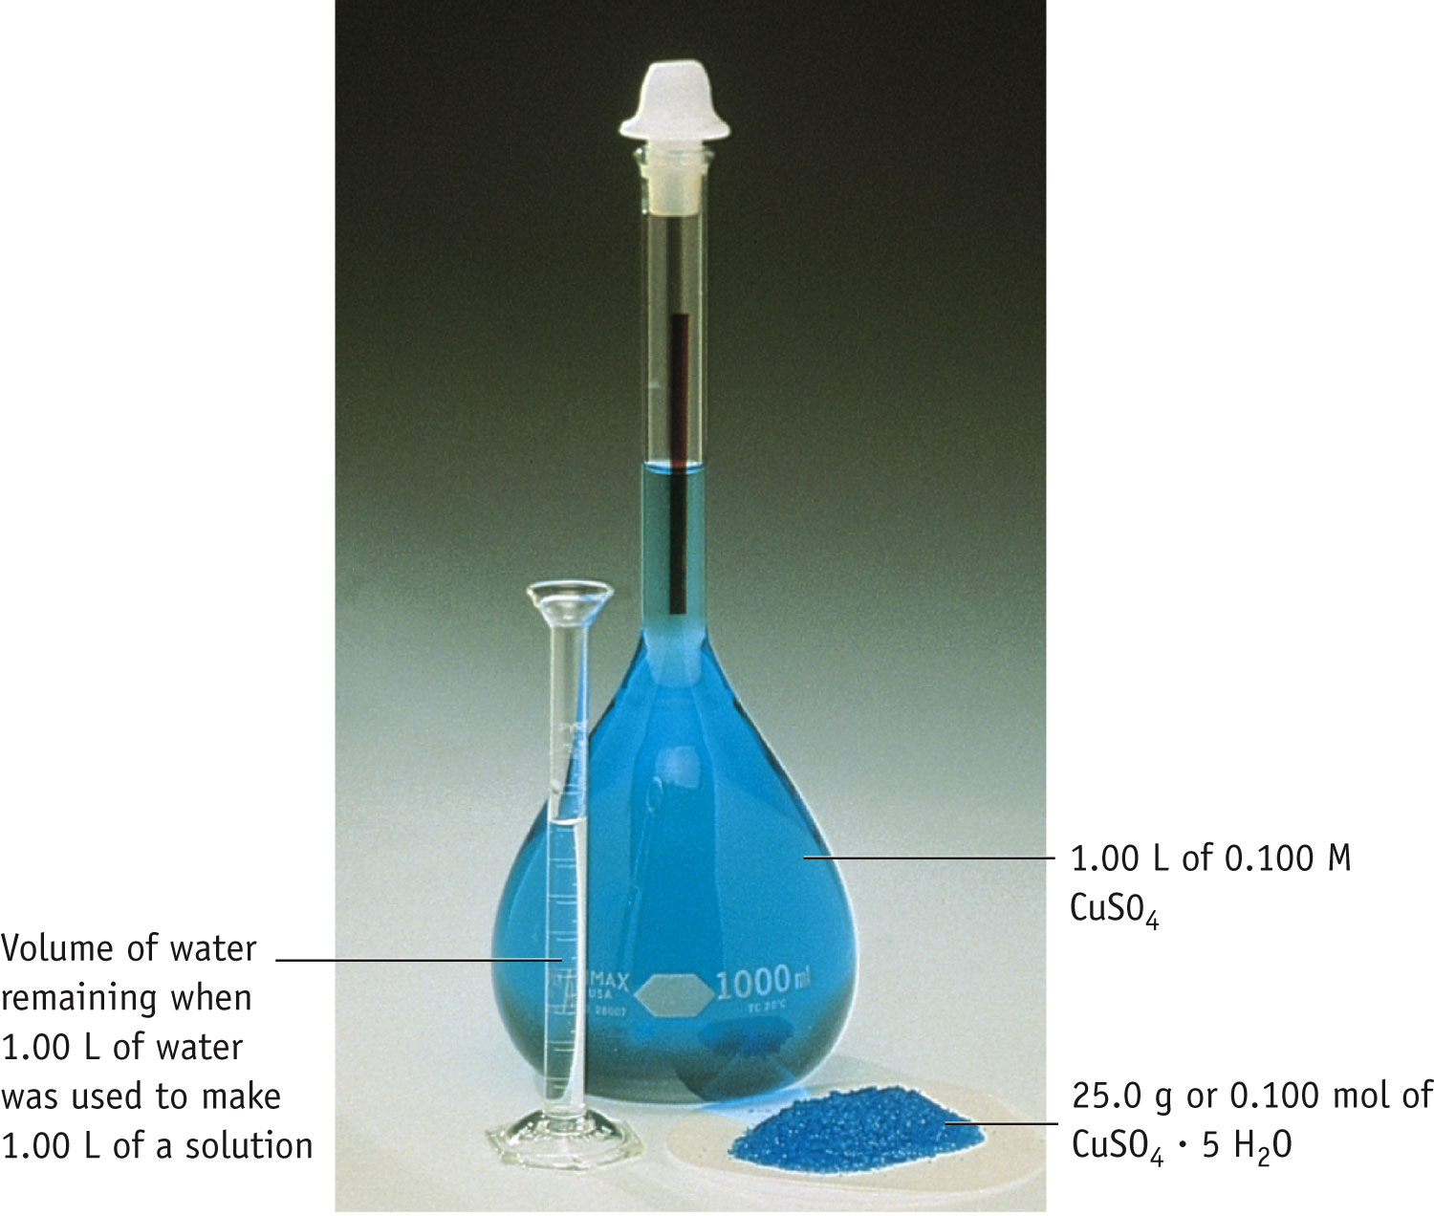
Solution Concentration & Solution Stoichiometry
Solution =
solute
+ solvent
That which is dissolved (lesser amount)
That which is dissolves (greater amount)

Slide 29
Molarity
Two solutions can contain the same compounds but be quite different because the proportions of those compounds are different.
Molarity is one way to measure the concentration of a solution.
moles of solute
Molarity (M) =
volume of solution in liters

Slide 30
Mixing a Solution
To create a solution of a known molarity, one weighs out a known mass (and, therefore, number of moles) of the solute.
The solute is added to a volumetric flask, and solvent is added to the line on the neck of the flask.

Slide 31
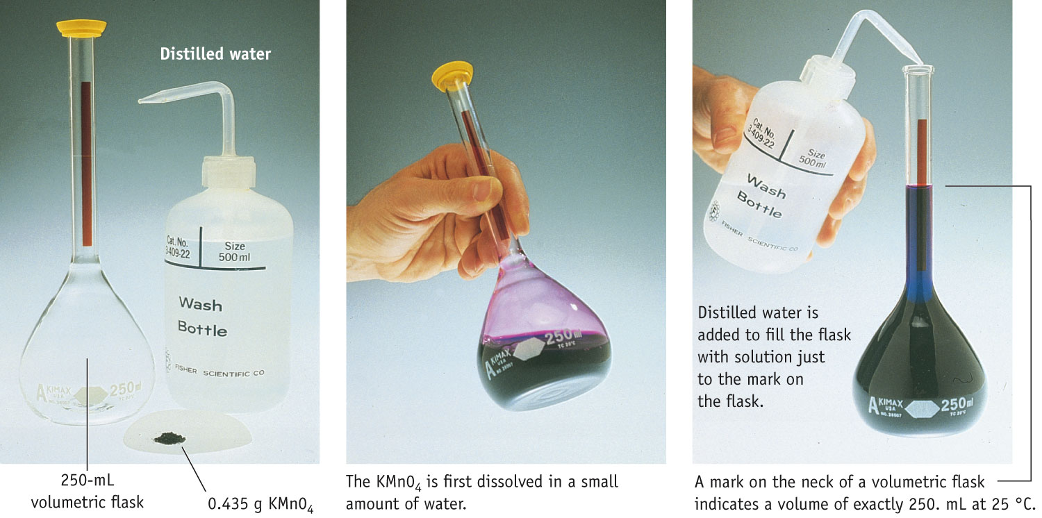
Preparing Solution of Known Concentration

Slide 32
Preparing Solutions
Weigh out the solid solute and carefully transfer it to the volumetric flask.
Dissolve in a volume of solvent less than the flask volume.
Fill the volumetric flask to the calibration mark with solvent.
Invert the flask many times to ensure homogeneous mixing.

Slide 33
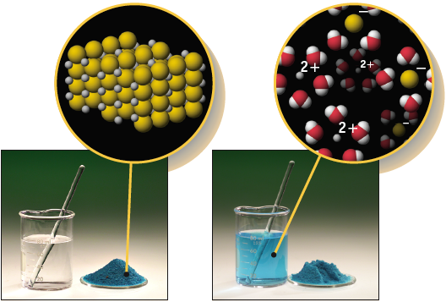
Ion Concentrations in a Solution
CuCl₂(aq) →
Cu²⁺(aq) + 2Cl⁻(aq)
For every one copper (II) ion in solution, there are two chloride ions.
[CuCl₂] = 0.30 M = [Cu²⁺] = 0.30 M
[Cl⁻] = 2 × 0.30 M = 0.60 M

Slide 34
Dilution
One can also dilute a more concentrated solution by
Using a pipet to deliver a volume of the solution to a new volumetric flask, and
Adding solvent to the line on the neck of the new flask.

Slide 35
Dilution
The molarity of the new solution can be determined from the equation
M₁ × V₁ = M₂ × V₂
where M₁ and M₂ are the molarity of the concentrated and dilute solutions, respectively, and V₁and V₂ are the volumes of the two solutions.

Slide 36
Molarity Practice
Identify the mass of sodium sulfate that would be required to make 250 mL of a 0.5M solution
Identify the volume of this solution that would be required to prepare 100 mL of a 0.20 M solution of sodium sulfate.
What is the concentration of the [Na⁺] and [SO₄²⁻] in this final solution?

Slide 37
Using Molarities in Stoichiometric Calculations

Slide 38
Practice: Soln. Stoichiometry
What mass of NaCl is needed to precipitate the silver ions from 20.0 ml of a
0.100M silver nitrate solution?
Write/balance equation
Apply stoichiometry

Slide 39
AgNO₃ (aq) + NaCl (aq) → AgCl (s) + NaNO₃ (aq)
Ans. 0.117g NaCl

Slide 40
Acid Base & Stoichiometry
What is the volume of 0.125M nitric acid required to react with 1.30g of barium hydroxide?
Write the balance equations (watch your solubility rules)
2HNO_{3(aq)} + Ba(OH)_{2(s)} → 2H₂O(l) + Ba(NO₃)_{2(aq)}
Apply stoichiometry
Ans: 0. 121L (121 mL)

Slide 41
Using Molarities in Stoichiometric Calculations

Slide 42
Acid/Base Neutralization
What volume of a 0.115M perchloric acid solution is needed to neutralize a 50.0 ml solution of 0.0875M sodium hydroxide?
Write & balance equation
HClO₄ (aq) + NaOH (aq) → H₂O (l) + NaClO₄ (aq)
Apply stoichiometry
Ans. 38.0 mL

Slide 43
Titration
Titration is an analytical technique in which one can calculate the concentration of a solute in a solution.

Slide 44
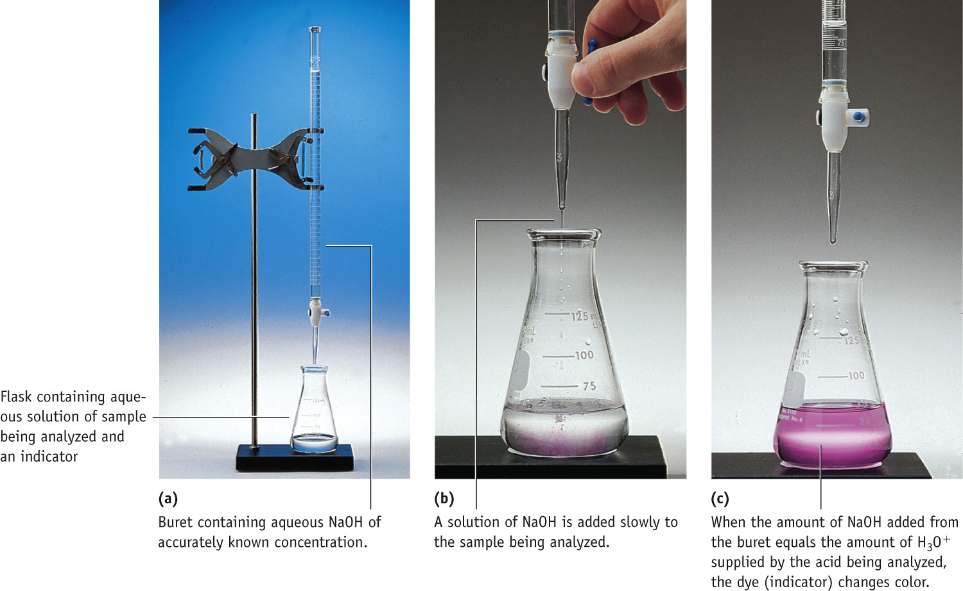
Setup for Titrating an Acid with a Base

Slide 45
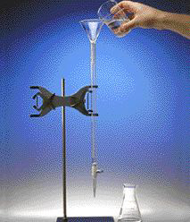
Titrations
1. Add solution from the buret.
2. Reagent (base) reacts with compound (acid) in solution in the flask.
3. Indicator shows when exact stoichiometric reaction has occurred.
4. Net ionic equation
H₃O⁺(aq) + OH⁻(aq)
→ 2 H₂O (l)
5. At equivalence point
moles H₃O⁺ = moles OH⁻
Notes:
See Chapter 4 Video Presentation Slide 9

Slide 46
Using Molarities in Stoichiometric Calculations

Slide 47
KHP
A common standard used in base (OH–) standardizations in the mono–protic acid, KHP.
KHP is an acronym for: potassium hydrogen phthalate
(not potassium hydrogen phosphorous)
The H-atom in the upper right of the compound dissociates to yield H⁺(aq)
1 mol of KHP yields 1 mol of H⁺ when dissolved in solution
KHP (aq) → H⁺(aq) + KP–(aq)
The molar mass of KHP is 204.22 g/mol (C₈H₅O₄K)

Slide 48
Problem:
A student prepares a solution of approximately 0.5 M NaOH(aq). He performs a standardization of the solution using KHP as the standard to determine the exact concentration.
Determine the [OH–] from the data collected:

Slide 49
Problem:
A student prepares a solution of approximately 0.5 M NaOH(aq). He performs a standardization of the solution using KHP as the standard to determine the exact concentration.
Determine the [OH–] from the data collected:
mass KHP + flask:
mass empty flask:
95.3641 g
final buret reading:
initial buret reading:
30.12 mL
95.0422 g
1.56 mL

Slide 50
Problem:
A student prepares a solution of approximately 0.5 M NaOH(aq). He performs a standardization of the solution using KHP as the standard to determine the exact concentration.
Determine the [OH–] from the data collected:
mass KHP + flask:
mass empty flask:
95.3641 g
final buret reading:
initial buret reading:
30.12 mL
95.0422 g
1.56 mL
mass KHP:
0.3219 g
vol. NaOH:
28.56 mL
Remember, [OH–] = [NaOH] Strong Electrolyte!!!

Slide 51
Problem:
A student prepares a solution of approximately 0.5 M NaOH(aq).
He performs a standardization of the solution using KHP as the standard to determine the exact concentration.
Determine the [OH–] from the data collected:
from the stoichiometry, one mole of OH⁻ reacts with 1 mol of KHP
[NaOH] = 0.05519 M

Slide 52
pH
pH is defined as the negative base-10 logarithm of the concentration of hydronium ion.
pH = -log [H₃O⁺]
An acid has a higher [H₃O⁺] than pure water, so its pH is <7.
A base has a lower [H₃O⁺] than pure water, so its pH is >7.

Slide 53
The pH Scale: 0 to 14
The pH of a solution provides a way to express the acidity, or the concentration of H⁺ in solution:
low pH = high [H⁺]
acidic solution
high pH = low [H⁺]
basic solution
a pH of 7 indicates that the solution is neutral

Slide 54
Spectrophotometry
Spectrophotometry is the interaction between light and matter that provides quantitative information about solution concentration.

Slide 55
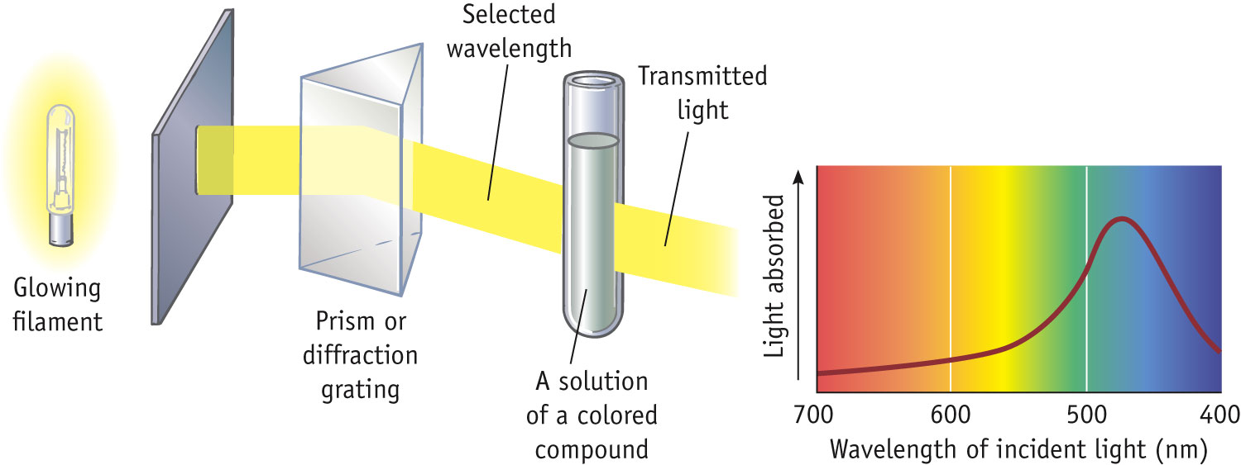
An Absorption Spectrophotometer
Light Source
Wavelength Selection
Sample Container
Spectrum

Slide 56
Spectrophotometry
Amount of light absorbed by a sample depends on path length and solute concentration.
Different concentration of Cu²⁺
Same concentration, different pathlengths

Slide 57
Spectrophotometry
BEER-LAMBERT LAW relates amount of light absorbed and the path length and solute concentration.
A = absorbance l = path length
ε = molar absorptivity c = concentration
There is a linear relation between A and c for a given path length and compound.
Once the instrument is calibrated, knowing absorbance one can determine concentration.

Slide 58
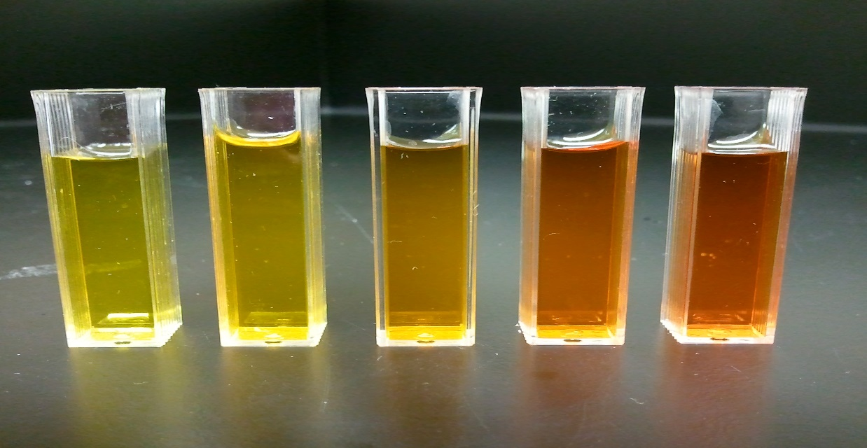
Beer’s Law:
“ The thicker the glass the darker the brew, the less light that passes through”

Slide 59
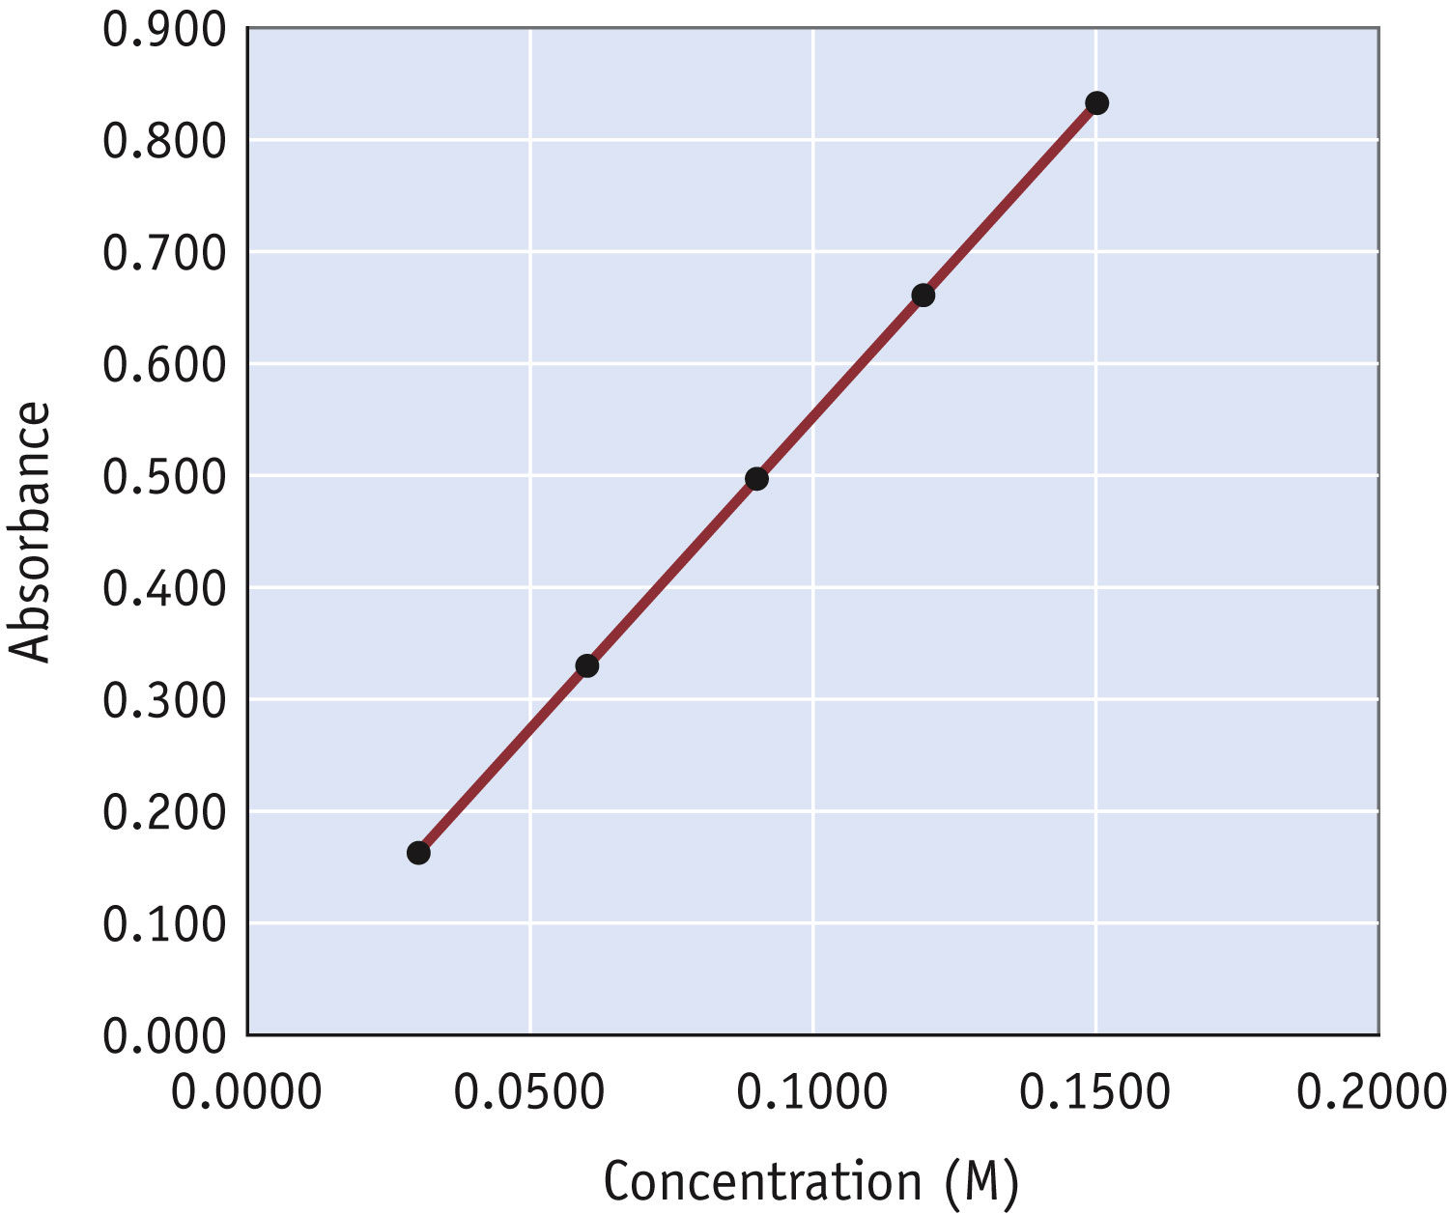
Spectrophotometry
To use the Beer-Lambert law you must first calibrate the instrument.
The calibration plot can be used to find the unknown concentration of a solution from a measured Absorbance.

