Slide 1
Chapter 18
Other Aspects of Aqueous Equilbria:
Concepts: Common Ion Effect
Buffer solutions
Acid-Base Titrations
Ksp (solubility constant)
Complex ions

Slide 2
Common Ion Effect:
What is it?
Common ion effect occurs when a weak acid and its conjugate base or a weak base/conjugate acid are both present in a solution.
Concepts to consider:
General chemistry of the system being studied
Stoichiometry of the reaction
Equilibrium –ICE & K_{a or} K_{b}
Any additional changes to system: consider LeChatelier’s principle

Slide 3
Weak acid/conjugate base:
(example)
HC₂H₃O₂ + H₂O ↔ C₂H₃O₂⁻ + H₃O⁺
pH determined using Ka of acetic acid
Addition of sodium acetate will decrease the % ionization of acetic acid, resulting in a decrease [H₃O⁺] and an increase in pH
Weak base/conjugate acid: same concepts apply!
(example)
NH₃ + H₂O ↔ NH₄⁺ + OH⁻
Addition of NH₄+ will cause the equilibrium to shift towards reactants and decrease the [OH-]
Think Le Chatalier’s principle!

Slide 4
The Common-Ion Effect
To summarize:
The extent of ionization of a weak acid (or base) is decreased by adding to the solution a strong electrolyte (soluble salt) that has an ion in common with that weak acid or base.
The system now has the presence of both the conjugate acid/base pair.

Slide 5
Calculation: Common Ion Effect
What is the pH of 0.15M acetic acid solution?
What is the new pH when 1.56g of sodium acetate is added to 500 mL of this solution?
Strategy:
Set up ICE chart
Calculate [H₃O⁺], K_{a} for acetic acid : 1.8 x 10 ⁻⁵
Calculate pH
Set up similar ICE chart now with the presence of the [acetate ion].
Calculate the pH

Slide 6
Calculation: Stoichiometry
What is the pH of a solution that results from adding 25.0 mL of 0.0500M NaOH to 25.0 mL of 0.100M Lactic acid (HC₃H₅O₃),
Ka = 1.4 x 10⁻⁴
Strategy:
Stoichiometry to determine what species remain after the acid/base reaction.
Determine your limiting reactant.
Calculate the concentration [ ] for remaining species
Construct and ICE chart
Determine [H₃O+] and solve for pH
Answer: pH = 3.85

Slide 7
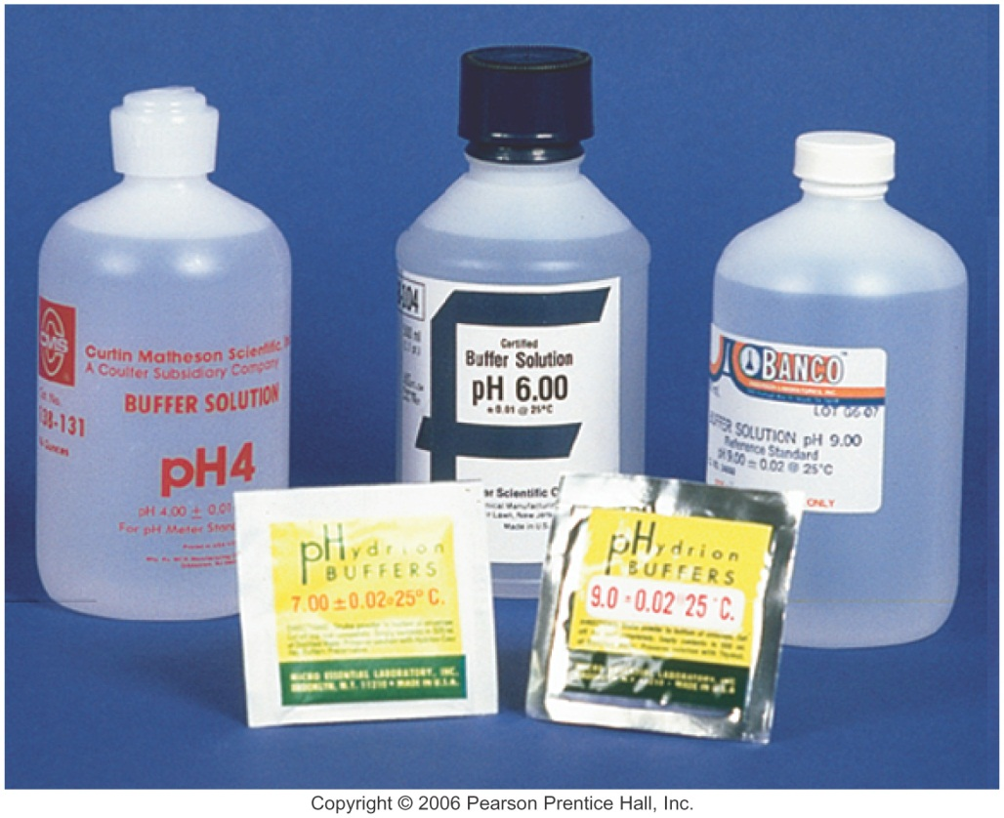
Buffers
Buffers are solutions of a weak conjugate acid-base pair.
They are particularly resistant to pH changes, even when strong acid or base is added.

Slide 8
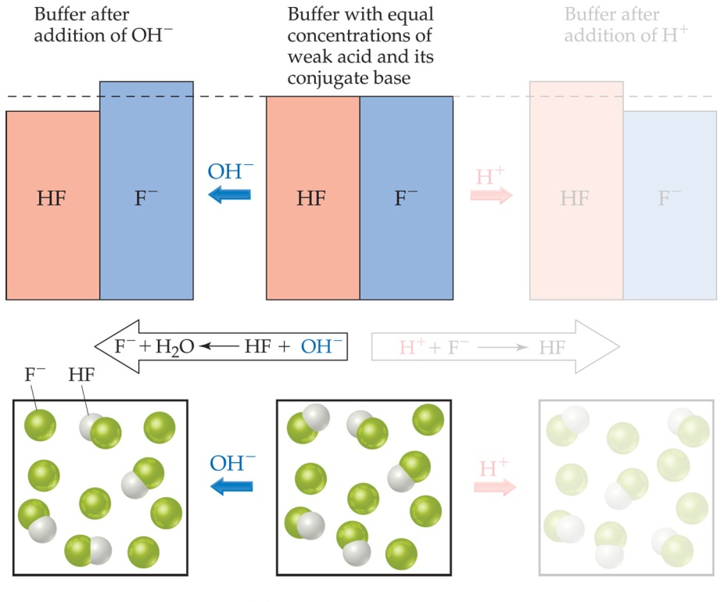
Buffers
If a small amount of hydroxide is added to an equimolar solution of HF in NaF, for example, the HF reacts with the OH⁻ to make F⁻ and water.

Slide 9
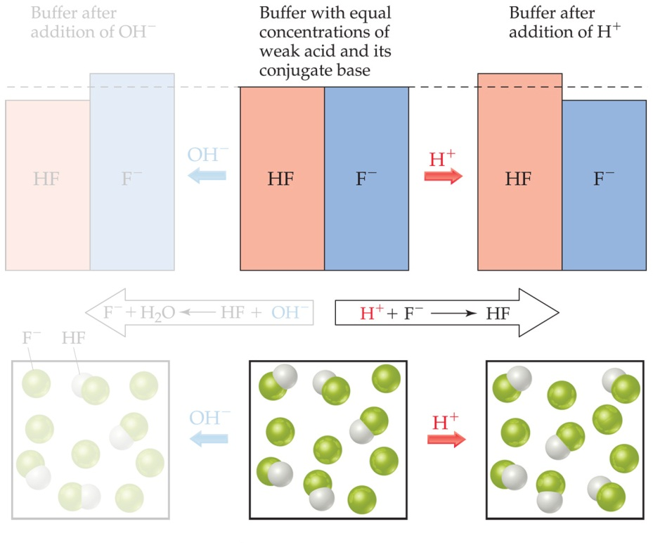
Buffers
Similarly, if acid is added, the F⁻ reacts with it to form HF and water.

Slide 10
Buffer Solutions
A buffer is a solution that can resist the change in pH brought on by the addition of a strong acid or a strong base.
Buffering is most affective when pH = pKa
[weak acid ] = [conjugate base]
Buffering capacity is determined by the concentration of the weak acid and its conjugate base.
This relationship is defined by the Henderson -Hasselbalch equation:
pH = pKa + log [base]/[acid]

Slide 11
Buffer Calculations
Consider the equilibrium constant expression for the dissociation of a generic acid, HA:
HA + H₂O
H₃O⁺ + A⁻
[H₃O⁺] [A⁻]
[HA]
K_{a} =

Slide 12
Buffer Calculations
Rearranging slightly, this becomes
[A⁻]
[HA]
K_{a} =
[H₃O⁺]
Taking the negative log of both side, we get
[A⁻]
[HA]
base
−log K_{a} =
−log [H₃O⁺] + −log
pK_{a}
acid
pH

Slide 13
Buffer Calculations
So
[base]
[acid]
pK_{a} = pH − log
Rearranging, this becomes
[base]
[acid]
pH = pK_{a} + log
This is the Henderson–Hasselbalch equation.

Slide 14
Calculating pH of a buffer
Determine the pH of an acetic acid buffer with [HC₂H₃O₂] = 0.700M and [C₂H₃O₂⁻] = 0.600M. (Ka = 1.8 x 10⁻⁵)
Strategy: set up ICE chart
Set up Ice Chart
Determine [H₃O⁺]
Calculate pH
-or-
Apply Henderson-Hasselbach equation:

Slide 15
Preparing a Buffer:
Select acid whose pKa is close to desired pH
Buffering capacity- means there’s adequate amt. of acid/conjugate base to “absorb” the addition of acid/base to system. General range is 0.1-1.0M

Slide 16
pH Range and Buffers:
The pH range is the range of pH values over which a buffer system works effectively.
When preparing a buffer, it is best to choose an acid with a pK_{a} close to the desired pH.

Slide 17
Sample Calculation:
Calculate the ratio of [NH₃]/[NH₄⁺] needed to produce a buffered solution with the following pH values: (Ka = 5.6 x 10⁻¹⁰)
pH = 9.00
pH = 10.00
(0.56, 5.6)

Slide 18
Preparation of a buffer:
A buffered solution is made by adding 75.0g of sodium acetate to 500.0mL of 0.64M of Acetic Acid. What is the pH of the final solution (assuming no volume change). Ka= 1.8 x 10⁻⁵
pH = 5.20

Slide 19
Preparation of a Buffer:
Identify the ratio needed to prepare a buffer solution from HC₂H₃O₂ and NaC₂H₃O₂ to have a pH of 5.0 (Ka = 1.8 x 10⁻⁵)
Ratio [C₂H₃O₂⁻]: [HC₂H₃O₂]
1.82 : 1.00

Slide 20
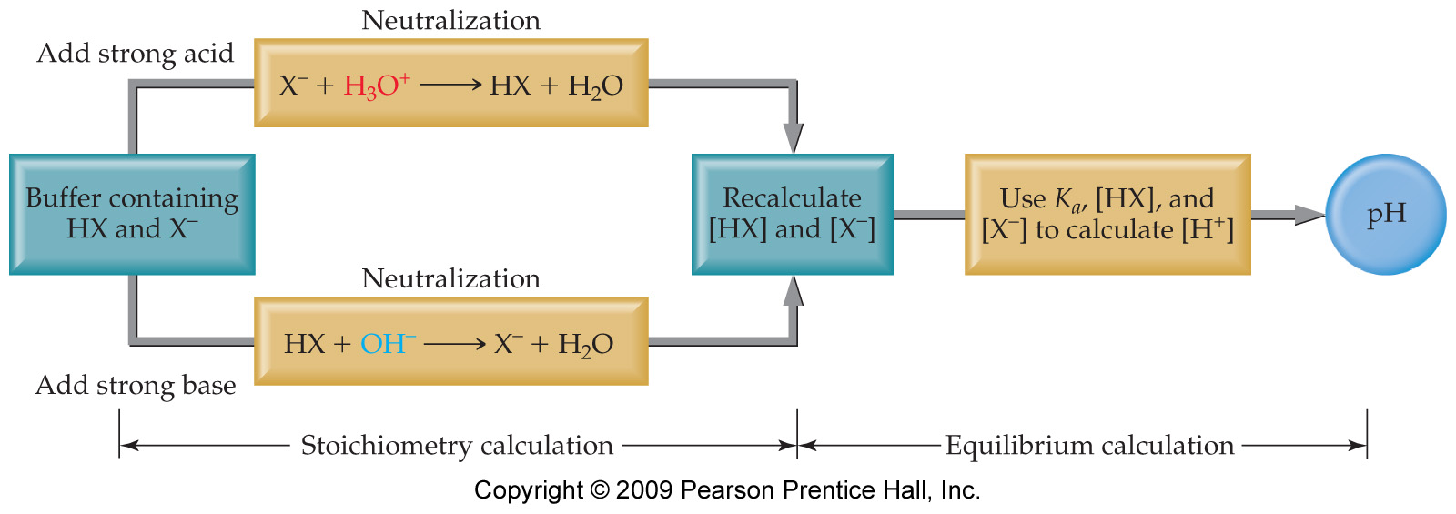
When Strong Acids or Bases Are Added to a Buffer…
…it is safe to assume that all of the strong acid or base is consumed in the reaction.

Slide 21
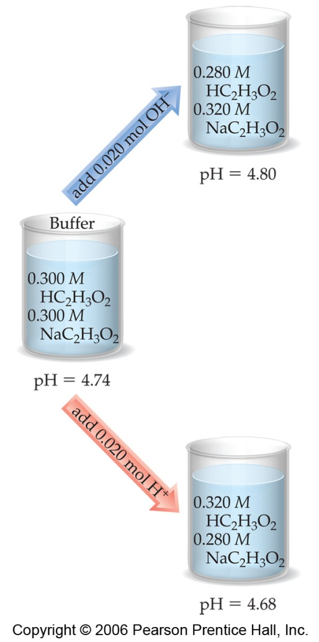
Addition of Strong Acid or Base to a Buffer
Determine how the neutralization reaction affects the amounts of the weak acid and its conjugate base in solution.
Use the Henderson–Hasselbalch equation to determine the new pH of the solution.

Slide 22
Calculating pH Changes in Buffers
A buffer is made by adding 0.300 mol HC₂H₃O₂ and 0.300 mol NaC₂H₃O₂ to enough water to make 1.00 L of solution. The pH of the buffer is 4.74. Calculate the pH of this solution after 0.020 mol of NaOH is added.

Slide 23
Calculating pH Changes in Buffers
Before the reaction, since
mol HC₂H₃O₂ = mol C₂H₃O₂⁻
pH = pK_{a} = −log (1.8 × 10⁻⁵) = 4.74

Slide 24
Calculating pH Changes in Buffers
The 0.020 mol NaOH will react with 0.020 mol of the acetic acid:
HC₂H₃O₂(aq) + OH⁻(aq) ⎯⎯→ C₂H₃O₂⁻(aq) + H₂O(l)
 | HC₂H₃O₂ | C₂H₃O₂⁻ | OH⁻
Before reaction | 0.300 mol | 0.300 mol | 0.020 mol
After reaction | 0.280 mol | 0.320 mol | 0.000 mol

Slide 25
Calculating pH Changes in Buffers
Now use the Henderson–Hasselbalch equation to calculate the new pH:
(0.320)
(0.200)
pH = 4.74 + log
pH = 4.74 + 0.06
pH
pH = 4.80

Slide 26
Sample calculation:
Calculate the pH after 0.15mole of solid NaOH is added to 1.00L of a buffer containing 0.50M propanoic acid (HC₃H₅O₂, K_{a}= 1.3 x 10⁻⁵) and 0.8M sodium propanoate.
Ans. 5.32

Slide 27
Additional buffer problem:
You dissolve 0.425g of NaOH in 2.00L of a buffer solution that has [H₂PO₄⁻]=[HPO₄⁻²]=0.132M.
What is the pH of the solution before adding NaOH?
What is the pH of the solution after the addition of NaOH?

