Slide 1
Chapter 11: Gases

Slide 2
Characteristics of Gases
Unlike liquids and solids, gases
  expand to fill their containers;
  are highly compressible;
  have extremely low densities.

Slide 3
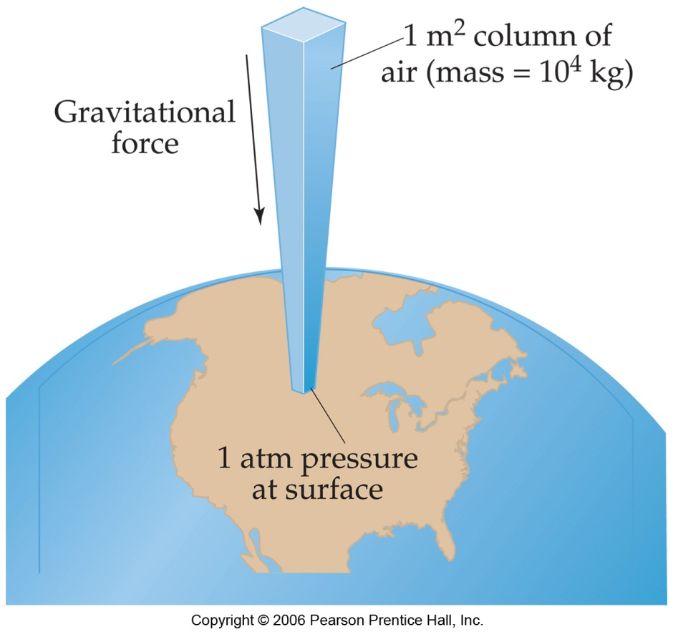
Pressure
Pressure is the amount of force applied to an area.
F
A
P =
Atmospheric pressure is the weight of air per unit of area.

Slide 4
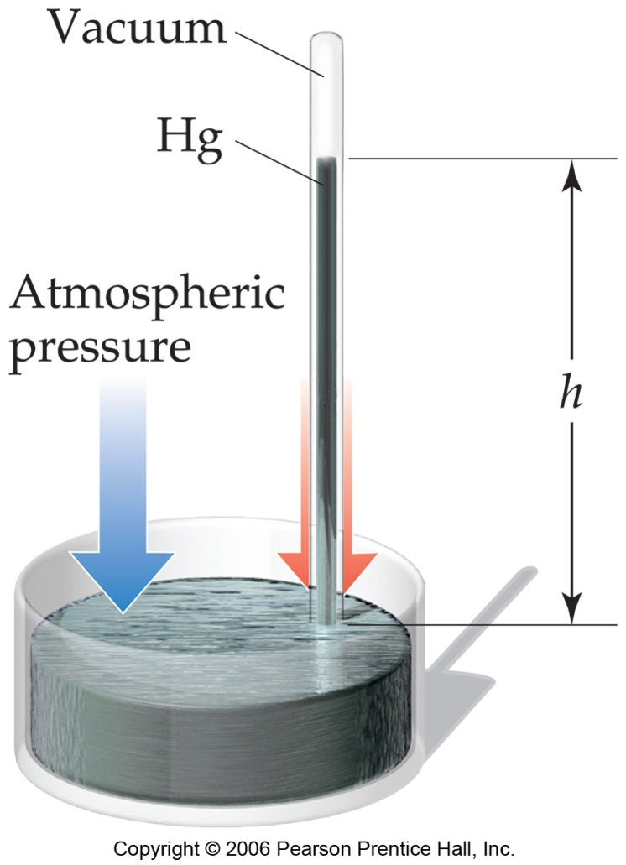
Units of Pressure
mm Hg or torr
  These units are literally the difference in the heights measured in mm (h) of two connected columns of mercury.
Atmosphere
  1.00 atm = 760 torr

Slide 5
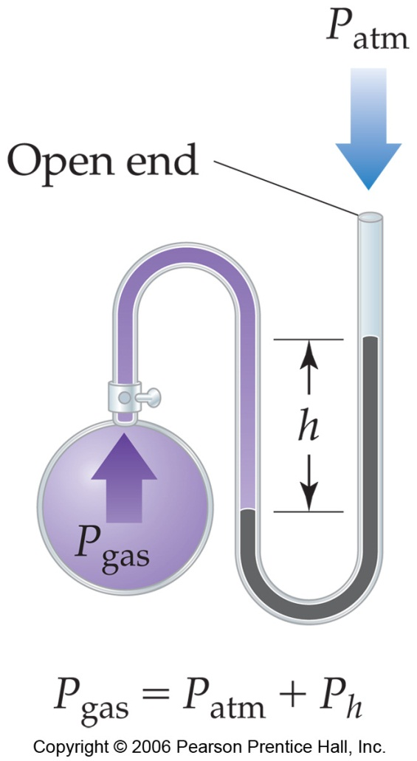
Manometer
This device is used to measure the difference in pressure between atmospheric pressure and that of a gas in a vessel.

Slide 6
Standard Pressure
Normal atmospheric pressure at sea level is referred to as standard pressure.
It is equal to
  1.00 atm
  760 torr (760 mm Hg)
  101.325 kPa

Slide 7
Gas Laws:
Four variable are need to describe gases.
Pressure (P)
Volume (V)
Temperature (T, Kelvin)
Amount (n, mole)
Understanding the interrelationship of these variables allow scientists to study properties of gases quantitatively on the molecular/atomic level.

Slide 8
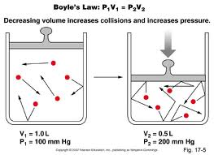
Boyle’s Law
The volume of a fixed quantity of gas at constant temperature is inversely proportional to the pressure.

Slide 9
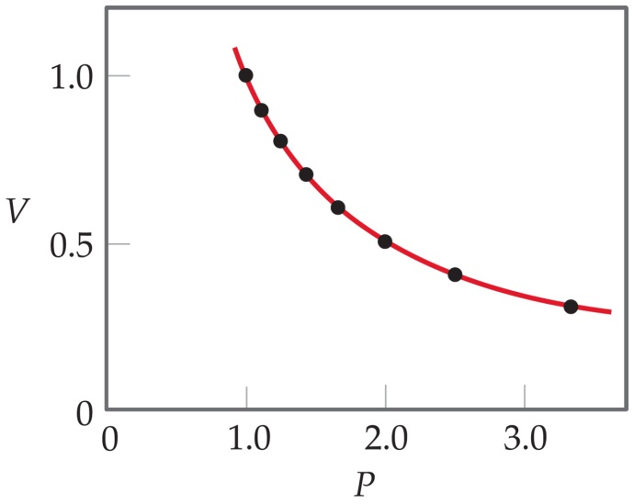
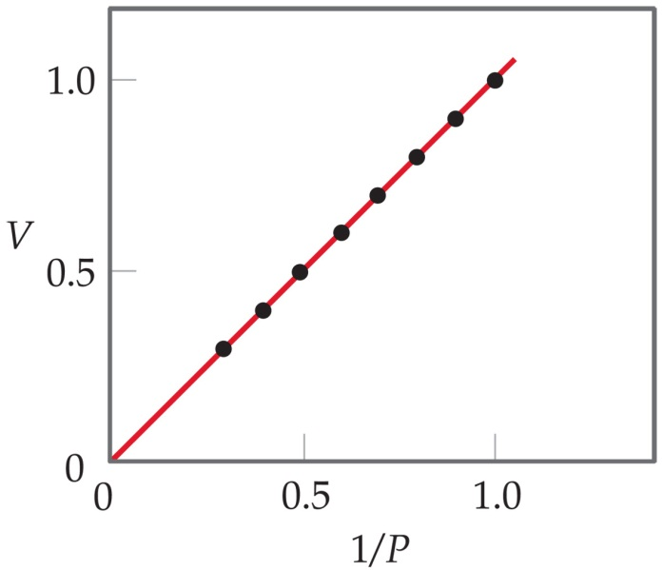
As P and V are inversely proportional
A plot of V versus P results in a curve.
PV = k
Since
  V = k (1/P)
  This means a plot of V versus 1/P will be a straight line.

Slide 10
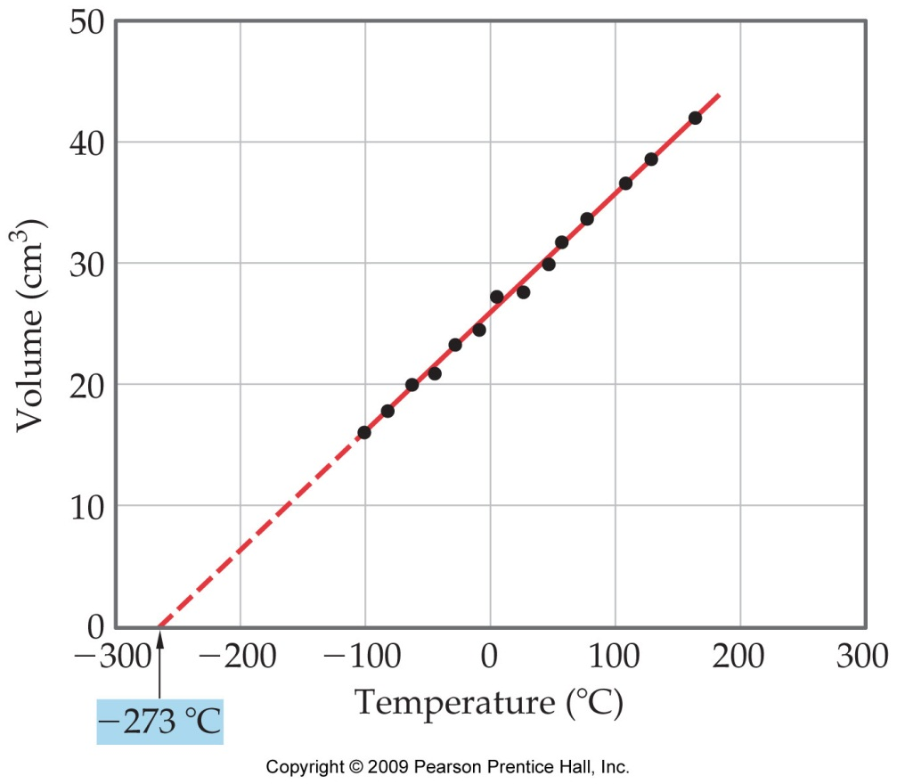

Charles’s Law
When a given amount of gas is held at a constant pressure, its volume is directly proportional to the Kelvin temperature
The volume of a fixed amount of gas at constant pressure is directly proportional to its absolute temperature.
V
T
i.e.,
= k
A plot of V versus T will be a straight line.

Slide 11
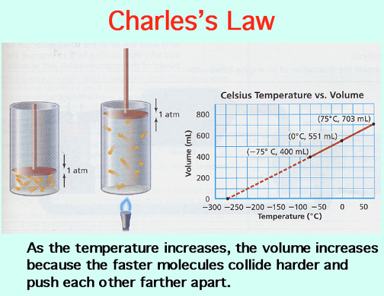

Slide 12
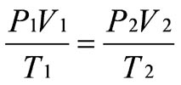
The General (combined) Gas law
Relates properties of P,V, T only when the amount of gas is unchanged.

Slide 13
Sample problem:
A sample of Argon gas initially at 0°C occupies 2.24L and exerts 760 mm Hg. If the gas is heated to 100. °C and allowed to expand to 3.00L, what is the new pressure of the gas?
Answer: 775 mm Hg

Slide 14
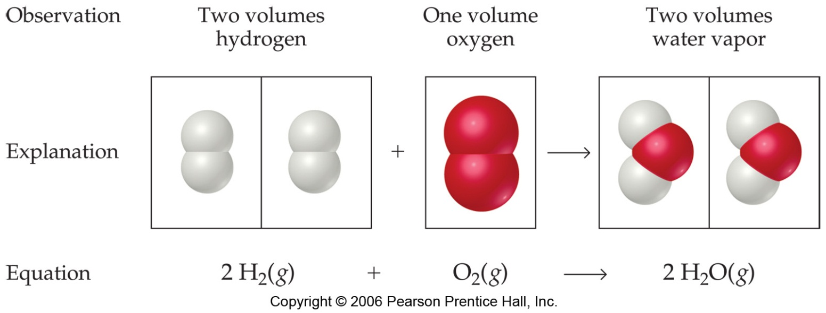
Avogadro’s Law
The volume of a gas at constant temperature and pressure is directly proportional to the number of moles of the gas.
Mathematically, this means
V = kn

Slide 15
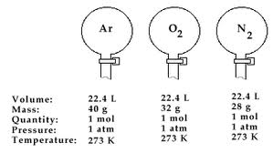
Avogadro’s Law & Molar Volume
Under conditions of STP (1 atm., 273K),
one mole of a gas occupies 22.4L

Slide 16
Ideal-Gas Equation
So far we’ve seen that
      V ∝ 1/P (Boyle’s law)
      V ∝ T (Charles’s law)
      V ∝ n (Avogadro’s law)
Combining these, we get
nT
P
V ∝

Slide 17
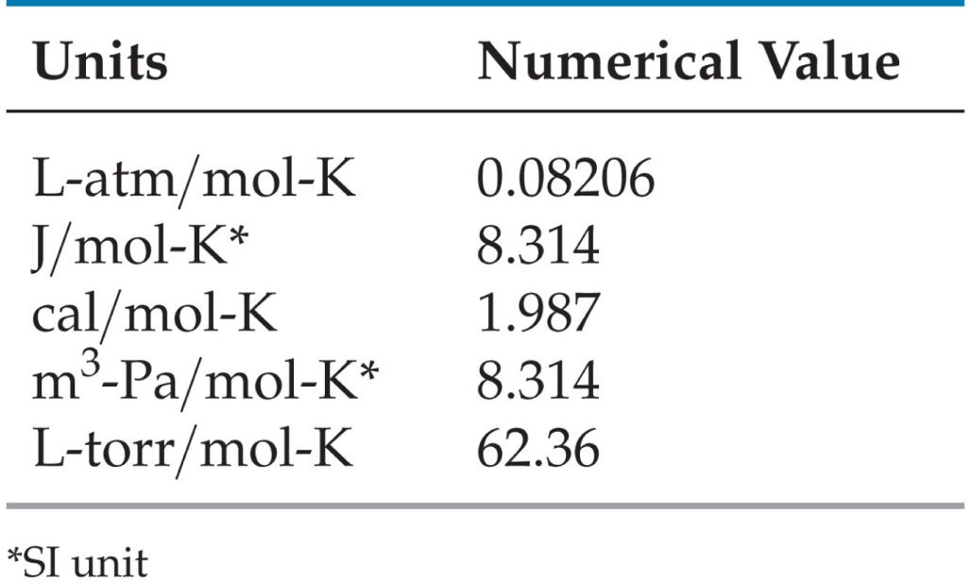
Ideal-Gas Equation
The constant of proportionality is known as R, the gas constant.

Slide 18
Ideal-Gas Equation
The relationship
nT
P
V ∝
nT
P
then becomes
V = R
or
PV = nRT

Slide 19
Sample Problem:
What pressure should 1.00g of oxygen exert if it is in a 250 mL vessel at a temperature of 15°C?
Answer = 2.96 atm.

Slide 20
Densities of Gases
Understanding the density of a gas at a given temperature and pressure is useful. Likewise, knowing the density of a gas can allow us to determine the molar mass and possible identity of an unknown gas.
All this can be derived from the ideal gas law.
n = moles, m= mass (g), M = molar mass (g/mole)

Slide 21
Densities of Gases
Mass ÷ volume = density
So,
m
V
PΜ
RT
d =
=
Note: One only needs to know the molecular mass, the pressure, and the temperature to calculate the density of a gas.

Slide 22
Molecular Mass
We can manipulate the density equation to enable us to find the molecular mass of a gas:
PΜ
RT
d =
Becomes
dRT
P
Μ =

Slide 23
Sample Density problem:
Determine the density of nitrogen gas (N₂) and Carbon dioxide gas (CO₂) at STP
Answer: N₂= 1.25 g/L
CO₂= 1.96 g/L
Application of gas density

Slide 24
Gas Laws & Stoichiometry
The ideal gas law provides another method to calculate the number of moles of a species-useful in chemical reactions.
PV = nRT

Slide 25
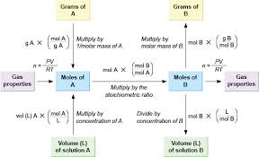
Gas Stoichiometry
Incorporation of the molar quantity allows us to address gas-phase chemical reactions quantitatively.

Slide 26
Sample Gas Law-Stoichiometry problem:
Mercury can be achieved by the following reaction :
__HgO(s) →__ Hg(l) + __O₂(g)
What volume of oxygen gas can be produced from 4.10 g of mercury (II) oxide at STP?
Strategy: Balance equation
Calculate moles of O₂(g)
Solve for volume using ideal gas law
Answer: 0.212L

Slide 27
Another problem:
Given the following equation, what mass of NO is produced from 500. L of NH₃ at 250.0ºC and 3.00 atm?
4NH₃(g) + 5O₂(g) → 4 NO(g) + 6H₂O(g)
Strategy: Balance equation (done)
Determine moles of NH₃ (ideal gas law)
Apply stoichiometry to solve for NO
Answer: 1050 g NO

Slide 28
Dalton’s Law of
Partial Pressures
The total pressure of a mixture of gases equals the sum of the pressures that each would exert if it were present alone.
In other words,
      P_{total} = P₁ + P₂ + P₃ + …

Slide 29
Dalton’s Law of Partial Pressure
& Mole Fraction
Dalton’s law states that the total pressure will be the sum of the pressure that each gas would exert if it were alone under the same condition:
P_{t} = P₁ + P₂ + P₃..etc.
The presence of the other gases does not affect the pressure that each gas exerts because each gas molecule is moving independently.
Total pressure is dependent on # of molecules. It doesn’t matter what the molecules are: PV = n_{total}RT

Slide 30
Partial Pressure problem:
What is the pressure of 5.00L of a gas mixture consisting of:
0.30moles of N₂,
0.20moles of O₂
0.15 moles of CO₂
The temperature is 298K.
(use the Ideal gas law: n_{total})
What is the partial pressure of each gas?
Answer: 3.18 atm.

Slide 31
…Mole Fraction
Knowing the mole fraction (X) for each gas allows us to determine their partial pressure:
X_{A} = Moles of component A
total moles
P_{A} = X_{A} P_{total}

Slide 32
Dalton’s Law:
What is the total pressure in atm of a gas mixture that contains 1.0g of H₂ and 8.0 g of Ar in a 3.0 L container at 27°C?
What is the partial pressure of each gas?
Answer: P_{H2} = 4.1 atm
P_{Ar} = 1.6 atm
P_{total} = 5.7 atm

Slide 33
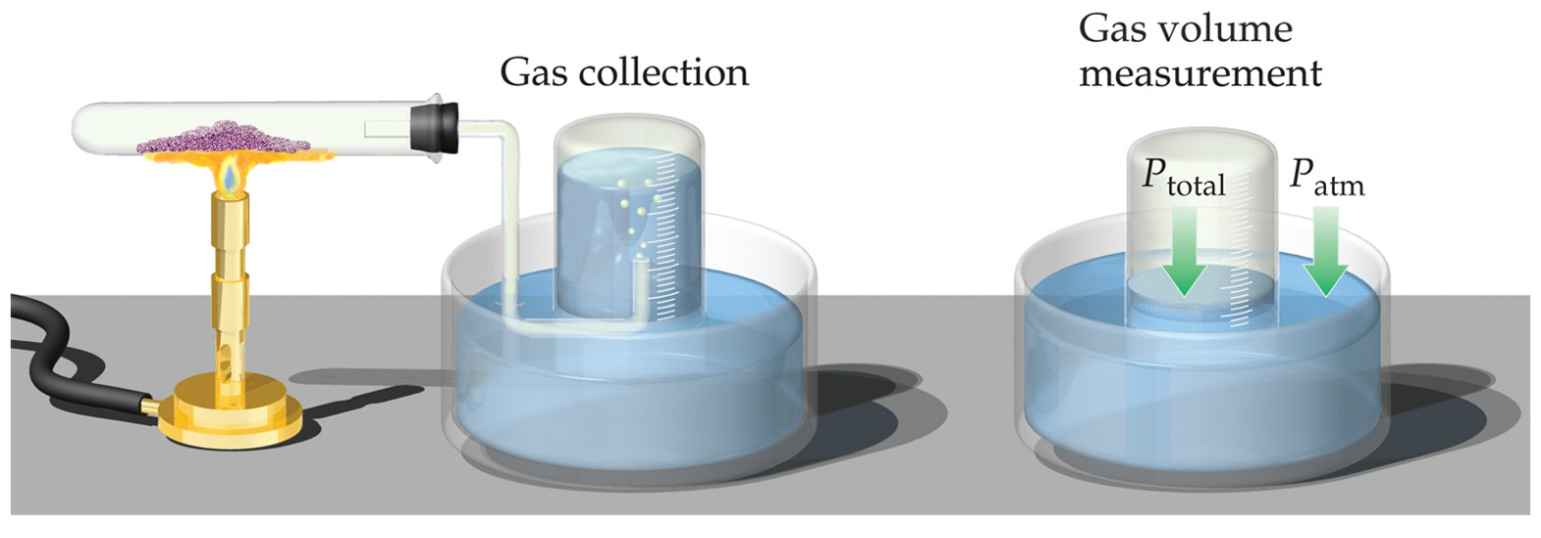
Partial Pressures
When one collects a gas over water, there is water vapor mixed in with the gas.
To find only the pressure of the desired gas, one must subtract the vapor pressure of water from the total pressure.

Slide 34
Kinetic Molecular Theory

Slide 35
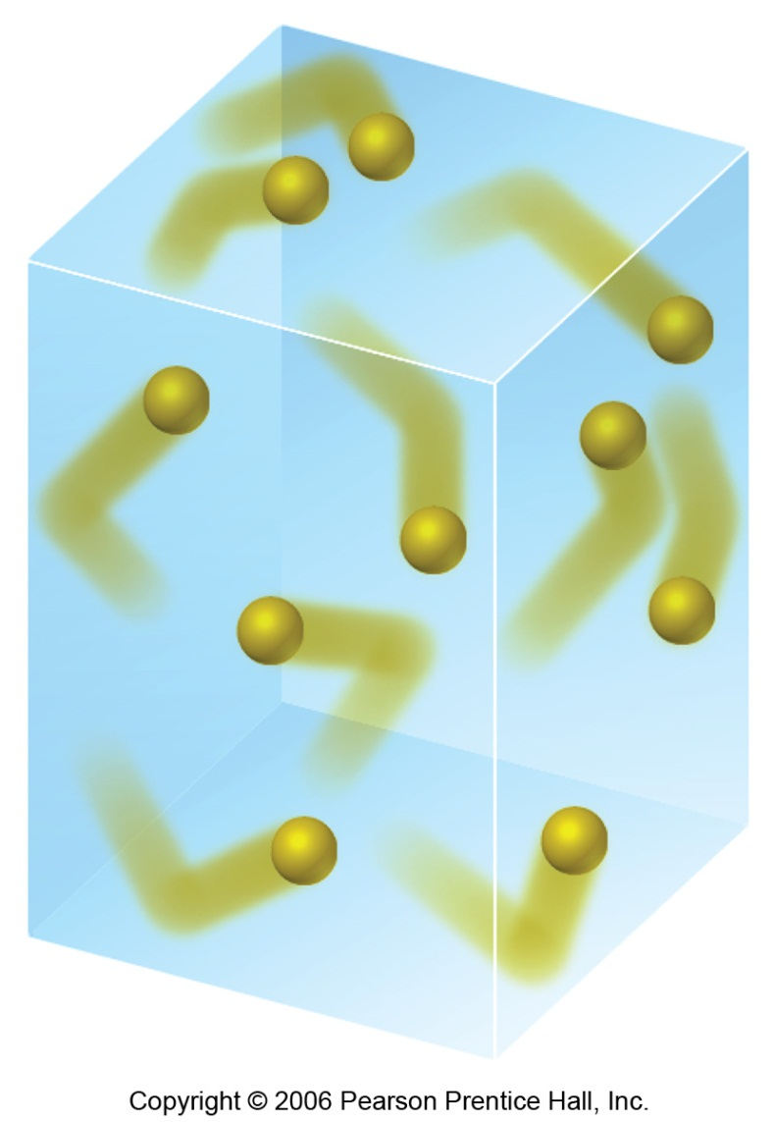
Kinetic-Molecular Theory
This is a model that aids in our understanding of what happens to gas particles as environmental conditions change.
(role of: temp (T), volume (V), amount (n) and pressure (P))

Slide 36
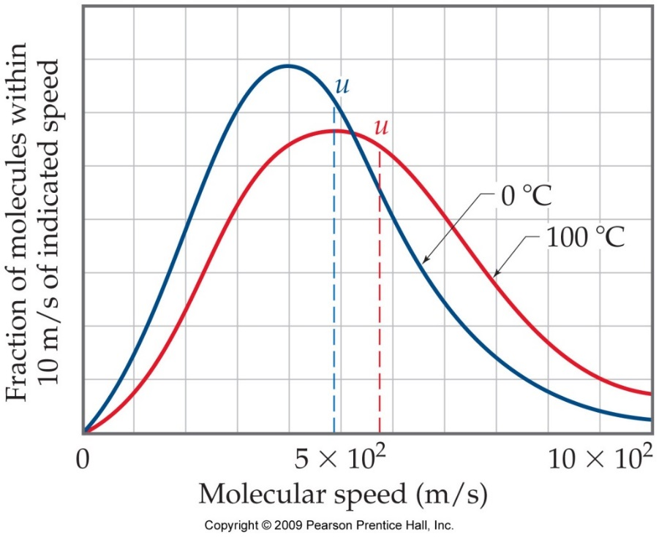
Main Tenets of Kinetic-Molecular Theory (KMT)
Energy can be transferred between molecules during collisions, but the average kinetic energy of the molecules does not change with time, as long as the temperature of the gas remains constant.

Slide 37
Main Tenets of Kinetic-Molecular Theory
Gases consist of large numbers of molecules that are in continuous, random motion.
The combined volume of all the molecules of the gas is negligible relative to the total volume in which the gas is contained (more empty space than “particles”).

Slide 38
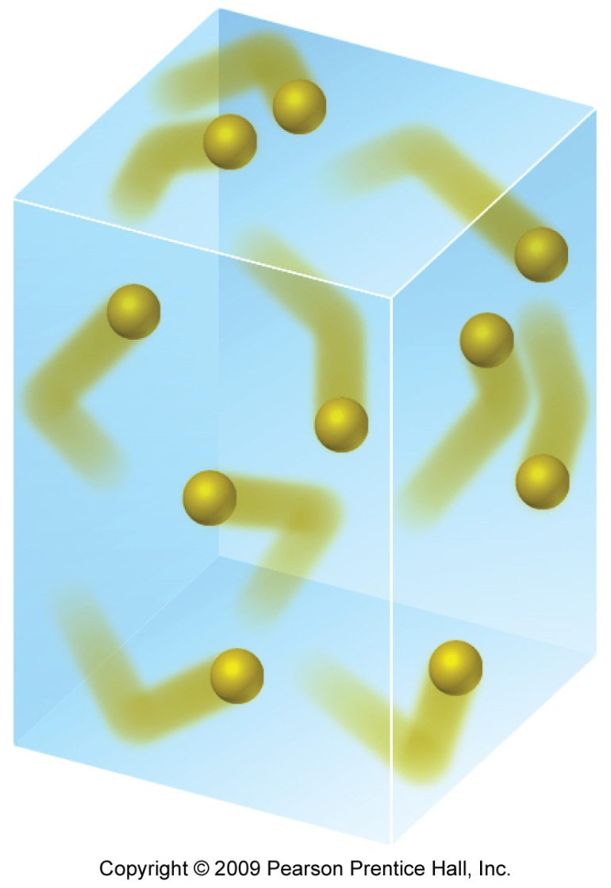
Main Tenets of Kinetic-Molecular Theory
Attractive and repulsive forces between gas molecules are negligible.

Slide 39
The Kinetic-Molecular Theory of Gases
Clausius (1857)
Postulates:
 A gas is a collection of a very large number of particles that remains in constant random motion.
 The pressure exerted by a gas is due to collisions with the container walls
 The particles are much smaller than the distance between them.

Slide 40
The Kinetic-Molecular Theory of Gases
 The particles move in straight lines between collisions with other particles and between collisions with the container walls. (i.e. the particles do not exert forces on one another between collisions.)
 The average kinetic energy (½ mv²) of a collection of gas particles is proportional to its Kelvin temperature.
 Gas particles collide with the walls of their container and one another without a loss of energy.

Slide 41
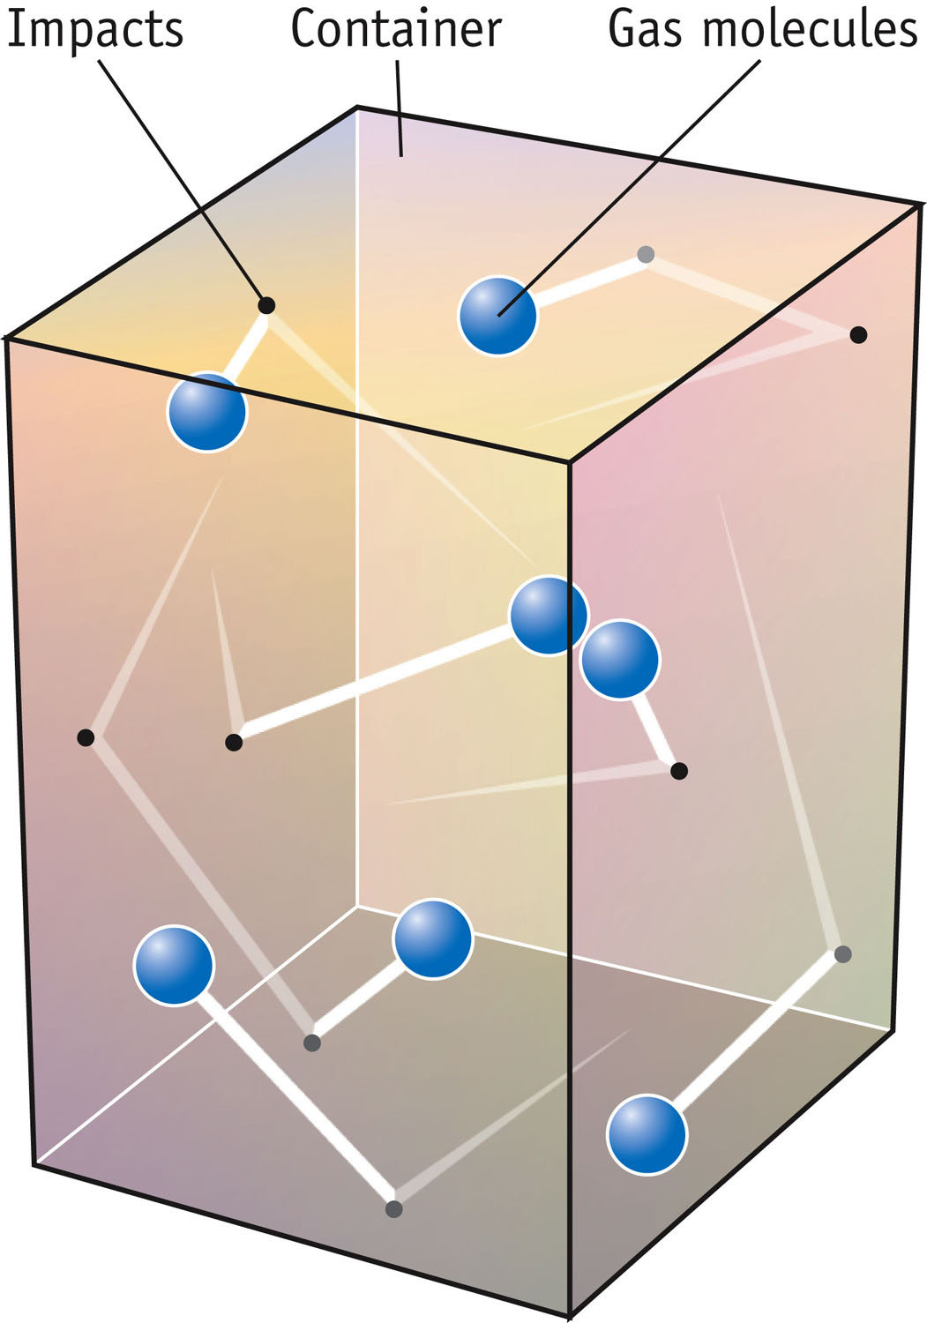
The Kinetic-Molecular Theory of Gases
Gas pressure at the particle level:

Slide 42
The Kinetic-Molecular Theory of Gases
The relationship between temperature (T) and velocity (u) (kinetic energy) can be found by the following:
Ideal gas law
KMT
Setting the two equal:
Careful for this!
solving:
The “root mean square velocity” for a gas is:

Slide 43
Kinetic-Molecular Theory
What is the RMS velocity of a nitrogen molecule in miles per hr at STP?
½
m/s
= 1.103×10³ mph

Slide 44
Kinetic-Molecular Theory
At the same T, all gases have the same average KE.
As T goes up, KE also increases — and so does speed.
Gas law simulation and KE
Notes:
See Chapter 11 Video Presentation Slide 11

Slide 45
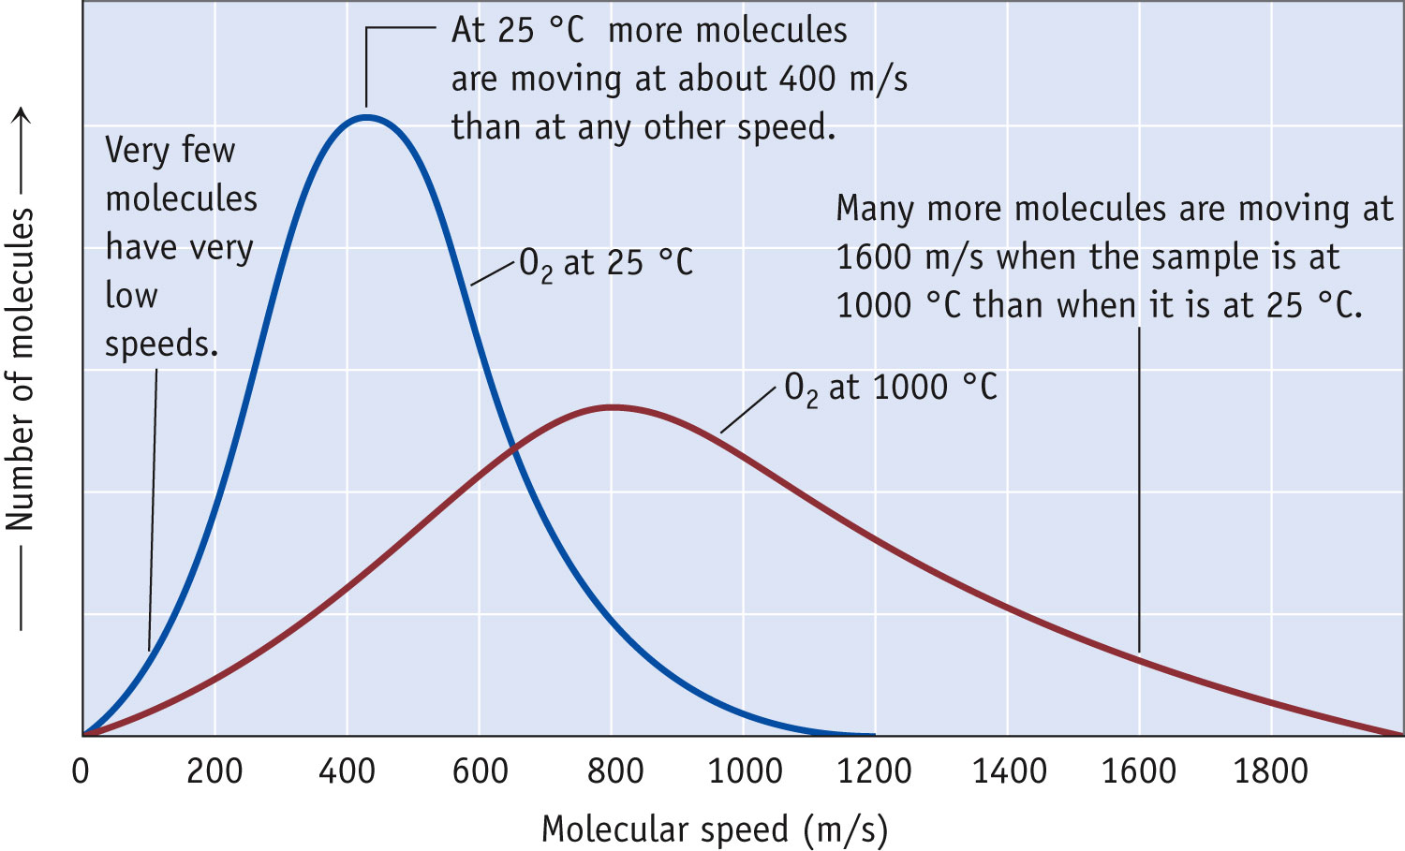
Kinetic Molecular Theory
For a given temperature, heavier gases move slower than lighter gases.
The velocities are described by a distribution.

Slide 46
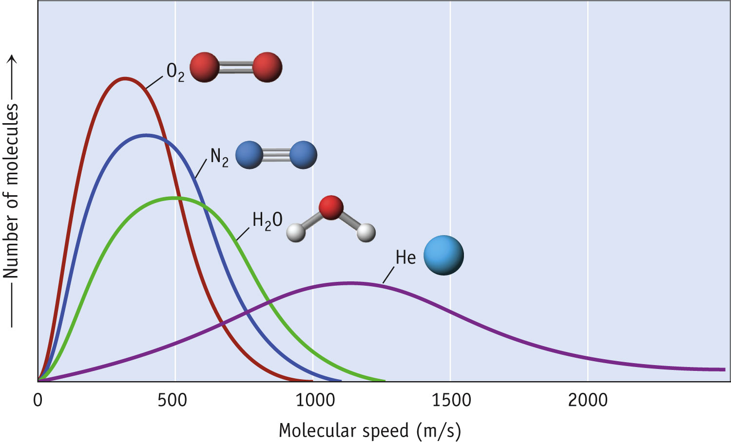
Velocity of Gas Particles
Average velocity decreases with increasing mass.

Slide 47
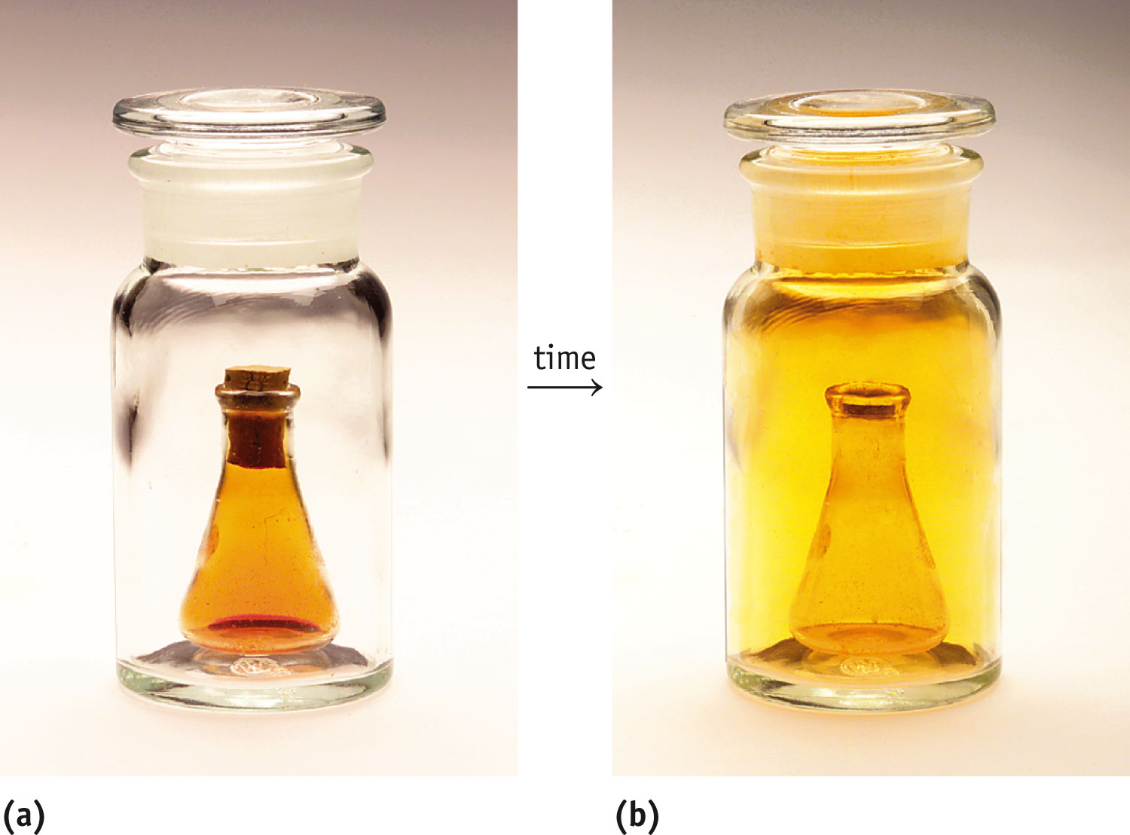
Gas Diffusion & Effusion
Diffusion is the process of gas migration due to the random motions and collisions of gas particles.
It is diffusion that results in a gas completely filling its container.
After sufficient time gas mixtures become homogeneous.

Slide 48
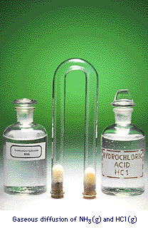
Gas Diffusion: Relation of mass to Rate of Diffusion
HCl and NH₃ diffuse from opposite ends of tube.
Gases meet to form NH₄Cl
HCl heavier than NH₃
Therefore, NH₄Cl forms closer to HCl end of tube.
Notes:
See Chapter 11 Video Presentation Slide 13

Slide 49
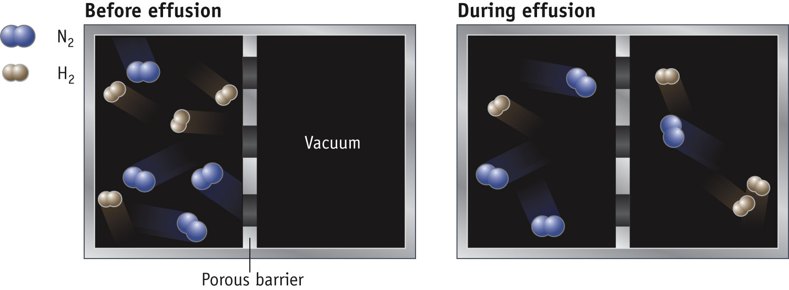
Gas Effusion
EFFUSION is the movement of molecules through a small hole into an empty container. (vacuum)
In this case, the H₂ molecules “escape” more quickly due to their lower molar mass.

Slide 50
Graham's Law: provides a mathematical relationship of kinetic energy.
KE₁
=
KE₂
1/2 m₁v₁²
=
1/2 m₂v₂²
m₁
v₂²
=
m₂
v₁²
√‾m₁
√‾v₂²
v₂
=
=
√‾v₁²
v₁
√‾m₂

Slide 51
Graham’s Law
Under certain conditions, methane gas (CH₄) diffuses at a rate of 12 cm/sec. Under the same conditions, an unknown gas diffuse at a rate of 8.0 cm/sec. What is the molar mass of the unknown gas?
Strategy: KE₁ = KE₂
(½M₁v₁² = ½ M₂v₂²)
Solve for M₂
Answer: M₂ = 36 g/mole

Slide 52
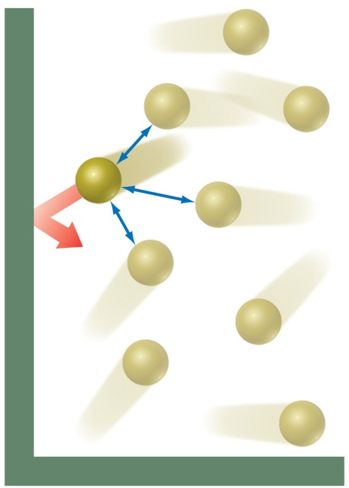
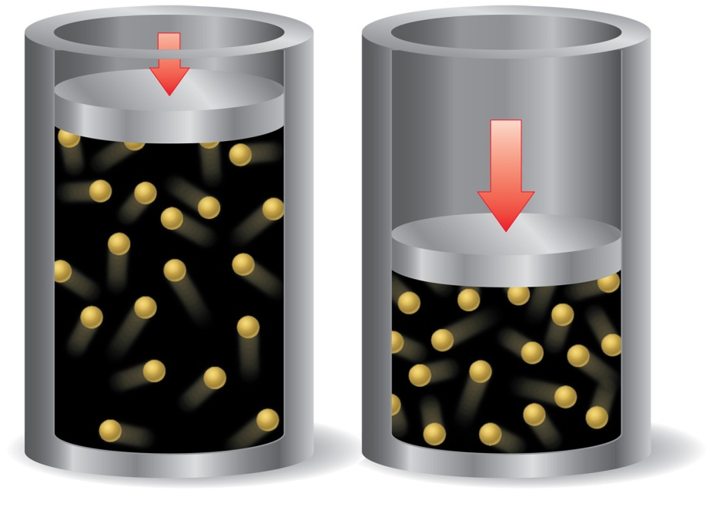
Deviations from Ideal Behavior
The assumptions made in the kinetic-molecular model (negligible volume of gas molecules themselves, no attractive forces between gas molecules, etc.) break down at high pressure and/or low temperature.

Slide 53
Real Gases
In the real world, the behavior of gases only conforms to the ideal-gas equation at relatively high temperature and low pressure.
Even the same gas will show wildly different behavior under high pressure at different temperatures.

