Slide 1
Chapter 8: Chemical Bonding
Understanding the forces that hold atoms together.

Slide 2
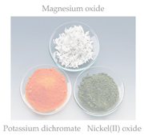
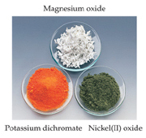
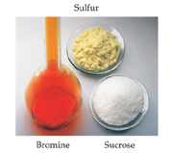
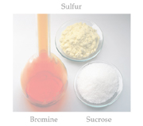
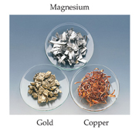
Chemical Bonds
Three basic types of bonds
Ionic
Electrostatic attraction between ions (metal/non-metal
Covalent
Sharing of electrons (non-metals)
Metallic
Metal atoms bonded to several other atoms. Cations in a “sea” of electrons.

Slide 3
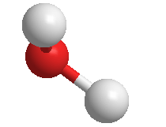
Two Extreme Forms of Connecting or Bonding Atoms
Ionic Bonding: complete transfer of 1 or more electrons from one atom to another.
(metals and non-metals)
Covalent Bonding: valence electrons shared between atoms.
(non-metals and non-metals)
Most bonds are somewhere in between.
Notes:
See Chapter 8 Video Presentation Slide 5

Slide 4
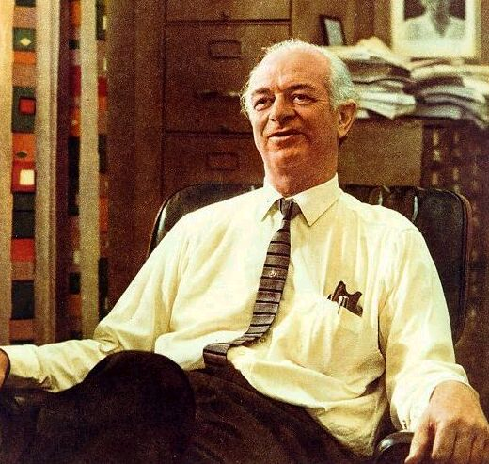
Chemical Bonds & Electronegativity
Electronegativity describes the ability of an atom in a molecule to attract shared electrons to itself.
Linus Pauling
1901 - 1994

Slide 5
Table of Electronegativities

Slide 6
Electronegativity & chemical bonds
Bond-type based on electronegativity:
Non-polar covalent: 0-0.3
Polar covalent : 0.4-1.7
Ionic > 1.7
Bond-type based on Classification:
Ionic bond:
Metal + Nonmetal
Covalent bond:
2 or more nonmetals

Slide 7
Use the electronegativity table to identify the chemical bond :
H - CI =
K - Br =
Si – Cl =
H – H =
Ca - Cl=

Slide 8
Answer:
H - Cl = polar covalent (0.9)
K - Br = Ionic (2.0)
Si - Cl= polar covalent (1.2)
H - H= Non-polar covalent (0)
Ca - Cl= Ionic (2.0)

Slide 9
Chemical bond & Charge distribution
Ionic: complete transfer of electrons resulting in (+)/(-) ions.
Non-polar covalent: even sharing of electrons
Polar covalent: uneven sharing of electrons resulting in partial charge distributions (+)/(-)

Slide 10
Ionic Bonding
Ionic Bonding results when an electron or electrons are transferred from one atom to another.
The transfer results in each attaining an octet or Noble gas electron configuration.
3s¹ 3s²3p⁵
e–
Na + Cl
→ Na⁺ Cl⁻
2s²2p⁶ 3s²3p⁶
Noble gas electron configurations →
Na⁺ Cl⁻
[Ne] [Ar]

Slide 11
Covalent Bonds
Polar-Covalent bonds
Electrons are unequally shared
Electronegativity difference between .3 and 1.7
Nonpolar-Covalent bonds
Electrons are equally shared
Electronegativity difference of 0 to 0.3

Slide 12
Polarity
A molecule, such as HF, that has a center of positive charge and a center of negative charge is said to be polar, or to have a dipole moment.

Slide 13
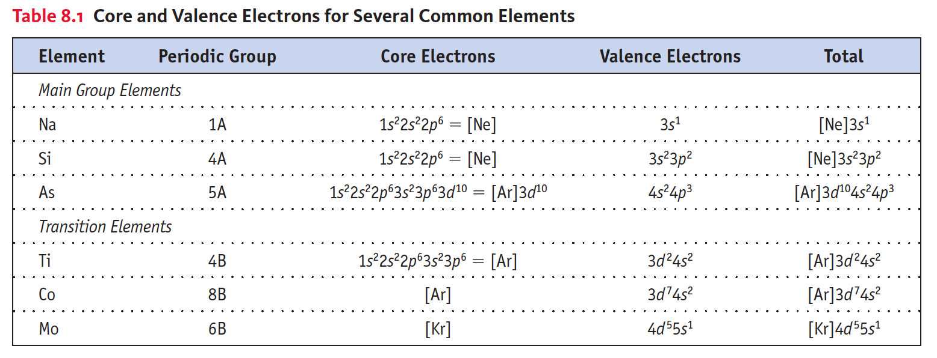
Covalent Bond Formation
A covalent bond results from a overlap of valence orbitals on neighboring atoms.
Valence Electrons and Lewis Symbols for Atoms:

Slide 14
Practice: Lewis Dot Structures
Draw the Lewis dot structure for the following atoms and ions:
Ca  Ca²⁺
Br  Br -
Ba  Ba²⁺
O  O²⁻

Slide 15
Lewis Dot Symbols
Notice that the group numbers of the main group elements represents the number of valence electrons (dots) for each element.

Slide 16
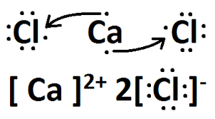
Lewis Structures for Ionic Compounds

Slide 17
Practice: Lewis Structures for Ionic Compounds
Draw the Lewis dot structure for the following ionic compounds:
CaBr₂
Li Br
BaO
Al₂O₃

Slide 18
Lewis Structures for Covalent Compounds
Lewis structures are representations of molecules showing all electrons, bonding and nonbonding.

Slide 19
Writing Lewis Structures for Covalent Compounds
PCl₃
Find the sum of valence electrons of all atoms in the polyatomic ion or molecule.
If it is an anion, add one electron for each negative charge.
If it is a cation, subtract one electron for each positive charge.
5 + 3(7) = 26

Slide 20
Writing Lewis Structures for Covalent Compounds
The central atom is the least electronegative element that isn’t hydrogen. Connect the outer atoms to it by single bonds.
Keep track of the electrons:
` 26 - 6 = 20

Slide 21
Writing Lewis Structures for Covalent Compounds
Fill the octets of the outer atoms.
Keep track of the electrons:
26 - 6 = 20; 20 - 18 = 2

Slide 22
Writing Lewis Structures for Covalent Compounds
Fill the octet of the central atom.
Keep track of the electrons:
26 - 6 = 20; 20 - 18 = 2; 2 - 2 = 0

Slide 23
Writing Lewis Structures for Covalent Compounds
If you run out of electrons before the central atom has an octet…
…form multiple bonds until it does.

Slide 24
Practice problems
Formula unit:
AlBr₃
CaCl₂
Molecules:
NH₃
CCl₄
Polyatomic ions:
SO₄²⁻
NO₃¹⁻

Slide 25
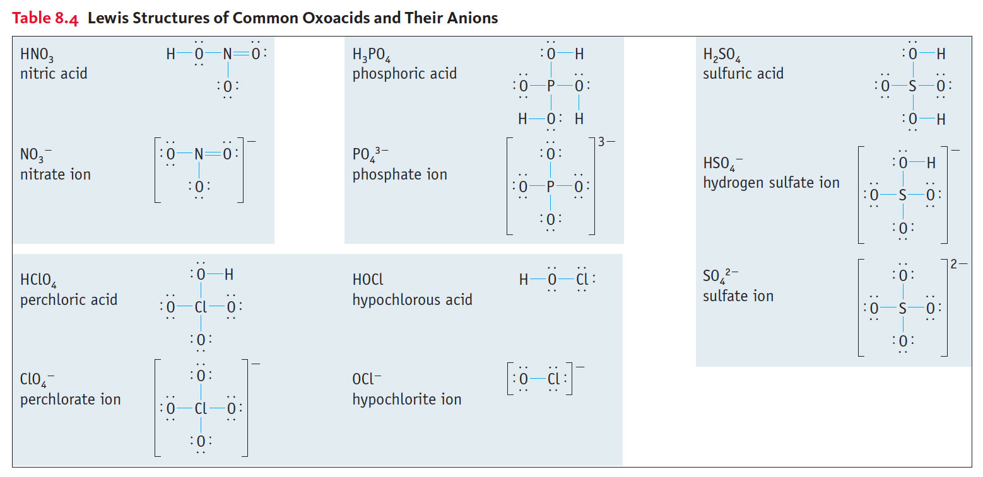
Lewis Structures of Common Oxoacids & Their Anions

Slide 26
Writing Lewis Structures
Assigning formal charge (confirmation of structure):
For each atom, count the electrons in lone pairs and half the electrons it shares with other atoms.
Subtract that from the number of valence electrons for that atom: the difference is its formal charge.

Slide 27
Practice problem:
Draw the Lewis structure for H₂CO and determine the formal charge.
Draw the Lewis structure for HCN and determine the formal charge.

Slide 28
Resonance
This is the Lewis structure we would draw for ozone, O₃.
+
-

Slide 29
Resonance
But this is at odds with the true, observed structure of ozone, in which…
…both O-O bonds are the same length.
…both outer oxygens have a charge of -1/2.

Slide 30
Resonance
One Lewis structure cannot accurately depict a molecule like ozone.
We use multiple structures, resonance structures, to describe the molecule.

Slide 31
Resonance
The organic compound benzene, C₆H₆, has two resonance structures.
It is commonly depicted as a hexagon with a circle inside to signify the delocalized electrons in the ring.

Slide 32
Exceptions to the Octet Rule
There are three types of ions or molecules that do not follow the octet rule:
Ions or molecules with an odd number of electrons
Ions or molecules with less than an octet
Ions or molecules with more than eight valence electrons (an expanded octet)

Slide 33
Odd Number of Electrons
Though relatively rare and usually quite unstable and reactive, there are ions and molecules with an odd number of electrons.

Slide 34
Fewer Than Eight Electrons
Consider BF₃:
Giving boron a filled octet places a negative charge on the boron and a positive charge on fluorine.
This would not be an accurate picture of the distribution of electrons in BF_{3.}

Slide 35
Fewer Than Eight Electrons
The lesson is: if filling the octet of the central atom results in a negative charge on the central atom and a positive charge on the more electronegative outer atom, don’t fill the octet of the central atom.

Slide 36
More Than Eight Electrons
The only way PCl₅ can exist is if phosphorus has 10 electrons around it.
It is allowed to expand the octet of atoms on the 3rd row or below.
Presumably d orbitals in these atoms participate in bonding.

Slide 37
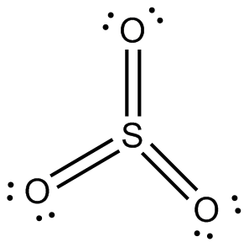
Practice using formal charge:
Draw the structure for SO₃
Draw the structure for SF₄

Slide 38
VSEPR
Understanding molecular geometry

Slide 39
Molecular Shapes (Geometry)
The shape of a molecule plays an important role in its reactivity.
By identifying the number of bonding and nonbonding electron pairs we can easily predict the shape of the molecule.

Slide 40
What Determines the Shape of a Molecule?
Electron pairs, whether they be bonding or nonbonding, repel each other.
By assuming the electron pairs are placed as far as possible from each other, we can predict the shape of the molecule.

Slide 41
Electron Domains
We can refer to the electron pairs as electron domains.
In a double or triple bond, all electrons shared between those two atoms are on the same side of the central atom; therefore, they count as one electron domain.
The central atom in this molecule, A, has four electron domains.

Slide 42
Valence Shell Electron Pair Repulsion Theory (VSEPR)
“The best arrangement of a given number of electron domains is the one that minimizes the repulsions among them.”

Slide 43
Electron-Domain Geometries
These are the electron-domain geometries for two through six electron domains around a central atom.

Slide 44
Molecular Geometries
The electron-domain geometry is often not the shape of the molecule, however.
The molecular geometry is that defined by the positions of only the atoms in the molecules, not the nonbonding pairs.

Slide 45
Molecular Geometries
Within each electron domain, then, there might be more than one molecular geometry.

Slide 46
Linear Electron Domain
In the linear domain, there is only one molecular geometry: linear.
NOTE: If there are only two atoms in the molecule, the molecule will be linear no matter what the electron domain is.

Slide 47
Trigonal Planar Electron Domain
There are two molecular geometries:
Trigonal planar, if all the electron domains are bonding,
Bent, if one of the domains is a nonbonding pair.

Slide 48
Tetrahedral Electron Domain
There are three molecular geometries:
Tetrahedral, if all are bonding pairs,
Trigonal pyramidal if one is a nonbonding pair,
Bent if there are two nonbonding pairs.

Slide 49
Trigonal Bipyramidal Electron Domain
There are two distinct positions in this geometry:
Axial
Equatorial

Slide 50
Trigonal Bipyramidal Electron Domain
Lower-energy conformations result from having nonbonding electron pairs in equatorial, rather than axial, positions in this geometry.

Slide 51
Trigonal Bipyramidal Electron Domain
There are four distinct molecular geometries in this domain:
Trigonal bipyramidal
Seesaw
T-shaped
Linear

Slide 52
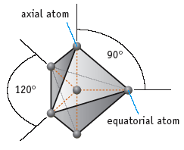
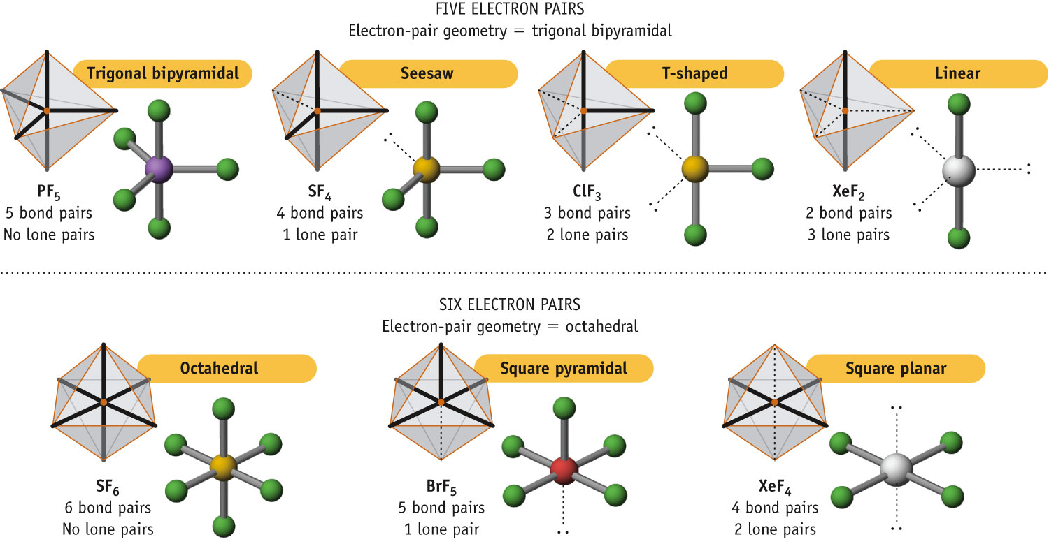
Molecular Geometries for 5 Electron Pairs
All based on trigonal bipyramidal shape

Slide 53
Octahedral Electron Domain
All positions are equivalent in the octahedral domain.
There are three molecular geometries:
Octahedral
Square pyramidal
Square planar

Slide 54
Molecular Geometries for 6 Electron Pairs
All are based on the 8-sided octahedron

Slide 55
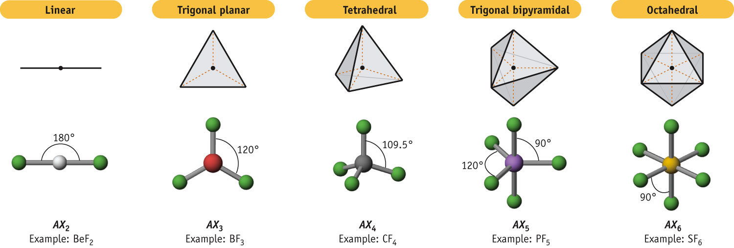
Electron Pair Geometries
2 pairs of electrons
3 pairs of electrons
4 pairs of electrons
5 pairs of electrons
6 pairs of electrons
Central Atoms Surrounded Only by Single-Bond Pairs
Notes:
See Chapter 8 Video Presentation Slide 7

Slide 56
Larger Molecules
In larger molecules, it makes more sense to talk about the geometry about a particular atom rather than the geometry of the molecule as a whole.

Slide 57
Nonbonding Pairs and Bond Angle
Nonbonding pairs are physically larger than bonding pairs.
Therefore, their repulsions are greater; this tends to decrease bond angles in a molecule.

Slide 58
Multiple Bonds and Bond Angles
Double and triple bonds place greater electron density on one side of the central atom than do single bonds.
Therefore, they also affect bond angles.

Slide 59
Electronegativity & Bond Polarity

Slide 60
Polarity
Molecular symmetry is a factor that helps us recognize the polarity of a molecule.
We will address bond polarity later but for now, look for symmetry/asymmetry in the molecules to address polarity.
In the case of CO₂, each C-O bond is polar but the symmetry of the molecule makes the molecule non-polar.

Slide 61
Polarity

Slide 62
Polarity
By adding the individual bond dipoles, one can determine the overall dipole moment for the molecule.

Slide 63
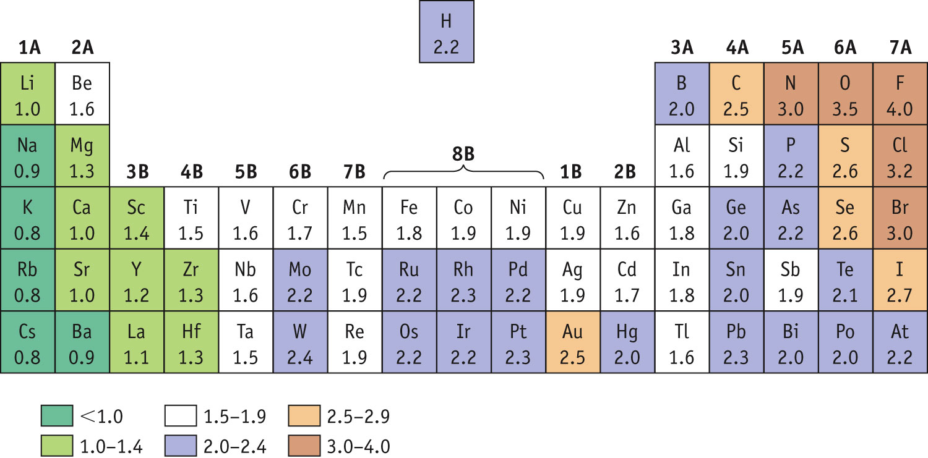
Bond Polarity & Electronegativity
Electronegativity Trend
Electronegativity (χ) measures the relative tendency for an atom to polarize a bond. It follows Z_{eff} on the periodic table.
Notes:
See Chapter 8 Video Presentation Slide 17

Slide 64
Bond Polarity & Electronegativity
As the difference in Electronegativity increases (Δχ), so does the ionic character of the bond.
Increasing covalent character

Slide 65
Example: HF
Fluorine has a larger electronegativity value than hydrogen.
This means that the electrons in the bond are skewed toward the F-atom.
The electrons shift toward the F-atom
This polarizes the molecule
H
F
more positive end
(+)
more negative end
(−)

Slide 66
Electronegativity: H vs. F
The greater the difference in electronegativity (Δχ) the more polar the covalent bond.
H vs. F
4.0 – 2.2 = 1.8
C vs. F
4.0 – 2.5 = 1.5
O vs. F
4.0 – 3.5 = 0.5
So in terms of polarity,
H-F
>
C-F
>
O-F

Slide 67
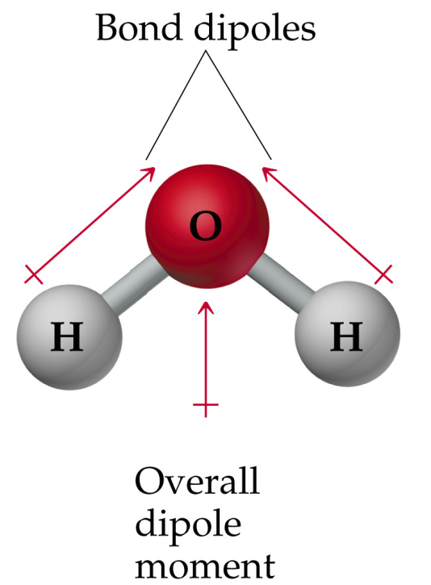
Bond Polarity & Molecular Polarity
When a molecule possesses a net dipole moment, it is polar.
The individual O-H
bond dipoles result
in a “net” or overall
dipole moment for the molecule.
The molecule
is therefore polar.
H₂O

Slide 68
Molecular Shape & Molecular Polarity
Notice also that the molecule’s symmetry can be broken along
either O-H bond axis:
This side…
does not look like this side!
Whenever there exists a line or plane of asymmetry, the molecule is Polar!

Slide 69
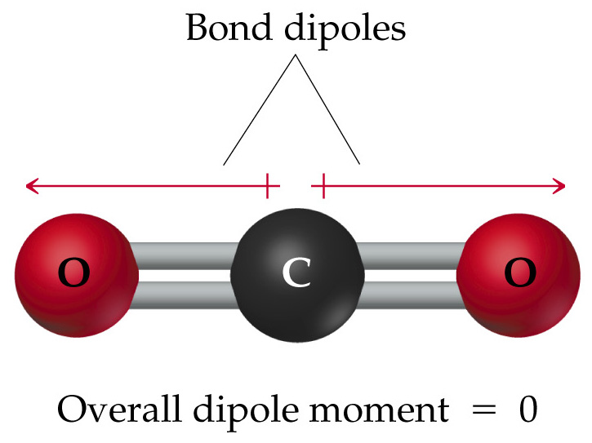
Molecular Shape & Molecular Polarity
CO₂
Symmetry across all bond axes.
non–polar

Slide 70
Dipole Moments & Molecular Polarity

Slide 71
Bond Properties: Order, Length, Energy
The order of a bond is the number of bonding electron pairs shared by two atoms in a molecule
Bond orders may be 1, 2, and 3, as well as fractional values.
Bond strength increases with bond order.
Bond length is inversely proportional to bond order.
Bond strength also increases with the difference in electronegativity between two covalently bonded atoms.

Slide 72
Fractional Bond Order
Fractional bond orders occur in molecules with resonance structures.
Consider NO₂⁻
:
:
O=N−O
:
:
:
The N—O bond order = 1.5

Slide 73
Bond Properties: Order, Length, Energy
Covalent bond strength increases with increasing Δχ
example: HCl bond is stronger than the HBr bond
Covalent bond strength increases with increasing bond order.
example: O=O bond in stronger than O–O bond
triple > double > single
Bond Order: 3 2 1
Bond length decreases with increasing bond order (Strength)
example: O=O bond is shorter than O–O bond
Therefore shorter!

Slide 74
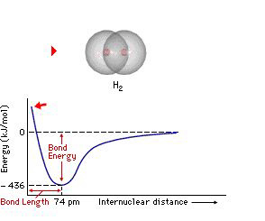
Bond Length
Bond length is the distance between the nuclei of two bonded atoms.
Notes:
See Chapter 8 Video Presentation Slide 14

Slide 75
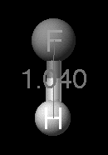
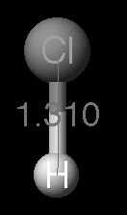
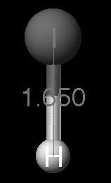
Bond Length
Bond length depends on size of bonded atoms.
H—F
H—Cl
Bond distances measured in Angstrom units where
1Å = 10⁻¹⁰ m.
H—I

Slide 76
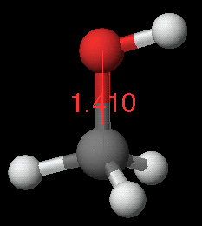
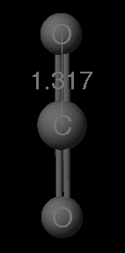
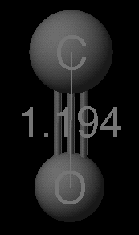
Bond Length
Bond length depends on bond order.
Bond distances measured in Angstrom units where
1Å = 10⁻¹⁰ m.

Slide 77
Bond Strength
BOND Bond dissociation enthalpy (kJ/mol)
H—H 436
C—C 346
C=C 602
C≡C 835
N≡N 945
The GREATER the number of bonds (bond order) the HIGHER the bond strength and the SHORTER the bond.
Notes:
See Chapter 8 Video Presentation Slide 15

Slide 78
Covalent Bond Strength
The strength of a bond is measured by determining how much energy is required to break the bond.
This is the bond enthalpy.
The bond enthalpy for a Cl-Cl bond, D(Cl-Cl), is measured to be 242 kJ/mol.

Slide 79
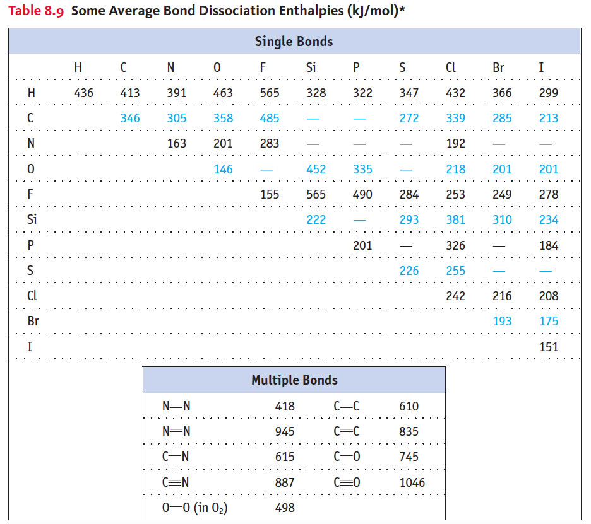

Slide 80
It takes energy to break bonds. (endothermic)
Energy is released when bonds are made. (exothermic)
If more energy is released than is required to break the reactant bonds, then the over all reaction is exothermic.
If more energy is required to break bonds than is released when the product bonds form, then the over all reaction is endothermic.
Δ_{r}H = Σ (bonds broken) − Σ (bonds formed)

Slide 81
Average Bond Enthalpies
This table lists the average bond enthalpies for many different types of bonds.
Average bond enthalpies are positive, because bond breaking is an endothermic process.

Slide 82
Average Bond Enthalpies
NOTE: These are average bond enthalpies, not absolute bond enthalpies; the C-H bonds in methane, CH₄, will be a bit different than the C-H bond in chloroform, CHCl₃.

Slide 83
Enthalpies of Reaction
Yet another way to estimate ΔH for a reaction is to compare the bond enthalpies of bonds broken to the bond enthalpies of the new bonds formed.
ΔH_{rxn} = Σ(bond enthalpies of bonds broken) - Σ(bond enthalpies of bonds formed)

Slide 84
Enthalpies of Reaction
CH₄ (g) + Cl₂ (g) ⎯⎯→
CH₃Cl (g) + HCl (g)
In this example, one C-H bond and one Cl-Cl bond are broken; one C-Cl and one H-Cl bond are formed.

Slide 85
Orbital Hybridization

Slide 86
Overlap and Bonding
We think of covalent bonds forming through the sharing of electrons by adjacent atoms.
In such an approach this can only occur when orbitals on the two atoms overlap.

Slide 87
Hybrid Orbitals
It’s hard to imagine tetrahedral, trigonal bipyramidal, and other geometries arising from the atomic orbitals we recognize.

Slide 88
Hybrid Orbitals
Mixing the s and p orbitals yields two degenerate orbitals that are hybrids of the two orbitals.
These sp hybrid orbitals have two lobes like a p orbital.
One of the lobes is larger and more rounded as is the s orbital.

Slide 89
Hybrid Orbitals
Consider beryllium:
In its ground electronic state, it would not be able to form bonds because it has no singly-occupied orbitals.

Slide 90
Hybrid Orbitals
But if it absorbs the small amount of energy needed to promote an electron from the 2s to the 2p orbital, it can form two bonds.

Slide 91
Hybrid Orbitals
With hybrid orbitals the orbital diagram for beryllium would look like this.
The sp orbitals are higher in energy than the 1s orbital but lower than the 2p.

Slide 92
Hybrid Orbitals
These two degenerate orbitals would align themselves 180° from each other.
This is consistent with the observed geometry of beryllium compounds: linear.

Slide 93
Hybrid Orbitals
Using a similar model for boron leads to…

Slide 94
Hybrid Orbitals
…three degenerate sp² orbitals.

Slide 95
Hybrid Orbitals
…four degenerate
sp³ orbitals.

Slide 96
Hybrid Orbitals
With carbon we get…

Slide 97
Hybrid Orbitals
…four degenerate
sp³ orbitals.

Slide 98
Hybrid Orbitals
Once you know the electron-domain geometry, you know the hybridization state of the atom.

Slide 99
Sigma (σ) Bonds
Sigma bonds are characterized by
Head-to-head overlap.
Cylindrical symmetry of electron density about the internuclear axis.

Slide 100
Pi (π) Bonds
Pi bonds are characterized by
Side-to-side overlap.
Electron density above and below the internuclear axis.

Slide 101
Multiple Bonds
In triple bonds, as in acetylene, two sp orbitals form a σ bond between the carbons, and two pairs of p orbitals overlap in π fashion to form the two π bonds.

Slide 102
Single Bonds
Single bonds are always σ bonds, because σ overlap is greater, resulting in a stronger bond and more energy lowering.

Slide 103
Multiple Bonds
In a multiple bond one of the bonds is a σ bond and the rest are π bonds.

Slide 104
Resonance
The organic molecule benzene has six σ bonds and a p orbital on each carbon atom.

Slide 105
Resonance
In reality the π electrons in benzene are not localized, but delocalized.
The even distribution of the π electrons in benzene makes the molecule unusually stable.

