Slide 1
Big Idea #5
Thermodynamics:
“The laws of thermodynamics describe the essential role of energy and explain and predict the direction of changes in matter

Slide 2
Basic concepts in Big Idea #5
Law of conservation of energy
Energy as heat or work
Direction of heat transfer (-)(+)
Specific heat calculations and calorimetry
Hess’s law & applications
Ability of energy to perform work (PΔV)
Prediction of Spontaneity
Gibb’s free energy
Gibbs equation (linking temp, enthalpy and entropy)

Slide 3
Law of Thermodynamics:
1st Law: Energy in conserved (neither created nor destroyed in any process)
2nd Law: the total entropy of the universe increases in any spontaneous process.
3rd Law: the entropy of a pure crystalline substance at absolute zero is zero (S =0)

Slide 4
Thermodynamics: Spontaneity, Entropy and Free energy
Definitions:
Spontaneous process: a process that can proceed without any outside intervention. (does not describe the rate)
Entropy (S)- a measure of the randomness of a system.
Enthalpy (H)- the heat flow in a process occurring at constant pressure (no work performed)
Free energy (G)- a thermodynamic function that relates entropy and enthalpy to spontaneity.

Slide 5
Heat & Specific Heat Capacity
When heat is absorbed or lost by a body, the temperature must change as long as the phase (s, g or l) remains constant.
q = heat lost or gained (J)
m = mass of substance (g)
C = the Specific Heat Capacity of a compound
ΔT = T_{final} − T_{initial} is the temperature change ( ºC or K)

Slide 6
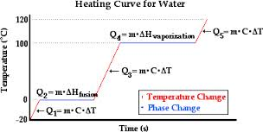
Calculation and Heating Curve

Slide 7
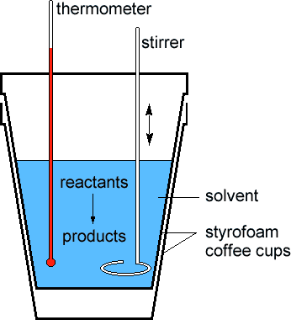
Calorimetry
Relates the energy flow
[⁻q system = ⁺q surrounding]

Slide 8
Enthalpy of a Reaction (Calculation of ΔH)
ΔH = Σ n ΔH_{f}°_{products} – Σ m ΔH_{f}° _{reactants}
where n and m are the stoichiometric coefficients.

Slide 9
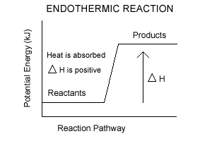
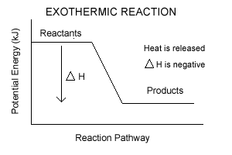
Thermochemical equation
Relates a reaction to the quantitative amount of energy absorbed (ΔH= +) or released (Δ H = -).
Provides a stoichiometric relationship between a balanced chemical equation and the energy associated with the reaction:

Slide 10
Entropy(S) and factors that increase entropy:
Phase change which increased randomness
Solid < liquid < Gas
Increase in temperature for any substance.
Increase in the number of moles of a gas.
Increase in volume of a gas.
Formation of a solution from a liquid or solid

Slide 11
Calculating entropy changes in a chemical reaction:
Standard molar entropy (S°).
ΔS° =  nΔS°(product) -  mΔS°(reactants)
S° elements at 298K are not zero.
S° gases> liquids> solids
S° generally increase with increasing molar mass
S° generally increase with increase number of atoms in the substance.

Slide 12
Gibb’s Free Energy:
Describes the “free energy” a system possesses to drive a spontaneous reaction and takes into account both enthalpy (H) and entropy (S)
ΔG = Δ H –T Δ S
ΔG < 0 spontaneous
ΔG > 0 non spontaneous
ΔG = 0 equilibrium

Slide 13
Calculations for ΔG:
ΔG° =  nΔG°(product) -  mΔG°(reactants)
Standard free energy of formation can be used, just like ΔH° & ΔS °
ΔG = Δ H –T Δ S
ΔH | ΔS | ΔG
- | + | (- ) Spontaneous
₊ | - | (+) not spontaneous
₊ | + | Depends on T (entropy driven)
- | - | Depends on T (enthaply driven

Slide 14
Relationship of Free energy and equilibrium (reaction is product or reactant favored)
When a system is at equilibrium Δ G = 0
We can now use the following equation:
ΔG° = -RT lnK
(Temp = Kelvin, R = 8.31J/mole K)
K | ΔG° | Reactant/Product favored | Spontaneous?
K>>1 | ΔG° < 0 | Product favored | Yes
K = 1 | ΔG° = 0 | At equilibrium | Equilibrium
K<< 1 | ΔG° > 0 | Reactant Favored | no

