Slide 1
Big Idea 4
Kinetics
Rates of chemical reactions are determined by details of the molecular collisions.

Slide 2
Concepts covered:
Factors that affect the rate of a reaction
Stoichiometric relationships and rate of a reaction
Determination of rate law equations
Order of reaction
Rate law, integrated rate law, straight line graph, half life expression.
Maxwell Boltzmann energy distribution
Potential energy diagram
Collision mechanisms
Role of catalysts

Slide 3
Factors That Affect Reaction Rates
Physical State of the Reactants
In order to react, molecules must come in contact with each other.
The more homogeneous the mixture of reactants, the faster the molecules can react
Temperature
At higher temperatures, reactant molecules have more kinetic energy, move faster, and collide more often and with greater energy.
Concentration of Reactants
Higher concentrations allow for more collisions.
The rate of the reaction decreases as reactants are consumed and their concentration decreases.
Presence of a Catalyst
Catalysts speed up reactions by changing the mechanism of the reaction.
Catalysts are not consumed during the course of the reaction.

Slide 4
Reaction Rates
C₄H₉Cl(aq) + H₂O(l) ⎯⎯→ C₄H₉OH(aq) + HCl(aq)
All reactions slow down over time.
Therefore, the best indicator of the rate of a reaction is the instantaneous rate near the beginning of the reaction.

Slide 5
Reaction Rates and Stoichiometry
Reaction rates can be monitored by following either the loss (-) of reactants or the production (+) of products as generalized below:
aA + bB
cC + dD
1
a
Δ[A]
Δt
1
b
Δ[B]
Δt
1
c
Δ[C]
Δt
1
d
Δ[D]
Δt
Rate = −
= −
=
=

Slide 6
Concentration and Rate
NH₄⁺(aq) + NO₂⁻(aq)
N₂(g) + 2 H₂O(l)
We can gain information about the rate of a reaction by seeing how the rate changes with changes in concentration.
If we compare Experiments 1 and 2, we see that when [NH₄⁺] doubles, the initial rate doubles.

Slide 7
Rate Laws
Rate = k [NH₄⁺] [NO₂⁻]
The overall reaction order can be found by adding the exponents on the reactants in the rate law.
This reaction is second-order overall.

Slide 8
Rate Law and Order or Reaction
0 order- the rate is independent of [reactant]
1st order- rate = [reactant]
2nd order- rate ∝ [reactant]²
3rd order- rate ∝ [reactant]³

Slide 9
Rate Law and Oder of Reaction
Since rate is defined as change in concentration (molarity)/time (s). The unit for k will vary based on the order of the reaction.
0 order: k = mole/L • s
1st order: k = 1/s
2nd order: k = L/mole • s
3rd order: k = L²/mole² • s

Slide 10
First-Order Processes
When ln P is plotted as a function of time, a straight line results.
Therefore,
The process is first-order.
k is the negative of the slope: 5.1 × 10⁻⁵ s⁻¹.

Slide 11
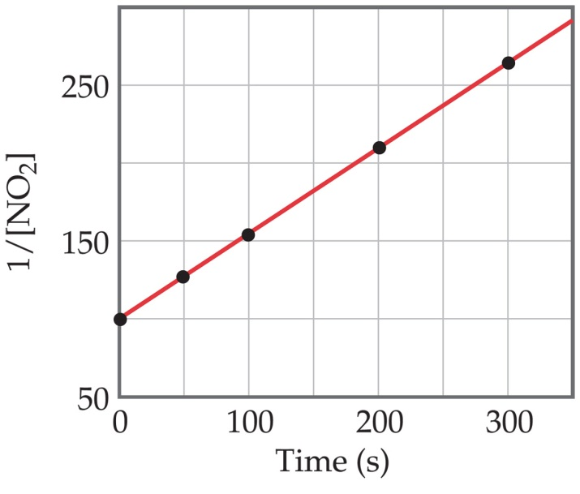
Second-Order Processes
1
[NO₂]
Graphing ln vs. t, however, gives this plot.
Because this is a straight line, the process is second-order in [A].
Time (s) | [NO₂], M | 1/[NO₂]
0.0 | 0.01000 | 100
50.0 | 0.00787 | 127
100.0 | 0.00649 | 154
200.0 | 0.00481 | 208
300.0 | 0.00380 | 263

Slide 12
Summary: Integrated rate law
Order | Rate Equation | Integrated Rate Equation | Straight Line Plot | Slope | k Units
0 | Rate = k[R]⁰ | [R]_{o} - [R]_{t} = kt | [R]_{t} vs. t | -k | mol/L⋅s
1 | Rate = k[R]¹ | ln([R]_{o}/[R]_{t}) = kt | ln[R]_{t} vs. t | -k | s⁻¹
2 | Rate = k[R]² | (1/[R]_{t}) - (1/[R]_{o}) = kt | 1/[R]_{t} vs. t | k | L/mol⋅s
 |  |  | memorize this!
Half-Life and First-Order Reactions:
(radioactivity is a first-order reaction)
ln becomes ln(2) = kt_{½}
ln(2) = 0.693
so… k = 0.693/ t_{½} and t_{½} = 0.693/k

Slide 13
Reaction Coordinate Diagrams
It is helpful to visualize energy changes throughout a process on a reaction coordinate diagram like this one for the rearrangement of methyl isonitrile.

Slide 14
Catalysts
Catalysts increase the rate of a reaction by decreasing the activation energy of the reaction.
Catalysts change the mechanism by which the process occurs.

Slide 15
Maxwell–Boltzmann Distributions
As the temperature increases, the curve flattens and broadens.
Thus at higher temperatures, a larger population of molecules has higher energy.

Slide 16
Reaction Mechanisms
The molecularity of a process tells how many molecules are involved in the process.

