Slide 1
Big Idea #3
Chemical Reactions
“Change in matter involves the rearrangement and/or reorganization of atoms and/or the electrons.”

Slide 2
Basic Concepts:
Chemical Formulas
Writing/balancing chemical equations
Stoichiometry
Limiting, excess reaction, % yield
Solutions: concentration
Aqueous reactions
Redox reactions & electrochemistry
Separation Methods (distillation, filtration, chromatography)
Analytical techniques (Titration, gravimetric, spectrophotometric)

Slide 3
Chemical Bonds:
Describes the force that holds atoms together and includes:
Covalent bonds – sharing of electrons between non-metals.
Ionic bonds - the electrostatic attraction of oppositely charged ions (metal + nonmetal)
Chemical formula: describes the bonded compound using the symbols for the elements and subscripts to define how many. Ex: H₂O, Na₂PO₄

Slide 4
Types of Formulas
Empirical formulas give the lowest whole-number ratio of atoms of each element in a compound.
Molecular formulas give the exact number of atoms of each element in a compound.

Slide 5
Diatomic Molecules
These seven elements occur naturally as molecules containing two atoms. It is important that you commit these to memory!
“Brian Helps Claire Find Out New Ideas”

Slide 6
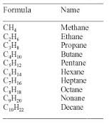
Naming Alkanes
It is useful for us to become familiar with simple organic nomenclature, starting with our saturated hydrocarbons (alkanes) for C₁ – C₁₀

Slide 7
Important points for Balancing Equations:
Write the correct formulas for the reactants and products.
Once the formulas are correct, do not change the subscripts!
Use coefficients to balance the elements.

Slide 8
Types of Reactions (patterns to watch for in balancing equations)
Combination (Synthesis): A + X → AX
Decomposition: AX → A + X
Single replacement : A + BX → AX + B
Double replacement : AX + BY → AY + BX
Combustion: C_{x}H_{x} + O₂ → CO₂ + H₂O

Slide 9
Stoichiometric Calculations
Starting with the mass of Substance A you can use the ratio of the coefficients of A and B to calculate the mass of Substance B formed (if it’s a product) or used (if it’s a reactant).

Slide 10
Limiting Reactants
The limiting reactant is the reactant present in the smallest stoichiometric amount.
In other words, it’s the reactant you’ll run out of first (in this case, the H₂).

Slide 11
Theoretical Yield
The theoretical yield is the maximum amount of product that can be made.
In other words it’s the amount of product possible as calculated through the stoichiometry problem.
This is different from the actual yield, which is the amount one actually produces and measures.

Slide 12
Percent Yield
One finds the percent yield by comparing the amount actually obtained (actual yield) to the amount it was possible to make (theoretical yield).
Actual Yield
Theoretical Yield
Percent Yield = x 100

Slide 13
Compositional Analysis & Stoichiometry
We’ve looked at this already when we addressed hydrates.

Slide 14
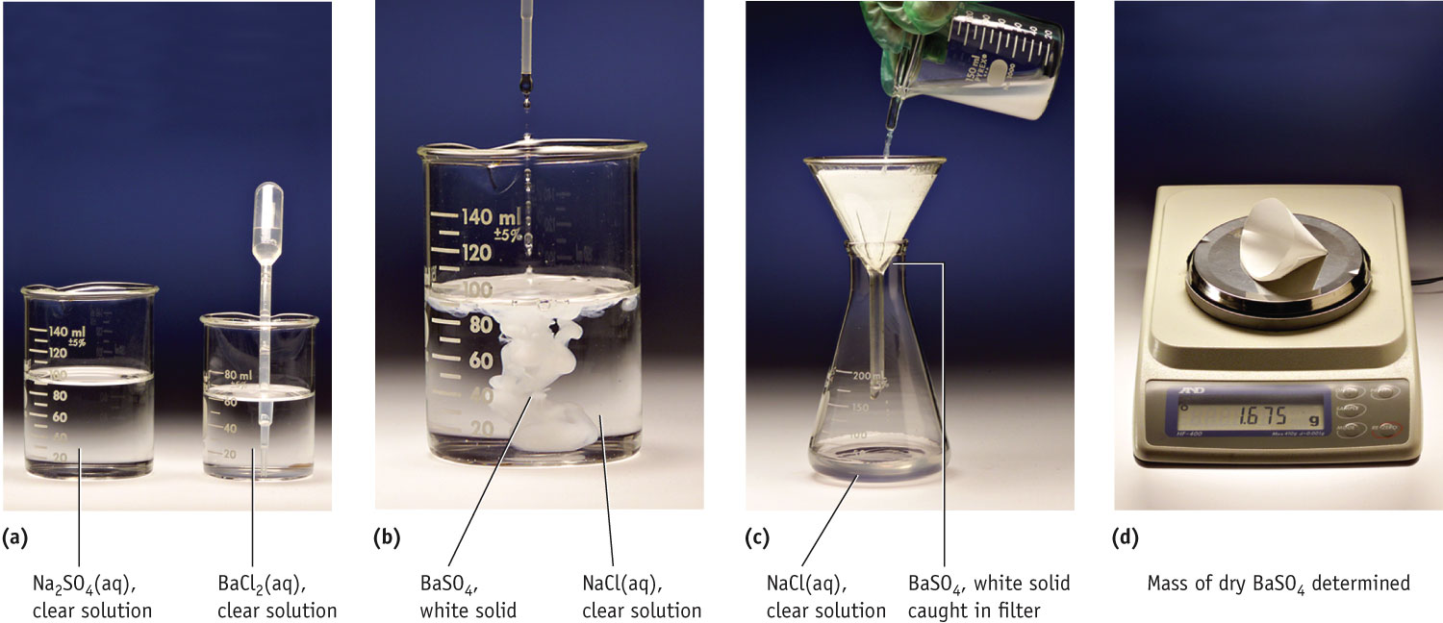
Chemical Analysis
Determination of the % sodium sulfate in the mineral Thenarite

Slide 15
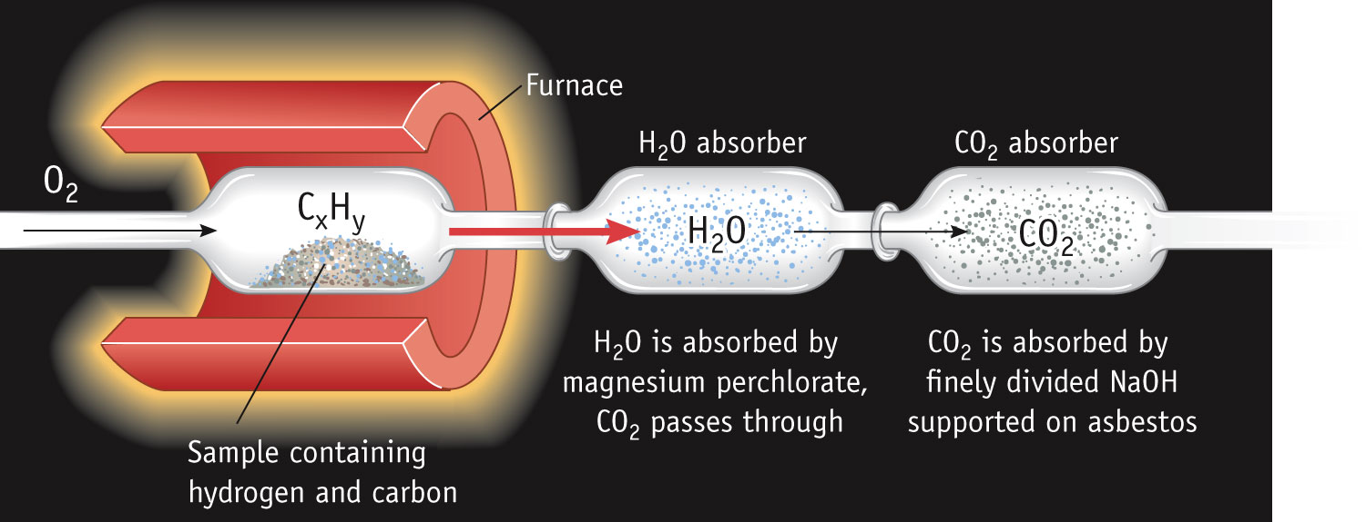
Determining the Formula of a Hydrocarbon by Combustion
Combustion involves the addition oxygen to another element.
When hydrocarbon molecules burn completely, the products are always carbon dioxide gas and water.
Notes:
See Chapter 4 Video Presentation Slide 6

Slide 16
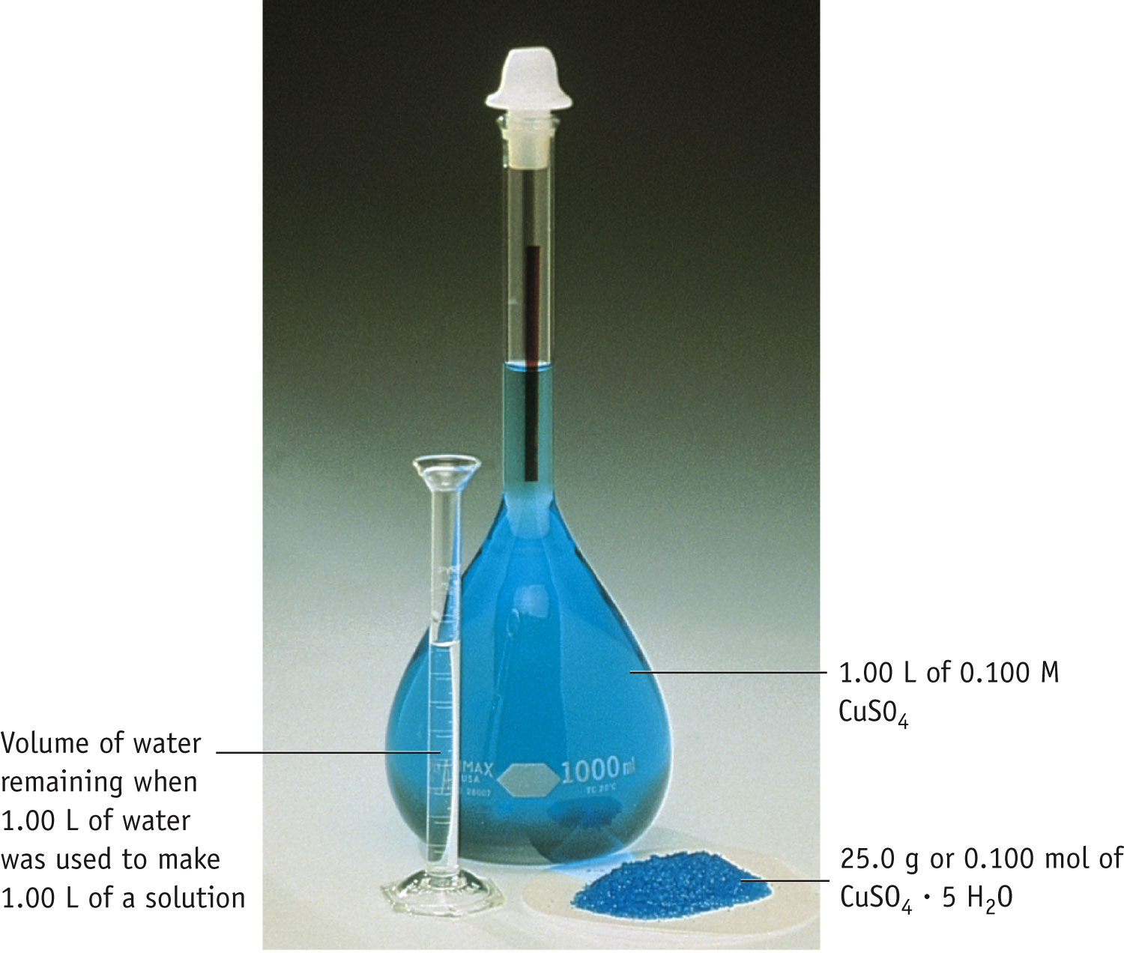
Terminology
Solution =
solute
+ solvent
That which is dissolved (lesser amount)
That which is dissolves (greater amount)

Slide 17
Molarity
Two solutions can contain the same compounds but be quite different because the proportions of those compounds are different.
Molarity is one way to measure the concentration of a solution.
moles of solute
Molarity (M) =
volume of solution in liters

Slide 18
Using Molarities in Stoichiometric Calculations

Slide 19
Strong Electrolytes Are…
Strong acids
Strong bases
Soluble ionic salts

Slide 20
Nonelectrolytes
Molecular compounds tend to be nonelectrolytes, except for acids and bases.

Slide 21
Summary: Writing Net Ionic Equations
Write a balanced molecular equation.
Dissociate all strong electrolytes.
Cross out anything that remains unchanged from the left side to the right side of the equation (spectator ions).
Write the net ionic equation with the species that remain.
Be sure to include charges on ions and states of your ions (aq) and precipitate (s).

Slide 22
Neutralization Reactions
When a strong acid reacts with a strong base, the net ionic equation is…
HCl (aq) + NaOH (aq) ⎯→ NaCl (aq) + H₂O (l)
H⁺ (aq) + Cl⁻ (aq) + Na⁺ (aq) + OH⁻(aq) ⎯→
Na⁺ (aq) + Cl⁻ (aq) + H₂O (l)
H⁺ (aq) + OH⁻ (aq) ⎯→ H₂O (l)

Slide 23
What about net ionic and insoluble salts?
Write the molecular equation and net ionic equation for the reaction between magnesium hydroxide and hydrochloric acid.
molecular: Mg(OH)₂(s) + 2HCl(aq) → MgCl₂(aq) + 2H₂O(l)
Net ionic: Mg(OH)₂(s) + 2H⁺(aq) → Mg²⁺(aq) + 2H₂O(l)

Slide 24
Gas-Forming Reactions
metal carbonates + acid → metal salt + CO₂₍g) + H₂O (l)
Na₂CO₃ (aq) + 2HCl(aq) → 2NaCl (aq) + CO₂(g) + H₂O(l)
Metal sulfide + acid → metal salt + H₂S(g)
Na₂S(aq) + 2HCl(aq) → 2NaCl(aq) + H₂S(g)
Metal Sulfite + acid → metal salt + SO₂(g) + H₂O(l)
Na₂SO₃(aq) + 2HCl(aq) → 2NaCl(aq) + SO₂(g) + H₂O(l)
Ammonium salt + strong base → metal salt + NH₃(g) + H₂O(l)
NH₄Cl(aq) + NaOH(aq) → NaCl(aq) + NH₃(g) + H₂O(l)

Slide 25
Oxidation Numbers
In order to keep track of what loses electrons and what gains them, we assign oxidation numbers.

Slide 26
Guidelines for Assigning Oxidation Numbers
Elements in their elemental form have an oxidation number of 0 .
The oxidation number of a monatomic ion is the same as its charge .
Oxygen is assigned an oxidation state of -2 in its covalent compounds (ex. CO₂). An exception to this rule occurs with peroxides(O₂²⁻).
Hydrogen is assigned +1 when found in covalent compounds with nonmetals. When forming metal hydrides, it is assigned -1.
Fluorine is always assigned an oxidation state of -1.

Slide 27
Oxidation Numbers cont.
The sum of the oxidation numbers in a neutral compound is 0.
The sum of the oxidation numbers in a polyatomic ion is the charge on the ion.

Slide 28
Steps for balancing half reactions:
Recognize reaction as a redox reaction by assigning oxidation numbers.
Separate the process into half-reactions- (Leo Ger)
Balance atoms of elements for each half reaction.
Balance each half reaction for charge (e-).
Multiply each half reaction by an appropriate factor (balance electrons)
Add the half reactions to produce the overall balance equations. Simplify if needed.

Slide 29
Half Reaction: Acidic Solution
Additonal step:
Balance oxygen's by adding H₂O,
balance hydrogen's with H⁺ ions.
Try it!
Cu(s) + NO₃⁻(aq) → Cu²⁺(aq) + NO(g)

Slide 30
Half Reaction: Basic Solutions
Additional step:
In the final step, for each H⁺ in the equation, add an OH⁻ on both sides of the equation.
On one side combine H⁺ , OH⁻ to H₂O
Simplify the each by reducing multiple H₂O
Try one:
ClO⁻ (aq) + S²⁻ (aq) → Cl⁻ + S(s)
Another:

Slide 31
Voltaic Cells
In spontaneous oxidation-reduction (redox) reactions, electrons are transferred and energy is released.

Slide 32
Voltaic Cells
A typical cell looks like this.
The oxidation occurs at the anode.
The reduction occurs at the cathode.

Slide 33
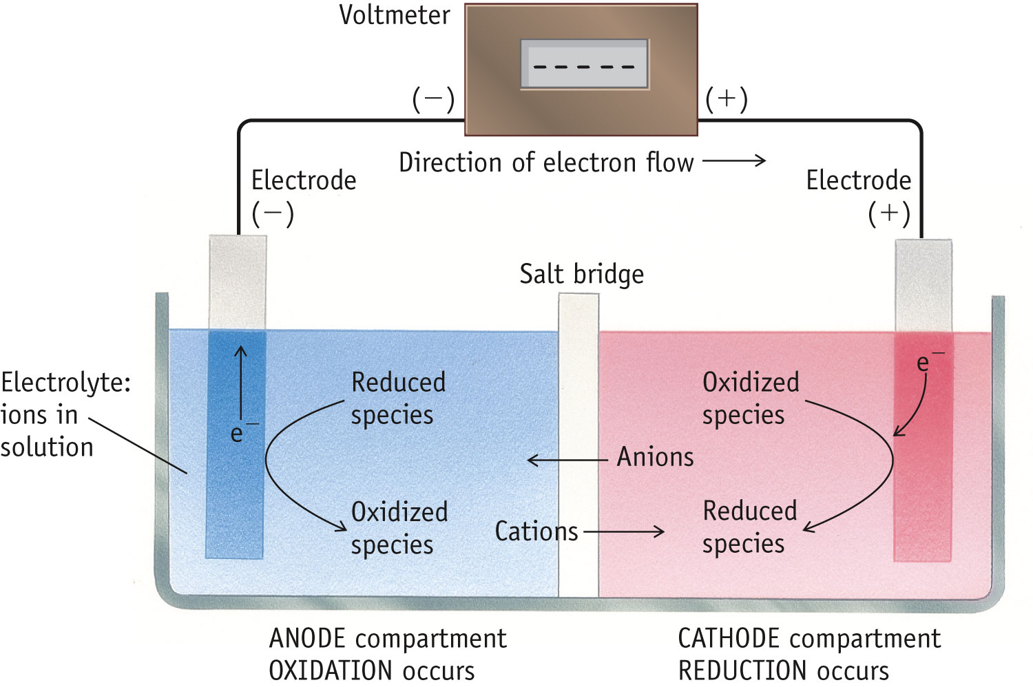
Terminology for Voltaic Cells

Slide 34
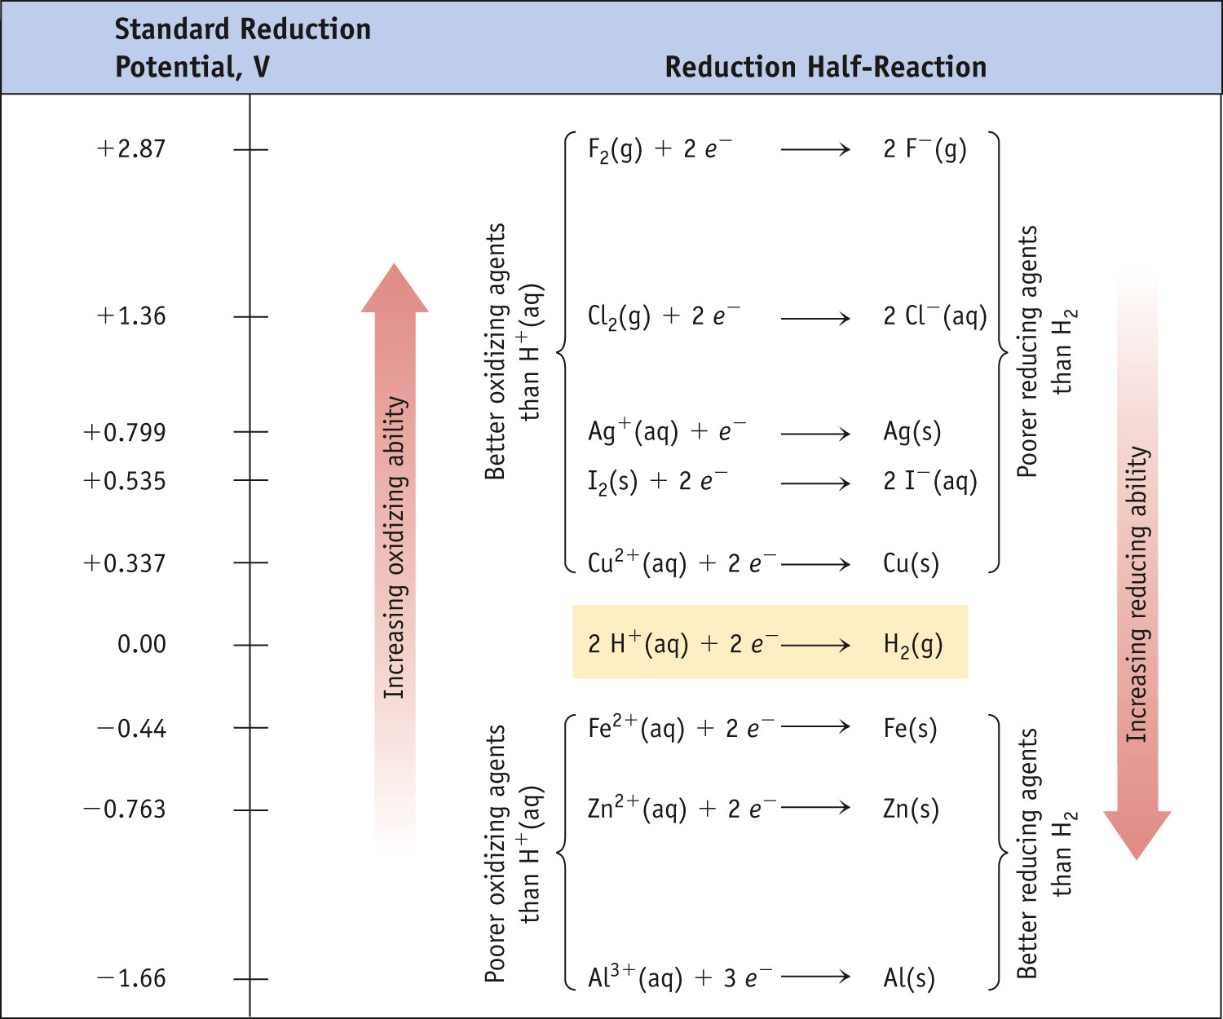
Potential Ladder for Reduction Half-Reactions
Stronger oxidizing agents
Stronger reducing agents

Slide 35
Standard Cell Potentials
The cell potential at standard conditions can be found through this equation:
°
°
°
E_{cell}
= E_{red} (cathode) − E_{red} (anode)
(also written as: E _{reduction} + E_{oxidation})
Because cell potential is based on the potential energy per unit of charge, it is an intensive property (amount is not a factor when calculating).

Slide 36
Cell Notation
Shorthand notation for describing the voltaic cell:
Anode information ll Cathode information
Ex: Cu(s)lCu2+ (aq 1.0M)ll Ag+ (aq, 1.0M)lAg(s)
Cell notation also applies when the metal(s) is not part of the reaction and an inert (non-reactive) electrode is used)
Ex: Pt_{(s)}l H_{2(g)} lH⁺_{(aq)} ll Ag⁺_{(aq)}l Ag_{(s)}

Slide 37
Concentration Cells
Notice that the Nernst equation implies that a cell could be created that has the same substance at both electrodes.
For such a cell,
E_{cell}
would be 0, but Q would not.
°
Therefore, as long as the concentrations are different, E will not be 0.

Slide 38
Electrolysis & Understanding Electrolytic Cells:
When a non-spontaneous redox reaction is made to occur by putting electrical energy into the system.
The battery (energy source) acts as a “pump” pushing electrons into the cathode and removing electrons from the anode.
To maintain electrical neutrality, a redox reaction must occur within the cell
consume electrons at the cathode - Reduction
liberate electrons at the anode - Oxidation

Slide 39
Galvanic –vs-Electrolytic Cells:

Slide 40
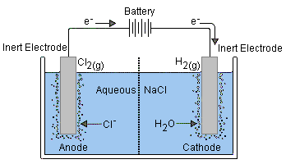
Electrolysis of Aqueous Solutions
Electrolysis in aqueous solutions also includes the presence of H₂O which may undergo either oxidation or reduction (depending on energy requirements)
Species present: [Na⁺, Cl⁻, H₂O]
Possible Reduction:
Na⁺(aq) + e⁻ → Na(s)
2H₂O(l) + 2e⁻ → H₂(g) + 2OH⁻(aq)
Possible Oxidation:
2Cl⁻(aq) → Cl₂(g) + 2e⁻
2H₂O(l) → 2H₂(g) + O₂(g) + 4e⁻
2H₂O(l) + 2Cl⁻(aq) → H₂(g) + 2OH⁻(aq) +Cl₂(g)
Since the process is NOT spontaneous, E must have a net (-) value.
Compare E(V) for each half reaction to determine what is occurring at each electrode.
This cell is unique when we compare the oxidation of Cl- & H₂O

Slide 41
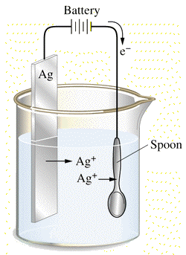
Calculations & electroplating
By knowing the # of moles e- that are required and the current flow/time one is able to calculate the mass of metal plated.
Using a solution containing Ag⁺(aq) ions, metallic silver is deposited on the cathode. A current of 1.2A is applied for 2.4 hours. What is the mass of silver formed?
(Useful conversions provided)
Charge: 2.4hrs 3600s 1.12A = 9675.8C
1 hr
Mass of Ag: 9676.8 C 1 mole e- 1 mole Ag(s) 107.9g
96,485C 1 mole e- 1mole Ag
Answer: 10.8g

Slide 42
Titration
Titration is an analytical technique in which one can calculate the concentration of a solute in a solution.

Slide 43
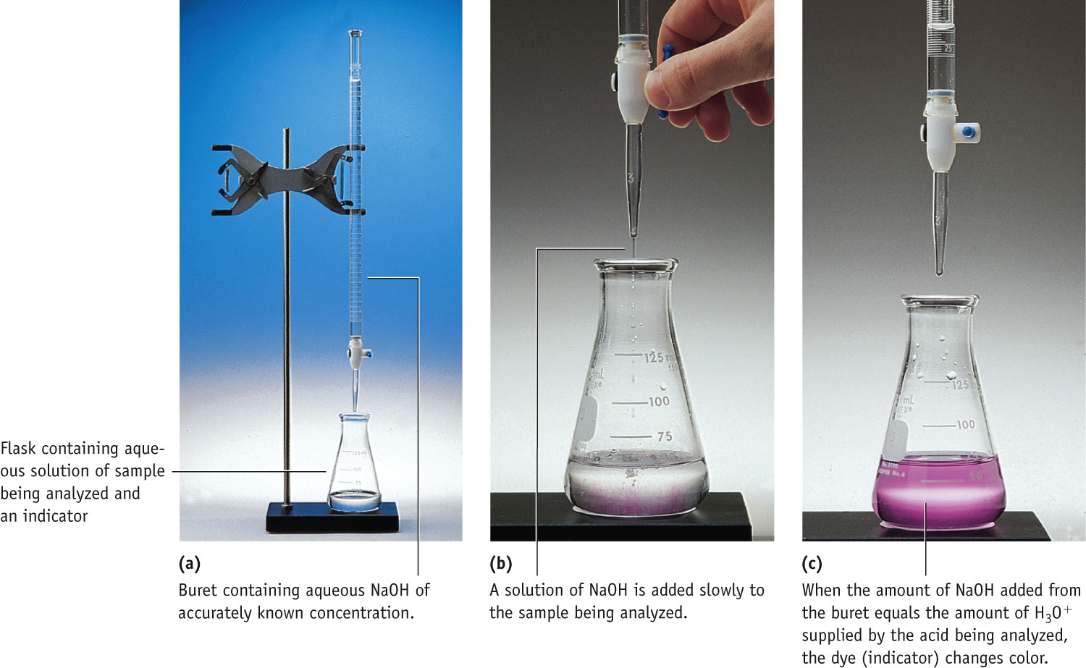
Setup for Titrating an Acid with a Base

Slide 44
KHP
A common standard used in base (OH–) standardizations in the mono–protic acid, KHP.
KHP is an acronym for: potassium hydrogen phthalate
(not potassium hydrogen phosphorous)
The H-atom in the upper right of the compound dissociates to yield H⁺(aq)
1 mol of KHP yields 1 mol of H⁺ when dissolved in solution
KHP (aq) → H⁺(aq) + KP–(aq)
The molar mass of KHP is 204.22 g/mol (C₈H₅O₄K)

Slide 45
Spectrophotometry
Spectrophotometry is the interaction between light and matter that provides quantitative information about solution concentration.

Slide 46
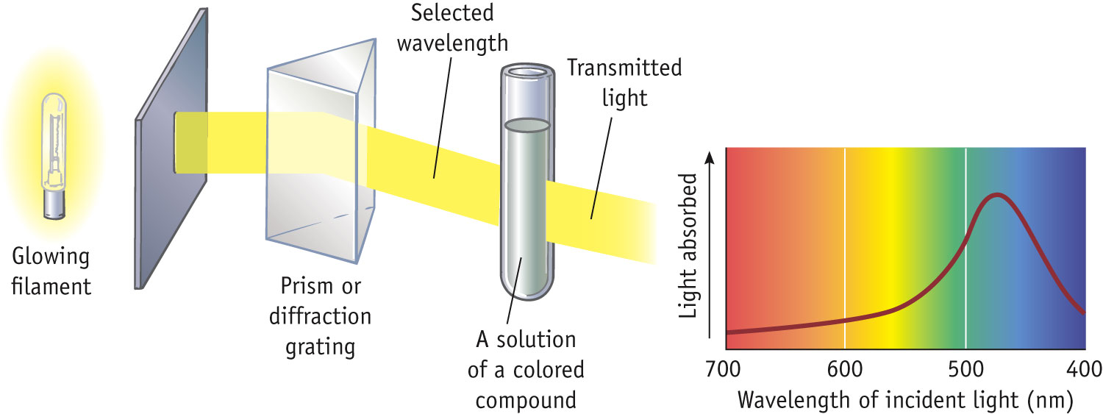
An Absorption Spectrophotometer
Light Source
Wavelength Selection
Sample Container
Spectrum

Slide 47
Spectrophotometry
BEER-LAMBERT LAW relates amount of light absorbed and the path length and solute concentration.
A = absorbance l = path length
ε = molar absorptivity c = concentration
There is a linear relation between A and c for a given path length and compound.
Once the instrument is calibrated, knowing absorbance one can determine concentration.

