Slide 1
Big Idea # 2
Chemical and physical properties of materials can be explained by the arrangement of atoms, ions or molecules and the forces between them.

Slide 2
Concepts covered:
Bonding (ionic, covalent, metallic)
Polarity/dipole moment
IMF useful summary IMF
Lewis Structures , formal charge
Molecular Geometry
KMT
Gases
Solutions
Concentration
Solubility
Colligative properties

Slide 3
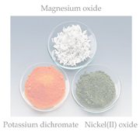
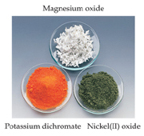
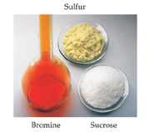
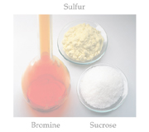
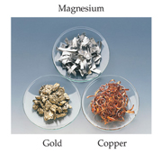
Chemical Bonds
Three basic types of bonds
Ionic
Electrostatic attraction between ions (metal/non-metal
Covalent
Sharing of electrons (non-metals)
Metallic
Metal atoms bonded to several other atoms. Cations in a “sea” of electrons.

Slide 4
Lewis Dot Symbols
Notice that the group numbers of the main group elements represents the number of valence electrons (dots) for each element.

Slide 5
Writing Lewis Structures
Assigning formal charge (confirmation of structure):
For each atom, count the electrons in lone pairs and half the electrons it shares with other atoms.
Subtract that from the number of valence electrons for that atom: the difference is its formal charge.

Slide 6
Exceptions to the Octet Rule
There are three types of ions or molecules that do not follow the octet rule:
Ions or molecules with an odd number of electrons
Ions or molecules with less than an octet
Ions or molecules with more than eight valence electrons (an expanded octet)

Slide 7
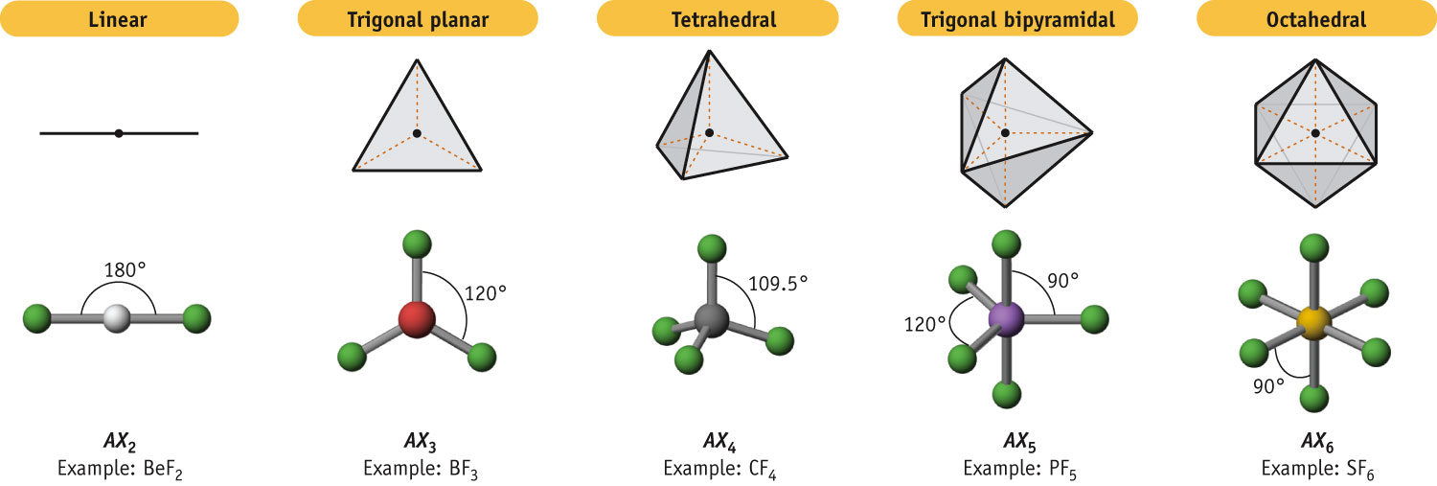
Electron Pair Geometries
2 pairs of electrons
3 pairs of electrons
4 pairs of electrons
5 pairs of electrons
6 pairs of electrons
Central Atoms Surrounded Only by Single-Bond Pairs
Notes:
See Chapter 8 Video Presentation Slide 7

Slide 8
Polarity
Molecular symmetry is a factor that helps us recognize the polarity of a molecule.
We will address bond polarity later but for now, look for symmetry/asymmetry in the molecules to address polarity.
In the case of CO₂, each C-O bond is polar but the symmetry of the molecule makes the molecule non-polar.

Slide 9
Polarity
By adding the individual bond dipoles, one can determine the overall dipole moment for the molecule.

Slide 10
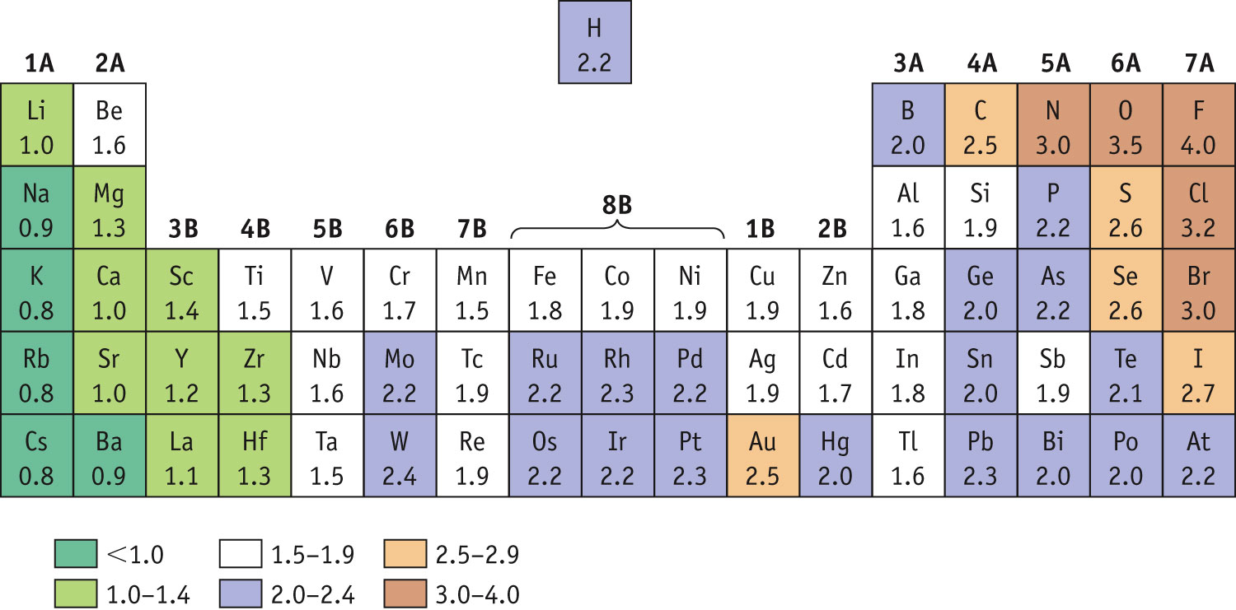
Bond Polarity & Electronegativity
Electronegativity Trend
Electronegativity (χ) measures the relative tendency for an atom to polarize a bond. It follows Z_{eff} on the periodic table.
Notes:
See Chapter 8 Video Presentation Slide 17

Slide 11
Bond Properties: Order, Length, Energy
The order of a bond is the number of bonding electron pairs shared by two atoms in a molecule
Bond orders may be 1, 2, and 3, as well as fractional values.
Bond strength increases with bond order.
Bond length is inversely proportional to bond order.
Bond strength also increases with the difference in electronegativity between two covalently bonded atoms.

Slide 12
It takes energy to break bonds. (endothermic)
Energy is released when bonds are made. (exothermic)
If more energy is released than is required to break the reactant bonds, then the over all reaction is exothermic.
If more energy is required to break bonds than is released when the product bonds form, then the over all reaction is endothermic.
Δ_{r}H = Σ (bonds broken) − Σ (bonds formed)

Slide 13
Hybrid Orbitals
Once you know the electron-domain geometry, you know the hybridization state of the atom.

Slide 14
Sigma (σ) Bonds
Sigma bonds are characterized by
Head-to-head overlap.
Cylindrical symmetry of electron density about the internuclear axis.

Slide 15
Multiple Bonds
In triple bonds, as in acetylene, two sp orbitals form a σ bond between the carbons, and two pairs of p orbitals overlap in π fashion to form the two π bonds.

Slide 16
Main Tenets of Kinetic-Molecular Theory (KMT)
Energy can be transferred between molecules during collisions, but the average kinetic energy of the molecules does not change with time, as long as the temperature of the gas remains constant.

Slide 17
Gas Laws:
Four variable are need to describe gases.
Pressure (P)
Volume (V)
Temperature (T, Kelvin)
Amount (n, mole)
Understanding the interrelationship of these variables allow scientists to study properties of gases quantitatively on the molecular/atomic level.

Slide 18
Avogadro’s Law & Molar Volume
Under conditions of STP (1 atm., 273K),
one mole of a gas occupies 22.4L

Slide 19
Gas Laws & Stoichiometry
The ideal gas law provides another method to calculate the number of moles of a species-useful in chemical reactions.
PV = nRT

Slide 20
Densities of Gases
Mass ÷ volume = density
So,
m
V
PΜ
RT
d =
=
Note: One only needs to know the molecular mass, the pressure, and the temperature to calculate the density of a gas.

Slide 21
Dalton’s Law of Partial Pressure & Mole Fraction
Dalton’s law states that the total pressure will be the sum of the pressure that each gas would exert if it were alone under the same condition:
P_{t} = P₁ + P₂ + P₃..etc.
The presence of the other gases does not affect the pressure that each gas exerts because each gas molecule is moving independently.
Total pressure is dependent on # of molecules. It doesn’t matter what the molecules are: PV = n_{total}RT

Slide 22
Gas Stoichiometry
Incorporation of the molar quantity allows us to address gas-phase chemical reactions quantitatively.

Slide 23
Summarizing Intermolecular Forces

Slide 24
States of Matter & Phase Changes

Slide 25
Vapor Pressure
The boiling point of a liquid is the temperature at which it’s vapor pressure equals atmospheric pressure.
The normal boiling point is the temperature at which its vapor pressure is 760 torr (1 atm).

Slide 26
Phase Diagrams
Phase diagrams display the state of a substance at various pressures and temperatures and the places where equilibria exist between phases.

Slide 27
Solution Concentration
Molarity(M): Moles solute/1L solution
Molality (m): Moles solute/1kg solvent
Mole fraction (X_{A}): Moles A* total moles solution
Mass percent: Mass solute x 100
total mass of solution
*In some applications, one needs the mole fraction of solvent, not solute.
Make sure you find the quantity you need!

Slide 28
Energy Changes in Solution
The enthalpy change of the overall process depends on ΔH for each of these steps.

Slide 29
Temperature
Generally, the solubility of solid solutes in liquid solvents increases with increasing temperature.

