Slide 1
Big Idea #1 “ Atoms, Elements and the Building Blocks of Matter”
Basic concepts covered:
Chemical elements are fundamental building blocks of matter.
Matter can be understood in terms of arrangement of atoms.
Atoms retain their identity in chemical reactions.

Slide 2
Big idea #1: Breakdown of concepts
Periodic table
Atomic mass/ mass spectroscopy
Mole and mole-related conversions
Avogadro’s number, molar mass, molarity, % composition and empirical formula
Electron Configuration
Coulomb’s Law
Photoelectric spectroscopy (PES)
Periodic trends
Scientists and their contributions

Slide 3
The Electron
Streams of negatively charged particles were found to emanate from cathode tubes.
J. J. Thompson is credited with their discovery (1897).
Thompson measured the charge/mass ratio of the electron to be 1.76 × 10⁸ coulombs/g.
Notes:
Figure 2.4

Slide 4
Millikan Oil Drop Experiment
Once the charge/mass ratio of the electron was known, determination of either the charge or the mass of an electron would yield the other.
Robert Millikan (University of Chicago) determined the charge on the electron in 1909.
Notes:
Figure 2.5

Slide 5
Discovery of the Nucleus
Ernest Rutherford shot α particles at a thin sheet of gold foil and observed the pattern of scatter of the particles.
Notes:
Figure 2.10

Slide 6
The Nuclear Atom
Rutherford postulated a very small, dense nucleus with the electrons around the outside of the atom.
Most of the volume of the atom is empty space.
Notes:
Figure 2.12

Slide 7
Mass Spectrometry
Operates by separating and detecting particles by their mass.
Useful for identifying the number of isotopes for a given element.
More sophisticated analysis will allow of interpretation of molecular structure.

Slide 8
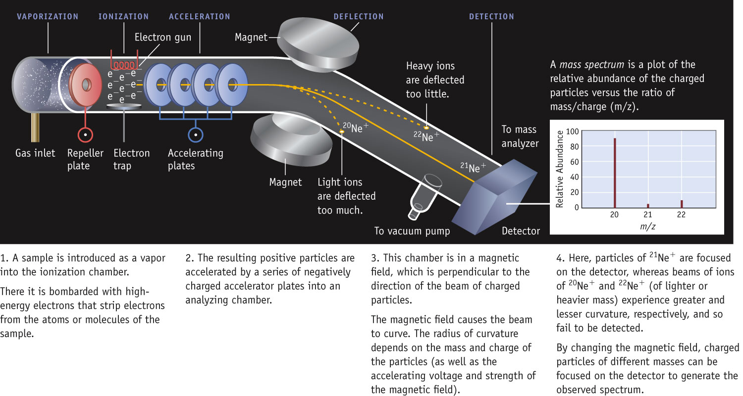
Masses of Isotopes determined with a mass spectrometer

Slide 9
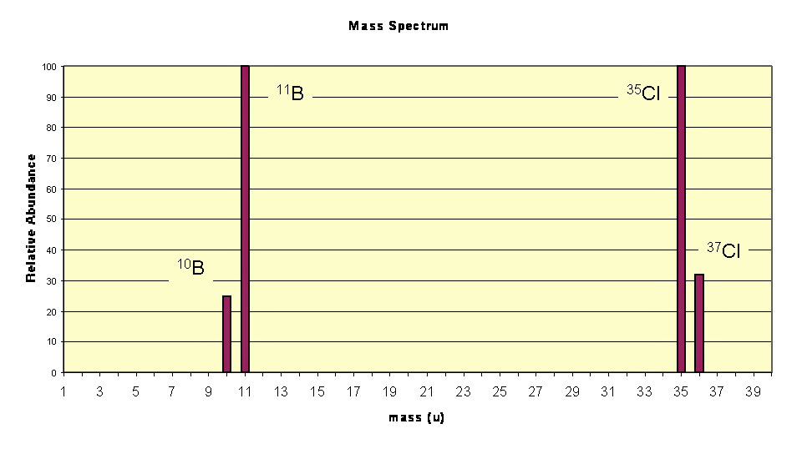
Isotope Abundance
The mass spectrometer gives information on the mass and relative abundance of each element’s isotopes.
Each isotope is represented by a Relative Abundance.

Slide 10
Interpreting Mass Spectra
Calculate the Average atomic mass for Si:
28.1117 amu

Slide 11
Photoelectron Spectroscopy (PES)
High energy beams (x-rays) used to eject electrons off the surface of a material, usually a solid. Understanding the binding energy of the electrons support the understanding of electron configuration and ionization energy. Applications include understanding valence energy levels and chemical bonding.

Slide 12
Interpretation of Photoelectron Spectra

Slide 13
Coulomb's Law
States the amount of energy that an electron has depends on its distance from the nucleus of the atom.
F= Energy,
k= Coulomb’s constant,
q₁ (q+)= magnitude of positive charge (nucleus)
q₂ (q-)= magnitude of negative charge (electron),
r= distance between the charges

Slide 14
Just a reminder:
Moles provide a bridge from the molecular scale to the real-world scale.
We’ve practices gram-mole-atom relationships.
Our next step is to apply this relationship across a balanced equation.
This is one of the MOST important skills of a chemist.
Use Dimensional Analysis!

Slide 15
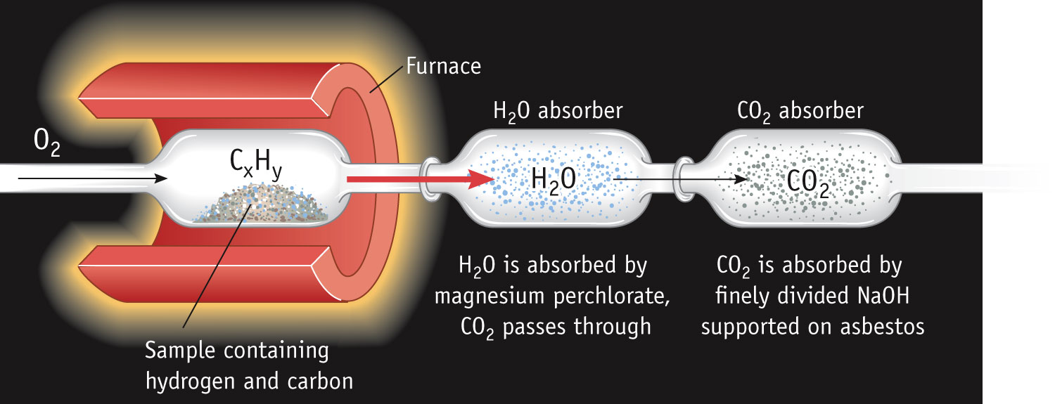
Determining the Formula of a Hydrocarbon by Combustion
Combustion involves the addition oxygen to another element.
When hydrocarbon molecules burn completely, the products are always carbon dioxide gas and water.
Notes:
See Chapter 4 Video Presentation Slide 6

Slide 16
Electromagnetic Radiation
All electromagnetic radiation travels at the same velocity: the speed of light (c), 3.00 × 10⁸ m/s.
The spectral regions of the electromagnetic spectrum vary according to frequency and wavelength.

Slide 17
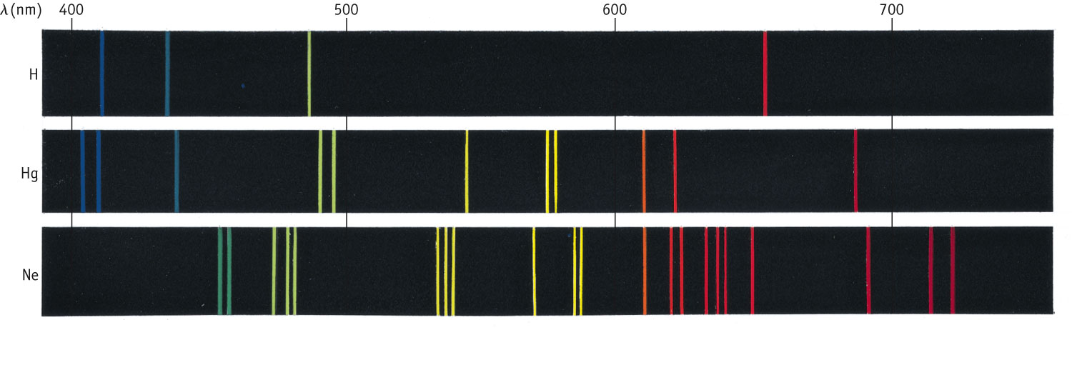
Line Spectra of Other Elements
Each element has a unique line spectrum.
The lines indicate that the electrons can only make “jumps” between allowed energy levels.
Knowing the color (wavelength) on can determine the magnitude of the energy gaps using Planck's Law.

Slide 18
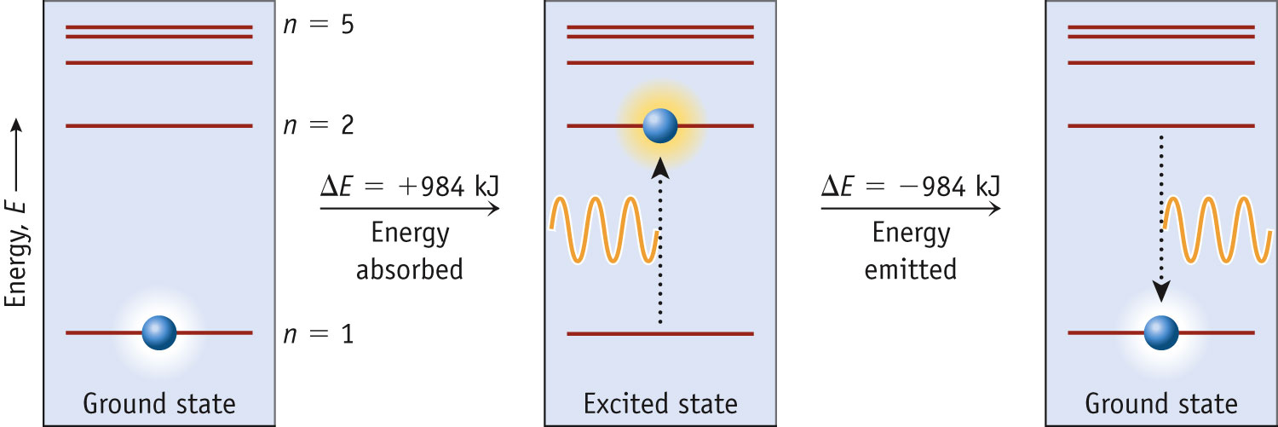
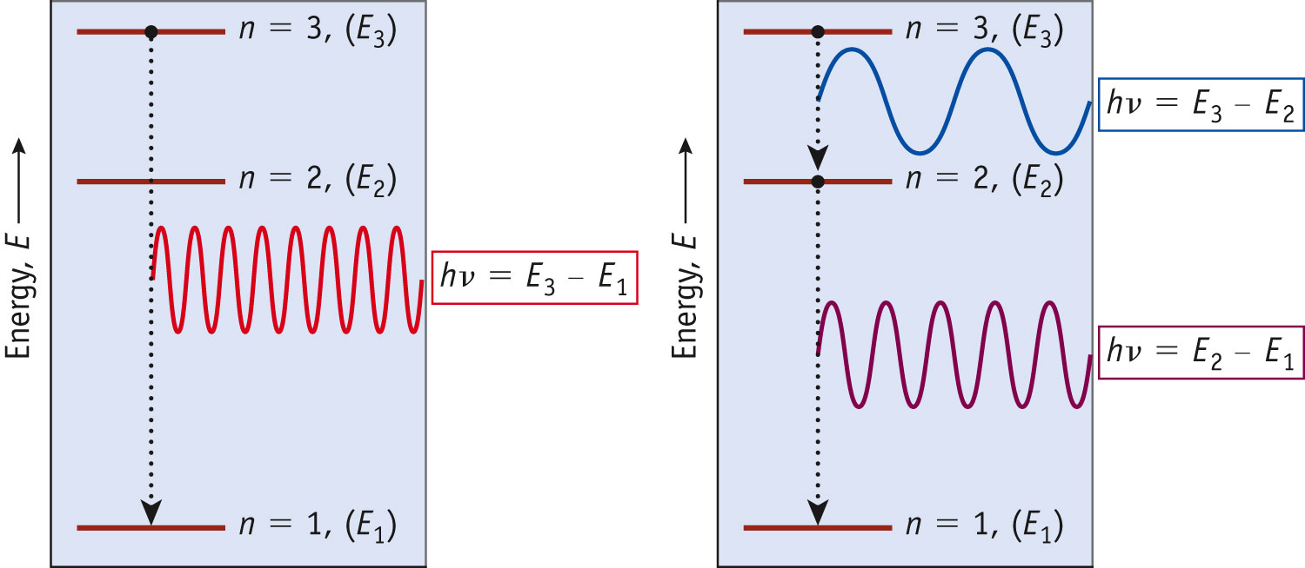
Energy Absorption/Emission
Since the gaps between states get closer and closer together with increasing n, the frequency of the light emitted changes.
Notes:
See Chapter 6 Video Presentation Slide 11

Slide 19
Energy Levels
Key terms and Vocabulary:
Ground State: The lowest energy level (n = 1)
Excited State: A subsequently higher energy level. n = 2 is the “first excited state” and so on.
Absorption: An electron moving from a lower energy level to a higher energy level via excitation.
Emission: An electron moving from a higher to a lower energy level accompanied by the release of a photon.

Slide 20
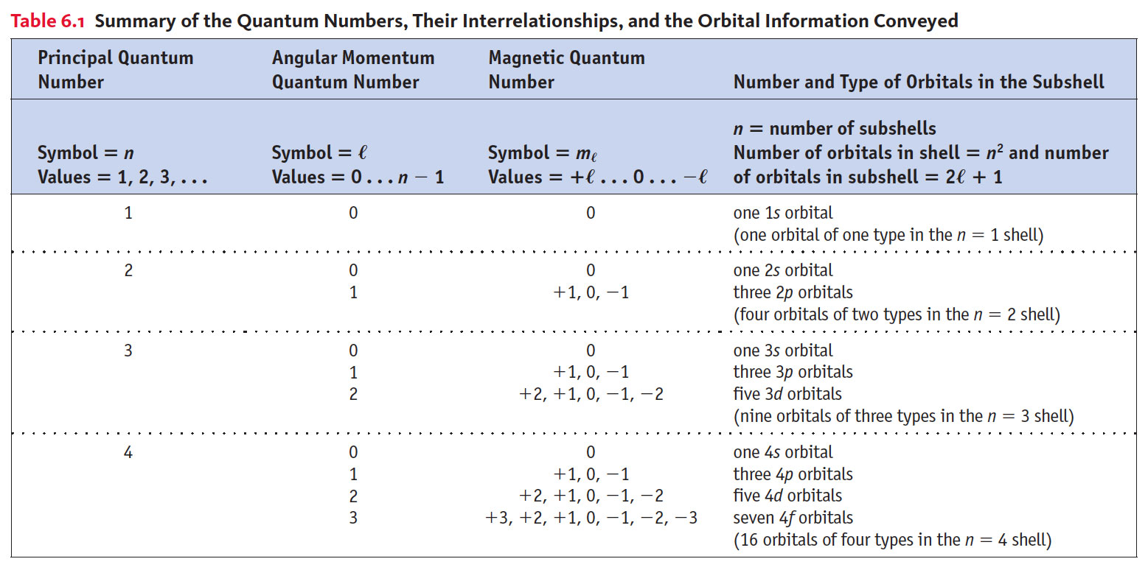
Summary of Quantum Numbers

Slide 21
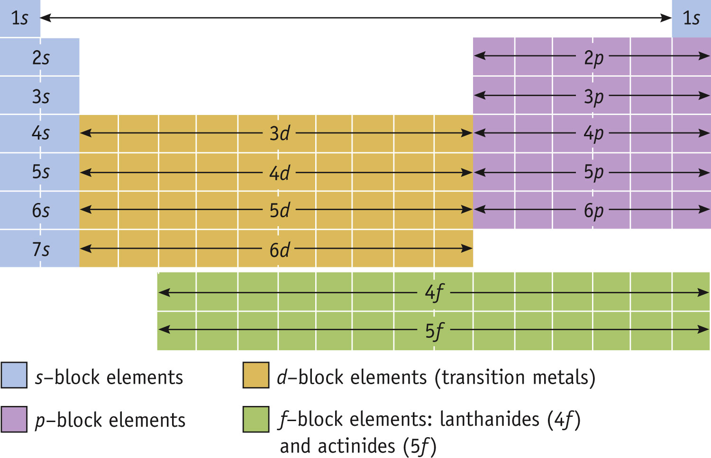
Electron Configurations & the Periodic Table

Slide 22
Orbital Filling Rules:
Aufbau Principle: Lower energy orbitals fill first.
Hund’s Rule: Degenerate orbitals (those of the same energy) are filled with electrons until all are half filled before pairing up of electrons can occur.
Pauli exclusion principle: Individual orbitals only hold two electrons, and each should have different spin.
“s” orbitals can hold 2 electrons
“p” orbitals hold up to 6 electrons
“d” orbitals can hold up to 10 electrons

Slide 23
Electron Spin & Magnetism
Diamagnetic Substances: Are NOT attracted to a magnetic field
Paramagnetic Substances: ARE attracted to a magnetic field.
Substances with unpaired electrons are paramagnetic.
Ferromagnetism when the spin of unpaired electrons in a solid align themselves in one direction.
Notes:
See Chapter 6 Video Presentation Slide 24

Slide 24
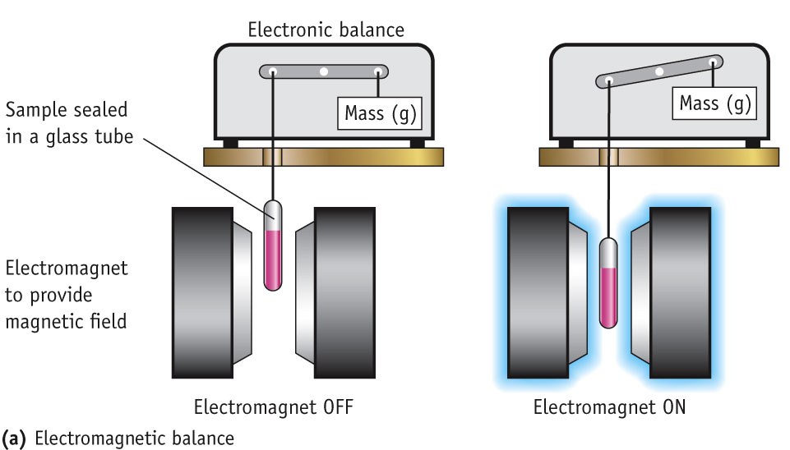
Measuring Paramagnetism
When a substance containing unpaired electrons is place into a magnetic field, it is attracted to that magnetic field.
The effect is proportional to the number of unpaired electrons.

Slide 25
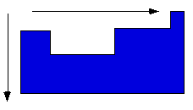
General Periodic Trends
Atomic and ionic size
Ionization energy
Electron affinity
Higher effective nuclear charge
Electrons held more tightly
Larger orbitals.
Electrons held less
tightly.
Notes:
See Chapter 7 Video Presentation Slides 8, 9, & 10

Slide 26
Ionization Energy
The ionization energy is the amount of energy required to remove an electron from the ground state of a gaseous atom or ion.
The first ionization energy is that energy required to remove first electron.
The second ionization energy is that energy required to remove second electron, etc.

Slide 27
Trends in First Ionization Energies
Generally, as one goes across a row, it gets harder to remove an electron.
As you go from left to right, Z_{eff} increases.

Slide 28
Sizes of Ions
Ionic size depends upon:
The nuclear charge.
The number of electrons.
The orbitals in which electrons reside.

Slide 29
Sizes of Ions
In an isoelectronic series, ions have the same number of electrons.
Ionic size decreases with an increasing nuclear charge.

Slide 30
Summary of Periodic Trends
Moving through the periodic table: | Atomic radii | Ionization Energy | Electron Affinity
Down a group | Increase | Decrease | Becomes less exothermic
Across a Period | Decrease | Increase | Becomes more exothermic

Slide 31
Molarity
Two solutions can contain the same compounds but be quite different because the proportions of those compounds are different.
Molarity is one way to measure the concentration of a solution.
moles of solute
Molarity (M) =
volume of solution in liters

Slide 32
Preparing Solutions
Weigh out the solid solute and carefully transfer it to the volumetric flask.
Dissolve in a volume of solvent less than the flask volume.
Fill the volumetric flask to the calibration mark with solvent.
Invert the flask many times to ensure homogeneous mixing.

Slide 33
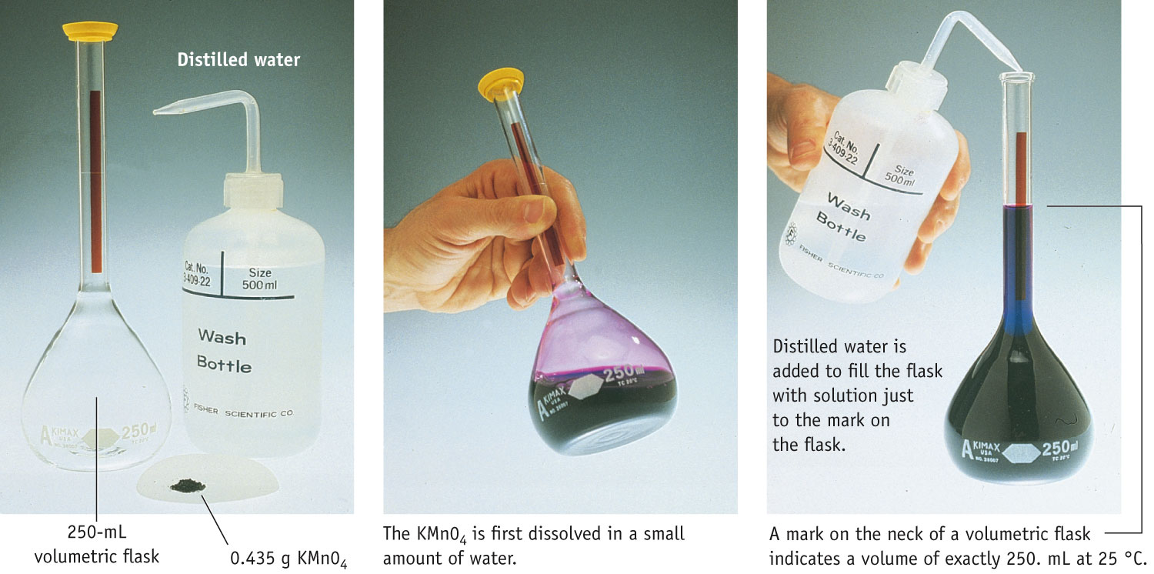
Preparing Solution of Known Concentration

Slide 34
Dilution
The molarity of the new solution can be determined from the equation
M₁ × V₁ = M₂ × V₂
where M₁ and M₂ are the molarity of the concentrated and dilute solutions, respectively, and V₁and V₂ are the volumes of the two solutions.

Slide 35
UV-Visible Spectra
Spectroscopy is the study of the interaction of energy with a sample for analysis. UV-Vis spectroscopy specifically addresses the absorbance or transmittance of a material at a specific wavelength within the UV/visible portion of the electromagnetic spectrum.
Almost every material in existence absorbs light of one wavelength or another. Materials will absorb light of one wavelength and not absorb light of a different wavelength. The absorption of specific wavelengths of light can be measured using a spectrophotometer. This information can be used to understand sample composition and concentration.

Slide 37
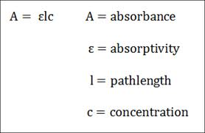
Interpretation of Beer’s Lambert Law:
Describes the linear relationship between solution concentration (M) and absorbance

Slide 38
Example: Calibration Curve

