Slide 1
Molecules, Compounds, and Formulas

Slide 2
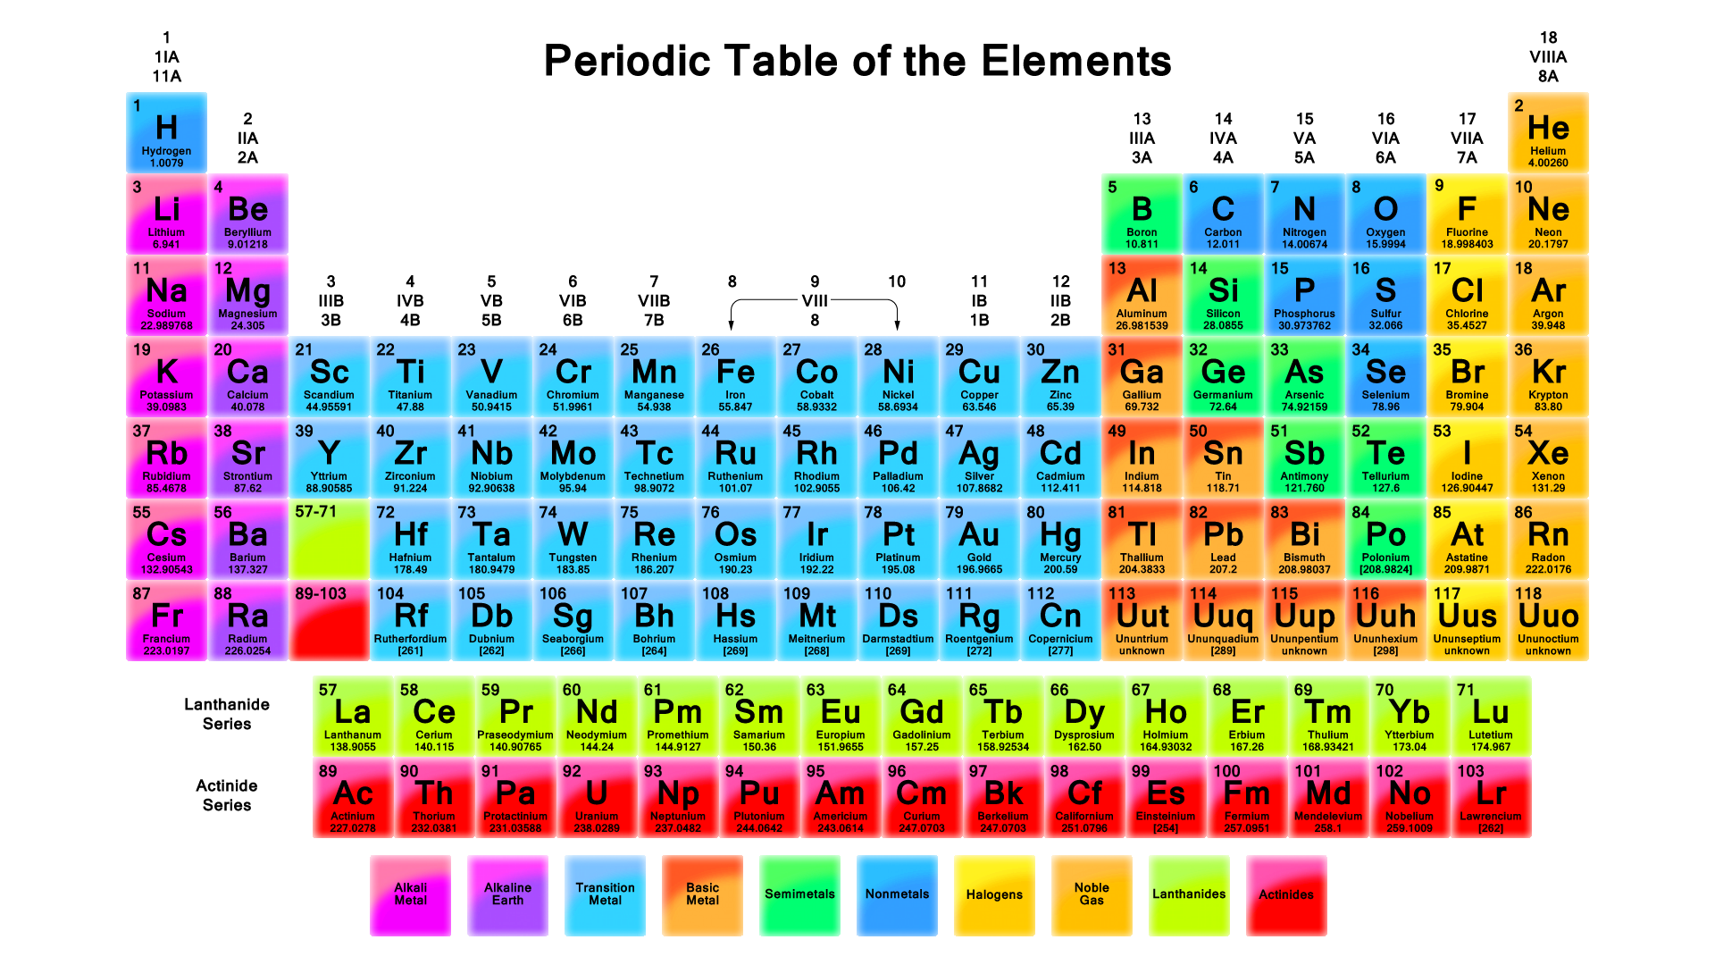
Organization of the Periodic table:
Groups/families - vertical arrangement #1-18
Periods – horizontal rows #1-7
Metals-Non-metals-Metalloids

Slide 3
Compounds & Molecules
COMPOUNDS are a combination of 2 or more elements in definite ratios by mass.
The character of each element is lost when forming a compound.
MOLECULES are the smallest unit of a compound that retains the characteristics of the compound. (non-metal combined with a non-metal)

Slide 4
Compounds
A compound is a distinct substance that contains two or more elements combined in a definite proportion by weight.
Atoms of the elements that constitute a compound are always present in simple whole number ratios.
They are never present as fractional parts.
Examples:
AB
A₂B
AB₂
A_{½}B
Never:

Slide 5
Chemical Bonds:
Describes the force that holds atoms together and includes:
  Covalent bonds – sharing of electrons between non-metals.
  Ionic bonds - the electrostatic attraction of oppositely charged ions (metal + nonmetal)
Chemical formula: describes the bonded compound using the symbols for the elements and subscripts to define how many. Ex: H₂O, Na₂PO₄

Slide 6
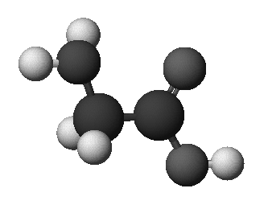
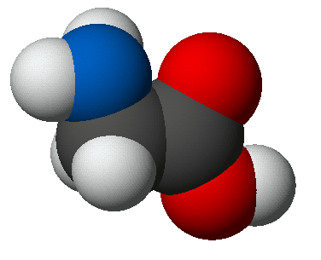
Molecular Modeling
Structural formula of glycine:
Ball & stick
Space-filling

Slide 7
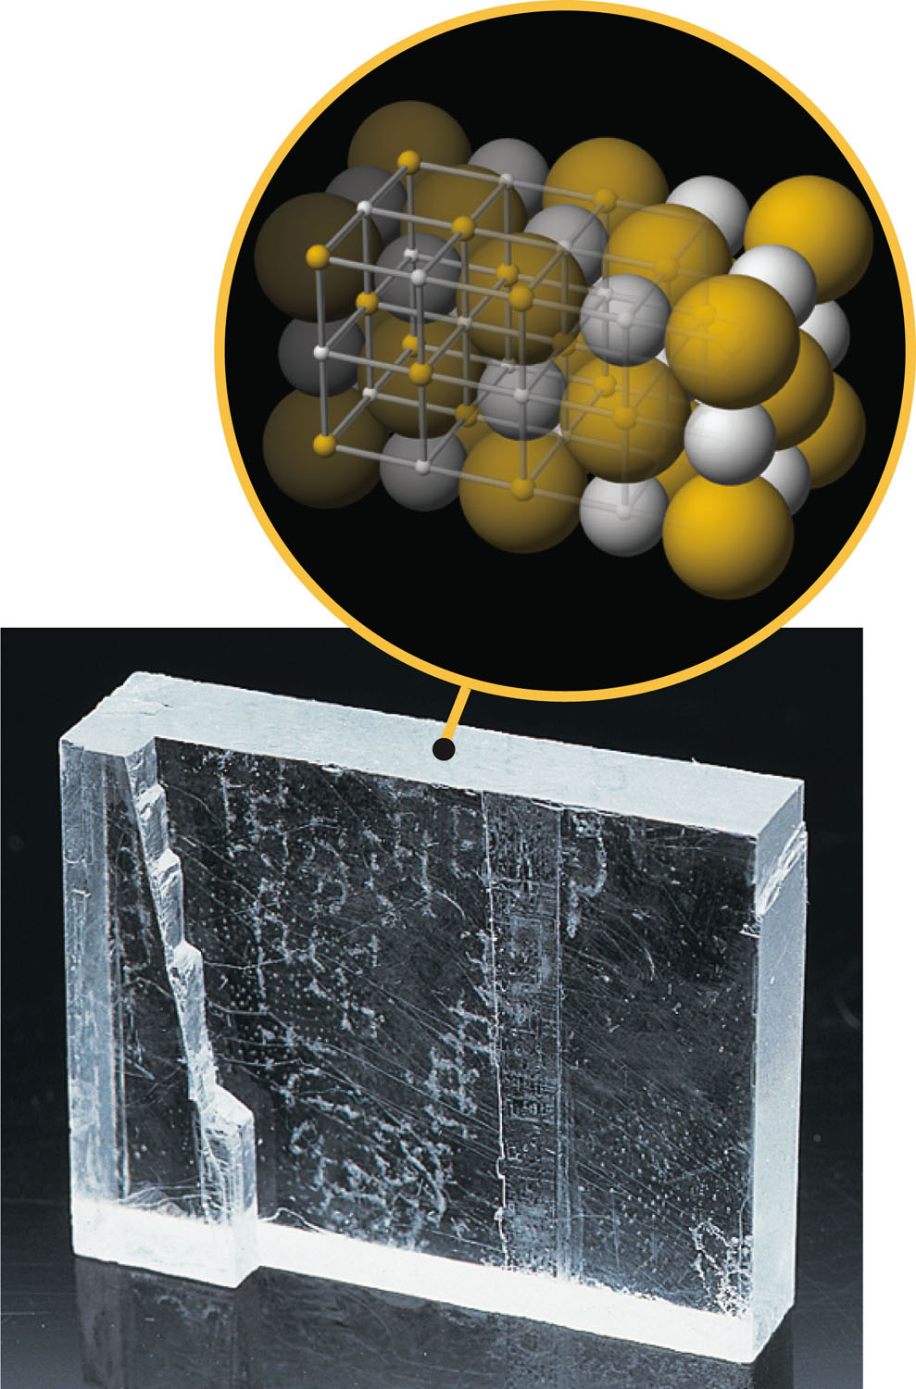
Ionic Compounds
Ionic compounds (metals & non-metals) constitute a major class of compounds.
They consist of ions, atoms or groups of atoms that bear a positive or negative electric charge.
Many familiar compounds are composed of ions. Table salt, or sodium chloride (NaCl) is one example.
These are generically referred to as salts.
NaCl

Slide 8
Ions & Ionic Compounds
IONS are atoms or groups of atoms with a formal positive or negative charge.
Removing electrons from an atom produces a CATION with a positive charge.
Adding a electrons to an atom gives an ANION with a negative charge.

Slide 9
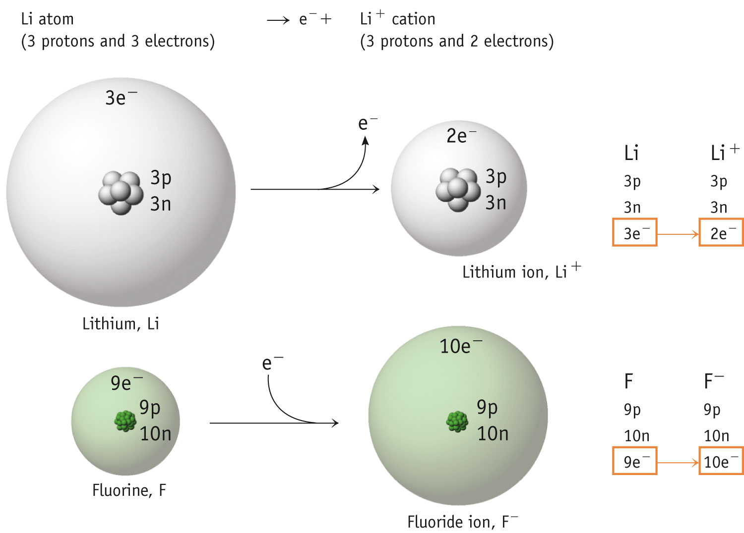
Ions & Ionic Compounds

Slide 10
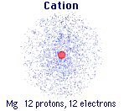
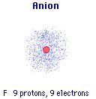
Forming Cations & Anions
A CATION forms when an atom loses one or more electrons.
An ANION forms when an atom gains one or more electrons
Mg → Mg²⁺ + 2 e-
F + e- → F⁻
Notes:
See Chapter 2 Video Presentation Slide 12 & 13

Slide 11
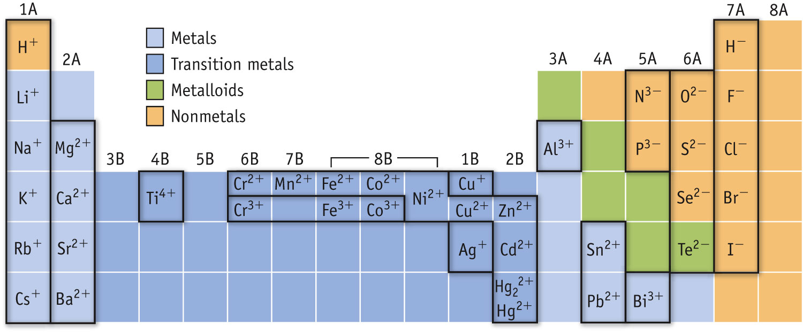
Predicting Ion Charges
In general
metals (Mg) lose electrons forming cations
nonmetals (F) gain electrons forming anions
Notes:
See Chapter 2 Video Presentation Slide 14

Slide 12
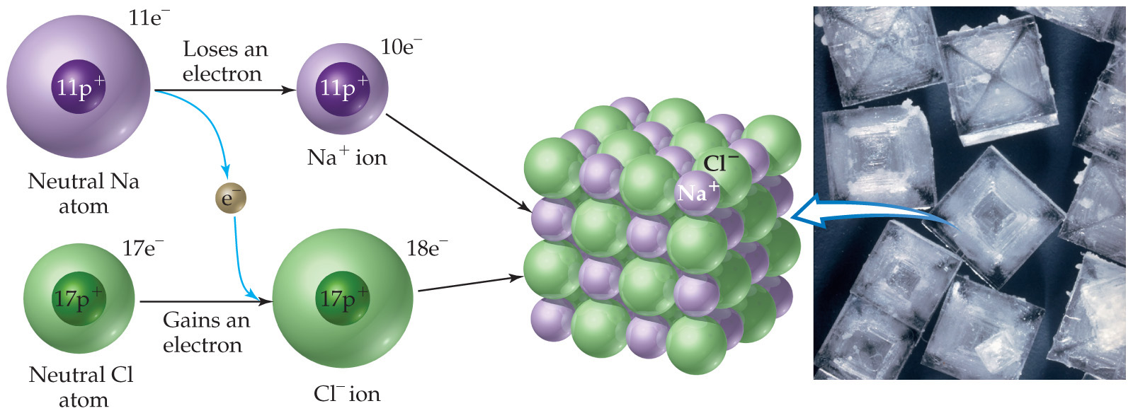
Ionic Bonds
Ionic compounds (such as NaCl) are generally formed between metals and nonmetals.

Slide 13
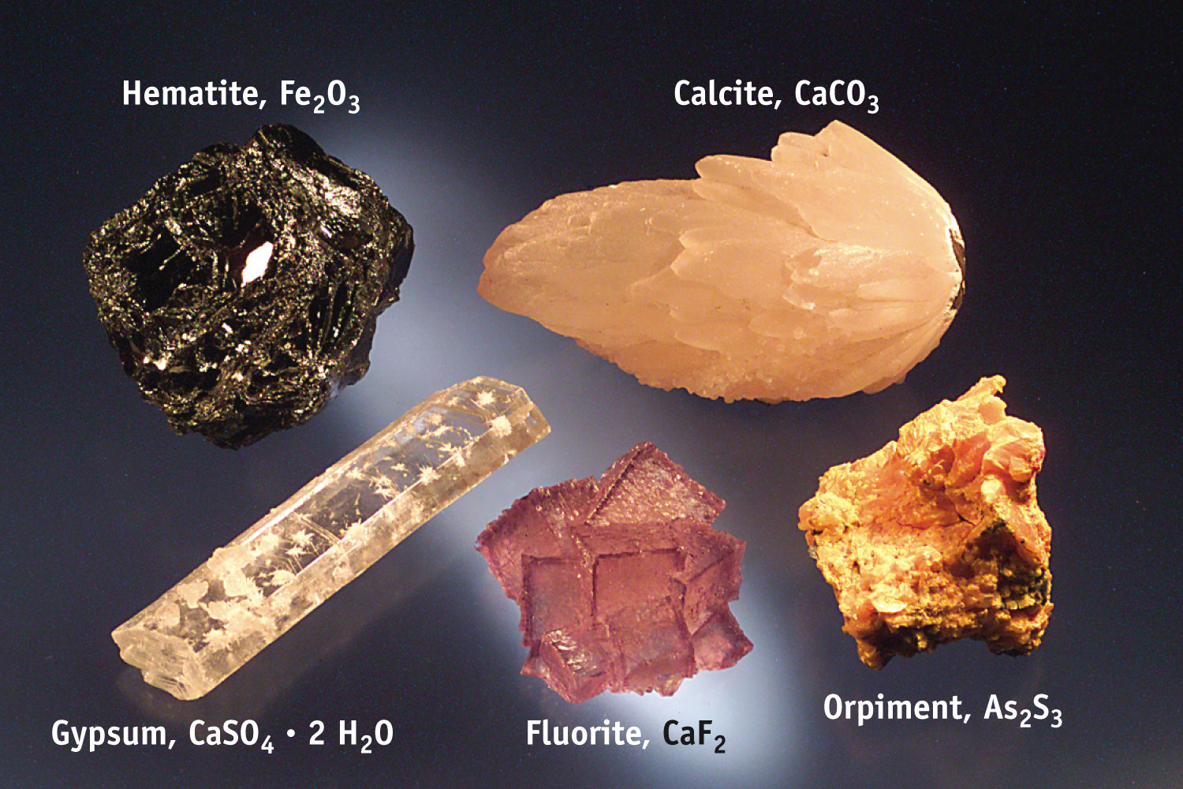
Ions & Ionic Compounds

Slide 14
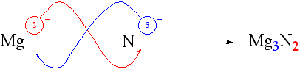
Writing Formulas
Because compounds are electrically neutral, one can determine the formula of a compound this way:
  The charge on the cation becomes the subscript on the anion.
  The charge on the anion becomes the subscript on the cation.
  If these subscripts are not in the lowest whole-number ratio, divide them by the greatest common factor.

Slide 15
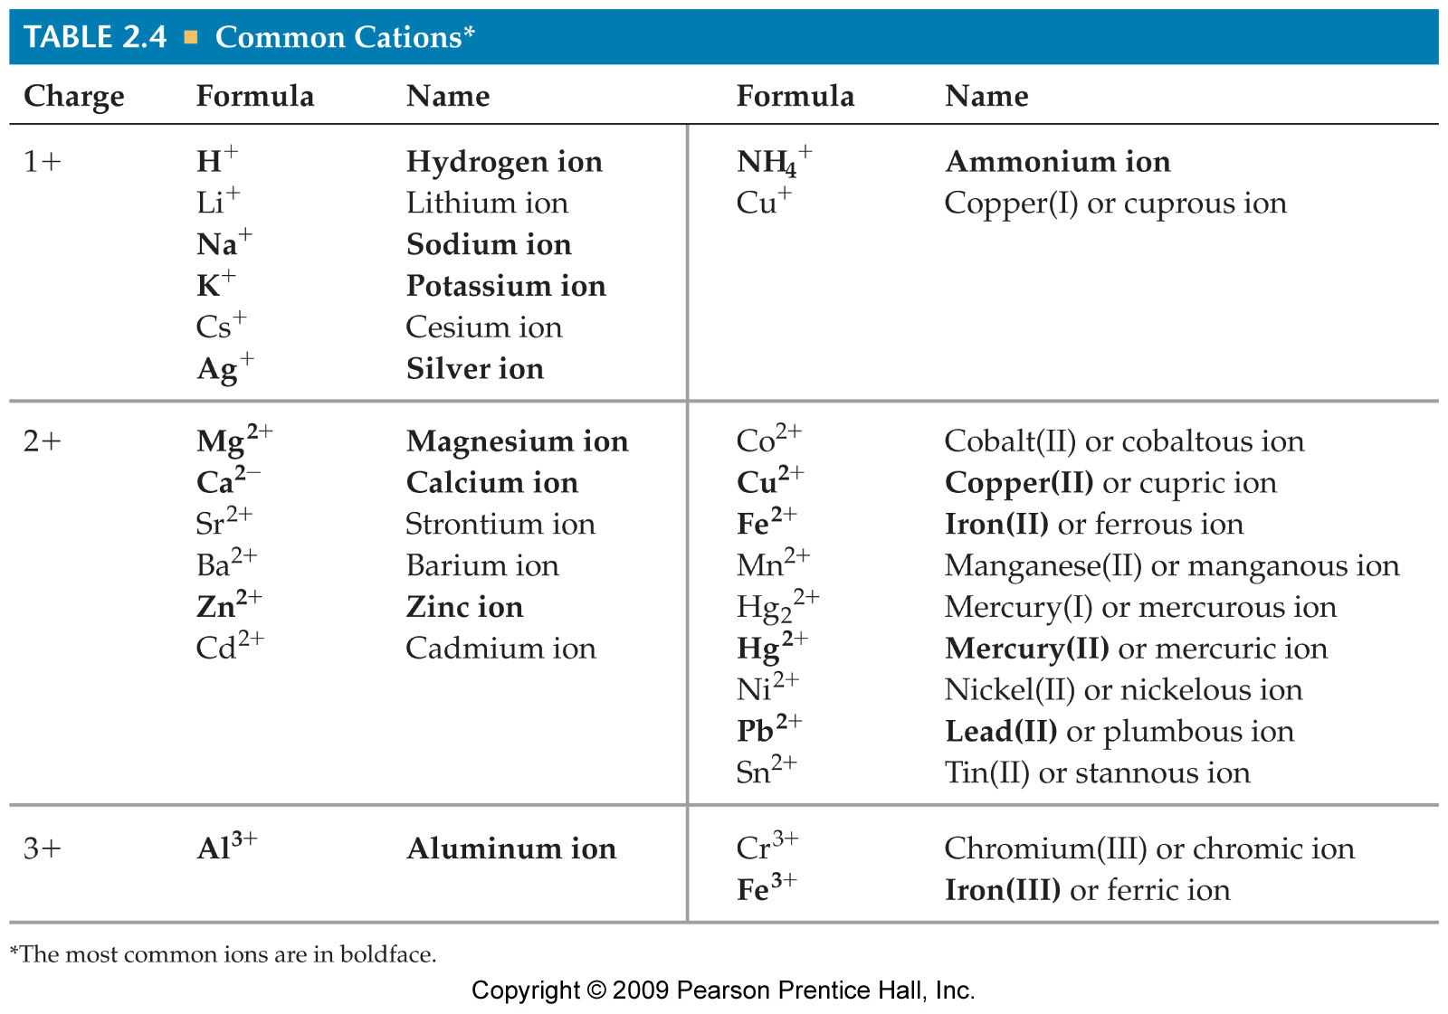
Common Cations

Slide 16
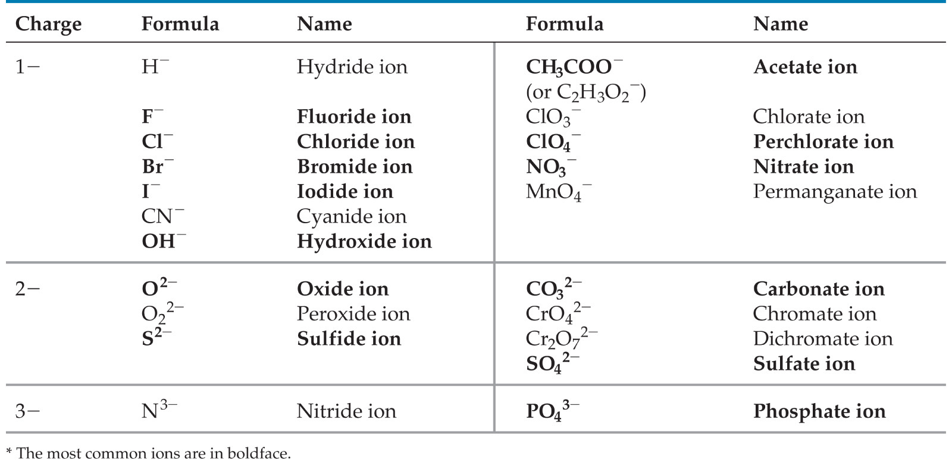
Common Anions

Slide 17
Naming Ionic Compounds
Write the name of the cation.
If the anion is an element, change its ending to -ide; if the anion is a polyatomic ion, simply write the name of the polyatomic ion.
If the cation can have more than one possible charge, write the charge as a Roman numeral in parentheses.

Slide 18
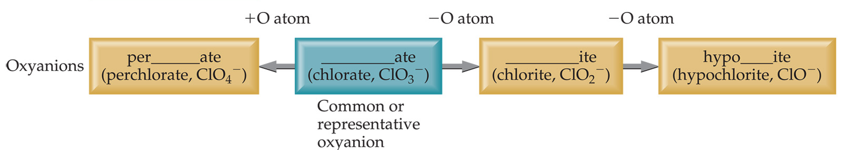
Patterns in Oxyanion Nomenclature
When there are two oxyanions (contain oxygen) involving the same element:
The one with the second fewest oxygens ends in -ite.
    ClO₂⁻ : chlorite
The one with the second most oxygens ends in -ate.
    ClO₃⁻ : chlorate

Slide 19
Patterns in Oxyanion Nomenclature
The one with the fewest oxygens has the prefix hypo- and ends in -ite.
    ClO⁻ : hypochlorite
The one with the most oxygens has the prefix per- and ends in -ate.
    ClO₄⁻ : perchlorate

Slide 20
Practice:
NaOH
Fe(NO₃)₃
KBrO₃
KCN
Copper (II) Sulfate
Ammonium chloride
Sodium perchlorate

Slide 21
Answers:
NaOH - Sodium hydroxide
Fe(NO₃)₃ – Iron (III) nitrate
KBrO₃ - Potassium Bromate
KCN - Potassium cyanide
Copper (II) Sulfate – CuSO₄
Ammonium chloride - NH₄Cl
Sodium perchlorate – NaClO₄

Slide 22
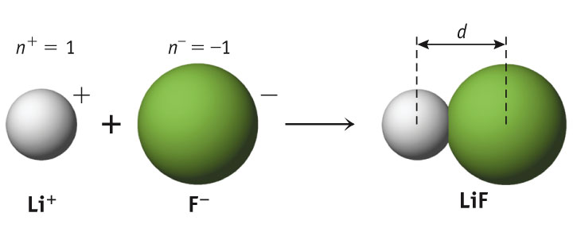
Properties of Ionic Compounds
Forming NaCl from Na(s) and Cl₂(g)
A metal atom can transfer an electron to a nonmetal atom.
The resulting cation and anion are attracted to each other by electrostatic forces.
Notes:
See Chapter 2 Video Presentation Slide 10 & 15

Slide 23
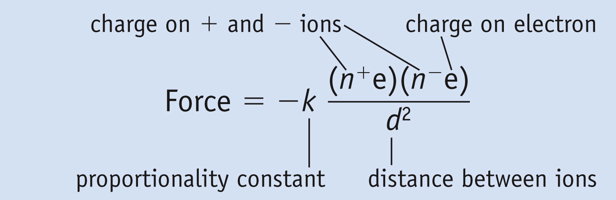
Electrostatic Forces
COULOMB’S LAW
As ion charges increase, the attractive forces between oppositely charged ions increases.
As the distance between ions increase, the attractive forces decreases.

Slide 24
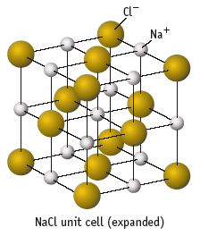
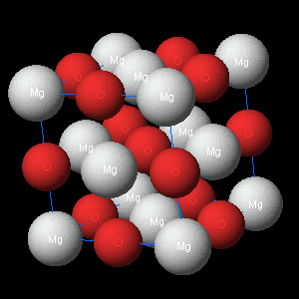
Affect of Coulomb’s Law
NaCl, Na⁺ and Cl⁻,
m.p. 804 ºC
MgO, Mg²⁺ and O²⁻
m.p. 2800 ºC
MgO with the greater charge and smaller bond distance has the higher melting point.

Slide 25
Naming Molecular Compounds
When non-metals combine, they form molecules.
They may do so in multiple forms:
CO “carbon monoxide”
CO₂ “carbon dioxide”
Because of this we need to specify the number of each atom by way of a prefix.
1 | mono | 6 | hexa
2 | di | 7 | hepta
3 | tri | 8 | octa
4 | tetra | 9 | nona
5 | penta | 10 | deca

Slide 26
Examples:
Formula Name:
BCl₃
boron trichloride
SO₃
sulfur trioxide
NO
nitrogen monoxide
nitrogen monooxide
or mononitrogen monoxide
we don’t write:
N₂O₄
dinitrogen tetraoxide
Notes:
Instructors note: Each element of the slide can be made to appear individually using the “custom animation” features of PowerPoint.

Slide 27
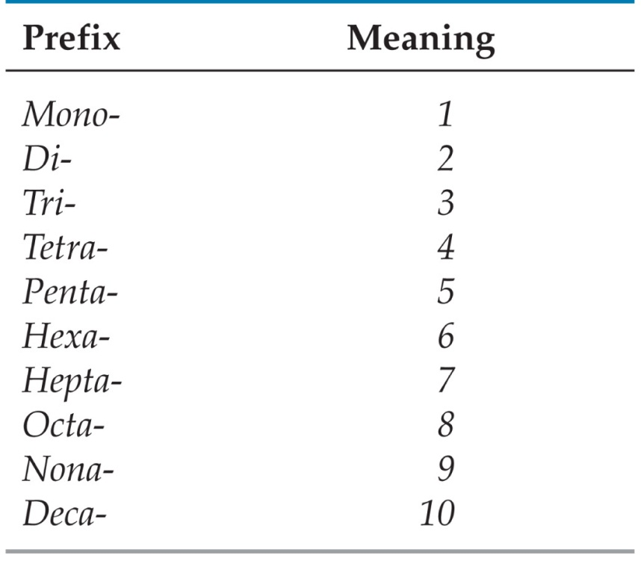
Naming Covalent Compounds (between two nonmetals)
The less electronegative atom is usually listed first.
A prefix is used to denote the number of atoms of each element in the compound (mono- is not used on the first element listed, however) .

Slide 28
Nomenclature of Binary Compounds
The ending on the more electronegative element is changed to -ide.
  CO₂: carbon dioxide
  CCl₄: carbon tetrachloride

Slide 29
Nomenclature of Binary Compounds
If the prefix ends with a or o and the name of the element begins with a vowel, the two successive vowels are often elided into one.
N₂O₅: dinitrogen pentoxide

Slide 30
Practice:
N₂O₄
NO₂
SF₆
CO₂
Tetraphosphorus decaoxide
Sulfur trioxide
Dinitrogen pentoxide

Slide 31
Answers:
N₂O₄ - Dinitrogen tetroxide
NO₂ – Nitrogen dioxide
SF₆ - Sulfur hexafluoride
CO₂ – Carbon dioxide
Tetraphosphorus decaoxide –P₄O₁₀
Sulfur trioxide - SO₃
Dinitrogen pentoxide - N₂O₅

Slide 32
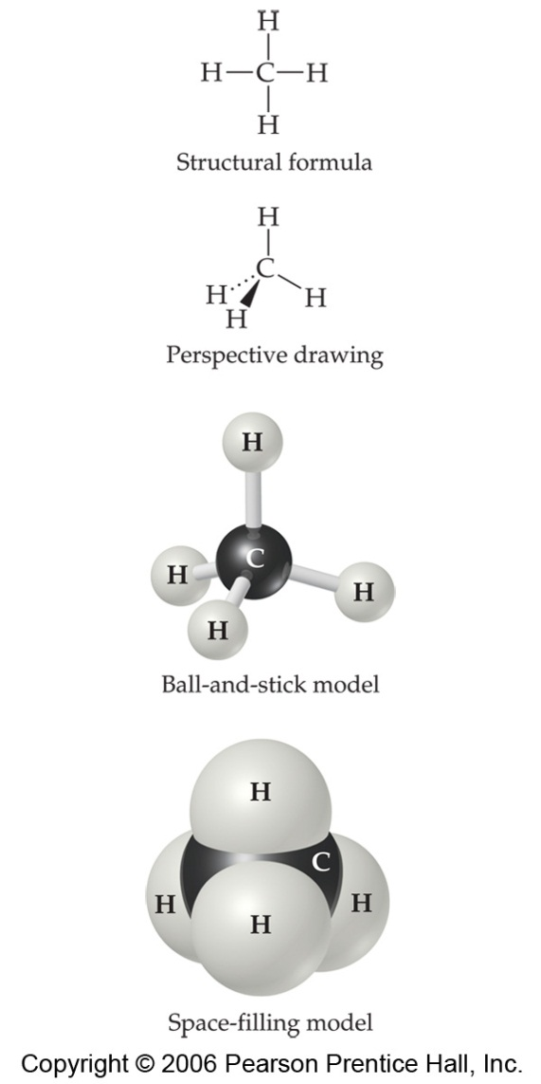
Types of Formulas
Structural formulas show the order in which atoms are bonded.
Perspective drawings also show the three-dimensional array of atoms in a compound.

Slide 33
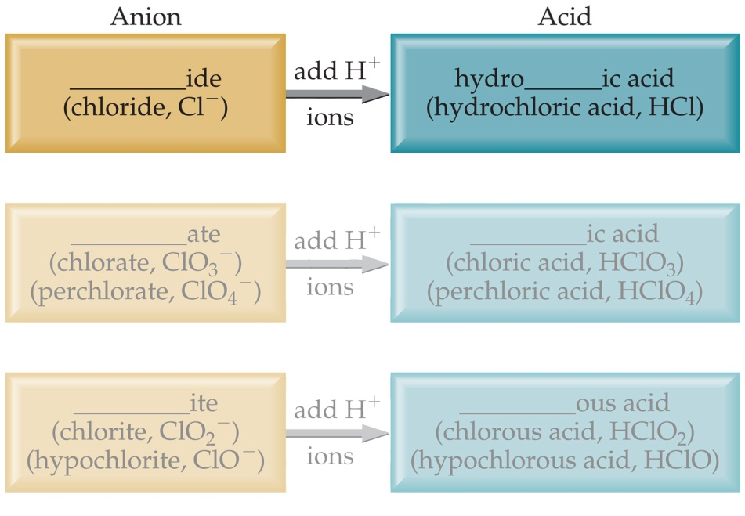
Acid Nomenclature
If the anion in the acid ends in -ide, change the ending to -ic acid and add the prefix hydro- .
  HCl: hydrochloric acid
  HBr: hydrobromic acid
  HI: hydroiodic acid

Slide 34
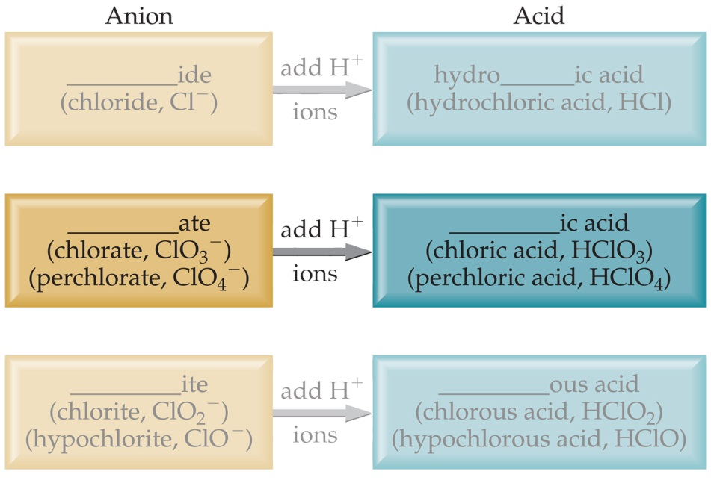
Acid Nomenclature
If the anion in the acid ends in -ate, change the ending to -ic acid.
  HClO₃: chloric acid
  HClO₄: perchloric acid

Slide 35
Types of Formulas
Empirical formulas give the lowest whole-number ratio of atoms of each element in a compound.
Molecular formulas give the exact number of atoms of each element in a compound.

Slide 36
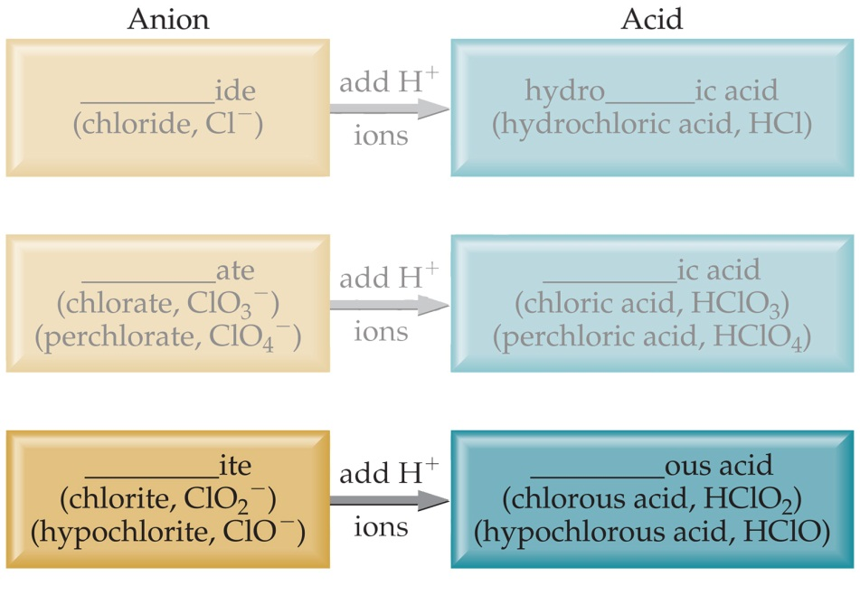
Acid Nomenclature
If the anion in the acid ends in -ite, change the ending to -ous acid.
  HClO: hypochlorous acid
  HClO₂: chlorous acid

Slide 37
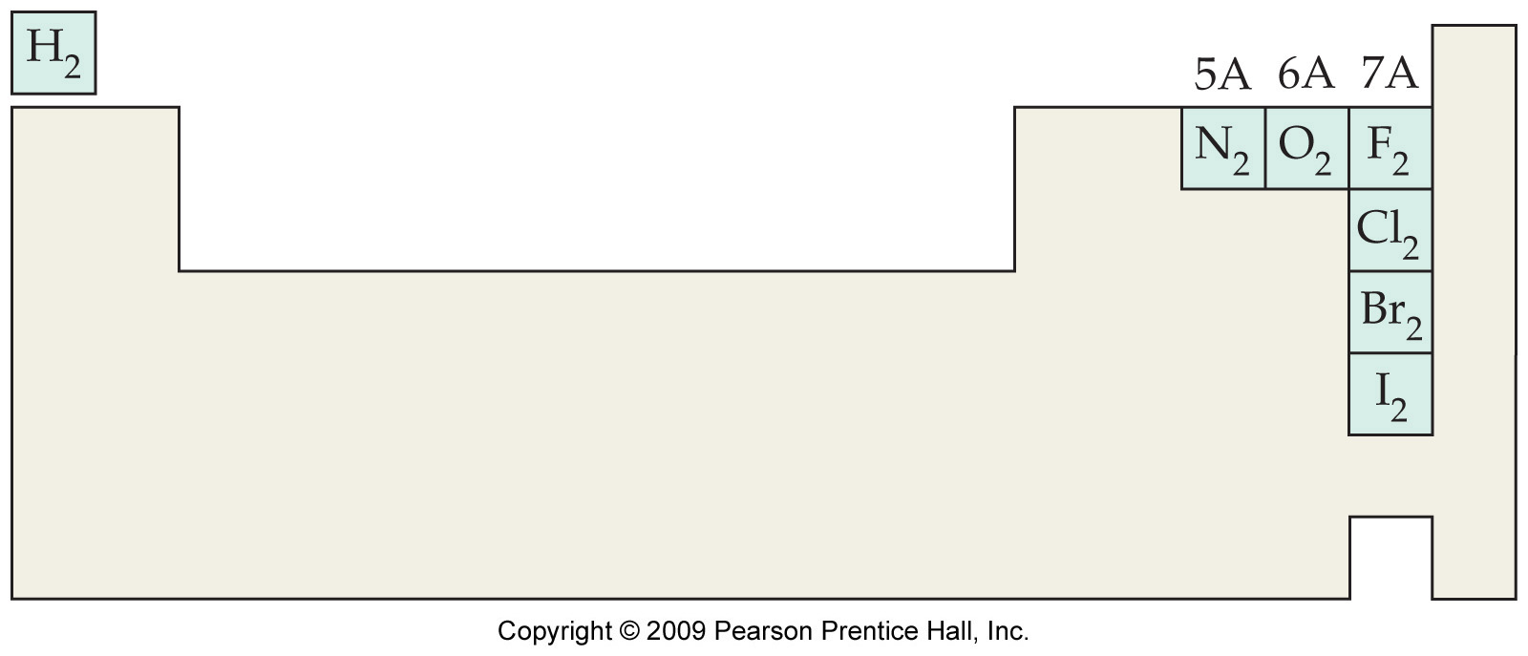
Diatomic Molecules
These seven elements occur naturally as molecules containing two atoms. It is important that you commit these to memory!
“Brian Helps Claire Find Out New Ideas”

Slide 38
Formula Weight (FW)
A formula weight is the sum of the atomic weights for the atoms in a chemical formula.
So, the formula weight of calcium chloride, CaCl₂, would be
    Ca: 1(40.08 amu)
    + Cl: 2(35.45 amu)
    110.98 amu
Formula weights are generally reported for ionic compounds.

Slide 39
Molecular Weight (MW)
A molecular weight is the sum of the atomic weights of the atoms in a molecule.
For the molecule ethane, C₂H₆, the molecular weight would be
C: 2(12.01 amu)
+ H: 6(1.01 amu)
30.08 amu

Slide 40
Percent Composition
So the percentage of carbon in ethane is…
(2)(12.01 amu)
%C =
(30.08 amu)
24.02 amu
=
x 100
30.08 amu
= 79.85%

Slide 41
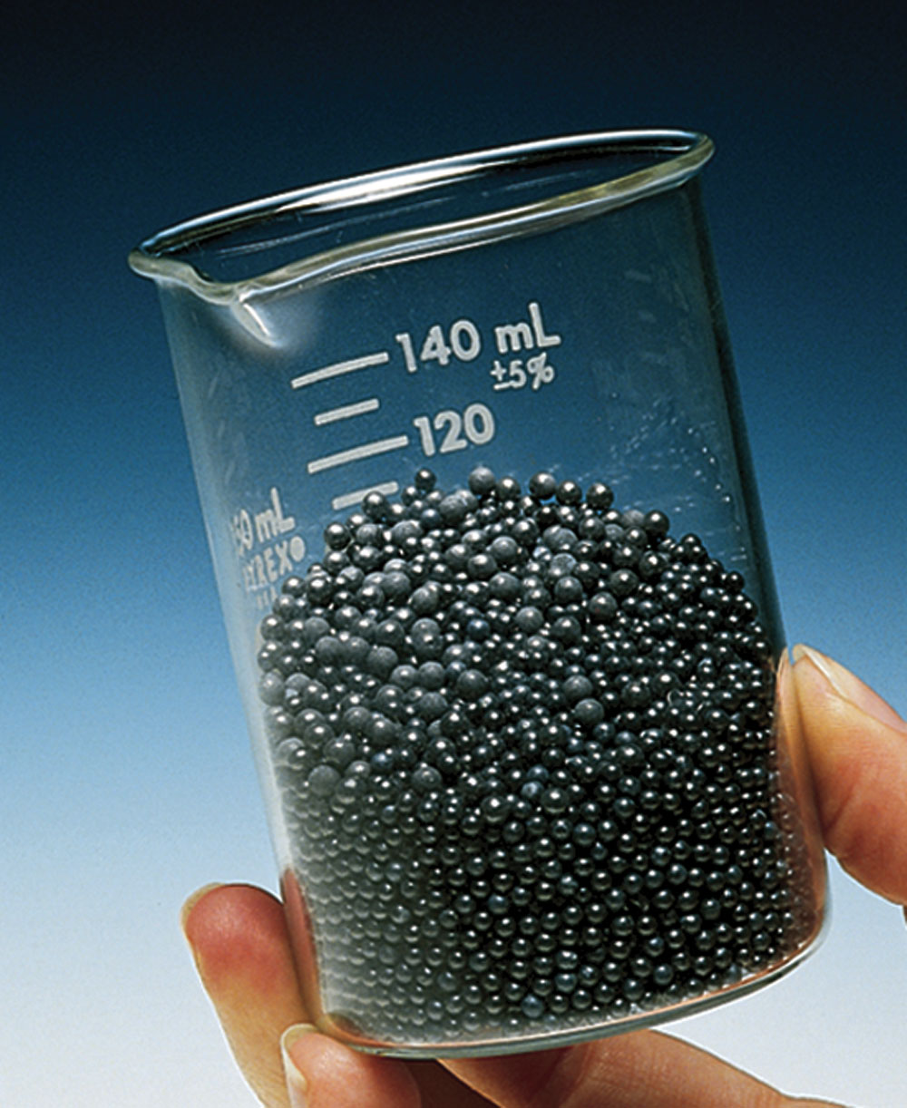
Counting Atoms: The Mole
Chemistry is a quantitative science—we need a “counting unit” the:
MOLE
1 mole is the amount of substance that contains as many particles (atoms, molecules) as there are in 12.0 g of ¹²C.
518 g of Pb, 2.50 mol

Slide 42
Counting Atoms: The Mole
Avogadro’s Number and the Mole
The concept of a mole is defined so that we may equate the amount of matter (mass) to the number of particles (mole).
The Standard is based upon the C -12 isotope.
The mass of one C - 12 atom is 1.99265 × 10⁻²³ g.
The atomic mass of C - 12 is defined as exactly 12 u.
Therefore: 1u = (the mass of one 12C atom ÷12)
= 1.66054 × 10⁻²⁴g
= 1.66054 × 10⁻²⁷ kg
Notes:
Instructors note: Each element of the slide can be made to appear individually using the “custom animation” features of PowerPoint.

Slide 43
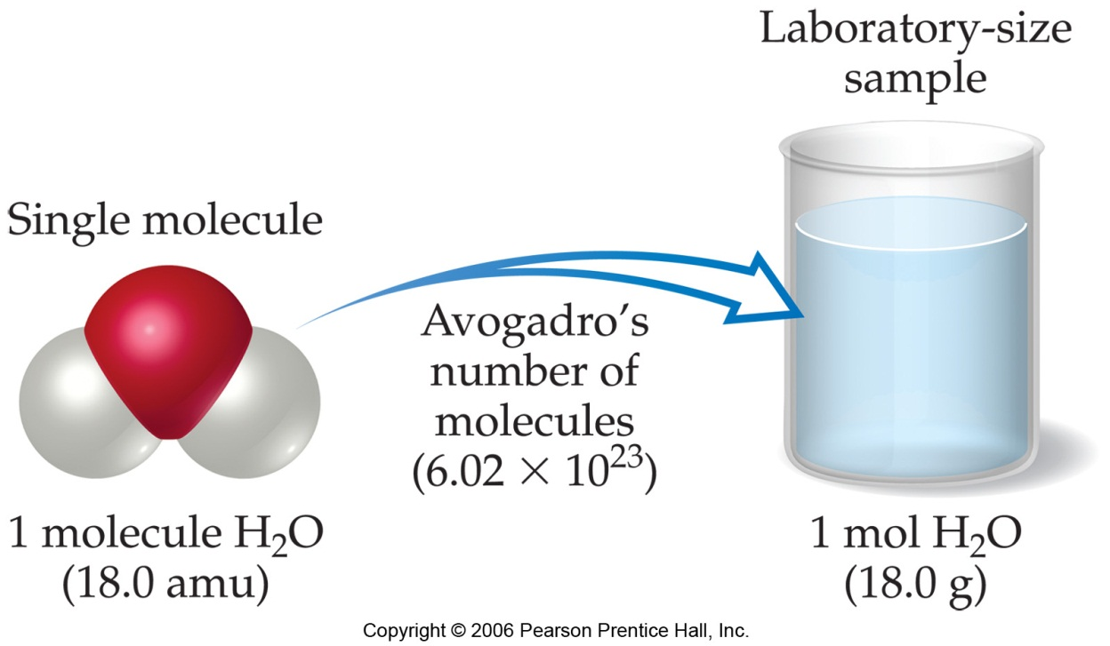
Avogadro’s Number
6.02 x 10²³
1 mole of ¹²C has a mass of 12 g.

Slide 44
Molar Mass
By definition, a molar mass is the mass of 1 mol of a substance (i.e., g/mol).
  The molar mass of an element is the mass number for the element that we find on the periodic table.
  The formula weight (in amu’s) will be the same number as the molar mass (in g/mol).

Slide 45
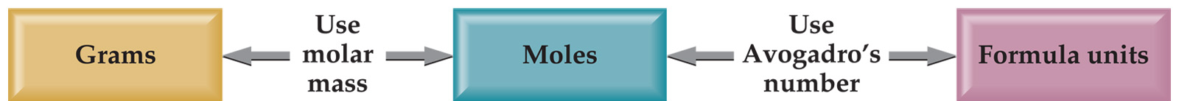
Using Moles
Moles provide a bridge from the molecular scale to the real-world scale.

Slide 46
Example: 1.056g of Sn is reacted with 1.947g of I₂. After the reaction is complete, 0.601g of Sn is recovered. What is the formula for SnI_{x}?
Now find the ratio of number of moles of moles of I and Sn that combined.
Empirical formula is SnI₄

Slide 47
Hydrates
A hydrate is a substance composed of an inorganic salt and physically bound water.
MX⋅nH₂O
salt
water
n = is the ratio of moles of water to 1 mole of the salt

Slide 48
Naming Hydrates
Salt name
+
prefix
hydrate
prefix:
mono, di, tri etc…
BaCl₂⋅2H₂O
barium chloride
dihydrate
⋅5H₂O
sodium sulfate pentahydrate
Na₂SO₄

Slide 49
Heating Hydrates
When a hydrate is heated, the water is liberated.
For every one mole of hydrate, n moles (in this case 2) of water are liberated.
After heating, any mass that remains is due to the salt residue.
Therefore, any mass loss in heating is due to the water loss.
mass sample – mass residue = mass water lost

Slide 50
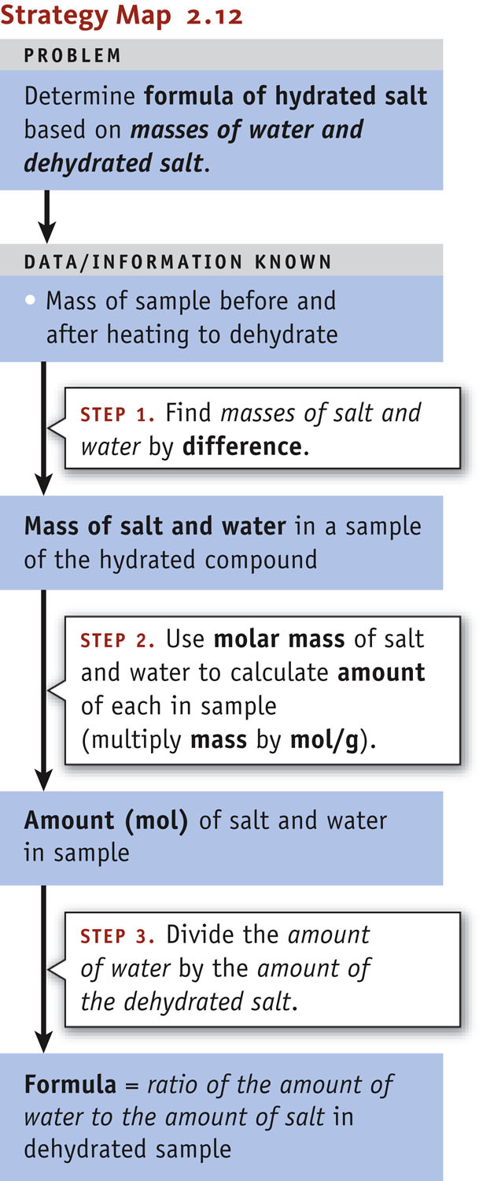
Hydrate Formulas
The solution to the problem involves the following series of steps.

Slide 51
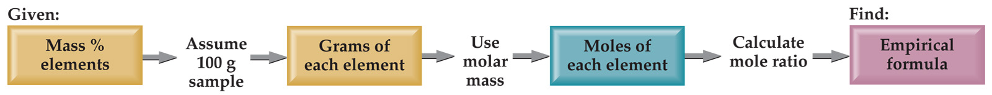
Calculating Empirical Formulas
One can calculate the empirical formula from the percent composition.

Slide 52
Calculating Empirical Formulas
The compound para-aminobenzoic acid (you may have seen it listed as PABA on your bottle of sunscreen) is composed of carbon (61.31%), hydrogen (5.14%), nitrogen (10.21%), and oxygen (23.33%). Find the empirical formula of PABA.

Slide 53
Calculating Empirical Formulas
Assuming 100.00 g of para-aminobenzoic acid,
C: 61.31 g x = 5.105 mol C
H: 5.14 g x = 5.09 mol H
N: 10.21 g x = 0.7288 mol N
O: 23.33 g x = 1.456 mol O
1 mol
12.01 g
1 mol
1.01 g
1 mol
14.01 g
1 mol
16.00 g

Slide 54
Calculating Empirical Formulas
Calculate the mole ratio by dividing by the smallest number of moles:
5.105 mol
0.7288 mol
C: = 7.005 ≈ 7
H: = 6.984 ≈ 7
N: = 1.000
O: = 2.001 ≈ 2
5.09 mol
0.7288 mol
0.7288 mol
0.7288 mol
1.458 mol
0.7288 mol

Slide 55
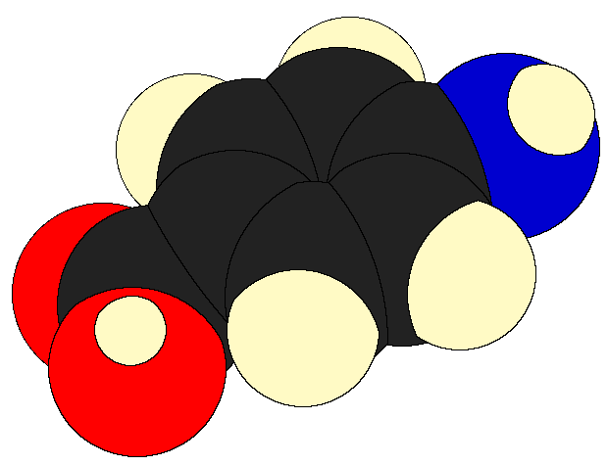
Calculating Empirical Formulas
These are the subscripts for the empirical formula:
C₇H₇NO₂

Slide 56
Naming Alkanes
It is useful for us to become familiar with simple organic nomenclature, starting with our saturated hydrocarbons (alkanes) for C₁ – C₁₀
Refer to Pg. 444 in your textbook to complete the definitions and table for the first 10 alkanes.

