Slide 1
The Scientific Method
“..a logical approach to solving problems by observing and collecting data, developing a hypothesis, conducting experiments to test the hypothesis and coming up with a conclusion that is supported by the data. Finally, the finding may be published for public use.”
https://www.youtube.com/watch?v=_7sSuhQ1_24

Slide 2
Steps of the scientific method:
1. Making Observations:
= your interpretation based on what you “see”.

Slide 3
Steps of the scientific method:
2. Forming a hypothesis
= predicting what might occur
written as an “if….then” statement

Slide 4
Steps of the Scientific method:
3. Testing
developing and conducting experiments
collect data
take measurements
make observations from the study

Slide 5
Steps of the scientific method:
4. Conclusions:
Use your finding to identify your answer. This will prove or disprove your hypothesis

Slide 6
Steps of the scientific method:
5. Publish Results
communicate study and learning from your research

Slide 7


When have you applied the scientific method?

Slide 8
Collecting Data:
Qualitative data: is data based on observations.
Quantitative data: is data based on numbers .

Slide 9
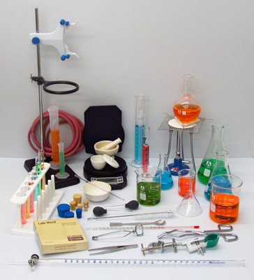
Lab equipment identification:
Lab equipment has a unique purpose. It will be important for you to recognize the equipment used in the chemistry lab and know how to use it!

