Slide 1
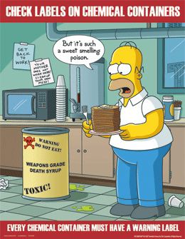
Chemical Safety Labels
NFPA- National Fire Protection Assoc.
MSDS – Material Safety Data Sheets

Slide 2
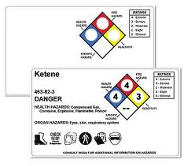
NFPA Label
Emergency response.
Color codes for safety concern.
Numerical scale for degree of hazard.

Slide 3
NFPA Label
Emergency response.
Color codes for safety concern.
  Blue: Health (toxicity)
  Red: Flammability
  Yellow: Reactivity (explosiveness)
  White: other specific hazards, i.e. radioactive
Numerical scale for degree of hazard.

Slide 4
NFPA Label
Emergency response.
Color codes for safety concern.
Numerical scale for degree of hazard.
scale: 0 – 4
      (minimal) (extreme)

Slide 5
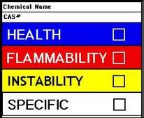
MSDS Label
(material safety Data sheet)
Occupational hazard (repeat exposure)
Similar scale to NFPA but more conservative due to exposure rate.

Slide 6
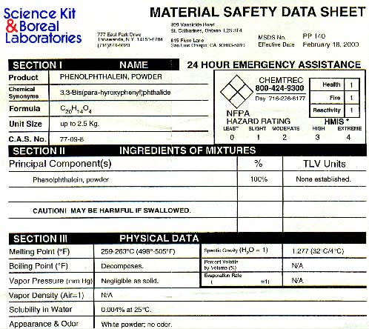
Your assignment:
Prepare an NFPA label from a MSDS sheet.
Include: Chemical Name, formula and other interesting facts.

