Slide 1
Nutrition
Chapter 7

Slide 2
Fact or Fiction?
To be well nourished is simply a matter of eating foods with enough of the right nutrients.
FALSE- Eating foods with enough nutrients is important, but equally important is to keep from eating too much or too little food.
The average American consumes about 130 pounds of fat per year.
TRUE

Slide 3
Fact or Fiction?
Of all the things in foods that cause diseases, sugar is probably the biggest trouble maker.
FALSE- Fat is by far the biggest culprit
A teaspoon of fat has more than twice the calories of a teaspoon of sugar.
TRUE
Electrolytes are dissolved minerals that carry electrical charges.
TRUE

Slide 4
Fact or Fiction?
To be sure to get enough protein, you must eat meat.
FALSE- You can easily get enough protein from grains, beans, vegetables, milk, and eggs without eating any meat.
Vitamin supplements can be useful in treating many diseases.
FALSE- The only disease that a vitamin supplement will cure is the one caused by a deficiency of that vitamin.

Slide 5
Fact or Fiction?
The best dietary measure against cancer is to take antioxidant vitamin pills each day.
FALSE- The best dietary measure against cancer is to consume at least 5 servings of vitamin-rich fruits and vegetables each day.
Most people easily get enough calcium, because it is found in so many foods.
FALSE- Low intakes of calcium are common, because few foods contain large amounts.

Slide 6
What do you think?
Is what we eat influenced by advertising?
Does advertising try to trick us into believing a food is healthier then it really is?
Why is our country so over weight?
Why is it important to develop healthy eating habits while your young?

Slide 7
What do you think?
Does food cost influence what Americans eat?
Why are processed foods usually cheaper then fresh healthier foods?
Is it ok to eat unhealthy foods if you counter it by exercising a lot?

Slide 8
INTRODUCTION TO NUTRITION
You choose to eat a meal about a 1,000 times a year.
You will choose when to eat, what to eat, and how much to eat about 65,000 times in your lifetime (if you live to be 65).
You will consume about 50 tons of food.

Slide 9
INTRODUCTION cont.
The average American consumes 130 pounds of fat per year.
This amount of fat would be equal to eating more than one full stick of butter each day.
Each day’s intake of nutrients may affect your body only slightly, but over a period of years, the effects of those intakes builds up.
This is why it’s important for you to learn now to make wise food choices.

Slide 10
BENEFITS OF NUTRITION
Good nutrition helps make people’s bodies strong, fit, and healthy
Bodies are beautiful in many different ways, but to be it’s most beautiful, it must be well nourished.
Adequate intakes of all the nutrients underlie the health of your complexion, the straightness of your bones, the shape and strength of your muscle

Slide 11
The Best Food for You
Your body is growing and renewing its parts all the time.
Each day it adds a little to its tissues as you gain height and strength.
It also replaces some old muscle, bone, skin, and blood with new tissues.
In this way some of the food you eat today becomes part of “you” tomorrow.

Slide 12
Best Food for You…
The best food for you, then, is the kind that supports normal growth and maintains strong muscle, sound bones, healthy skin, and enough blood to cleanse and nourish all the parts of your body.
It should also reduce your risks of developing illness later in life.
Your food choices along with your lifestyle choices either raise or lower your chances of becoming ill.

Slide 13
Dietary Guidelines for Americans
Eat a variety of foods.
Balance the food you eat with physical activity- maintain or improve your weight.
Choose a diet with plenty of grain products, vegetables, and fruits.
Choose a diet low in fat, saturated fat, and cholesterol.
Choose a diet moderate in sugars.
Choose a diet moderate in salt and sodium.

Slide 14
DEFICIENCIES AND MALNUTRITION
Some people do not obtain enough nutrients from their food. They may develop nutrient deficiencies or other forms of malnutrition.
Nutrient Deficiencies- Too little of one or more nutrients in the diet. A form of malnutrition.
Malnutrition- The result in the body of poor nutrition; under nutrition, over nutrition, or any nutrient deficiency.

Slide 15
DEFICEIENCIES AND MALNUTRITION cont.
Adolescents & teens are sensitive to deficiencies because they are growing at astonishing rates.
A person who does not receive proper nutrition during the teen years may never reach full height, because of all of the nutrients they need for growth.
After the person reaches adulthood, growth stops, even if the diet is excellent.

Slide 16
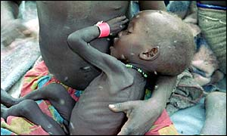
UNDERNUTRITION
A form of malnutrition caused by inadequate food intake or the body's inability to make use of needed nutrients.

Slide 17
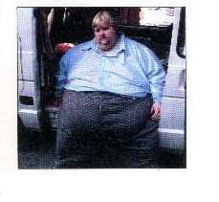
OVERNUTRITION
Too much food energy or excess nutrients to the degree of causing disease or increasing the risk of disease.
Regarded as a form of malnutrition when it leads to morbid obesity

Slide 18
KEY POINTS
Good nutrition promotes growth and helps prevent diseases.
Both under nutrition & over nutrition threaten health.

Slide 19
How many servings per Day?
Calories | Active Female Teen 2,200 | Active Male Teen 3,200
Fruits | 2 cups | 2 ½ cups
Vegetables | 3 cups | 4 cups
Grains | 7 ounces | 10 ounces
Protein | 6 ounces | 7 ounces
Dairy | 3 cups | 3 cups
Oil | 6 teaspoons | 11 teaspoons
Extras-fat and sugars | 290 calories | 650 calories

Slide 20
Energy From Nutrients
Carbohydrate
Provides energy as glucose
Fat
Provides energy as fatty acids
Protein
Builds working body parts and can provide energy as amino acids

Slide 21
Energy Contributions from Nutrients
Carbohydrate
4 calories per gram
Fat
9 calories per gram
Protein
4 calories per gram

Slide 22
Carbohydrates Important in our Diet
Starch:
The main carb in grains and vegetables, is the main energy source for people around the world
Fiber:
Helps maintain the health of the digestive tract. The body needs about 25 grams of fiber each day
Sugars:
Carbs found both in foods and the body.
Glucose: blood sugar of body’s fuel
Fructose: natural sugar in fruits and honey
Sucrose: also known as table sugar
Lactose: natural sugar in milk

Slide 23
Fats
Fat supplies body fuel
Some types of fat are essential and important for a healthy nervous system
Fat is stored in a layer of cells beneath the skin, mainly in the abdomen
Body fat helps insulate the body and protects the organs from shocks and bruises
Too much body fat, however, is not healthy!

Slide 24
Fats
The fats you consume come in two forms.
Saturated Fats
Mainly animal sources, including meat, whole milk, butter, and cream. These fats strongly associated with heart disease
Unsaturated Fats
Mainly come from vegetable oils. These fats less associated with heart disease

Slide 25
Proteins
Proteins are the body’s machinery. Protein is found in meats, fish, poultry, eggs, cheese, milk, grains, beans, and nuts.
A set of 20 different amino acids form proteins
Your body can make some of the amino acids for itself, but essential amino acids cannot be made by the body and must be eaten in foods.
A person who does not consume enough protein can become protein deficient.

Slide 26
Vitamins
There are two types of vitamins:
Fat-soluble
Vitamins able to dissolve in fat and remain in the body
Can be dangerous if a person takes too much
Water-soluble
Vitamins able to travel in the body’s watery fluids and leave the body readily in urine
You should eat foods that provide these types of vitamins regularly to replace those that you have lost

Slide 27
Minerals
All minerals, even those present in tiny amounts, are essential for proper body functioning
Calcium is the most abundant mineral in the human body
Iron is present in every living cell and is the body’s oxygen carrier
Not having enough iron can cause anemia
Electrolytes are minerals that dissolve in the body’s fluids and carry electrical charges. They help maintain proper balance of fluids in the body
Sodium, chloride, and potassium

Slide 28
Reading Food Labels

Slide 29
Body Fat Risks
Underweight: weight too low for health.
Obesity: over fatness to the point of injuring health

Slide 30
Major problems with too much body fat
Heart Disease
Stroke
Diabetes
Many cancers
Joint pain
Muscle pain

Slide 31
Overweight and obesity charts

Slide 32
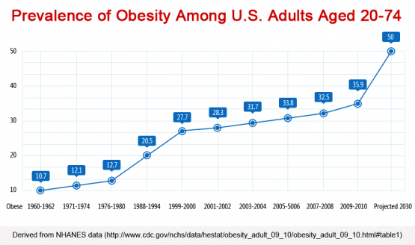
Past present and predictions

Slide 33
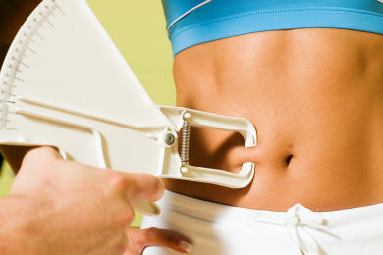
The right weight for you
Body fatness can be measured with a skin-fold caliper during a skin-fold test
Pinch test
-Scale weight does not determine someones body fatness.

Slide 34
Vocab
skin-fold test: a test of body fatness
skin-fold caliper: a pinching test that measures the thickness of a fold of skin on the back of a arm
pinch test: an informal way of measuring someone’s body fat
body mass index (BMI): an indicator of how eight overweight or underweight a person is

Slide 35
The right weight for you
The right weight for you depends on many factors
We should all shoot to have a healthy amount of body fat and pay less attention to what the scale says
Good body fat percentages
Males: 5%-14% Acceptable 20% or less
Females: 8%-23% Acceptable 30% or less

Slide 36
Fat Tissue, Lean Tissue, and Body Water
The body’s lean tissue is vital to health.
What a person wants to lose weight, they should lose fat whereas when a person wants to gain weight, they should gain lean tissue and fat.
Diuretic is a drug that causes the body to lose fluids.
This is a dangerous way to attempt to lose weight
Heavy exercise is losing large amounts of fluids by sweating
This is another dangerous weight-loss technique.
Body water is a large part of someone’s weight, so it is a temporary way to lose weight, but lose little body fat.

Slide 37
Fasting
When a person stops eating altogether, your body has to go into stored fuels like fat and glycogen
If an average person fasts, they have enough fat to provide their body with energy for weeks
Supplies of carbohydrates, stored as glycogen, are very little
When there is not enough glycogen left, your body begins breaking down protein in your muscles and organs and converting it to carbs
For every pound of body protein used for fuel, 3-4 pounds of water are lost
If you continued to not eat, you would die in about 10 days, but instead your body begins slowing down mentally and using stored fats and carbs

Slide 38
Other unsafe weight loss strategies
Fad diets and fasting aren’t safe and definitely aren’t effective in losing weight
Ways to maintain weight includes water pills, diet pills, muscle stimulators, and hormones.
Diet pills are medications that reduce the appetite or otherwise promote weight loss

Slide 39
Weight loss surgery the answer?
A large number of teens and adults have become obese, and face serious body-weight related diseases
Weight-loss surgery is available for everyone but you must have a BMI or 40 or greater.
Other factors include growth status, skeletal system maturity, emotional development, family support, and the ability to follow diet instructions.
Surgery can cause infections, nausea, and vomiting short-term, but nutrient deficiencies and psychological challenges can occur long-term.

Slide 40
Smart Weight loss
Step 1: Choose a calorie level you can live with
If you eat -500 calories a day for 7 days, then you have 3,500-calorie weekly shortage
That is enough to lose a pound of body fat
If you practice this plan you can easily maintain a healthy weight for the rest of your life
You should not lose more then 1-2 pounds per week.

Slide 41
Smart weight loss
Step 2: 3 meals a day is standard for our society, but in diets, many choose to eat 4 or 5 smaller meals
it is important to eat regularly, and before you get very hungry
when you decide to eat, eat the entire meal you have planned for yourself
don’t eat again until your next meal

Slide 42
Smart weight loss
Step 3: Control your portion sizes, they greatly influence your daily calorie intake
the bigger the food servings, the bigger the portions people consume
as people eat larger servings, their calorie totals increase
Measuring your food and reading labels before eating is always a good idea

Slide 43
Physical activity is critical
most people hate the idea of physical activities
weight loss is impossible without physical activity.
physical activity contributes to weight management by helping to develop body's lean tissue.

