Slide 1
Chapter 3
Your Changing Personality

Slide 2
Section 1: Life’s Stages and Human Needs
What do you think?
One of the most important tasks of the teen years is to work out an individual identity.
Human beings need the respect of others even more than they need shelter
People who imagine themselves as more successful than they are need to stop dreaming.

Slide 3
Section 1: Life’s Stages and Human Needs
Erikson’s Eight Stages of Life
Psychologist Erik Erikson has developed a theory that states people move through eight stages in the course of their lives.
In each stage they learn important things about themselves and the world.

Slide 4
Erikson’s Eight Stages of Life
1. Infancy (0-1)
2. Toddler Stage (1-2)
3. Preschool Age (3-5)
4. School Age (6-12)
5. Adolescence (13-20)
6. Young Adulthood (21-40)
7. Adulthood (41-60)
8. Older Adulthood (61 and older)

Slide 5
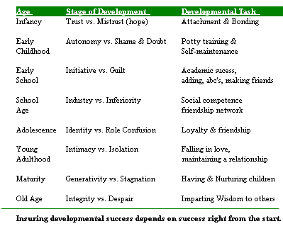

Slide 6
A Teen’s New Experiences
New Ideas and New Groups
Teens try out new ideas, develop new words, and give meaning to old phrases as they use their imaginations to explore and search for their identities.
New Ways of Thinking
Teens begin to think in abstract terms. Teens consider variables (changeable factors that affect outcomes) and use logic to make predictions of what might happen
New Emotions
Many teens will feel the ups and downs of different emotions

Slide 7
Human Needs According to Maslow
Erickson saw life’s tasks associated with age groups, however Maslow described them as a hierarchy (a ranking system in which each thing is placed above or below others)
It is considered a ladder of human needs that people of all ages experience at different times
Maslow linked these needs to life’s accomplishments
Maslow also believed people will first try to meet their basic needs before they can begin to think about “higher needs”

Slide 8
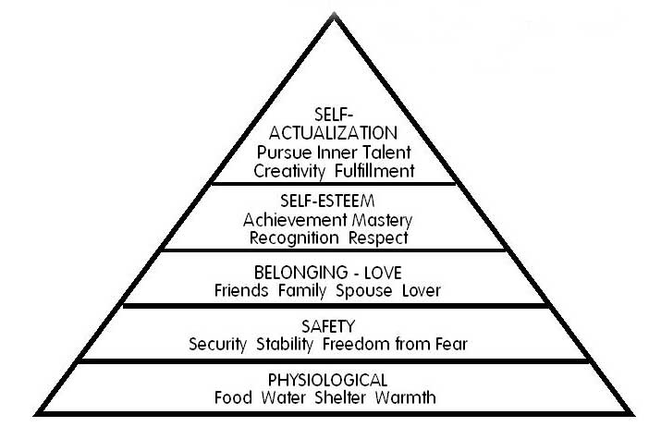

Slide 9
Section 2: Gender and Personality
Physical Maturation
Adolescence is a time of rapid physical growth and mental change
The beginning of adolescence is marked by puberty (the period of life in which a person becomes physically capable of reproduction)
The Adolescent Growth Spurt
Girls: intensive growth spurt by age 10 or 11
Boys: intensive growth spurt by age 12 or 13

Slide 11
Gender Identity
Your personality is affected by your gender-the classification of being male or female
The male or female roles people play are known as their gender roles, roles assigned by society to people of each gender.
The parts of the male or female role that a person adopts and lives by becomes that person’s gender identity, that part of a person’s self-image that is determined by the person’s gender.
What if the roles don’t fit?
People are individuals. Roles that fit one person perfectly may not fit another. If everyone accepted roles without question, societies would never change.
However we have stereotypes and these do not recognize one’s individuality and may harm individual development.

Slide 12
Section 3: Developing Self-Esteem
People who know and like themselves are emotionally healthy
Not only do they have a strong sense of self-efficacy for accomplishing tasks, but they also have high self-esteem (the value a person attaches to his or her self-image)
Many factors can benefit your self-image
Friends who value and respect you
Regular physical activity
Being involved in community activities
You give yourself the power to become the person you want to become and to do the things you want to do when positive ideas replace self-defeating messages

Slide 13
10 Ways to Improve Self-Esteem
1. Write positive statements about yourself
2. Find activities related to your goals
3. Be grateful for what you have
4. Practice positive self-talk
5. Search for books and movies with positive themes
6. Find friends who believe in you
7. Support others/ be a positive friend
8. Refuse to think negatively about yourself and others
9. Celebrate your successes
10. Give and receive appropriate affection

Slide 14
Section 4: The Importance of Peer Groups
A peer group is simply a group of friends similar to yourself in age and stage of life
Peer groups can be positive (influence on development) or negative (peer pressure or cliques) to adolescents
Most peer groups, though, provide their members with a sense of belonging
A circle of friends offers a place to share ideas, interest, and opinions. These friends also provide support and strength

Slide 15
The Value of Peer Groups
Peer groups can help teens feel a sense of belonging
An important function of peer groups is to help lessen teen’s natural fears
Peer groups provide shelter and comfort from within
Peer groups also help teens through tough times, as it is natural to share feelings with others.

Slide 16
Negative Peer Groups
Cliques
A peer group that rejects newcomers and judges both their members and nonmembers harshly
Cults
Groups of people who share intense admiration or adoration or a particular person or principle
Gangs
Groups that exist largely to express aggression against other groups

Slide 17
PEERS ARE IMPORTANT, MAKE SURE YOU CHOOSE THEM WITH CARE!

