Slide 1
Chapter 2: The Normal Distributions

Slide 2
Section 2.1: Standard Normal Calculations
All normal distributions
Share many common properties,
Are the same if measured in the same units.
Use the notation N(mean, standard deviation).
The standard normal distribution
Has a mean of 0 and standard deviation of 1.
N(0,1)
Taking any normal distribution and converting it to have a mean of 0 and StDev of 1 is called standardizing.

Slide 3
Standardizing and Z-Scores.
A standardized value is called a z-score.
A z-score tells us how many standard deviations the original observation falls away from the mean, and in which direction.
Observations larger than the mean have positive z-scores, while observations smaller than the mean have negative z-scores.
To standardize a value, subtract the mean of the distribution and then divide by the standard deviation.

Slide 4
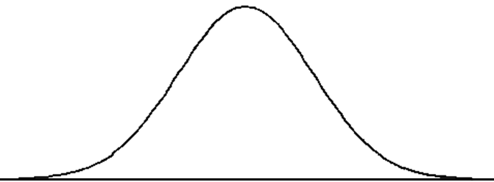
Eleanor – SAT’s
Gerald – ACT’s
500
680
18
27

Slide 5
Normal distribution calculations:
Area under a density curve represents a proportion of observations.
All normal distributions are the same when standardized
Allows for quick calculations of areas with only one equation to use.
However, in this course we will use a table to find areas.
Table A – first page of textbook.

Slide 6
Complete response to a normal distribution question
State the problem in terms of the observed variable x. Draw a picture of the distribution and shade the area of interest under the curve.
Standardize x to restate the problem in terms of a z-score. On the picture label the Z-score.
Find the required area under the standard normal curve by using table A, and the fact that the total area under the curve is 1.
Write your conclusion in the context of the problem.

Slide 7
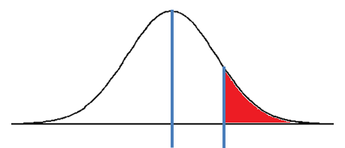
Let’s go though an example of how to use the table.
What proportion of all young women are greater than 68 inches tall, given that the distribution of heights for all young women follow N(64.5, 2.5)?
Step one – Find P(x > 68) on N(64.5, 2.5)
64.5
68

Slide 8
Step two – standardize x and label picture with z-score
64.5
68
Z-scores
0
1.4

Slide 9
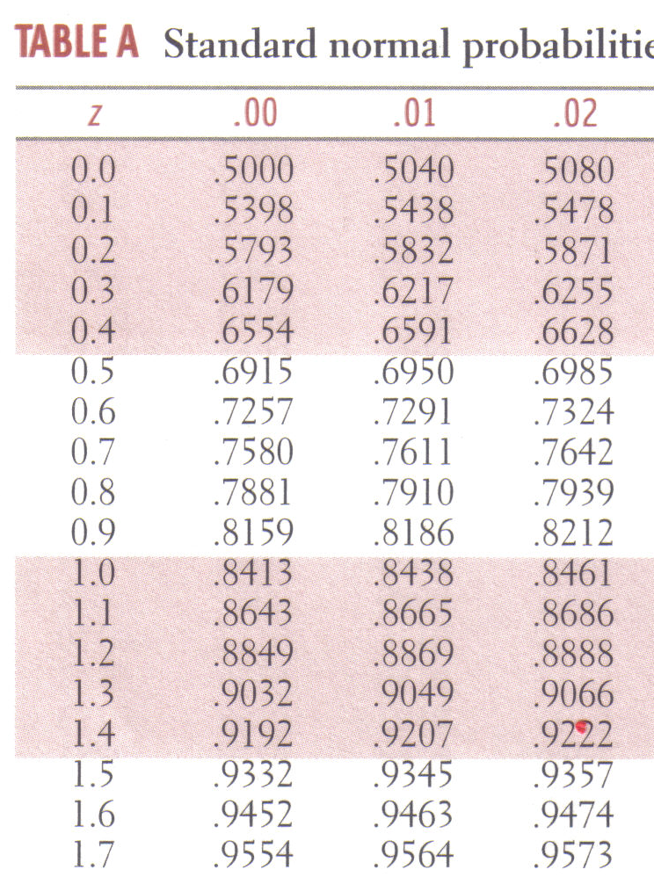
Step three – find the probability by using Table A, and the fact that the total area is equal to 1.
This value is for area to left of z-score, we need area to right of z-score in this problem.
P(z > 1.4) = 1 - .9192
P(z > 1.4) = .0808

Slide 10
Step four – write the conclusion in context of the problem.
8.08%
64.5
68
The proportion of young women that are taller than 68 inches is 8.08%

Slide 11
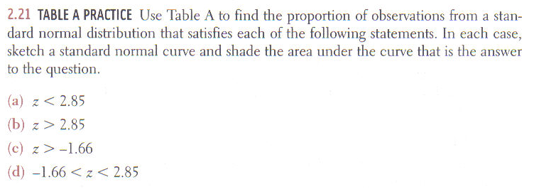
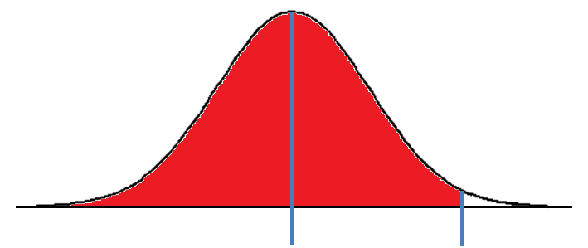
A. Find P(z < 2.85)
0
2.85

Slide 12
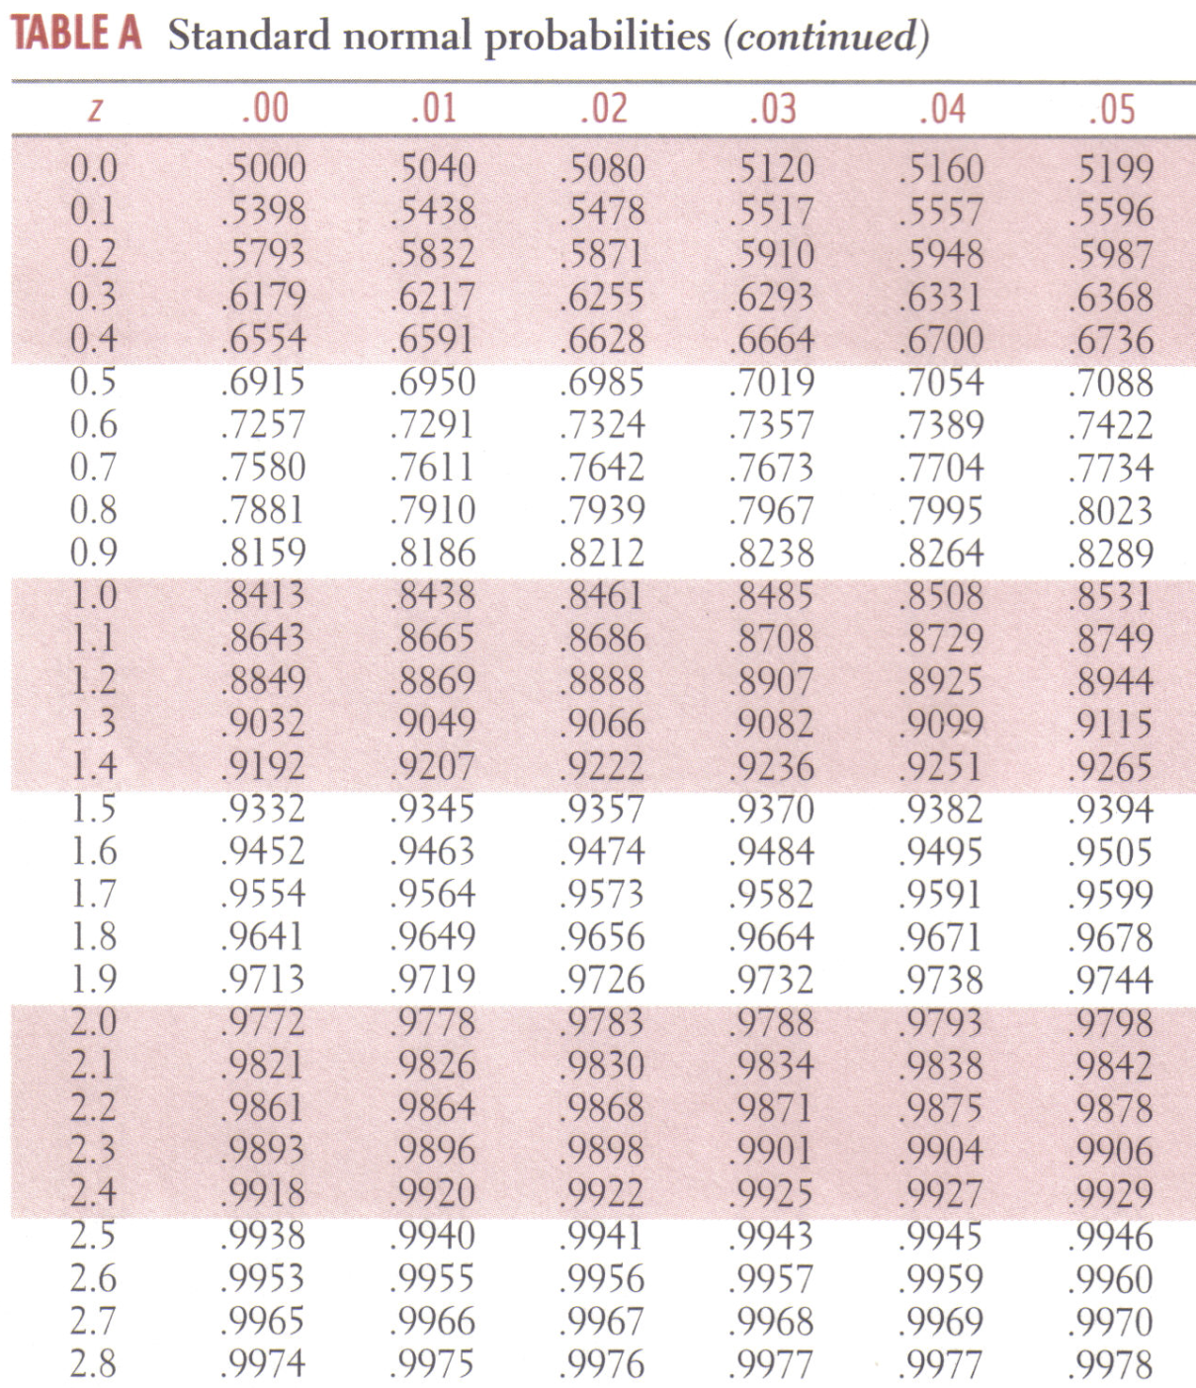
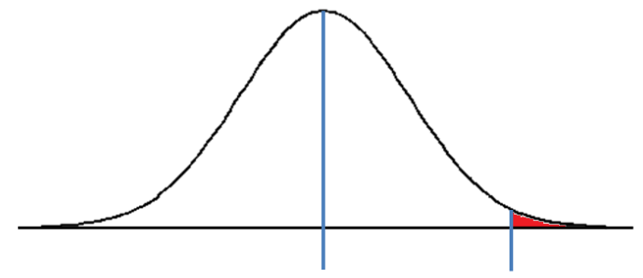
a. Find P(z < 2.85)
0
2.85
The probability that z falls below 2.85 is 99.78%
B. Find P(z > 2.85)
0
2.85
The probability that z falls above 2.85 is 1 minus the probability that it falls below.
100% - 99.78% = .22%

Slide 13
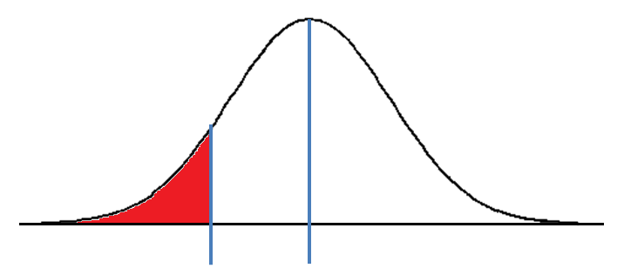
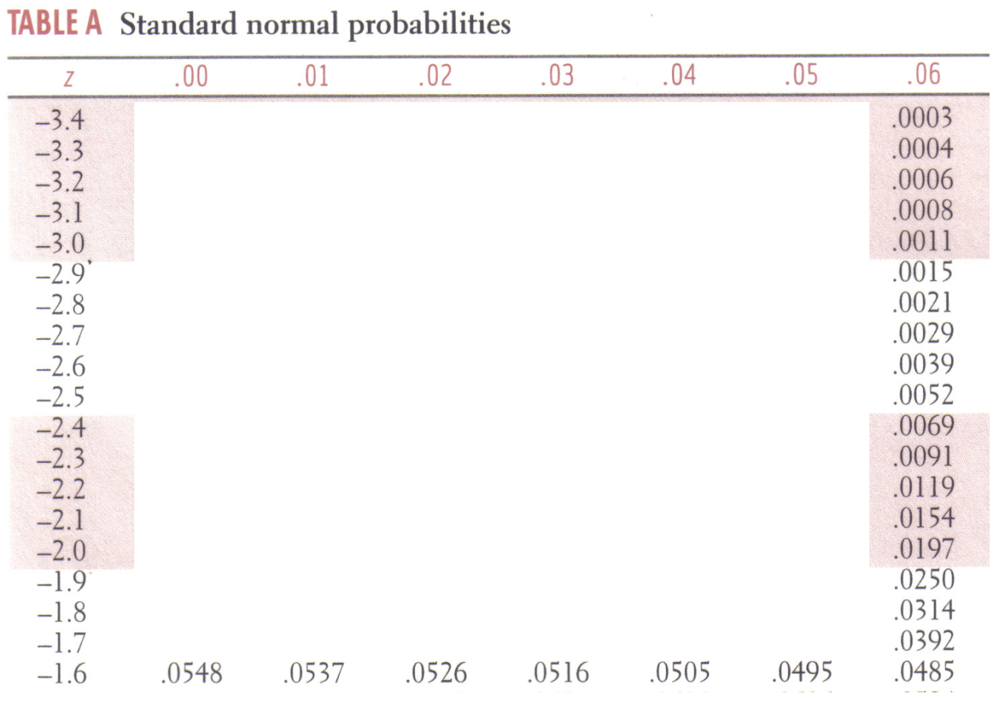
C. Find P(z < -1.66)
-1.66
0
The probability that z falls below -1.66 is 4.86%

Slide 14
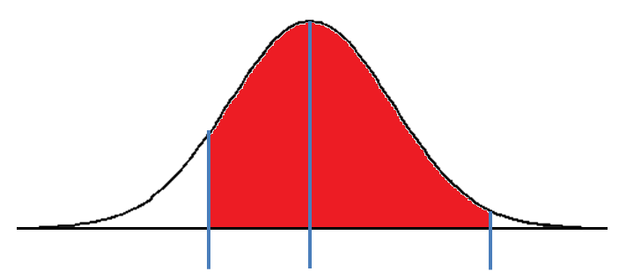
d. Find P(-1.66 < z < 2.85)
4.85%
.22%
-1.66
0
2.85
The probability that z falls between -1.66 and 2.85 is 1 minus the probability that is does not.
100% - 5.07% = 94.93%

Slide 15
Section 2.1 Day 1
Homework: #’s 11, 12, 47, 49, 53a&b, 54a&b, 55a&b
Additional notes packet, read and answer all questions pg. 17-20.

Slide 16
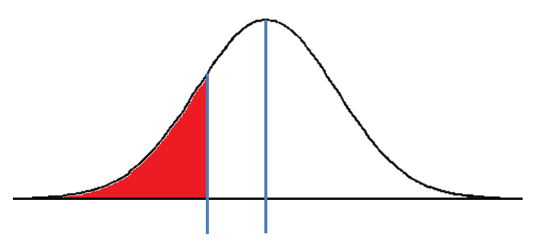
Using Table A to find Z.
Find point Z such that 25% fall below it.
25%
Z
0

Slide 17
Look for the closest number to the probability that you want. This case we will look at .2514.
The value for Z is -.67

Slide 18
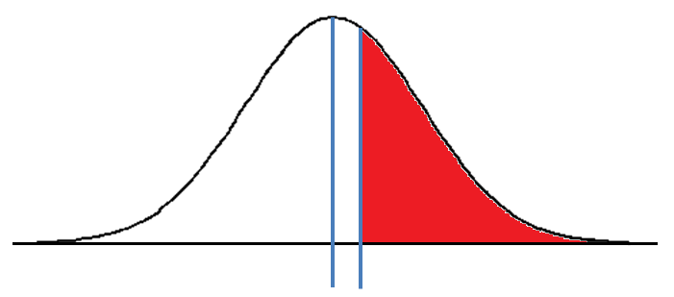
b. Find point z such that 40% fall above it
40%
Since the table is listed as area to the left of the line we need to look up in the table the value of .6000
0
Z
The value for Z is .25

Slide 19
Finding a value from a z-score
To calculate a value in which x% fall above or below the point
Use table A to find the z-score.
Substitute z, μ and σ into the equation and solve for x.

Slide 20
5 feet 6 inches and 6 feet tall?
61.5
64
66.5
69
71.5
74
76.5

Slide 21
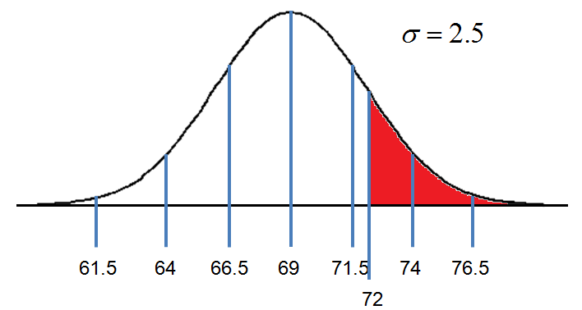
a. What percent of men are at least 6 feet tall?
61.5
64
66.5
69
71.5
74
76.5
Z
Looking up the value for Z = 1.2 on table A. P(Man < 6’) = 88.49%
So P(Man > 6’) = 100% - 88.49% = 11.51%

Slide 22
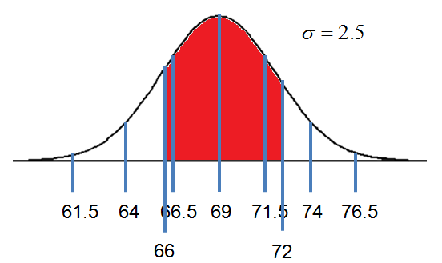
b. What percent of men are at between 5’6” and 6’ tall?
61.5
64
66.5
69
71.5
74
76.5
-Z₂
Z₁
Looking up the value for Z₁ = 1.2 on table A. P(Man < 6’) = 88.49%
Looking up the value for Z₂ = -1.2 on table A. P(Man < 5’6”) = 11.51%
So
P(5’6” < Man < 6’) = 88.49% - 11.51% = 76.98%

Slide 23
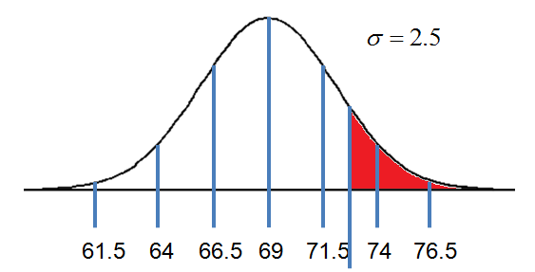
c. How tall must a man be to be in the tallest 10% of all adult men?
Reverse lookup in table A for the value closest to 90%. Table gives area under curve to the left of Z.
10%
From Table A, Z = 1.28 when P = .8997
61.5
64
66.5
69
71.5
74
76.5
For a man to be in the tallest 10% of all men, he must be 72.2” or taller.

Slide 24
Section 2.1 Complete
Homework: Chapter 2, #’s 51, 52, 53c, 54c, 59
Finish Standard Normal worksheet
Additional notes packet, read and answer all questions pg. 25-32.

Slide 25
Section 2.2: Density curves and the Normal Distributions
Chapter 1 gave a strategy for exploring data on a single quantitative variable.
Make a graph.
Describe the distribution.
Shape, center, spread, and any striking deviations.
Calculate numerical summaries to briefly describe the center and spread.
Five-number summary or,
Mean and standard deviation.

Slide 26
Density Curves
Chapter 2 tells us the next step.
If the overall pattern of a large number of observations is very regular, describe it with a smooth curve.
This curve is a mathematical model for the distribution.
Gives a compact picture of the overall pattern.
Known as a density curve.

Slide 27
Density Curves
A density curve describes the overall pattern of a distribution.
Is always on or above the horizontal axis.
The area under the curve represents a proportion.
Has an area of exactly 1 underneath it.
The median of a density curve is the equal-areas point.
Point that divides the area under the curve in half.
The mean of a density curve is the balance point.
Point that the curve would balance at if made of solid material.

Slide 28
Mathematical Model
A density curve is an idealized description of the distribution of data.
Values calculated from a density curve are theoretical and use different symbols.
Mean
Greek letter mu $μ$ (population)
$\overline{x}$ (sample)
Standard deviation
Greek letter sigma $σ$ (population)
s (sample)

Slide 29
Find the proportion of observations within the given interval
1.0
.75
.5
.25
0
0
.25
.5
.75
1.0
1.25
1.5
1.75
2.0
P(0 < X < 2)
P(.25 < X < .5)
P(.25 < X < .75)
P(1.25 < X < 1.75)
P(.5 < X < 1.5)
P(1.75 < X < 2)
= 1.0
= .125
= .25
= .25
= .46875
= .15625

Slide 30
Density Curve modeled by an equation
A density curve fits the model y = .25x
Graph the line.
Use the area under this density curve to find the proportion of observations within the given interval
P(1 < X < 2)
P(.5 < X < 2.5)
If the curve starts at x = 0, what value of x does it end at?
What value of x is the median?
What value of x is the 62.5th percentile?

Slide 31
Answers
Graph
P(1 < X < 2)
P(.5 < X < 2.5)
Max Value of X
Median
62.5th percentile
1.0
.5
1.0
2.0
3.0
= .375
2.24
2.83
= .75

Slide 32
Normal distributions:
Normal curves
Curves that are symmetric, single-peaked, and bell-shaped. They are used to describe normal distributions.
The mean is at the center of the curve.
The standard deviation controls the spread of the curve.
The bigger the St Dev, the wider the curve.
There are roughly 6 widths of standard deviation in a normal curve, 3 on one side of center and 3 on the other side.

Slide 33
Normal Curve

Slide 34
Here are 3 reasons why normal curves are important in statistics.
Normal distributions are good descriptions for some distributions of real data.
Normal distributions are good approximations to the results of many kinds of chance outcomes.
Most important is that many statistical inference procedures based on normal distributions work well for other roughly symmetric distributions.

Slide 35
The 68-95-99.7 rule or Empirical rule:
68% of the observations fall within one standard deviation of the mean.
95% of the observations fall within two standard deviation of the mean.
99.7% of the observations fall within three standard deviation of the mean.

Slide 36
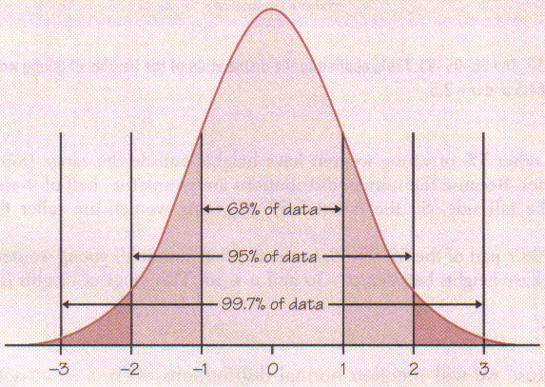

Slide 37
61.5
64
66.5
69
71.5
74
76.5

Slide 38
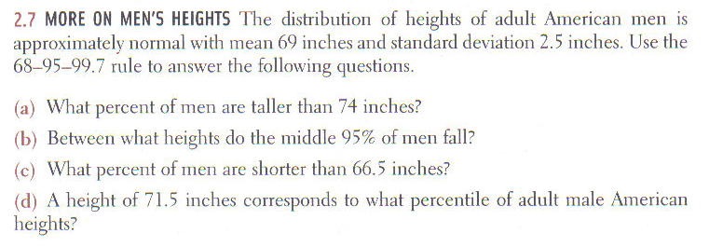
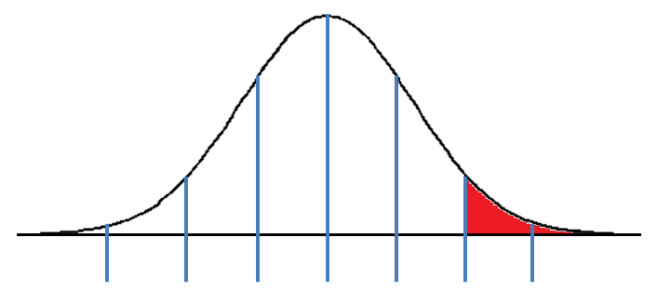
2.5%
95%
2.5%
61.5
64
66.5
69
71.5
74
76.5

Slide 39
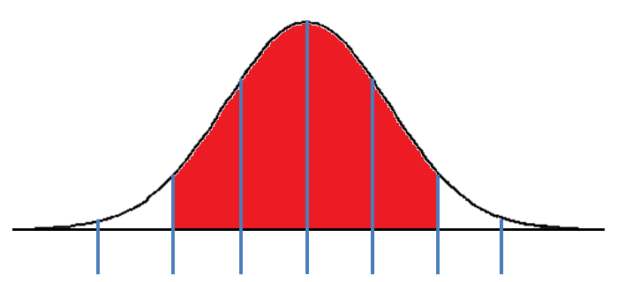
2.5%
64 to 74 in
95%
61.5
64
66.5
69
71.5
74
76.5

Slide 40
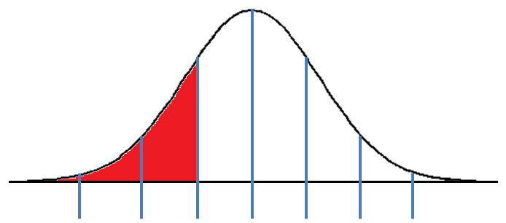
2.5%
64 to 74 in
16%
68%
16%
61.5
64
66.5
69
71.5
74
76.5

Slide 41
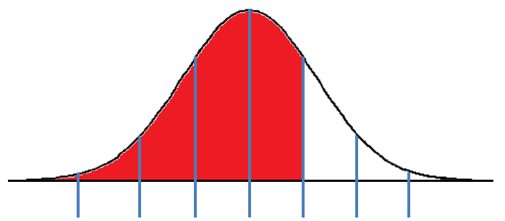
2.5%
64 to 74 in
16%
84%
68%
50%
34%
61.5
64
66.5
69
71.5
74
76.5

Slide 42
Section 2.2 Complete
Homework: Chapter 2, #’s 35, 36, 37, 41-45
Additional notes packet, read and answer all questions pg. 21-24

Slide 43
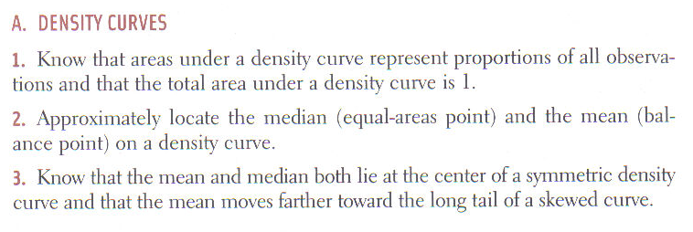
Chapter review

Slide 44
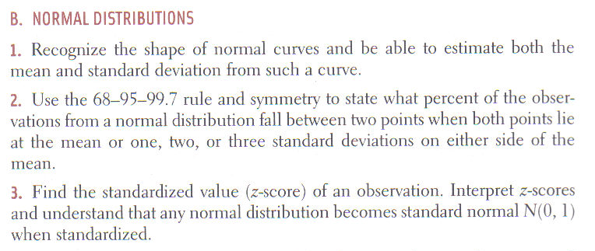

Slide 45
Chapter 2 Complete
Homework: Unit 1 review sheet.
Additional notes packet, read and answer all questions pg. 33-38.
Study for Unit 1 Test

