Slide 1
Chapter 1 & Section 2.1 Exploring Data

Slide 2
Introduction
Statistics:
the science of data. We begin our study of statistics by mastering the art of examining data. Any set of data contains information about some group of individuals. The information is organized in variables.
Individuals:
The objects described by a set of data. Individuals may be people, but they may also be other things.
Variable:
Any characteristic of an individual.
Can take different values for different individuals.

Slide 3
Variable Types
Categorical variable:
places an individual into one of several groups of categories.
Quantitative variable:
takes numerical values for which arithmetic operations such as adding and averaging make sense.
Distribution:
pattern of variation of a variable
tells what values the variable takes and how often it takes these values.

Slide 4
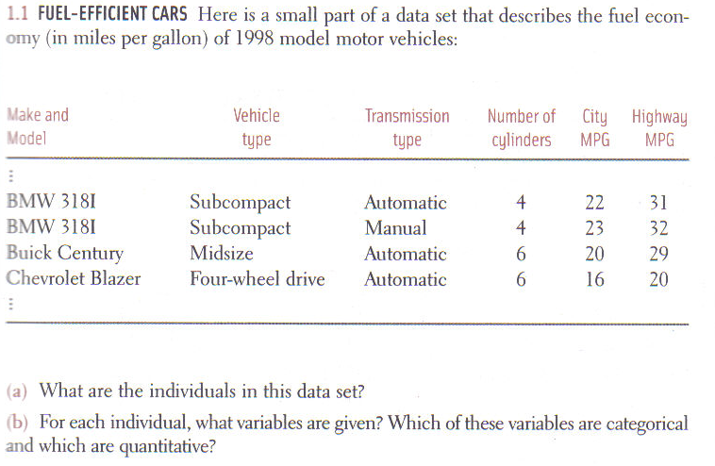

Slide 5
A. The individuals are the BMW 318I, the Buick Century, and the Chevrolet Blazer.
B. The variables given are
Vehicle type (categorical)
Transmission type (categorical)
Number of cylinders (quantitative)
City MPG (quantitative)
Highway MPG (quantitative)

Slide 6
1.1 & 1.2: Displaying Distributions with graphs
Graphs used to display data:
bar graphs, pie charts, dot plots, stem plots, histograms, and time plots
Purpose of a graph:
Helps to understand the data.
Allows overall patterns and striking deviations from that pattern to be seen.
Describing the overall pattern:
Three biggest descriptors:
shape, center and spread.
Next look for outliers and clusters.

Slide 7
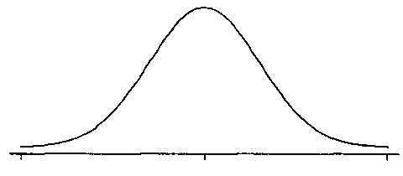
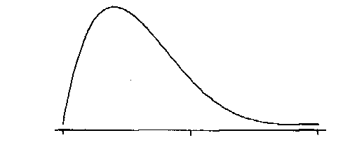
Shape
Concentrate on main features.
Major peaks, outliers (not just the smallest and largest observations), rough symmetry or clear skewness.
Types of Shapes:
Symmetric
Skewed right
Skewed left

Slide 8
How to make a bar graph.

Slide 9
1.5 How to make a bar graph.
Percent of females among people earning doctorates in 1994.
70
62.2%
60.8%
60
50
Percent
40
40.7%
30
21.7%
20
15.4%
11.1%
10
Computer science
Physical sciences
Education
Engineering
Life sciences
Psychology

Slide 10
No, a pie chart is used to display one variable with all of its categories totaling 100%

Slide 11
How to make a dotplot
Highway mpg for some 2000 midsize cars
10
8
Frequency or
Count
6
4
2
21
22
23
24
25
26
27
28
29
30
31
32
MPG

Slide 12
How to make and read a stemplot
A stemplot is similar to a dotplot but there are some format differences. Instead of dots actual numbers are used. Instead of a horizontal axis, a vertical one is used.
Stems
Leaves
Leaves are single digits only
52 3 6
This arrangement would be read as the numbers 523 and 526.

Slide 13
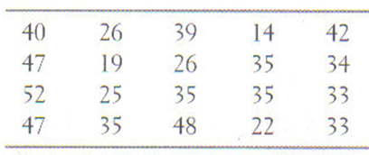
How to make and read a stemplot
With the following data, make a stemplot.
Stems
Leaves

Slide 14
How to make and read a stemplot
Lets use the same stemplot but now split the stems
Stems
Leaves
Split stems
Leaves, first stem uses number 0-4, second uses numbers 5-9

Slide 15
How to construct a histogram
The most common graph of the distribution of one quantitative variable is a histogram.
To make a histogram:
Divide the range into equal widths. Then count the number of observations that fall in each group.
Label and scale your axes and title your graph.
Draw bars that represent each count, no space between bars.

Slide 16
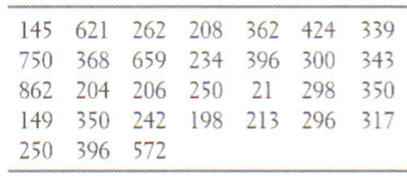

Slide 17
Divide range into equal widths and count
Scale
Counts
0 < CEO Salary < 100
1
100 < CEO Salary < 200
3
200 < CEO Salary < 300
11
300 < CEO Salary < 400
10
400 < CEO Salary < 500
1
500 < CEO Salary < 600
1
600 < CEO Salary < 700
2
700 < CEO Salary < 800
1
800 < CEO Salary < 900
1

Slide 18
Draw and label axis, then make bars
CEO Salary in thousands of dollars
11
Shape – the graph is skewed right
10
Center – the median is the first value in the $300,000 to $400,000 range
9
8
7
Spread – the range of salaries is from $21,000 to $862,000.
Count
6
5
Outliers – there does not look like there are any outliers, I would have to calculate to make sure.
4
3
2
1
100
200
300
400
500
600
700
800
900
Thousand dollars

Slide 19
New terms used when graphing data.
Relative frequency:
Category count divided by the total count
Gives a percentage
Cumulative frequency:
Sum of category counts up to an including the current category
Ogives (pronounced O-Jive)
Cumulative frequencies divided by the total count
Relative cumulative frequency graph
Percentile:
The p^{th} percentile of a distribution is the value such that p percent of the observations fall at or below it.

Slide 20
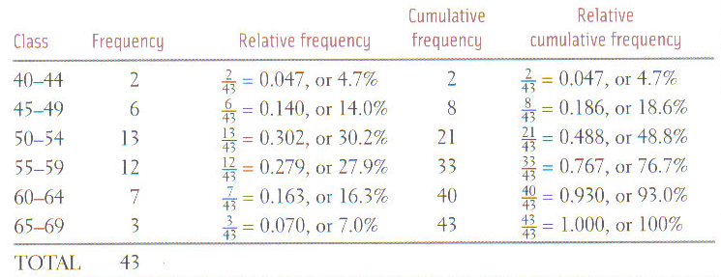
Lets look at a table to see what an ogive would refer to.

Slide 21
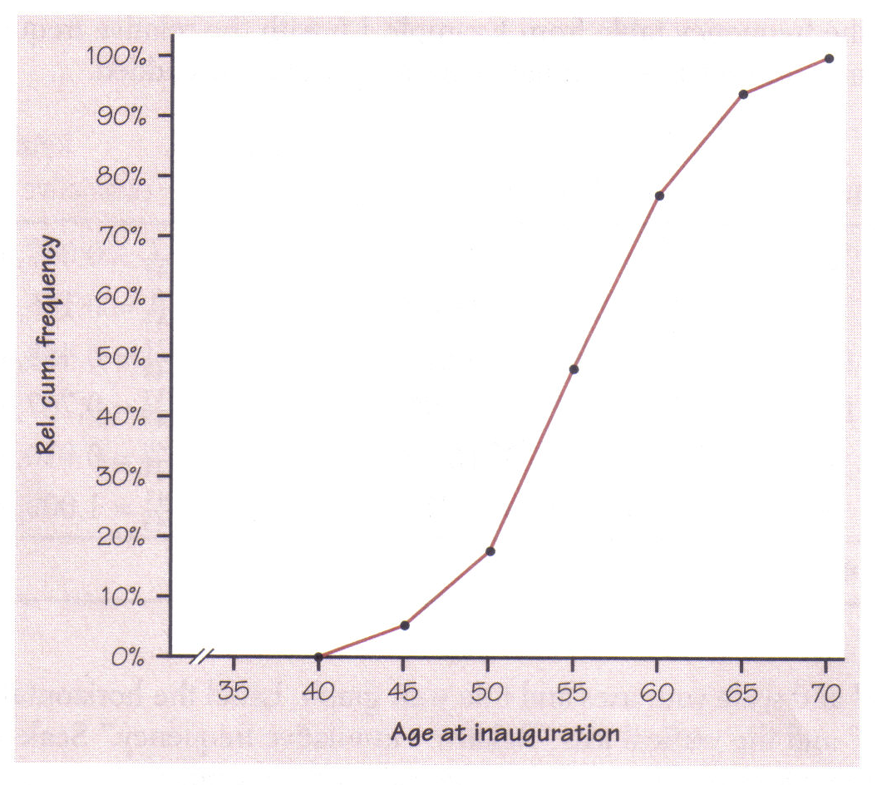
The graph of an ogive for this data would look like this.

Slide 22
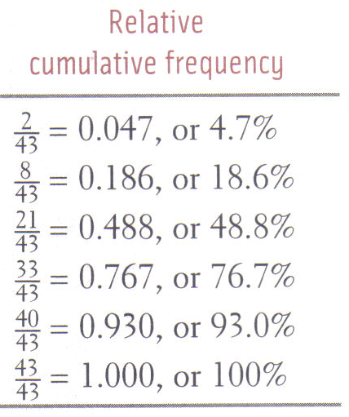
85th percentile
Median
10th percentile
Find the age of the 10th percentile, the median, and the 85th percentile?
47
55.5
62.5

Slide 23
Last graph of this section
Time plots :
Graph of each observation against the time at which it was measured.
Time is always on the x-axis.
Use time plots to analyze what is occurring over time.

Slide 24
Deaths from cancer per 100,000
204
194
Deaths
184
174
164
154
144
134
45
50
55
60
65
70
75
80
85
90
95
Year

Slide 25
Section 1.1 & 1.2
Homework: #’s Section 1-1: 2, 4, 6, 9, 38a, 48a&b, Section 1-2: 52, 56 (use scale starting at 7 with width of .5, make an ogive and use it to estimate the value of the center and also the 90th percentile) 58, Section 2-1: 9, R1.1 & 6, R2.2
Complete additional notes packet pg. 1-4.

Slide 26
Section 1.3: Describing Quantitative Data with Numbers.
Center:
Mean
Median
Mode – (only a measure of center for categorical data)
Spread:
Range
Interquartile Range (IQR)
Variance
Standard Deviation

Slide 27
Measuring center:
Mean:
Most common measure of center.
Is the arithmetic average.
Formula:
or
Not resistant to the influence of extreme observations.

Slide 28
Measuring center:
Median
The midpoint of a distribution
The number such that half the observations are smaller and the other half are larger.
If the number of observations n is odd, the median is the center of the ordered list.
If the number of observations n is even, the median M is the mean of the two center observations in the ordered list.
Is resistant to the influence of extreme observations.

Slide 29
Quick summary of measures of center.
Measure | Definition | Example using 1,2,3,3,4,5,5,9
Mean
Middle value for an odd # of data values
For 1,2,3,3,4,5,5,9, the middle values are 3 and 4. The median is:
Median
Mean of the 2 middle values for an even # of data values
The most frequently occurring value (Categorical data only)
Two modes: 3 and 5
Mode
Set is bimodal.

Slide 30
Comparing the Mean and Median.
The location of the mean and median for a distribution are effected by the distribution’s shape.
Symmetric
Skewed right
Median and Mean
Median and Mean
Skewed left
Mean and Median

Slide 32
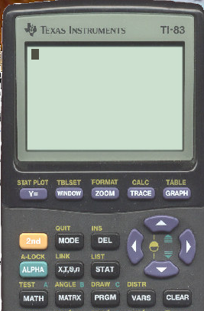
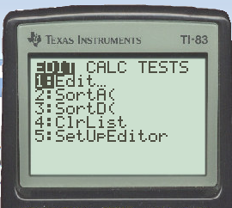
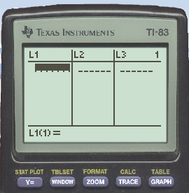

Slide 33
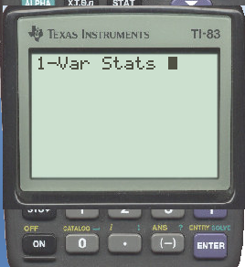
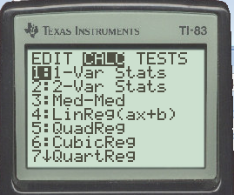
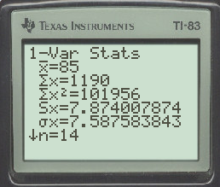

Slide 34
Since zero is an outlier it effects the mean, since the mean is not a resistant measurement of the center of data.

Slide 36
Measuring spread or variability:
Range
Difference between largest and smallest points.
Not resistant to the influence of extreme observations.
Interquartile Range (IQR)
Measures the spread of the middle half of the data.
Is resistant to the influence of extreme observations.
Quartile 3 minus Quartile 1.

Slide 37
To calculate quartiles:
Arrange the observations in increasing order and locate the median M.
The first quartile Q₁ is the median of the observations whose position in the ordered list is to the left of the overall median.
The third quartile Q₃ is the median of the observations whose position in the ordered list is to the right of the overall median.

Slide 38
The five number summary and box plots.
The five number summary
Consists of the
min, Q_{1,} median, Q_{3,} max
Offers a reasonably complete description of center and spread.
Used to create a boxplot.
Boxplot
Shows less detail than histograms or stemplots.
Best used for side-by-side comparison of more than one distribution.
Gives a good indication of symmetry or skewness of a distribution.
Regular boxplots conceal outliers.
Modified boxplots put outliers as isolated points.

Slide 39
Start by finding the 5 number summary for each of the groups.
Use your calculator and put the two lists into their own column, then use the 1-var Stats function.
Min Q₁ M Q₃ Max
Women: 101 126 138.5 154 200
Men: 70 98 114.5 143 187

Slide 40
How to construct a side-by-side boxplot
SSHA Scores for first year college students
Women
Men
70
80
90
100
110
120
130
140
150
160
170
180
190
200
Scores

Slide 41
Calculating outliers
Outlier
An observation that falls outside the overall pattern of the data.
Calculated by using the IQR
Anything smaller than or larger than is an outlier
Min
Q₁
Median
Q₃
Max

Slide 42
Constructing a modified boxplot
Min Q₁ M Q₃ Max
Women: 101 126 138.5 154 200

Slide 43
Constructing a modified boxplot
Min Q₁ M Q₃ Max
Women: 101 126 138.5 154 200
SSHA Scores for first year college students
Women
70
80
90
100
110
120
130
140
150
160
170
180
190
200
Scores

Slide 44
Section 1.3 Day 1
Homework: #’s 84, 86, 88, 91, 92
Complete additional notes packet pg. 5-12.

Slide 45
Measuring Spread:
Variance (s²)
The average of the squares of the deviations of the observations from their mean.
In symbols, the variance of n observations x₁, x₂, …, x_{n} is
Standard deviation (s)
The square root of variance.
or

Slide 46
How to find the mean and standard deviation from their definitions.
With the list of numbers below, calculate the standard deviation.
5, 6, 7, 8, 10, 12

Slide 48
Properties of Variance:
Uses squared deviations from the mean because the sum of all the deviations not squared is always zero.
Has square units.
Found by taking an average but dividing by n-1.
The sum of the deviations is always zero, so the last deviation can be found once the other n-1 deviations are known.
Means only n-1 of the squared deviations can vary freely, so the average is found by dividing by n-1.
n-1 is called the degrees of freedom.

Slide 49
Properties of Standard Deviation
Measures the spread about the mean and should be used only when the mean is chosen as the measure of center.
Equals zero when there is no spread, happens when all observations are the same value. Otherwise it is always positive.
Not resistant to the influence of extreme observations or strong skewness.

Slide 50
Mean & Standard Deviation Vs. Median & the 5-Number Summary
Mean & Standard Deviation
Most common numerical description of a distribution.
Used for reasonably symmetric distributions that are free from outliers.
Five-Number Summary
Offer a reasonably complete description of center and spread.
Used for describing skewed distributions or a distribution with strong outliers.

Slide 51
Always plot your data.
Graphs
Give the best overall picture of a distribution.
Numerical measures of center and spread
Only give specific facts about a distribution.
Do not describe its entire shape.
Can give a misleading picture of a distribution or the comparison of two or more distributions.

Slide 52
Changing the unit of measurement.
Linear Transformations
Changes the original variable x into the new variable x_{new.}
x_{new} = a + bx
Do not change the shape of a distribution.
Can change one or both the center and spread.
The effects of the changes follow a simple pattern.
Adding the constant (a) shifts all values of x upward or downward by the same amount.
Adds (a) to the measures of center and to the quartiles but does not change measures of spread.
Multiplying by the positive constant (b) changes the size of the unit of measurement.
Multiplies both the measures of center (mean and median) and the measures of spread (standard deviation and IQR) by (b).

Slide 53
The table shows an original data set and two different linear transformations for that set.
Original (x) | x + 12 | 3(x) - 7
5 | 17 | 8
6 | 18 | 11
7 | 19 | 14
8 | 20 | 17
10 | 22 | 23
12 | 24 | 29
What are the original and transformed mean, median, range, quartiles, IQR, variance and standard deviation?

Slide 54
Original Data
Mean:
Median:
Q₁:
Q₃:
IQR:
Range:
Variance:
St Dev:
x + 12
Mean:
Median:
Q₁:
Q₃:
IQR:
Range:
Variance:
St Dev:
3(x) – 7
Mean:
Median:
Q₁:
Q₃:
IQR:
Range:
Variance:
St Dev:

Slide 55
Section 1.3 & 2.1 Day 2
Homework: #’s Section 1-3: 97, 98, 103; Section 2-1: 19, 20, 22, R.2.3
Complete additional notes packet pg. 13-16.

Slide 56
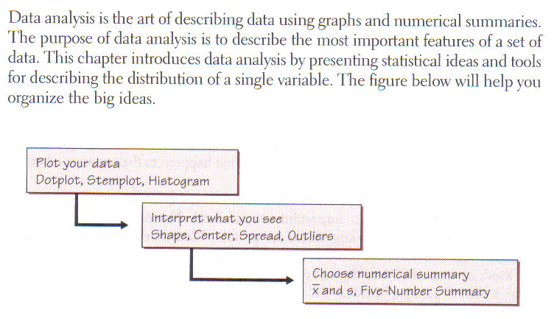
Chapter review

Slide 57
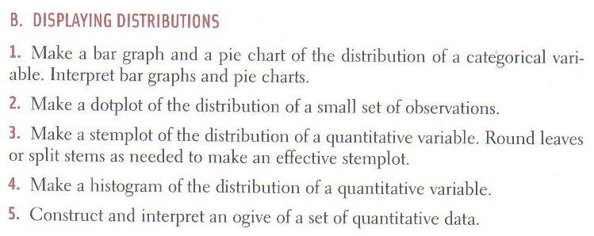

Slide 58
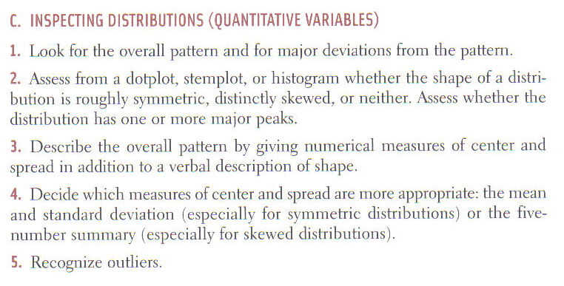

Slide 60
