Slide 1
Section 3-8 Slopes of Parallel and Perpendicular Lines
Michael Schuetz

Slide 2
Key Concepts
Slopes of Parallel Lines
If two nonvertical lines are parallel, then their slopes are equal
If the slopes of two distinct nonvertical lines are equal, then the lines are parallel
Any two vertical lines or horizontal lines are parallel

Slide 3
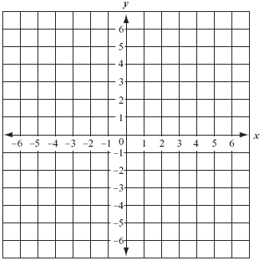
Are lines a and b parallel?
a
b

Slide 4
What is the equation of the line that is parallel to y=-3x – 5 that contains (-1, 8)
Identify the slope of the given line.
Since we know the slope and one point, use point-slope form
Substitute
Simplify

Slide 5
Key Concepts
Slopes of Perpendicular Lines
If two nonvertical lines are perpendicular, then the product of their slopes is -1.
If the slopes of two nonvertical lines have a product of -1, then the lines are perpendicular.
Any vertical line and horizontal line are perpendicular.

Slide 6
Are lines a and b perpendicular?
a
b

Slide 7
What is the equation of the line that is perpendicular to y=2x – 5 that contains (4, -1)
Identify the slope of the given line and state the perpendicular slope.
Since we know the slope and one point, use point-slope form
Substitute
Simplify

Slide 8
HW: p. 201 #’s 7-25 odd, 41

