Slide 1
Chapter 4: More on Two-Variable Data

Slide 2
4.2: Cautions about Correlation & Regression
Correlation and Regression
  Describe only linear relationships
  Are not resistant
    One influential observation or incorrectly entered data point can greatly change these measures.
Extrapolation
  Use of a regression line for prediction far outside the domain
  Such predictions are not generally accurate

Slide 3
Cautions about Correlation & Regression cont.
Lurking Variable
  Variable not among the explanatory or response variables
  May influence the interpretation of relationships among those variables.
Confounding Variable
  Two variables are confounded when their effects on a response variable cannot be distinguished from each other
  May be either explanatory variables or lurking variables

Slide 4
Cautions about Correlation & Regression cont.
Studies Using Averaged Data
  Resist (don’t) applying results to individuals
    Correlations usually too high when applied to individuals
Causation (cause & effect)
  Even a very strong association between two variables is not by itself good evidence that there is a cause-and-effect link
    High correlation DOES NOT imply causation
  Establishing Causation
    Conduct a carefully designed experiment
    Control effects of possible lurking variables

Slide 5
Section 4.2 Complete
Homework: #’s 27, 28, 33, 36
Any questions on pg. 25-28 in additional notes packet

Slide 6
Section 4.3: Relations in Categorical Data
Categorical Variables
  Use counts or percentages that fall into various categories
  Organized into two-way tables
    Two-way tables describe two categorical variables
    Rows make up one variable; columns make up the other
 | One Variable with its categories
Second variable |  | Cat 1 | Cat 2 | Cat 3 | Cat 4 | Total
 | Cat 1 | X₁₋₁ | X₁₋₂ | X₁₋₃ | X₁₋₄ | Marginal Distributions
 | Cat 2 | X₂₋₁ | X₂₋₂ | X₂₋₃ | X₂₋₄
 | Total | Marginal Distributions |  |  |  | Total
Conditional Distributions will be created by taking these values and dividing by either one of the Marginal Distributions

Slide 7
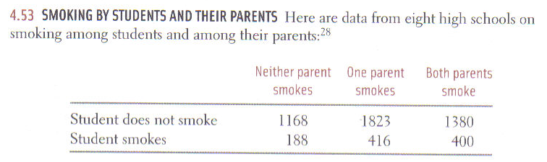
(a) How many students do these data describe?
(b) What percent of these students smoke?
(c) Give the marginal distribution of parents’ smoking behavior, both in counts and in percents.

Slide 8
26.7%
41.7%
31.6%
(a) How many students do these data describe?
(b) What percent of these students smoke?
(c) Give the marginal distribution of parents’ smoking behavior, both in counts and in percents.
(d) Give the conditional distribution of parents’ smoking behavior given the student does not smoke.

Slide 9
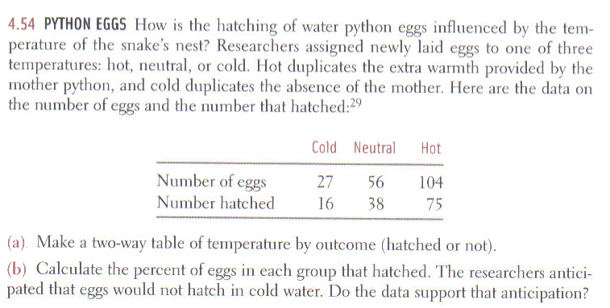
 | Cold | Neutral | Hot
Hatched | 16 | 38 | 75
Did not hatch | 9 | 18 | 29
64%
68%
72%
36%
32%
28%

Slide 10
Simpson’s Paradox:
Refers to the reversal of the direction of a comparison or an association when data from several groups are combined to form a single group.
  The principle behind this reversal is that of weighted averages. Using a higher weight in one category for one group while the second group uses a second category to be its higher weight.

Slide 11
An Example of Simpson’s Paradox
Upper Wabash Tech has two professional schools, business and law. Here are two-way tables of applicants to both schools, categorized by gender and admission decision.
  Combine the data to make a single two-way table of gender by admission decision.
Business |  |  |  | Law
 | Admit | Deny |  |  | Admit | Deny
Male | 480 | 120 |  | Male | 10 | 90
Female | 180 | 20 |  | Female | 100 | 200

Slide 12
Cont.
Business |  |  |  | Law
 | Admit | Deny |  |  | Admit | Deny
Male | 480 | 120 |  | Male | 10 | 90
Female | 180 | 20 |  | Female | 100 | 200
  What percent of males are admitted? What percent of females are admitted? Which percent is higher?
  Now compute the percent males and females admitted by each of the separate schools. Which percents are higher?
Percent
Percent
80%
10%
90%
34%
Combined
 | Admit | Deny
Male
Female
Percent
490
210
70%
280
220
56%

Slide 13
Cont.
  Why is this occurring? Explain how it can happen that Wabash appears to favor males when each school individually favors females.
Ans: The business school accepts a higher percentage of students all together than the law school does. So when 86% of the males applied to the business school while only 40% of the females applied to the business school, more males got into Wabash university all together. This gives the appearance that Wabash favors males. This reversal of the direction of an association when data from several groups are combined to form a single group is know as Simpson’s Paradox.

Slide 14
Section 4.3 Complete
Homework: #’s 55, 59, 61, 62,
Any questions on pg. 29-32 in additional notes packet

Slide 15
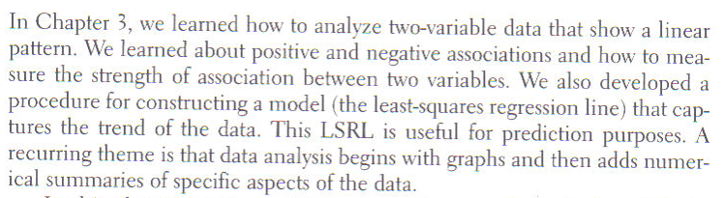
Chapter Review

Slide 16
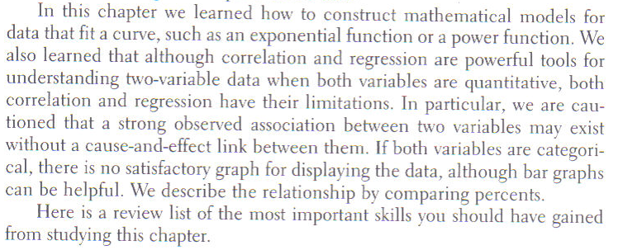

Slide 17
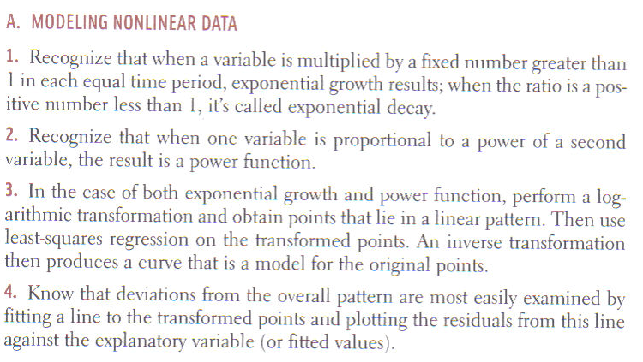

Slide 18
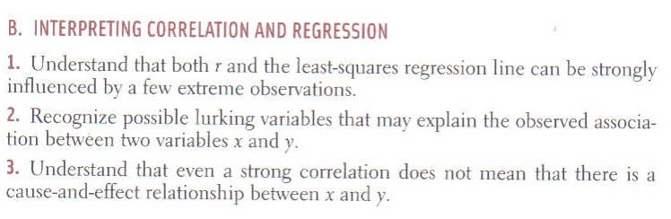

Slide 19
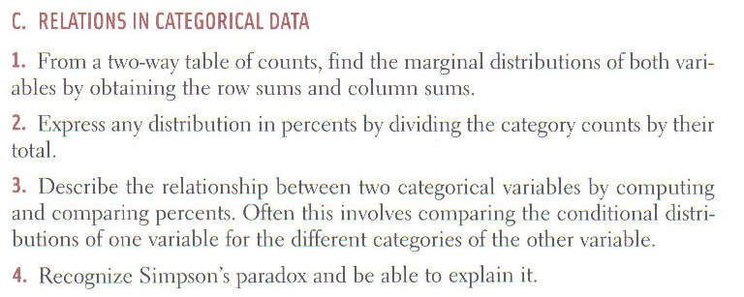

Slide 20
Chapter 4 Complete
Homework: #’s 79, 81, 83
Any questions on pg. 33-36 in additional notes packet

