Slide 1
Chapter 3: Examining Relationships

Slide 2
Intro:
This section is going to focus on relationships among several variables for the same group of individuals. In these relationships, does one variable cause the other variable to change?
Explanatory Variable:
Attempts to explain the observed outcomes
Independent variable
Response Variable:
Measures an outcome of a study
Dependent variable

Slide 3
Principles That Guide Examination of Data
Same as one-variable methods from Ch. 1 and 2
Plot the data, then add numerical summaries.
Look for overall patterns and deviation from those patterns.
When the overall pattern is quite regular, use a compact mathematical model to describe it.

Slide 4
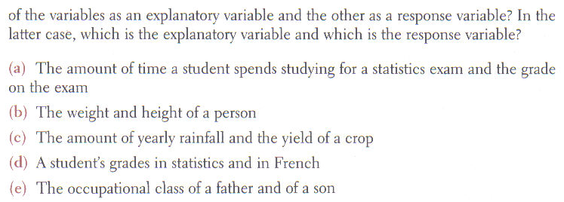
Explanatory – Time studying
Response – Exam grade
Explore the relationship
Explanatory – Rainfall
Response – Crop yield
Explore the relationship
Explanatory – Father’s class
Response – Son’s class

Slide 5
3.1: Scatterplots
Most effective way to display relationship between two quantitative variables
Shows the relationship between two quantitative variables measured on the same individuals
Each individual in the data appears as the point in the plot
Plot the explanatory variable on the horizontal axis
Plot the response variable on the vertical axis.

Slide 6
Examining scatterplots:
Describe the overall pattern of a scatterplot by:
Form – linear, quadratic, logarithmic, etc.
Direction – positive or negative.
Strength of the relationship – weak, moderate, or strong.
An important kind of deviation is an outlier.
Variable Association:
Positively associated
Direct Variation
Negatively Associated
Inverse Variation

Slide 7
Tips for drawing scatterplots:
Scale the vertical and horizontal axes.
Intervals must be uniform
Use a symbol to indicate a break in the scale
Label both axes, and title the graph.
If you are given a grid, try to adopt a scale that makes your plot use the whole grid.

Slide 8
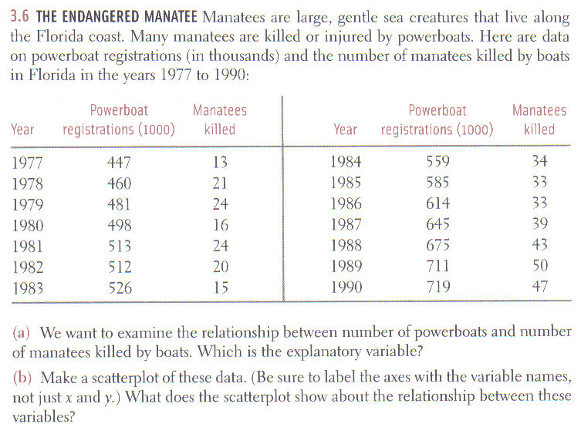

Slide 9
Manatees
A) The explanatory variable is the number of powerboat registrations.
B) Make a scatterplot.
60
Manatee deaths cause by powerboats
50
40
Manatee Fatalities
30
20
10
400
450
500
550
600
650
700
750
Powerboat registrations (in 1000’s)

Slide 10
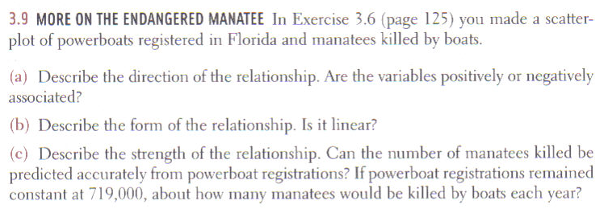
The direction of the relationship is positive, because the trend shows that as powerboat registrations increased there were more deaths to manatees.
The form of the relationship looks to be linear.
The strength of the relationship looks strong, because there aren’t to many points that deviate away from the occurring trend.

Slide 11
Section 3.1 Complete
Homework: #’s 2, 3, 12, 15, 16, 23
Any questions on pg. 1-4 in additional notes packet

Slide 12
3.2: Correlation
Measures the direction and strength of a linear relationship between two variables.
Usually written as r.
The formula is a little complex and most of the time we will use our calculators.

Slide 13
Facts about correlation:
Makes no distinction between explanatory and response variables
Requires that both variables be quantitative
The correlation between the incomes of a group of people and what city they live in cannot be calculated because city is a categorical variable.
r does not change when we change the units of measurement of x, y, or both
r has no unit of measurement; it is just a number.
Positive r indicates positive association
Negative r indicates negative association.

Slide 14
Facts about correlation:
r is always a number between -1 and 1
Values near 0 indicate a very weak linear relationship
The strength increases as r moves toward -1 or 1.
Measures the strength of only a linear relationship
Does not describe curved relationships
r is not a resistant measurement
Use r with caution when there are outliers
r is not a complete description of two-variable data
Need to use the means and standard deviations of BOTH x and y along with the correlation when describing the data.

Slide 15
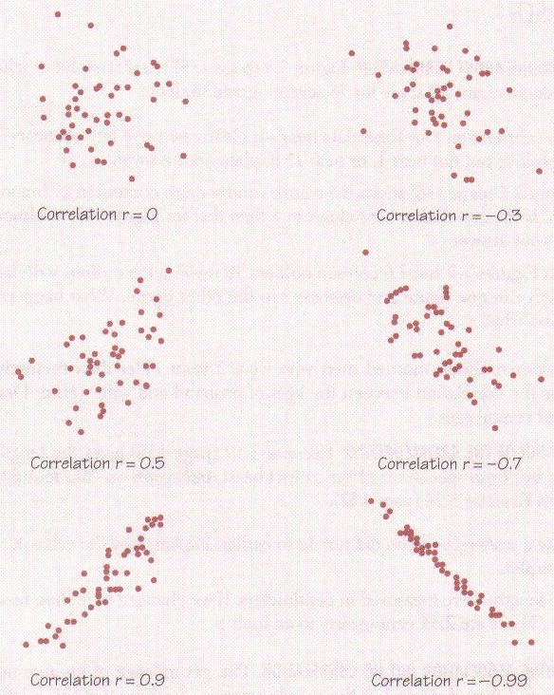
Correlation Charts
Correlation measures how closely related the data is to a linear approximation. The slope of the correlation gives the sign of the value.

Slide 16
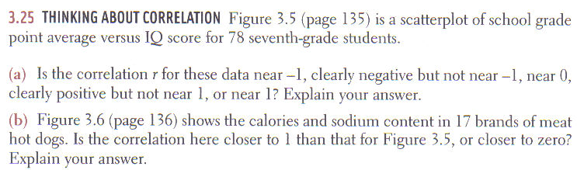
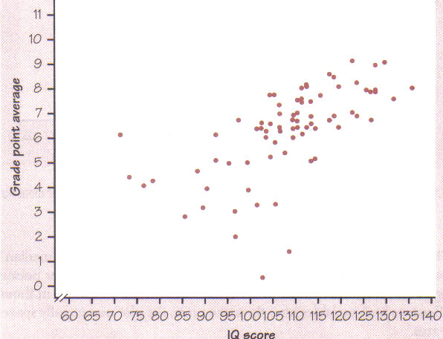
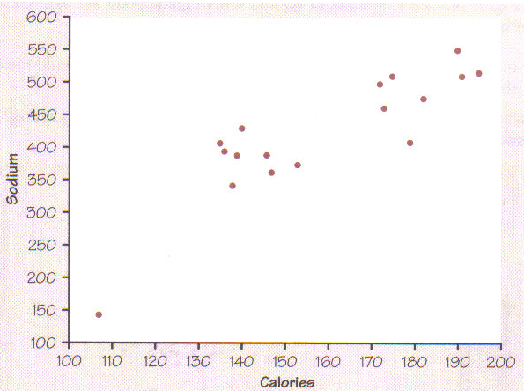

Slide 17
Calculator Problem
Take yesterday's example of Manatee deaths and put the data into your calculator’s lists
List₁ – Powerboat registration (explanatory)
List₂ – Manatees killed (response)

Slide 18
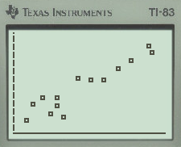
Make a Scatterplot
Use 2nd Y=
Turn plot 1 on
The first type of graph is a scatterplot
Xlist = L₁
Ylist = L₂
Press the zoom key then number 9

Slide 19
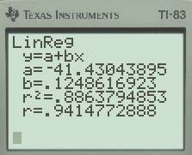
Find the Correlation
Press 2nd 0
Brings up catalog
Find DiagnosticOn and press enter twice
Press the STAT key
Scroll over to CALC
Use either option 4 or 8

Slide 20
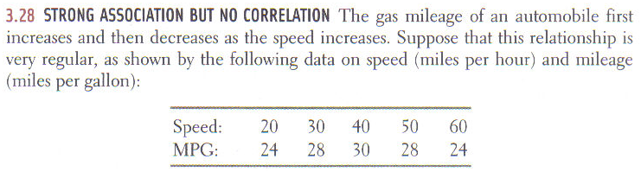
Calculator Problem
Make a scatterplot on your calculator.
Does there appear to be a strong relationship between speed and MPG?
Calculate r.
Why is r = 0, when there is a strong relationship?
r only measures the strength of a linear relationship

Slide 21
Section 3.2 Complete
Homework: #’s 26, 27, 30, 33, 37
Any questions on pg. 5-8 in additional notes packet

Slide 22
3.3: Least-Squares Regression
Correlation measures the strength and direction of the linear relationship
Least-squares regression
Method for finding a line that summarizes that relationship in a specific setting.
Describes how a response variable y changes as an explanatory variable x changes
Used to predict the value of y for a given value of x
Unlike correlation, requires an explanatory and response variable.

Slide 23
Least-squares regression line (LSRL).
The equation is $\hat{y}=a+bx$
$\hat{y}$is used because the equation is a prediction
The slope is b and the y-intercept is a
Every least-squares regression line passes through the point $\left(\overline{x},\overline{y}\right)$

Slide 24
Facts about least-squares regression.
Distinction between explanatory and response variables is essential
If we reversed the roles of the two variables, we get a different LSRL
LSRL is calculated by minimizing the sum of the squares of $y−\hat{y}$
There is a close connection between correlation and the slope of the regression line
As r gets closer to 0, $\hat{y}$ moves less in response to changes in x.

Slide 25
Interpretation of LSRL
Slope
For every unit increase in x, there is on average a change of b units in $\hat{y}$
y-intercept
Value of $\hat{y}$ when x = 0
Only meaningful when x can actually take values close to zero.

Slide 26
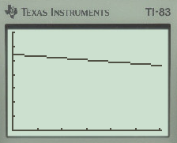
y=5.43-.0053x
Window
0 < X < 151
0 < Y < 7
By looking at the equation or the graph, the association between time and pH is negative.
This means that there is an inverse relationship between weeks and pH levels. As more weeks go by the pH level of the rain gets lower, meaning the rain is becoming more acidic.

Slide 27
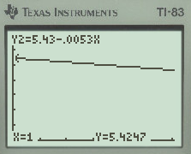
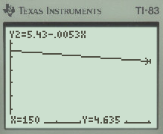
x = 1, y = 5.4247
x = 150, y = 4.635

Slide 28
The slope of the regression line is -.0053. This means that with the passing of each week, on average, the pH level of rain in the Colorado wilderness decreases by .0053.

Slide 30
Calculator Problem Continued
Take yesterday's example of Manatee deaths and put the data into your calculator’s lists
List₁ – Powerboat registration (explanatory)
List₂ – Manatees killed (response)

Slide 31
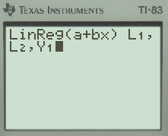
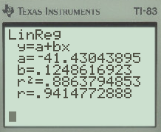
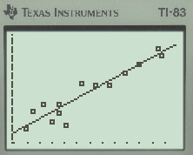
Find the LSRL and Overlay it on your Scatterplot
Press the STAT key
Scroll over to CALC
Use either option 4 or 8
After the command is on your home screen:
Put the following L₁, L₂, Y₁
To get Y₁, press VARS, Y-VARS, Function

Slide 32
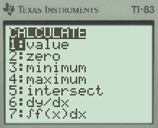
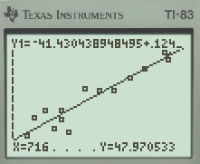
Use the LSRL to Predict
With an equation stored on the calculator it makes it easy to calculate a value of y for any known x.
Use the LSRL to predict the number of manatee deaths for a year that had 716,000 powerboat registrations.
2nd Trace, Value
x = 716 (remember scale)

Slide 33
The role of r² in regression.
Coefficient of determination
The fraction of the variation in the values of y that is explained by least-squares regression of y on x.
Measurement of the contribution of x in predicting y.
Equation is tedious
But it can be shown algebraically to be equal to the correlation coefficient squared (r²)

Slide 34
Example - Calculation
The wording of this question gives the value of r².
Take the square root

Slide 35
Example – Sentence Structure
Data from problem # 44 shows:
x = January stock change
y = Entire year stock change
What is the coefficient of determination and what does it mean in the context of this problem?
r² = .335
This means that 33.5% of the variation in the change in stock index for the entire year can be explained by the least-squares regression of entire year stock change on January’s stock change.

Slide 36
Section 3.3 Day 1
Homework: #’s 43, 45, 52a&b, 54
Any questions on pg. 9-12 in additional notes packet

Slide 37
3.3: Least-Squares Regression – Day 2
Residuals
Deviations from the overall pattern
Measured as vertical distances
Difference between an observed value of the response variable and the value predicted by the regression line
Observed y – predicted $\hat{y}$
The sum of the least-squares residuals are always zero

Slide 38
Continue with Manatees
Find the residual for the observed value of 447,000 powerboats
From previous $\hat{y}=−41.4304+.1249x$
Substitution of 447 gives $\hat{y}=14.39$
Observed data at 447 is 13
$y−\hat{y}=13−14.39=−1.39$

Slide 39
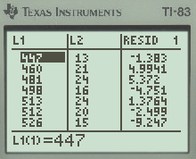
See all of the residuals at once
The calculator calculates the residuals for all points every time it runs a linear regression command
To see this, press 2nd STAT and under NAMES scroll down to RESID
The residuals will be in the order of the data
Can also set up your “screen of lists” to always have residuals showing

Slide 40
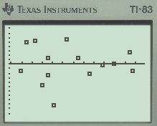
What to do with all the residuals
Residual Plot
Scatterplot of the regression residuals against the explanatory variable
Help to assess the fit of a regression line
If the regression line captures the overall relationship between x and y, the residuals should have no systematic pattern
Residual Plot for the Manatees

Slide 41
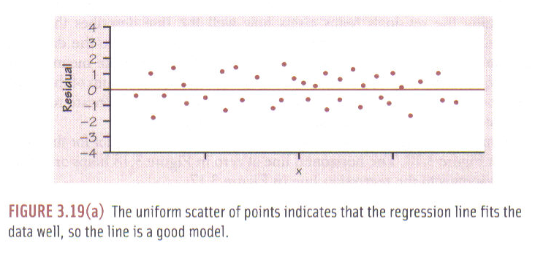
Good Fit
Below is a residual plot that shows a linear model is a good fit to the original data
Reason
There is a uniform scatter of points

Slide 42
Poor Fit
Below are two residual plots that show a linear model is not a good fit to the original data
Reasons
Curved pattern
Residuals get larger with larger values of x

Slide 43
Influential observations:
Outlier
An observation that lies outside the overall pattern in the y direction of the other observations.
Influential Point
An observation is influential if removing it would markedly change the result of the LSRL
Are outliers in the x direction of a scatterplot
Have small residuals, because they pull the regression line toward themselves.
If you just look at residuals, you will miss influential points.
Can greatly change the interpretation of data.

Slide 44
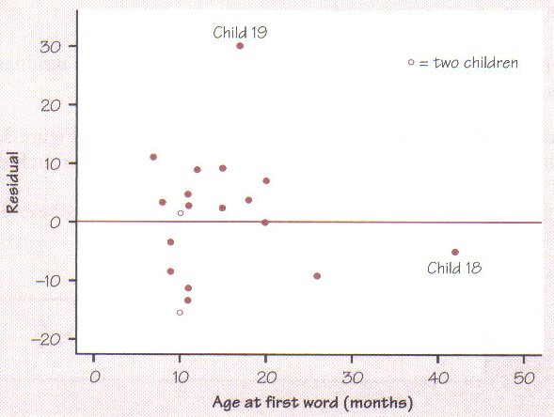
Location of Influential observations
Child 19
Outlier
Child 18
Influential Point

Slide 45
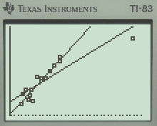
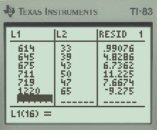
Manatee
Add the point, (year 2013, boats 1220, manatees 65) to the data we have.
Run a LSRL command and store the new line in L₂
Look how the point drastically changed the LSRL
But it does not have the largest absolute residual

Slide 46
Section 3.3 Day 2 Complete
Homework: #’s 46, 47, 48, 51, 53, 55, 57
Any questions on pg. 13-16 in additional notes packet

Slide 47
MINITAB printout
A healthy cereal should be low in both calories and sodium. Data for 77 cereals were examined and judged acceptable for inference. The 77 cereals had between 50 and 160 calories per serving and between 0 and 320 mg of sodium per serving. The regression analysis is shown.
R-squared = 9.0%
s = 80.49 with 77 – 2 = 75 degrees of freedom
Variable | Coefficient | SE(Coeff) | t-ratio | Prob
Constant | 21.4143 | 51.47 | 0.416 | 0.6706
Calories | 1.29357 | 0.4738 | ? | ?

Slide 48
MINITAB printout
Find the following:
Line of best fit.
Interpret the slope in context.
Interpret the y-int in context.
Correlation coefficient, what does it tell you in context?
Interpret r² in context.
R-squared = 9.0%
s = 80.49 with 77 – 2 = 75 degrees of freedom
Variable | Coefficient | SE(Coeff) | t-ratio | Prob
Constant | 21.4143 | 51.47 | 0.416 | 0.6706
Calories | 1.29357 | 0.4738 | ? | ?

Slide 49
Line of best fit.
Variable | Coefficient | SE(Coeff) | t-ratio | Prob
Constant | 21.4143 | 51.47 | 0.416 | 0.6706
Calories | 1.29357 | 0.4738 | ? | ?
y-axis →
x-axis →
In the variable column there are always two entrees, one is your explanatory variable and one is your response variable. The explanatory variable is named with the label for your x-axis and the response variable is called constant.
^
^

Slide 50
Interpret the y-int in context.
Interpret the slope in context.
The slope equals 1.29357.
This means that for every additional calorie increase in a serving of cereal of one, on average, the amount of sodium will also increase by 1.3 mg per serving.
The y-int equals 21.4143.
This means that for a serving of cereal with zero calories, there are still 21.4 mg of sodium per serving.

Slide 51
Correlation coefficient, what does it tell you in context?
The correlation coefficient is the square-root of r².
This means there is a weak, positive, linear association between calorie count and sodium amount in a serving of cereal.

Slide 52
The meaning of r².
In regression, R² (coefficient of determination), is a statistical measure of how well the regression line approximates the real data points. An R² of 1.0 indicates that the regression line perfectly fits the data. R² has a range of values from 0 to 1. It is the proportion of variability in a data set that is accounted for by the statistical model.

Slide 53
Interpret r² in context.
R² = 9%.
9% of the variability in the amount of sodium per serving of cereal is (explained or accounted) by the regression model with calories per serving of cereal. This proportion provides a measure of how well future predictions of sodium content can be made from calorie count by the model. In this case it shows a weak relationship.

Slide 54
Reading MINITAB Complete
Homework: Finish worksheet on Minitab
Any questions on pg. 17-20 in additional notes packet

Slide 55
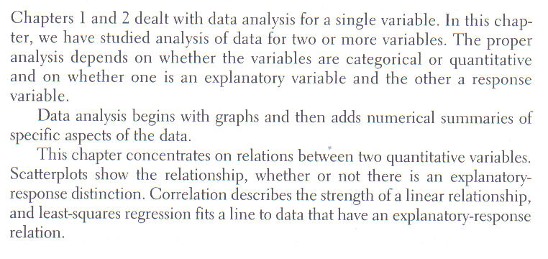
Chapter Review

Slide 57
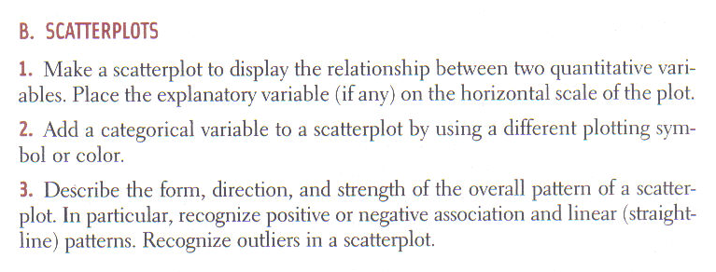

Slide 59
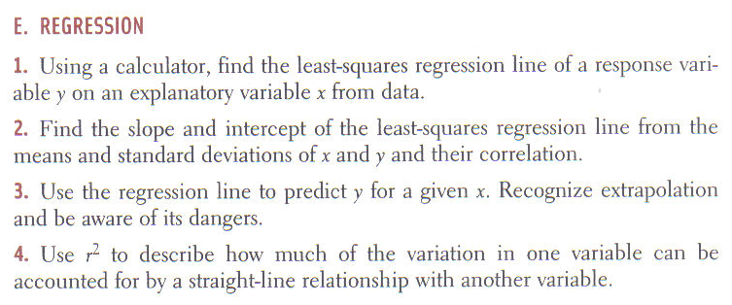

Slide 60
Chapter 3 Complete
Homework: #’s 62, 63, 68a&b, 71
Any questions on pg. 21-24 in additional notes packet

