Slide 1
Chapter 2: Objects and Primitive Data

Slide 2
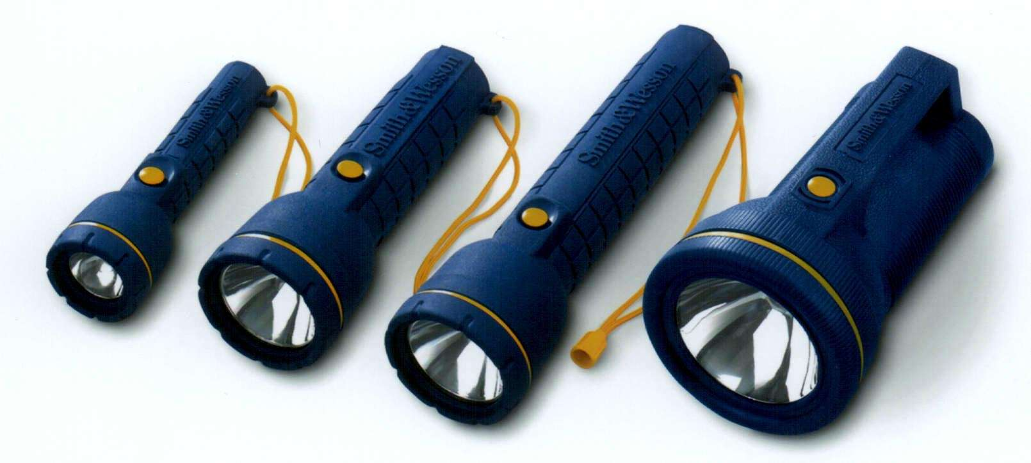
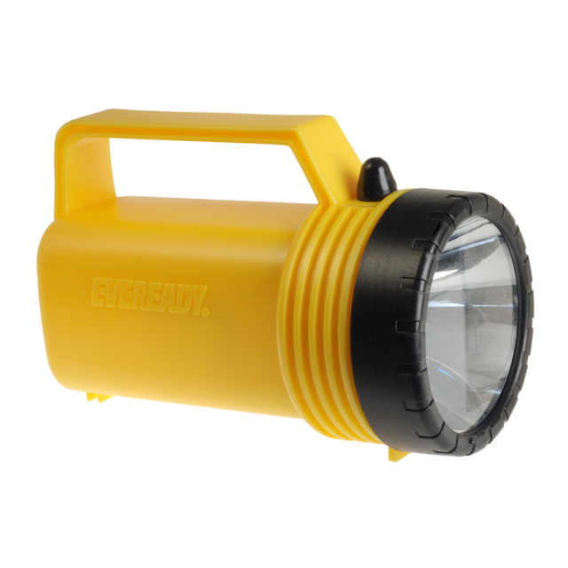

Slide 3
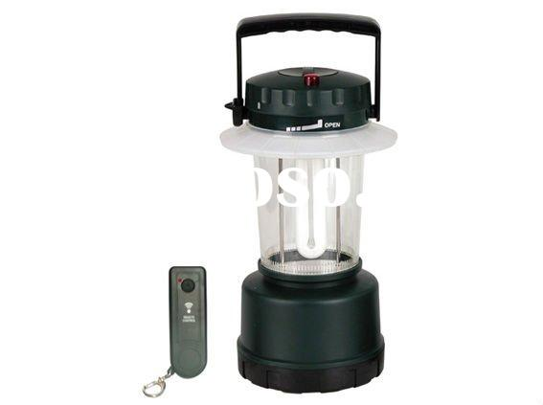
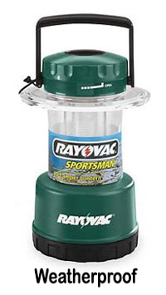
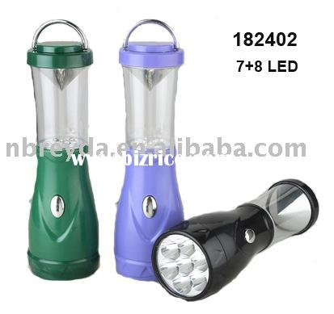

Slide 4
Object-Oriented Programming
The following concepts are important to object-oriented programming:
object
attribute
method
class
encapsulation
inheritance
polymorphism

Slide 5
Introduction to Objects
An object represents something with which we can interact in a program (manipulated)
An object’s attributes are the values it stores internally which represent its state.
A class represents a concept,
“an object is an instance of a class”
A method is a set of instructions defining a behavior or activity for an object.

Slide 6
Encapsulation is also known as data hiding.
private vs public data fields.
We can use a class or methods of a class without knowing how they do the job – this is called abstraction.
Classes can be created from other classes through the use of inheritance. Inheritance is a form of code reuse between parent and child classes.
Polymorphism is the idea that we can refer to objects of different but related types in the same way.

Slide 8
A Little more on Abstraction
We don't have to know how the println method works in order to invoke it
A human being can manage only seven (plus or minus 2) pieces of information at one time
But if we group information into chunks (such as objects) we can manage many complicated pieces at once
Classes and objects help us write complex software

Slide 9
Using Objects
The System.out object represents a destination to which we can send output
In the Lincoln program, we invoked the println method of the System.out object:
System.out.println ("Whatever you are, be a good one.");
object
method
information provided to the method
(parameters)

Slide 10
The print Method
The System.out object provides another service as well
The print method is similar to the println method, except that it does not advance to the next line
Therefore anything printed after a print statement will appear on the same line
See Countdown.java (page 61)

Slide 11
//********************************************************************
// Countdown.java Author: Lewis/Loftus/Cocking
//
// Demonstrates the difference between print and println.
//********************************************************************
public class Countdown
{
//-----------------------------------------------------------------
// Prints two lines of output representing a rocket countdown.
//-----------------------------------------------------------------
public static void main (String[] args)
{
System.out.print ("Three... ");
System.out.print ("Two... ");
System.out.print ("One... ");
System.out.print ("Zero... ");
System.out.println ("Liftoff!"); // appears on first output line
System.out.println ("Houston, we have a problem.");
}
}

Slide 12
Output…
Three…Two…One…Zero…Liftoff!
Houston, we have a problem.

Slide 13
Assignment
Read pages 58 through 67
Sections 2.0, 2.1
Begin Next Reading Assignment
Section 2.2, 2.3, 2.4

Slide 14
Character Strings
Every character string is an object in Java, defined by the String class
Every string literal, delimited by double quotation marks, represents a String object
The string concatenation operator (+) is used to append one string to the end of another
It can also be used to append a number to a string
A string literal cannot be broken across two lines in a program
See Facts.java (page 64)

Slide 15
public static void main (String[] args)
{
// Strings can be concatenated into one long string
System.out.println ("We present the following facts for your "
+ "extracurricular edification:");
System.out.println ();
// A string can contain numeric digits
System.out.println ("Letters in the Hawaiian alphabet: 12");
// A numeric value can be concatenated to a string
System.out.println ("Dialing code for Antarctica: " + 672);
System.out.println ("Year in which Leonardo da Vinci invented "
+ "the parachute: " + 1515);
System.out.println ("Speed of ketchup: " + 40 + " km per year");
}
}

Slide 16
String Concatenation
The plus operator (+) is also used for arithmetic addition
The function that the + operator performs depends on the type of the information on which it operates
If both operands are strings, or if one is a string and one is a number, it performs string concatenation
If both operands are numeric, it adds them
The + operator is evaluated left to right
Parentheses can be used to force the operation order
See Addition.java (page 65)

Slide 17
//********************************************************************
// Addition.java Author: Lewis/Loftus/Cocking
//
// Demonstrates the difference between the addition and string
// concatenation operators.
//********************************************************************
public class Addition
{
//-----------------------------------------------------------------
// Concatenates and adds two numbers and prints the results.
//-----------------------------------------------------------------
public static void main (String[] args)
{
System.out.println ("24 and 45 concatenated: " + 24 + 45);
System.out.println ("24 and 45 added: " + (24 + 45));
}
}

Slide 18
Escape Sequences
What if we wanted to print a double quote character?
The following line would confuse the compiler because it would interpret the second quote as the end of the string
System.out.println ("I said "Hello" to you.");
An escape sequence is a series of characters that represents a special character
An escape sequence begins with a backslash character (\), which indicates that the character(s) that follow should be treated in a special way
System.out.println ("I said \"Hello\" to you.");

Slide 19
Escape Sequences
Some Java escape sequences:
Escape Sequence
\b
\t
\n
\r
\"
\'
\\
Meaning
backspace
tab
newline
carriage return
double quote
single quote
backslash
See Roses.java (page 67)

Slide 20
//********************************************************************
// Roses.java Author: Lewis/Loftus/Cocking
//
// Demonstrates the use of escape sequences.
//********************************************************************
public class Roses
{
//-----------------------------------------------------------------
// Prints a poem (of sorts) on multiple lines.
//-----------------------------------------------------------------
public static void main (String[] args)
{
System.out.println ("Roses are red,\n\tViolets are blue,\n" +
"Sugar is sweet,\n\tBut I have \"commitment issues\",\n\t" +
"So I'd rather just be friends\n\tAt this point in our " +
"relationship.");
}
}

Slide 21
Variables
A variable is a name for a location in memory
A variable must be declared by specifying the variable's name and the type of information that it will hold
data type
variable name
int total;
int count, temp, result;
Multiple variables can be created in one declaration

Slide 22
Variables
A variable can be given an initial value in the declaration
int sum = 0;
int base = 32, max = 149;
When a variable is referenced in a program, its current value is used
See PianoKeys.java (page 68)

Slide 23
//********************************************************************
// PianoKeys.java Author: Lewis/Loftus/Cocking
//
// Demonstrates the declaration, initialization, and use of an
// integer variable.
//********************************************************************
public class PianoKeys
{
//-----------------------------------------------------------------
// Prints the number of keys on a piano.
//-----------------------------------------------------------------
public static void main (String[] args)
{
int keys = 88;
System.out.println ("A piano has " + keys + " keys.");
}
}

Slide 24
Assignment Operator (=)/Statement
An assignment statement changes the value of a variable
The assignment operator is the = sign
int total;
total = 55;
The expression on the right is evaluated and the result is stored in the variable on the left
The value that was in total is overwritten
You can assign only a value to a variable that is consistent with the variable's declared type
See Geometry.java (page 70)

Slide 25
public class Geometry
{
//-----------------------------------------------------------------
// Prints the number of sides of several geometric shapes.
//-----------------------------------------------------------------
public static void main (String[] args)
{
int sides = 7; // declaration with initialization
System.out.println ("A heptagon has " + sides + " sides.");
sides = 10; // assignment statement
System.out.println ("A decagon has " + sides + " sides.");
sides = 12;
System.out.println ("A dodecagon has " + sides + " sides.");
}
}

Slide 26
Constants
A constant is an identifier that is similar to a variable except that it holds one value while the program is active
The compiler will issue an error if you try to change the value of a constant during execution
In Java, we use the final modifier to declare a constant
final int MIN_HEIGHT = 69;
Constants:
give names to otherwise unclear literal values
facilitate updates of values used throughout a program
prevent inadvertent attempts to change a value

Slide 27
Primitive Data
There are exactly eight primitive data types in Java
Four of them represent integers:
byte, short, int, long
Two of them represent floating point numbers:
float, double
One of them represents characters:
char
And one of them represents boolean values:
boolean
Only three are in the AP subset: int, double, and boolean

Slide 28
Numeric Primitive Data
The difference between the numeric primitive types is their size and the values they can store.
The int type stores only integer numbers while double includes a decimal place.
Type
int
double
Storage
32 bits
64 bits
Min Value
-2,147,483,648
+/- 1.7 x 10³⁰⁸ with 15 significant digits
Max Value
2,147,483,647

Slide 29
Boolean
A boolean value represents a true or false condition
A boolean also can be used to represent any two states, such as a light bulb being on or off
The reserved words true and false are the only valid values for a boolean type
boolean done = false;

Slide 30
Characters
A char variable stores a single character from the Unicode character set
A character set is an ordered list of characters, and each character corresponds to a unique number
The Unicode character set uses sixteen bits per character, allowing for 65,536 unique characters
It is an international character set, containing symbols and characters from many world languages
Character literals are delimited by single quotes:
'a' 'X' '7' '$' ',' '\n'

Slide 31
Characters
The ASCII character set is older and smaller than Unicode, but is still quite popular
The ASCII characters are a subset of the Unicode character set, including:
uppercase letters
lowercase letters
punctuation
digits
special symbols
control characters
A, B, C, …
a, b, c, …
period, semi-colon, …
0, 1, 2, …
&, |, \, …
carriage return, tab, ...

Slide 32
Arithmetic Expressions
An expression is a combination of one or more operands and their operators
Arithmetic expressions compute numeric results and make use of the arithmetic operators:
Addition +
Subtraction -
Multiplication *
Division /
Remainder %
If either or both operands associated with an arithmetic operator are floating point, the result is a floating point

Slide 33
Division and Remainder
If both operands to the division operator (/) are integers, the result is an integer (the fractional part is discarded)
14 / 3 equals?
4
8 / 12 equals?
0
The remainder operator (%) returns the remainder after dividing the second operand into the first
14 % 3 equals?
2
8 % 12 equals?
8

Slide 34
Reading Input
System.in has minimal set of features–it can only read one byte at a time
In Java 5.0, Scanner class was added to read keyboard input in a convenient manner
nextDouble() reads a double
nextLine() reads a line (until user hits Enter)
next() reads a word (until any white space)
Scanner scan= new Scanner(System.in); System.out.print("Enter quantity: "); int quantity = scan.nextInt();

Slide 35
Example using Scanner class
import java.util.Scanner;
//must be included at the top of every program
Scanner scan = new Scanner(System.in);
System.out.print("Enter quantity: ");
int quantity = scan.nextInt();
System.out.print("Enter price: ");
double price = scan.nextDouble();

Slide 36
Scanner class continued:
To read in Strings use next() or nextLine();
the next() method reads the next word and
the nextLine() method is used to read in multiple words.
System.out.print("Enter city: ");
String sentence = scan.nextLine();
System.out.print("Enter your first name: ");
String name = scan.next();

Slide 37
Formatting Numbers
Use the printf method of the PrintStream class
Example:
double total = 3.50;
final double TAX_RATE = 8.5;// Tax rate in percent
double tax = total * TAX_RATE / 100; // tax is 0.2975
System.out.println("Total: " + total);
System.out.println("Tax: " + tax);
Output is
Total: 3.5
Tax: 0.2975

Slide 38
printf continued…
You may prefer the numbers to be printed with 2 digits
System.out.printf("Total:%5.2f", total);
System.out.printf("Tax:%7.2f", tax);
Output is
Total: 3.50
Tax: 0.30

Slide 39
Homework Assignment 5
Read pages 63 – 79
Multiple Choice 2.1 – 2.6, True/False 2.1 – 2.6, Short Answer 2.2 – 2.5
Programming Assignments 2.1 – 2.7

Slide 40
Chapter 2 Continued:

Slide 41
Operator Precedence
Operators can be combined into complex expressions
result = total + count / max - offset;
Operators have a well-defined precedence which determines the order in which they are evaluated
Multiplication, division, and remainder are evaluated prior to addition, subtraction, and string concatenation
Arithmetic operators with the same precedence are evaluated from left to right
Parentheses can be used to force the evaluation order

Slide 42
Operator Precedence
What is the order of evaluation in the following expressions?
a + b + c + d + e
a + b * c - d / e
1
2
3
4
3
1
4
2
a / (b + c) - d % e
2
1
4
3
a / (b * (c + (d - e)))
4
3
2
1

Slide 43
Assignment Operator Revisited
The assignment operator has a lower precedence than the arithmetic operators
First the expression on the right hand
side of the = operator is evaluated
answer = sum / 4 + MAX * lowest;
4
1
3
2
Then the result is stored in the
variable on the left hand side

Slide 44
Assignment Operator (=) Revisited
The right and left hand sides of an assignment statement can contain the same variable
First, one is added to the
original value of count
count = count + 1;
Then the result is stored back into count
(overwriting the original value)

Slide 45
Data Conversions
Sometimes it is convenient to convert data from one type to another
For example, we may want to treat an integer as a floating point value during a computation
Conversions must be handled carefully to avoid losing information
Widening conversions are safest because they usually do not lose information (int to double)
Narrowing conversions can lose information (double to int)

Slide 46
Data Conversions
In Java, data conversions can occur in three ways:
assignment conversion
arithmetic promotion
casting
Assignment conversion occurs when a value of one type is assigned to a variable of another
Only widening conversions can happen via assignment
Arithmetic promotion happens automatically when operators in expressions convert their operands

Slide 47
Data Conversions
Casting is the most powerful, and dangerous, technique for conversion
Both widening and narrowing conversions can be accomplished by explicitly casting a value
To cast, the type is put in parentheses in front of the value being converted
For example, if total and count are integers, but we want a floating point result when dividing them, we can cast total:
result = (double) total / count;

Slide 48
Creating Objects
A variable holds either a primitive type or a reference to an object
A class name can be used as a type to declare an object reference variable
String title;
No object is created with this declaration
An object reference variable holds the address of an object
The object itself must be created separately

Slide 49
Creating Objects
Generally, we use the new operator to create an object
title = new String ("Java Software Solutions");
This calls the String constructor, which is
a special method that sets up the object
Creating an object is called instantiation
An object is an instance of a particular class

Slide 50
Creating Objects
Because strings are so common, we don't have to use the new operator to create a String object
title = "Java Software Solutions";
This is special syntax that works only for strings
Once an object has been instantiated, we can use the dot operator to invoke its methods
title.length()

Slide 51
String Methods
The String class has several methods that are useful for manipulating strings
Many of the methods return a value, such as an integer or a new String object

Slide 52
Some String Methods p 84
String someString = new String(“Whatever.”);
char let = someString.charAt(5);
boolean ans = someString.equals(“I don’t care.”);
boolean ans2 = someString.equalsIgnoreCase(“whatever.”);
int index = someString.indexOf(“ate”);

Slide 53
String someString = “Pound it!”
int len = someString.length();
String small = someString.substring(0, 5);
String inner = someString.substring(4);
String lower = someString.toLowerCase();
String upper = someString.toUpperCase();

Slide 54
StringMutation.java
//********************************************************************
// StringMutation.java Author: Lewis/Loftus/Cocking
//
// Demonstrates the use of the String class and its methods.
//********************************************************************
public class StringMutation
{
//-----------------------------------------------------------------
// Prints a string and various mutations of it.
//-----------------------------------------------------------------
public static void main (String[] args)
{
String phrase =("Change is inevitable");
String mutation1, mutation2, mutation3, mutation4;
System.out.println ("Original string: \"" + phrase + "\"");
System.out.println ("Length of string: " + phrase.length());

Slide 55
mutation1 = phrase.concat (", except from vending machines.");
mutation2 = mutation1.toUpperCase();
mutation3 = mutation2.replace ('E', 'X');
mutation4 = mutation3.substring (3, 30);
// Print each mutated string
System.out.println ("Mutation #1: " + mutation1);
System.out.println ("Mutation #2: " + mutation2);
System.out.println ("Mutation #3: " + mutation3);
System.out.println ("Mutation #4: " + mutation4);
System.out.println ("Mutated length: " + mutation4.length());
}
}

Slide 56
Class Libraries
A class library is a collection of classes that we can use when developing programs
The Java standard class library is part of any Java development environment
The System class and the String class are part of the Java standard class library
Other class libraries can be created by programmers like you

Slide 57
Packages
The classes of the Java standard class library are organized into packages
Some of the packages in the standard class library are:
Math, String, System
Package
java.lang
java.applet
java.awt
javax.swing
java.util
Purpose
General support
Creating applets for the web
Graphics and graphical user interfaces
Additional graphics capabilities and components
Utilities
Random, Scanner
Color, Rectangle

Slide 58
The import Declaration
To use one of these classes you must import the class, and then use just the class name in your program
import java.util.Random;
import java.util.Scanner;
To import all classes in a particular package, you can use the * wildcard character
import java.util.*;

Slide 59
The import Declaration
All classes of the java.lang package are imported automatically into all programs
That's why we didn't have to import the System or String classes explicitly in earlier programs
The Random class is part of the java.util package
It provides methods that generate pseudorandom numbers

Slide 60
Class Methods
Static methods can be invoked through the class name, instead of through an object of the class
The Math class is a static class and contains many static methods, providing various mathematical functions, such as absolute value, trigonometry functions, square root, etc.
double temp = Math.sqrt(x*y) + Math.pow(x, y);

Slide 61
Math Class See p 94.
int num = -34;
int absNum = Math.abs(num);
double dec = 4.3;
double absDec = Math.abs(dec);
double pwr = Math.pow (2, 4);
double num2 = 49.0
double sqrRtNum2 = Math.sqrt(num2)

Slide 62
Random Class pp. 91 - 93
Random rand = new Random();
int num 1;
double num2;
num1 = rand.nextInt(10);
//returns a random number in the range 0 to num-1
num2 = rand.nextDouble();
/* returns a random number between 0.0 (inclusive) and 1.0 (exclusive) (0.0, 1.0]
/*

Slide 63
RandomNumbers.java
//********************************************************************
// RandomNumbers.java Author: Lewis/Loftus/Cocking
//
// Demonstrates the import statement, and the creation of pseudo-
// random numbers using the Random class.
//********************************************************************
import java.util.Random;
public class RandomNumbers
{
//-----------------------------------------------------------------
// Generates random numbers in various ranges.
//-----------------------------------------------------------------
public static void main (String[] args)
{
Random generator = new Random();
int num1;
double num2;
num1 = generator.nextInt(10);
System.out.println ("From 0 to 9: " + num1);

Slide 64
num1 = generator.nextInt(10) + 1;
System.out.println ("From 1 to 10: " + num1);
num1 = generator.nextInt(15) + 20;
System.out.println ("From 20 to 34: " + num1);
num1 = generator.nextInt(20) - 10;
System.out.println ("From -10 to 9: " + num1);
num2 = generator.nextDouble();
System.out.println ("A random double [between 0-1]: " + num2);
num2 = generator.nextDouble() * 6; // 0.0 to 5.999999
num1 = (int) num2 + 1;
System.out.println ("From 1 to 6: " + num1);
}
}

Slide 65
Formatting Output
The NumberFormat class has static methods that return a formatter object
getCurrencyInstance()
getPercentInstance()
Each formatter object has a method called format that returns a string with the specified information in the appropriate format
See Price.java (page 97)

Slide 66
Price.java
//********************************************************************
// Price.java Author: Lewis/Loftus/Cocking
//
// Demonstrates the use of various Keyboard and NumberFormat
// methods.
//********************************************************************
import java.util.Scanner;
import java.text.NumberFormat;
public class Price
{
//-----------------------------------------------------------------
// Calculates the final price of a purchased item using values
// entered by the user.
//-----------------------------------------------------------------
public static void main (String[] args)
{
final double TAX_RATE = 0.06; // 6% sales tax
int quantity;
double subtotal, tax, totalCost, unitPrice;
System.out.print ("Enter the quantity: ");

Slide 67
Scanner scan = new Scanner(System.in)
quantity = scan.nextInt();
System.out.print ("Enter the unit price: ");
unitPrice = scan.nextDouble();
subtotal = quantity * unitPrice;
tax = subtotal * TAX_RATE;
totalCost = subtotal + tax;
// Print output with appropriate formatting
NumberFormat money = NumberFormat.getCurrencyInstance();
NumberFormat percent = NumberFormat.getPercentInstance();
System.out.println ("Subtotal: " + money.format(subtotal));
System.out.println ("Tax: " + money.format(tax) + " at "
+ percent.format(TAX_RATE));
System.out.println ("Total: " + money.format(totalCost));
}
}

Slide 68
Formatting Output
The DecimalFormat class can be used to format a floating point (decimal) value in generic ways
For example, you can specify that the number should be printed to three decimal places
The constructor of the DecimalFormat class takes a string that represents a pattern for the formatted number
See CircleStats.java (page 99)

Slide 69
//********************************************************************
// CircleStats.java Author: Lewis/Loftus/Cocking
//
// Demonstrates the formatting of decimal values using the
// DecimalFormat class.
//********************************************************************
import java.util.Scanner;
import java.text.DecimalFormat;
public class CircleStats
{
//-----------------------------------------------------------------
// Calculates the area and circumference of a circle given its
// radius.
//-----------------------------------------------------------------
public static void main (String[] args)
{
int radius;
double area, circumference;

Slide 70
Scanner scan = new Scanner(System.in);
System.out.print ("Enter the circle's radius: ");
radius = scan.nextInt();
area = Math.PI * Math.pow(radius, 2);
circumference = 2 * Math.PI * radius;
// Round the output to three decimal places
DecimalFormat fmt = new DecimalFormat ("0.###");
System.out.println ("The circle's area: " + fmt.format(area));
System.out.println ("The circle's circumference: "
+ fmt.format(circumference));
}
}

Slide 71
Assignments
Assignment 6:
Read pages 79-103
Multiple Choice 2.7 – 2.10,
True/False 2.7 – 2.8, Short Answer 2.6, 2.7
Refer to your syllabus for due dates.
Programming Projects from the textbook: p 120:
2.8-2.13
Complete Lab Assignments
Names and Places
Table of Student Grades
Circle – Area and Circumference of a Circle

Slide 72
Applets
A Java application is a stand-alone program with a main method (like the ones we've seen so far)
A Java applet is a program that is intended to transported over the Web and executed using a web browser
An applet also can be executed using the appletviewer tool of the Java Software Development Kit
An applet doesn't have a main method
Instead, there are several special methods that serve specific purposes

Slide 73
Applets
The paint method, for instance, is executed automatically and is used to draw the applet’s contents
The paint method accepts a parameter that is an object of the Graphics class
A Graphics object defines a graphics context on which we can draw shapes and text
The Graphics class has several methods for drawing shapes

Slide 74
Applets
The class that defines an applet extends the Applet class
See Einstein.java (page 105)
An applet is embedded into an HTML file using a tag that references the bytecode file of the applet class
The bytecode version of the program is transported across the web and executed by a Java interpreter that is part of the browser

Slide 75
Einstein.java
//********************************************************************
// Einstein.java Author: Lewis/Loftus/Cocking
//
// Demonstrates a basic applet.
//********************************************************************
import java.applet.Applet;
import java.awt.*;
public class Einstein extends Applet
{
//-----------------------------------------------------------------
// Draws a quotation by Albert Einstein among some shapes.
//-----------------------------------------------------------------
public void paint (Graphics page)
{
page.drawRect (50, 50, 40, 40); // square
page.drawRect (60, 80, 225, 30); // rectangle
page.drawOval (75, 65, 20, 20); // circle
page.drawLine (35, 60, 100, 120); // line
page.drawString ("Out of clutter, find simplicity.", 110, 70);
page.drawString ("-- Albert Einstein", 130, 100);
}
}

Slide 76
HTML File for Einstein Applet
<HTML>
<HEAD>
</HEAD>
<BODY BGCOLOR="000000">
<CENTER>
<APPLET
code = "Einstein.class"
width = "500"
height = "300"
>
</APPLET>
</CENTER>
</BODY>
</HTML>

Slide 77
Drawing Shapes – page 108
Let's explore some of the methods of the Graphics class that draw shapes in more detail
A shape can be filled or unfilled, depending on which method is invoked
The method parameters specify coordinates and sizes
Recall from Chapter 1 that the Java coordinate system has the origin in the top left corner
Shapes with curves, like an oval, are usually drawn by specifying the shape’s bounding rectangle
An arc can be thought of as a section of an oval

Slide 78
Drawing a Line
10
150
X
20
45
Y
page.drawLine (10, 20, 150, 45);
or
page.drawLine (150, 45, 10, 20);

Slide 79
Drawing a Rectangle
50
X
20
40
100
Y
page.drawRect (50, 20, 100, 40);

Slide 80
Drawing an Oval
175
X
20
80
bounding
rectangle
Y
50
page.drawOval (175, 20, 50, 80);

Slide 81
The Color Class
A color is defined in a Java program using an object created from the Color class
The Color class also contains several static predefined colors, including:
Object
Color.black
Color.blue
Color.cyan
Color.orange
Color.white
Color.yellow
RGB Value
0, 0, 0
0, 0, 255
0, 255, 255
255, 200, 0
255, 255, 255
255, 255, 0

Slide 82
The Color Class
Every drawing surface has a background color
Every graphics context has a current foreground color
Both can be set explicitly
See Snowman.java (page111)

Slide 83
Snowman.java
//********************************************************************
// Snowman.java Author: Lewis/Loftus/Cocking
//
// Demonstrates basic drawing methods and the use of color.
//********************************************************************
import java.applet.Applet;
import java.awt.*;
public class Snowman extends Applet
{
//-----------------------------------------------------------------
// Draws a snowman.
//-----------------------------------------------------------------
public void paint (Graphics page)
{
final int MID = 300;
final int TOP = 200;
setBackground (Color.cyan);
page.setColor (Color.blue);
page.fillRect (150, 325, 300, 50); // ground

Slide 84
page.setColor (Color.yellow);
page.fillOval (40, 40, 80, 80); // sun
page.setColor (Color.white);
page.fillOval (MID-20, TOP, 40, 40); // head
page.fillOval (MID-35, TOP+35, 70, 50); // upper torso
page.fillOval (MID-50, TOP+80, 100, 60); // lower torso
page.setColor (Color.black);
page.fillOval (MID-10, TOP+10, 5, 5); // left eye
page.fillOval (MID+5, TOP+10, 5, 5); // right eye
page.drawArc (MID-10, TOP+20, 20, 10, 190, 160); // smile
page.drawLine (MID-25, TOP+60, MID-50, TOP+40); // left arm
page.drawLine (MID+25, TOP+60, MID+55, TOP+60); // right arm
page.drawLine (MID-20, TOP+5, MID+20, TOP+5); // brim of hat
page.fillRect (MID-15, TOP-20, 30, 25); // top of hat
}
}

Slide 85
HTML File for Snowman.java
<HTML>
<HEAD>
</HEAD>
<BODY BGCOLOR="000000">
<CENTER>
<APPLET
code = "Snowman.class"
width = "500"
height = "300"
>
</APPLET>
</CENTER>
</BODY>
</HTML>

Slide 86
Summary
Chapter 2 has focused on:
predefined objects
primitive data
the declaration and use of variables
expressions and operator precedence
creating and using objects
class libraries
Java applets
drawing shapes

Slide 87
Assignment
Complete Programming Projects p 121 2.14, 2.15.
Refer to your syllabus for due dates.

